Slide 1
Twin + Platform DCO Platform GPU Tower
Server Dept.
Q2’2012

Slide 2
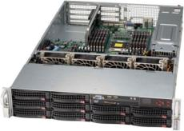
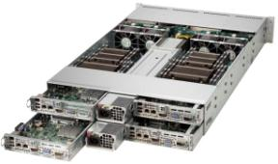
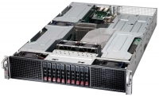
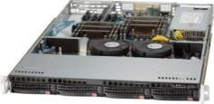
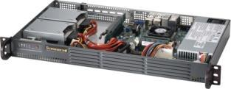
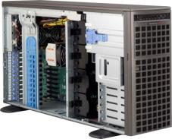
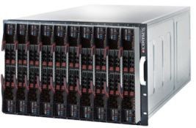
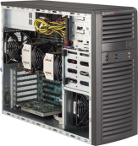
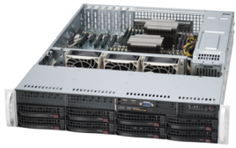
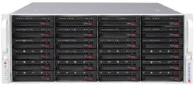
Twin Architecture High-Performance Computing High Density Cloud Computing 2UTwin², 2UTwin²+, 2UTwin, 2UTwin+, 1UTwin
Resource Optimized (WIO/UIO)
Twin Architecture
GPU SuperComputing
Data Center Optimized
Embedded
Application Optimized: Multi I/O
SuperBlade
Workstation
Mainstream Business Solutions
Storage Server
Notes:
Twin Architecture
Double or Triple The Density
Advanced Storage and I/O Options
Resource Optimized
UIO/WIO/WIO+ Design Lead To Enhanced Expandability
GPU SuperComputing
Taking Full Advantage Of Parallel Processing Power
Mainstream
Cost Effective General Application
Application Optimized
Focus n Expansion and Data center
Workstation
Entry to Professional Workstations

Slide 3
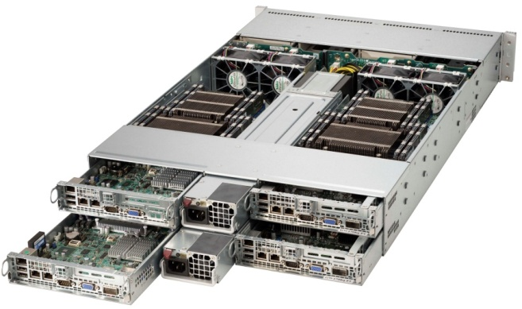
The Twin Architecture
Phenomenal success since its debut 5+ years ago, more than (xxx)K nodes deployed and operational
Wide-range of usage across multiple industries:
HPC
Oil & Gas
Web Portal – Front End
Storage
Continue to attract more users with the Cloud explosion
More than 40 SKU available on the X9 platform alone!
Doubled density → Increases space utilization
50% more HDD Bay → Increases capacity
Share power source → Decreases PUE
Shared Cooling → Further decreases PUE
Hot-swap → Improves serviceability
Integrated I/O → Reduced cost, Increases versatility

Slide 4
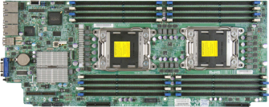
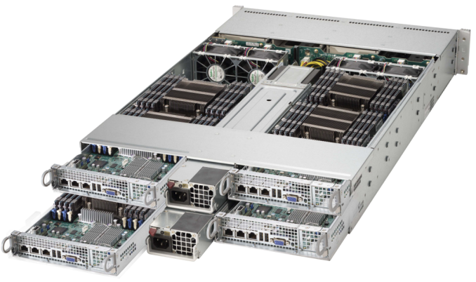
2U Twin²+ New Features 4 node in 2U
DOM
SATA Disk on Module
Memory up to 512GB DDR3 Reg. ECC
Intel® Xeon® Sandy Bridge
E5-2600 Series Socket R
4x high efficient Cooling
Fans
PCI-Express 3.0 x8
MicroLP slot
IB FDR: AOC-CIBF-m1
10G SFP+: AOC-CTG-i1S
Platinum level high efficient 1620W redundant power supply
AOC-CIBF-m1
AOC-CTG-i1S
6 Hotswap 2.5” SAS/SATA per node
or
3 Hotswap 3.5” SAS/SATA per node
PCI-Express 3.0 x8 for SMCI AOC LSI 2108 or 2008
Node 1 Node 2 Node 3 Node 4

Slide 5
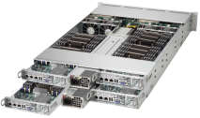
2UTwin²+ Series X9 Product Specification
Model Name (SYS-) | 6027TR-HTRF+ | 6027TR-H70RF+ | 6027TR-H71RF+ | 2027TR-HTRF+ | 2027TR-H70RF+ | 2027TR-H71RF+
CPU per node | 2 Xeon E5-2600 series | 2 Xeon E5-2600 series | 2 Xeon E5-2600 series | 2 Xeon E5-2600 series | 2 Xeon E5-2600 series | 2 Xeon E5-2600 series
Memory per node | Up to 16 DDR3 1600 Reg ECC, 512GB | Up to 16 DDR3 1600 Reg ECC, 512GB | Up to 16 DDR3 1600 Reg ECC, 512GB | Up to 16 DDR3 1600 Reg ECC, 512GB | Up to 16 DDR3 1600 Reg ECC, 512GB | Up to 16 DDR3 1600 Reg ECC, 512GB
HDD per node | 3 H/S 3.5” | 3 H/S 3.5” | 3 H/S 3.5” | 6 H/S 2.5” | 6 H/S 2.5” | 6 H/S 2.5”
Controller per node | PCH-A (AHCI 2 SATA3, 1 SATA2) | LSI 2008 SAS2 (BPN-ADP-SAS2-L6i) | LSI 2108 SAS2 (BPN-ADP-SAS2-H6iR) | PCH-A (AHCI 2 SATA3, 4 SATA2) | LSI 2008 SAS2 (BPN-ADP-SAS2-L6i) | LSI 2108 SAS2 (BPN-ADP-SAS2-H6iR)
I/O slots per node | 1 MicroLP e3.0x8 | 1 MicroLP e3.0x8 | 1 MicroLP e3.0x8 | 1 MicroLP e3.0x8 | 1 MicroLP e3.0x8 | 1 MicroLP e3.0x8
NIC per node | 2 GbE (I350) | 2 GbE (I350) | 2 GbE (I350) | 2 GbE (I350) | 2 GbE (I350) | 2 GbE (I350)
IPMI per node | IPMI 2.0 & KVM w/ LAN | IPMI 2.0 & KVM w/ LAN | IPMI 2.0 & KVM w/ LAN | IPMI 2.0 & KVM w/ LAN | IPMI 2.0 & KVM w/ LAN | IPMI 2.0 & KVM w/ LAN
PSU | 1620W Redun. Platinum | 1620W Redun. Platinum | 1620W Redun. Platinum | 1620W Redun. Platinum | 1620W Redun. Platinum | 1620W Redun. Platinum
Depth | 2U 28.5" (724mm) | 2U 28.5" (724mm) | 2U 28.5" (724mm) | 2U 26.75" (679mm) | 2U 26.75" (679mm) | 2U 26.75" (679mm)

Slide 6
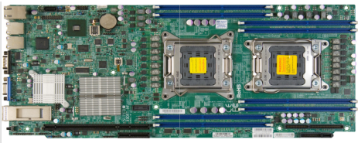
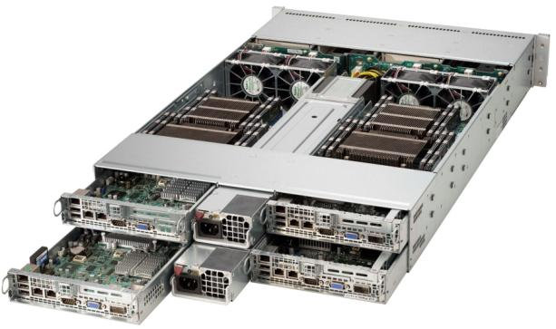
2U Twin² New Features 4 node in 2U
DOM
SATA Disk on Module
Memory up to 256GB DDR3 Reg. ECC
Intel® Xeon® Sandy Bridge
E5-2600 Series Socket R
4x high efficient Cooling
Fans
Mellanox ConnectX QDR/FDR InfiniBand onboard (selected module)
Platinum level high efficient 1620W redundant power supply
PCI-Express 3.0 x16 (low profile)
6 Hotswap 2.5” SAS/SATA per node
or
3 Hotswap 3.5” SAS/SATA per node
PCI-Express 3.0 x8 for SMCI AOC LSI 2108 or 2008
Node 1 Node 2 Node 3 Node 4

Slide 7
2UTwin² Series Product Specification
Model Name (SYS-) | 6027TR-HTRF 6027TR-HTQRF 6027TR-HTFRF | 6027TR-H70RF 6027TR-H70QRF 6027TR-H70FRF | 6027TR-H71RF 6027TR-H71QRF 6027TR-H71FRF | 2027TR-HTRF 2027TR-HTQRF 2027TR-HTFRF | 2027TR-H70RF 2027TR-H70QRF 2027TR-H70FRF | 2027TR-H71RF 2027TR-H71QRF 2027TR-H71FRF
CPU per node | 2 Xeon E5-2600 series | 2 Xeon E5-2600 series | 2 Xeon E5-2600 series | 2 Xeon E5-2600 series | 2 Xeon E5-2600 series | 2 Xeon E5-2600 series
Memory per node | Up to 8 DDR3 1600 Reg ECC, 256GB | Up to 8 DDR3 1600 Reg ECC, 256GB | Up to 8 DDR3 1600 Reg ECC, 256GB | Up to 8 DDR3 1600 Reg ECC, 256GB | Up to 8 DDR3 1600 Reg ECC, 256GB | Up to 8 DDR3 1600 Reg ECC, 256GB
HDD per node | 3 H/S 3.5” | 3 H/S 3.5” | 3 H/S 3.5” | 6 H/S 2.5” | 6 H/S 2.5” | 6 H/S 2.5”
Controller per node | PCH-A (AHCI 2 SATA3, 1 SATA2) | LSI 2008 SAS2 (BPN-ADP-SAS2-L6i) | LSI 2108 SAS2 (BPN-ADP-SAS2-H6iR) | PCH-A (AHCI 2 SATA3, 4 SATA2) | LSI 2008 SAS2 (BPN-ADP-SAS2-L6i) | LSI 2108 SAS2 (BPN-ADP-SAS2-H6iR)
I/O slots per node | 1 LP e3.0x16 | 1 LP e3.0x16 | 1 LP e3.0x16 | 1 LP e3.0x16 | 1 LP e3.0x16 | 1 LP e3.0x16
NIC per node | 2 GbE (I350) +1 IB QDR (-HTQRF) +1 IB FDR (-HTFRF) | 2 GbE (I350) +1 IB QDR (-H70QRF) +1 IB FDR (-H70FRF) | 2 GbE (I350) +1 IB QDR (-H71QRF) +1 IB FDR (-H71FRF) | 2 GbE (I350) +1 IB QDR (-HTQRF) +1 IB FDR (-HTFRF) | 2 GbE (I350) +1 IB QDR (-H70QRF) +1 IB FDR (-H70FRF) | 2 GbE (I350) +1 IB QDR (-H71QRF) +1 IB FDR (-H71FRF)
IPMI per node | IPMI 2.0 & KVM w/ LAN | IPMI 2.0 & KVM w/ LAN | IPMI 2.0 & KVM w/ LAN | IPMI 2.0 & KVM w/ LAN | IPMI 2.0 & KVM w/ LAN | IPMI 2.0 & KVM w/ LAN
PSU | 1620W Redun. Platinum | 1620W Redun. Platinum | 1620W Redun. Platinum | 1620W Redun. Platinum | 1620W Redun. Platinum | 1620W Redun. Platinum
Depth | 2U 28.5" (724mm) | 2U 28.5" (724mm) | 2U 28.5" (724mm) | 2U 26.75" (679mm) | 2U 26.75" (679mm) | 2U 26.75" (679mm)

Slide 8
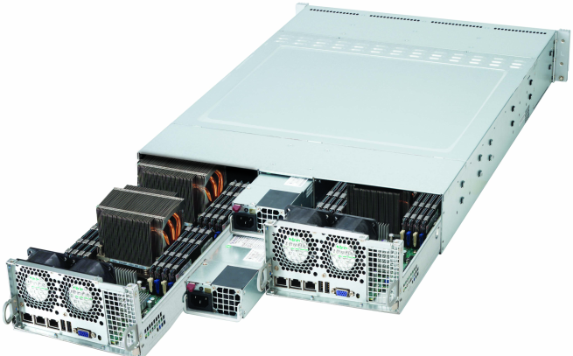
2U Twin+ New Features
DOM
SATA Disk on Module
Memory up to 512GB DDR3 Reg. ECC
Intel® Xeon® Sandy Bridge
E5-2600 Series Socket R
2x Optional Cooling Fans (Rear) for Higher CPU W & Operating Temp. Support
PCI-Express 3.0 x8
MicroLP slot
IB FDR: AOC-CIBF-m1
10G SFP+: AOC-CTG-i1S
Platinum+ level high efficient 1280W redundant power supply
AOC-CIBF-m1
AOC-CTG-i1S
12 Hotswap 2.5” SAS/SATA per node
or
6 Hotswap 3.5” SAS/SATA per node
PCI-Express 3.0 x8 for SMCI AOC LSI 2108 or 2008 coming soon 2208
Node 1 Node 2

Slide 9
2UTwin+ Series X9 Product Specification
Model Name (SYS-) | 6027TR-DTRF+ | 6027TR-D70RF+ | 6027TR-D71RF+ | 2027TR-D70RF+
CPU per node | 2 Xeon E5-2600 series | 2 Xeon E5-2600 series | 2 Xeon E5-2600 series | 2 Xeon E5-2600 series
Memory per node | Up to 16 DDR3 1600 Reg ECC, 512GB | Up to 16 DDR3 1600 Reg ECC, 512GB | Up to 16 DDR3 1600 Reg ECC, 512GB | Up to 16 DDR3 1600 Reg ECC, 512GB
HDD per node | 6 H/S 3.5” | 6 H/S 3.5” | 6 H/S 3.5” | 12 H/S 2.5”
Controller per node | PCH-A (AHCI 2 SATA3, 4 SATA2) | LSI 2008 SAS2 (BPN-ADP-SAS2-L6i) | LSI 2108 SAS2 (BPN-ADP-SAS2-H6iR) | LSI 2008 SAS2 (BPN-ADP-E16-L)
I/O slots per node | 1 MicroLP e3.0x8 | 1 MicroLP e3.0x8 | 1 MicroLP e3.0x8 | 1 MicroLP e3.0x8
NIC per node | 2 GbE (I350) | 2 GbE (I350) | 2 GbE (I350) | 2 GbE (I350)
IPMI per node | IPMI 2.0 & KVM w/ LAN | IPMI 2.0 & KVM w/ LAN | IPMI 2.0 & KVM w/ LAN | IPMI 2.0 & KVM w/ LAN
PSU | 1280W Redun. Platinum | 1280W Redun. Platinum | 1280W Redun. Platinum | 1280W Redun. Platinum
Depth | 2U 28.5" (724mm) | 2U 28.5" (724mm) | 2U 28.5" (724mm) | 2U 26.75" (679mm)

Slide 10
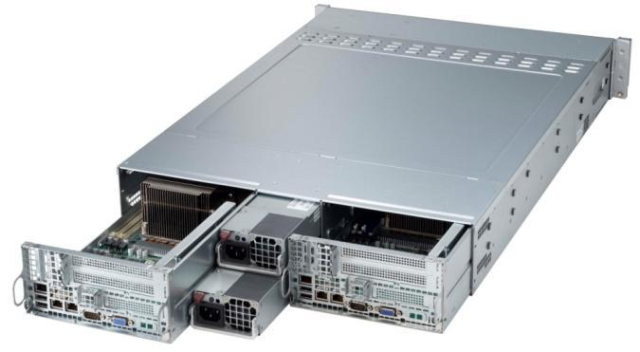
2U Twin New Features 2U TWIN > 1U + 1U
DOM
SATA Disk on Module
Memory up to 256GB DDR3 Reg. ECC
Intel® Xeon® Sandy Bridge
E5-2600 Series Socket R
Supports 135W 2.9GHz
4x high efficient Cooling
Fans
Mellanox ConnectX QDR/FDR InfiniBand onboard (selected module)
Platinum+ level high efficient 1280W redundant power supply
3 PCI-Express 3.0 x8 (1x LP, 2x FHHL)
12 Hotswap 2.5” SAS/SATA per node
or
6 Hotswap 3.5” SAS/SATA per node
PCI-Express 3.0 x8 for SMCI AOC LSI 2108 or 2008 coming soon 2208
Node 1 Node 2

Slide 11
2U Twin Series Product Specification
Model Name (SYS-) | 6027TR-DTRF 6027TR-DTQRF 6027TR-DTFRF | 6027TR-D70RF 6027TR-D70QRF 6027TR-D70FRF | 6027TR-D71RF 6027TR-D71QRF 6027TR-D71FRF | 2027TR-D70RF 2027TR-D70QRF 2027TR-D70FRF
CPU per node | 2 Xeon E5-2600 series | 2 Xeon E5-2600 series | 2 Xeon E5-2600 series | 2 Xeon E5-2600 series
Memory per node | Up to 8 DDR3 1600 Reg ECC, 256GB | Up to 8 DDR3 1600 Reg ECC, 256GB | Up to 8 DDR3 1600 Reg ECC, 256GB | Zup to 8 DDR3 1600 Reg ECC, 256GB
HDD per node | 6 H/S 3.5” | 6 H/S 3.5” | 6 H/S 3.5” | 12 H/S 2.5”
Controller per node | PCH-A (AHCI 2 SATA3, 4 SATA2) | LSI 2008 SAS2 (BPN-ADP-SAS2-L6i) | LSI 2108 SAS2 (BPN-ADP-SAS2-H6iR) | LSI 2008 SAS2 (BPN-ADP-E16-L)
I/O slots per node | 2 FHHL e3.0x8 1 LP e3.0x8 | 2 FHHL e3.0x8 1 LP e3.0x8 | 2 FHHL e3.0x8 1 LP e3.0x8 | 2 FHHL e3.0x8 1 LP e3.0x8
NIC per node | 2 GbE (I350) +1 IB QDR (-DTQRF) +1 IB FDR (-DTFRF) | 2 GbE (I350) +1 IB QDR (-D70QRF) +1 IB FDR (-D70FRF) | 2 GbE (I350) +1 IB QDR (-D71QRF) +1 IB FDR (-D71FRF) | 2 GbE (I350) +1 IB QDR (-D70QRF) +1 IB FDR (-D70FRF)
IPMI per node | IPMI 2.0 & KVM w/ LAN | IPMI 2.0 & KVM w/ LAN | IPMI 2.0 & KVM w/ LAN | IPMI 2.0 & KVM w/ LAN
PSU | 1280W Redun. Platinum | 1280W Redun. Platinum | 1280W Redun. Platinum | 1280W Redun. Platinum
Depth | 2U 28.5" (724mm) | 2U 28.5" (724mm) | 2U 28.5" (724mm) | 2U 26.75" (679mm)

Slide 12
SAS2 RAID Daughter Card
BPN-ADP-SAS2-H6IR
LSI 2108 Hardware RAID
6 port SAS2
512MB DDR2 cache
RAID 0, 1, 5, 6, 10, 50, 60
Battery backup header ready
BPN-ADP-SAS2-L6i
LSI 2008 Software RAID
6 port SAS2
RAID 0, 1, 10, 5 (option)
BPN-ADP-E16-L
LSI 2008 with Expander
12 port SAS2
RAID 0, 1, 10, 5 (option)

Slide 13
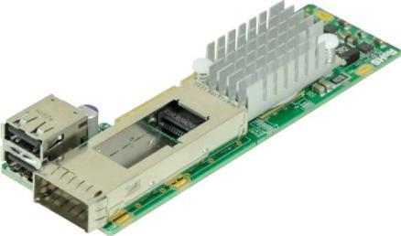
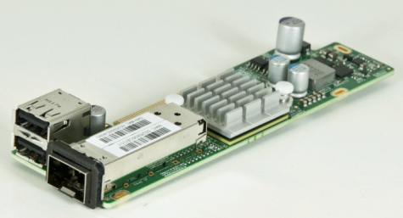
MicroLP Card
AOC-CIBF-m1
Mellanox ConnectX-3 FDR (56Gbps)
Single QSFP connector + Dual USB 2.0 ports
PCI-e x8 Gen. 3 (5GT/s), MicroLP Form Factor
GPU communication acceleration
Precision Clock Synchronization
Hardware-based I/O virtualization
Dynamic power management
Fibre Channel encapsulation (FCoIB or FCoE)
Ethernet encapsulation (EoIB)
AOC-CTG-i1S
Intel® 82599EN, 10Gbps per port
Single SFP+ Ports + Dual USB 2.0 ports
PCI-e x8 Gen. 2 (5GT/s), MicroLP Form Factor
Support for Fiber Channel over Ethernet (FCoE)
Load balancing on multiple CPUs
iSCSI remote boot support
Intel® PROSet Utility for Windows Device Manager
Next-Generation VMDq (64 queues per port)
IPv6 Offloading

Slide 14
2U Twin²/Twin/Twin²+/Twin+ X9 series model matrix
2U Twin² models
Storage | 3.5" HDD x3 /node |  |  | 2.5" HDD x6 /node
 | Intel PCH-A SATA3+SATA2 | LSI 2008 SAS2 (SW RAID) | LSI 2108 SAS2 (HW RAID) | Intel PCH-A SATA3+SATA2 | LSI 2008 SAS2 (SW RAID) | LSI 2108 SAS2 (HW RAID)
GbE only | 6027TR-HTRF | 6027TR-H70RF | 6027TR-H71RF | 2027TR-HTRF | 2027TR-H70RF | 2027TR-H71RF
QDR IB | 6027TR-HTQRF | 6027TR-H70QRF | 6027TR-H71QRF | 2027TR-HTQRF | 2027TR-H70QRF | 2027TR-H71QRF
FDR IB | 6027TR-HTFRF | 6027TR-H70FRF | 6027TR-H71FRF | 2027TR-HTFRF | 2027TR-H70FRF | 2027TR-H71FRF
2U Twin²+ models
GbE only | 6027TR-HTRF+ | 6027TR-H70RF+ | 6027TR-H71RF+ | 2027TR-HTRF+ | 2027TR-H70RF+ | 2027TR-H71RF+
2U Twin models
Storage | 3.5" HDD x6 /node |  |  | 2.5" HDD x12 /node
 | Intel PCH-A SATA3+SATA2 | LSI 2008 SAS2 (SW RAID) | LSI 2108 SAS2 (HW RAID) | Intel PCH-A SATA3+SATA2 | LSI 2008 SAS2 with Expander | LSI 2108 SAS2 (HW RAID)
GbE only | 6027TR-DTRF | 6027TR-D70RF | 6027TR-D71RF | N/A | 2027TR-D70RF | N/A
QDR IB | 6027TR-DTQRF | 6027TR-D70QRF | 6027TR-D71QRF | N/A | 2027TR-D70QRF | N/A
FDR IB | 6027TR-DTFRF | 6027TR-D70FRF | 6027TR-D71FRF | N/A | 2027TR-D70FRF | N/A
2U Twin+ models
GbE only | 6027TR-DTRF+ | 6027TR-D70RF+ | 6027TR-D71RF+ | N/A | 2027TR-D70RF+ | N/A

Slide 15
2U Twin series
For 2U Twin2 it is 115W at 35C.
HDD less also support 130W at 35C.
130W at 30C full load front drive.
If you like to support 135W we need to use special fan also has some limitation.
For 2U Twin can support 130W at 35C. (SNK-P0048P rear)
If like to support 135W we have new heatsink coming will support that. (SNK-P0048PW rear)
For 2U Twin+ support 135W at 35C or higher temp.

Slide 16
Data Center Optimized Servers Solutions
Resource Optimized (WIO/UIO)
Twin Architecture
GPU SuperComputing
Data Center Optimized
Embedded
Application Optimized: Multi I/O
SuperBlade
Workstation
Mainstream Business Solutions
Storage Server
Notes:
Twin Architecture
Double or Triple The Density
Advanced Storage and I/O Options
Resource Optimized
UIO/WIO/WIO+ Design Lead To Enhanced Expandability
GPU SuperComputing
Taking Full Advantage Of Parallel Processing Power
Mainstream
Cost Effective General Application
Application Optimized
Focus n Expansion and Data center
Workstation
Entry to Professional Workstations

Slide 17
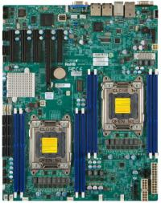
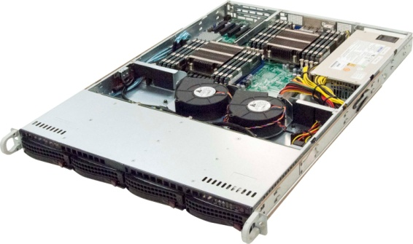
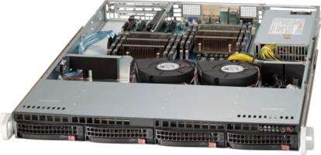
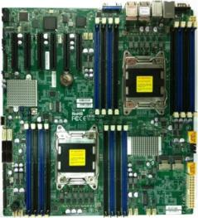
Data Center Cost Effective Solutions
Model Name (SYS-) | 6017R-TDF | 6017R-TDF+
CPU | 2 Xeon E5-2600 series (115W / 35 °C) (130W / 30 °C) | 2 Xeon E5-2600 series (115W / 35 °C) (130W / 30 °C)
Memory (Max.) | 8 DDR3 1600 Reg ECC,256GB | 16 DDR3 1600 Reg ECC,512GB
HDD | 4x hot-swap 3.5" SATA2 HDD bays | 4x hot-swap 3.5" SATA2 HDD bays
Controller | Intel C602 (PCH-A) | Intel C602J (PCH-J)
I/O slots | PCI-E 3.0 x16 | PCI-E 3.0 x8
NIC | 2 GbE (I350) | 2 GbE (I350)
IPMI | IPMI 2.0 & KVM w/ LAN | IPMI 2.0 & KVM w/ LAN
PSU | 440W Platinum Level power supply | 600W Gold Level power supplies
Depth | 1U 25.6" (650mm) | 1U 25.6" (650mm)
Features | Earth Friendly Bulk Pack (20 sys/pack) Quick release slide rail | Earth Friendly Bulk Pack (20 sys/pack) Quick release slide rail

Slide 18
GPU SuperComputing High-Performance, Enterprise-Class Super Computing GPU Accelerated Computation Engineering & Scientific
Resource Optimized (WIO/UIO)
Twin Architecture
GPU SuperComputing
Data Center Optimized
Embedded
Application Optimized: Multi I/O
SuperBlade
Workstation
Mainstream Business Solutions
Storage Server
Notes:
Twin Architecture
Double or Triple The Density
Advanced Storage and I/O Options
Resource Optimized
UIO/WIO/WIO+ Design Lead To Enhanced Expandability
GPU SuperComputing
Taking Full Advantage Of Parallel Processing Power
Mainstream
Cost Effective General Application
Application Optimized
Focus n Expansion and Data center
Workstation
Entry to Professional Workstations

Slide 19
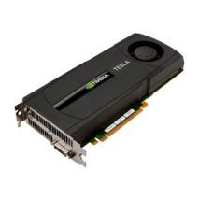
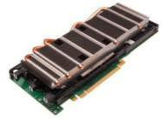
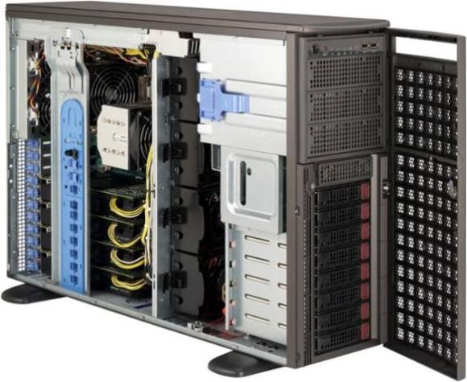
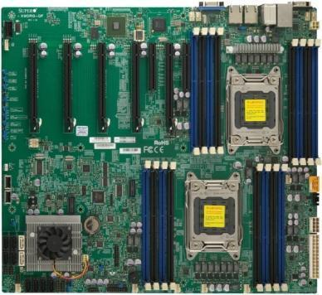
Tower / 4U Rackmount GPU Server Features
Up to 4 Double Width GPU cards + 2 PCIe3.0x8, 1 PCIe2.0x4
SYS-7047GR-TRF
4 C-series
GPU Cards
SYS-7047GR-TPRF
4 M-series
GPU Cards
Intel® Xeon® Sandy Bridge E5-2600 Series Socket R
Support 150W
Platinum level
high efficient 1620W redundant power supply
Optimize Cooling System Design
8 Hotswap 3.5”
SATA/SSD Drive
X9DRG-QF

Slide 20
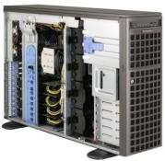
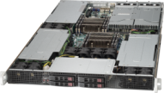
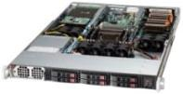
X9 GPU solutions Standard models
Model (SYS-) | 1017GR-TF | 5017GR-TF | 1027GR-TRF | 1027GR-TSF | 2027GR-TRF | 7047GR-TRF
CPU | 1 Xeon E5-2600 series | 1 Xeon E5-2600 series | 2 Xeon E5-2600 series | 2 Xeon E5-2600 series | 2 Xeon E5-2600 series | 2 Xeon E5-2600 series
Memory | Up to 8 DDR3 1600 Reg ECC, 256GB | Up to 8 DDR3 1600 Reg ECC, 256GB | Up to 8 DDR3 1600 Reg ECC, 256GB | Up to 8 DDR3 1600 Reg ECC, 256GB | Up to 8 DDR3 1600 Reg ECC, 256GB | Up to 16 DDR3 1600 Reg ECC, 512GB
HDD | 6 H/S 2.5” | 3 H/S 3.5” | 4 H/S 2.5” | 4 H/S 2.5” | 10 H/S 2.5” | (8 + 2) H/S 3.5"
Controller | Intel C602 PCH-A (AHCI 2 SATA3, AHCI 4 SATA2) | Intel C602 PCH-A (AHCI 2 SATA3, AHCI 1 SATA2) | Intel C602 PCH-A (AHCI 2 SATA3, AHCI 2 SATA2) | Intel C602 PCH-A (AHCI 2 SATA3, AHCI 2 SATA2) | Intel C602 PCH-A (AHCI 2 SATA3, AHCI 4 SATA2, SCU 4 SATA2) | Intel C602 PCH-A (AHCI 2 SATA3, AHCI 4 SATA2, SCU 4 SATA2)
I/O slots | 2 GPU 1 LP e3.0x8 | 2 GPU 1 LP e3.0x8 | 3 GPU 1 LP e3.0x8 | 3 GPU 1 LP e3.0x8 | 4 GPU 1 FHFL e3.0x4 1 LP e3.0x8 | 4 GPU (Active Cooling) 2 FHFL e3.0x8
NIC | 2 GbE (I350) | 2 GbE (I350) | 2 GbE (I350) | 2 GbE (I350) | 2 GbE (I350) | 2 GbE (I350)
IPMI | IPMI 2.0 & KVM w/ LAN | IPMI 2.0 & KVM w/ LAN | IPMI 2.0 & KVM w/ LAN | IPMI 2.0 & KVM w/ LAN | IPMI 2.0 & KVM w/ LAN | IPMI 2.0 & KVM w/ LAN
Power Supply | 1400W platinum | 1400W platinum | 1800W platinum redundant | 1800W platinum | 1800W platinum redundant | 1620W platinum redundant
Depth | 1U 28.2” (716mm) | 1U 28.5” (724mm) | 1U 28.2” (716mm) | 1U 28.2” (716mm) | 2U 30.5” (775mm) | 4U 26.5” (673mm)

Slide 21
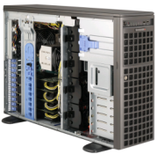
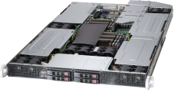
X9 GPU solutions Enhanced models
6 GPUs in 2U
4 GPUs in 1U
10GbE onboard
10GbE onboard
M-series GPU
Model (SYS-) | 2027GR-TRFH 2027GR-TRFHT | 1027GR-TQF 1027GR-TQFT | 2027GR-TRFT | 1027GR-TRFT | 7047GR-TPRF
CPU | 2 Xeon E5-2600 | 2 Xeon E5-2600 | 2 Xeon E5-2600 | 2 Xeon E5-2600 | 2 Xeon E5-2600
Memory | Up to 8 DDR3 1600 Reg ECC, 256GB | Up to 8 DDR3 1600 Reg ECC, 256GB | Up to 8 DDR3 1600 Reg ECC, 256GB | Up to 8 DDR3 1600 Reg ECC, 256GB | Up to 16 DDR3 1600 Reg ECC, 512GB
HDD | 10 H/S 2.5” | 4 H/S 2.5” | 10 H/S 2.5” | 4 H/S 2.5” | (8 + 2) H/S 3.5"
Controller | Intel C602 PCH-A (AHCI 2 SATA3, AHCI 4 SATA2, SCU 4 SATA2) | Intel C602 PCH-A (AHCI 2 SATA3, AHCI 2 SATA2) | Intel C602 PCH-A (AHCI 2 SATA3, AHCI 4 SATA2, SCU 4 SATA2) | Intel C602 PCH-A (AHCI 2 SATA3, AHCI 2 SATA2) | Intel C602 PCH-A (AHCI 2 SATA3, AHCI 4 SATA2, SCU 4 SATA2)
I/O slots | 6 GPU 1 LP e3.0x8 | 4 GPU 1 LP e3.0x8 | 4 GPU 1 FHFL e3.0x4 1 LP e3.0x8 | 3 GPU 1 LP e3.0x8 | 4 GPU (Passive Cooling) 2 FHFL e3.0x8
NIC | 2 GbE (I350) 2 10GbE (X540) [TRFHT] | 2 GbE (I350) 2 10GbE (X540) [TQFT] | 2 GbE (I350) 2 10GbE (X540) | 2 GbE (I350) 2 10GbE (X540) | 2 GbE (I350)
IPMI | IPMI 2.0 & KVM w/ LAN | IPMI 2.0 & KVM w/ LAN | IPMI 2.0 & KVM w/LAN | IPMI 2.0 & KVM w/LAN | IPMI 2.0 & KVM w/ LAN
Power Supply | 1800W platinum redundant | 1800W platinum | 1800W platinum redundant | 1800W platinum redundant | 1620W platinum redundant
Depth | 2U 30.5” (775mm) | 1U 28.2” (716mm) | 2U 30.5” (775mm) | 1U 28.2” (716mm) | 4U 26.5” (673mm)

Slide 22
Thank You
Server Department

