Slide 1

A quest for activity cycles
in low-mass stars
K. Vida
Konkoly Observatory
FIKUT 6, 2012
Budapest

Slide 2
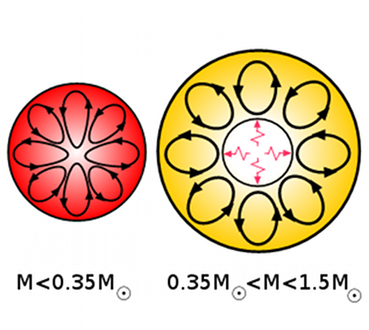
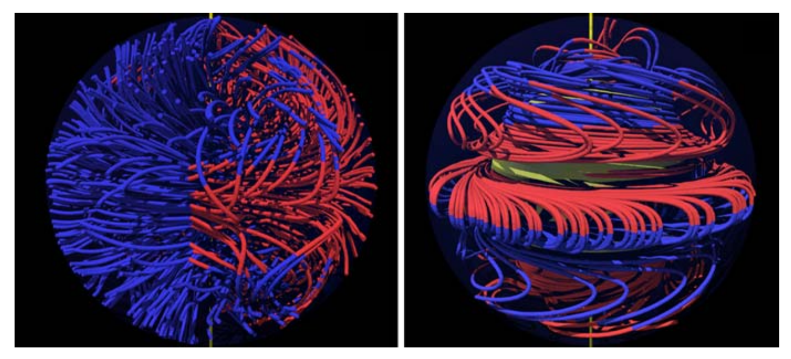
Introduction
Stars of different masses (interior structures) are supposed to have different kinds of magnetic dynamos
Stars with masses like the Sun, are supposed to have activity cycles
Strassmeier, 2009 A&ARv 17, 251
Possibly an α2-dynamo
Solar-like αΩ or distributed α2Ω dynamo

Slide 3
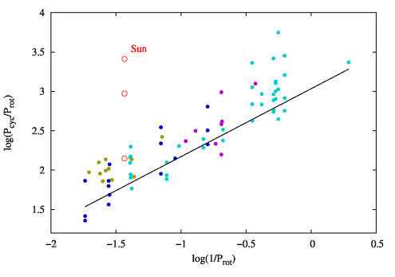
Introduction
Stars of different masses (interior structures) are supposed to have different kinds of magnetic dynamos
Stars with masses like the Sun, are supposed to have activity cycles
The length of the cycle seems to be connected with the rotation rate
Oláh & Strassmeier (2002, AN, 323, 361)
Fit is to the shortest activity cycles.

Slide 4
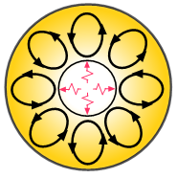

The sample

Slide 5
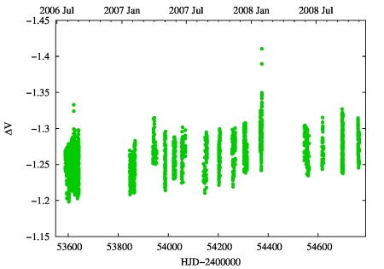
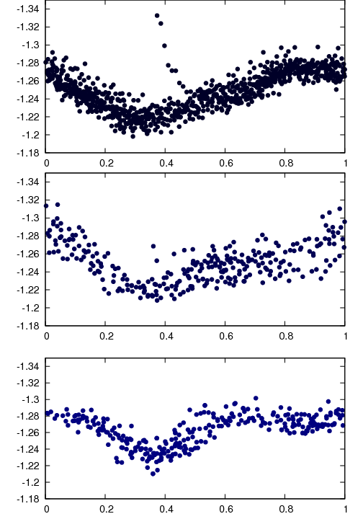
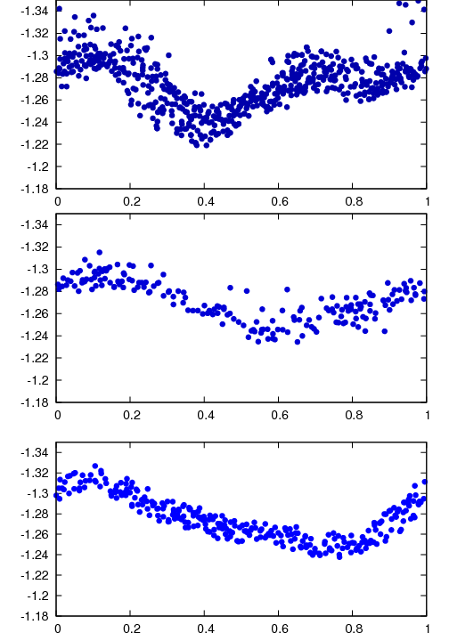
EY Dra
evolution of the light curve
flip-flop effect

Slide 6
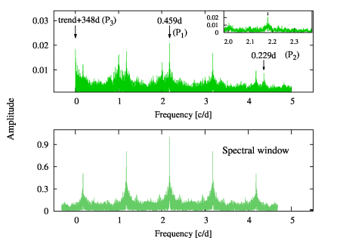
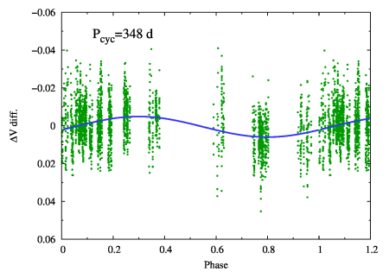
EY Dra
evolution of the light curve
flip-flop effect
a cycle of ~350 days

Slide 7
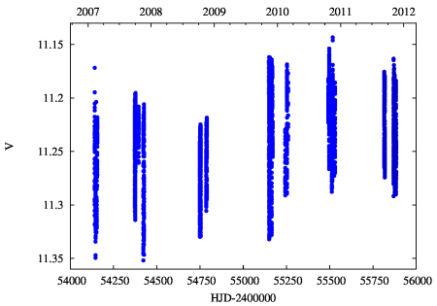
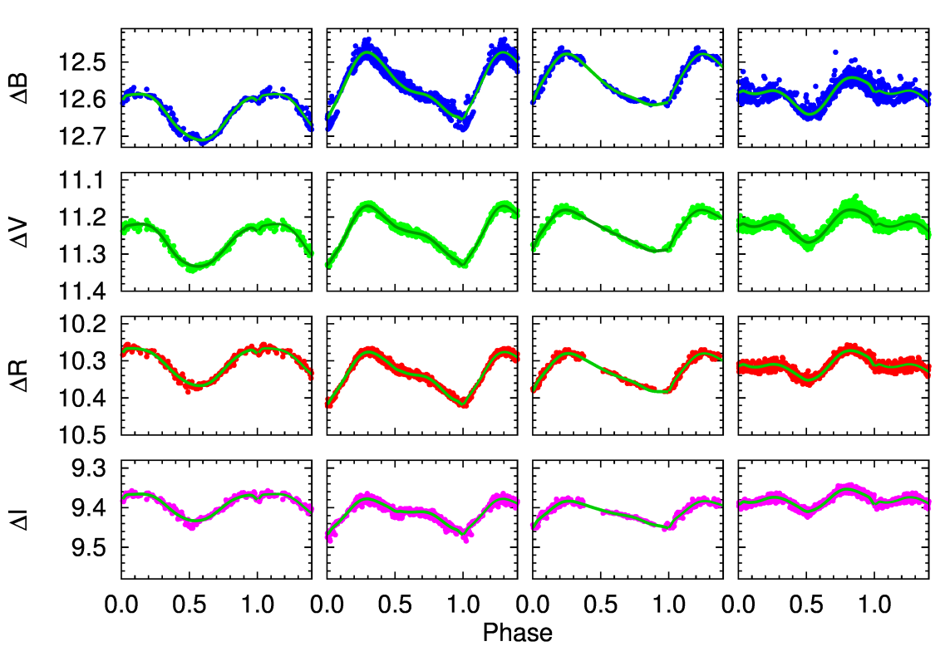
V405 And
grazing eclipsing binary
slowly evolving light curve

Slide 8
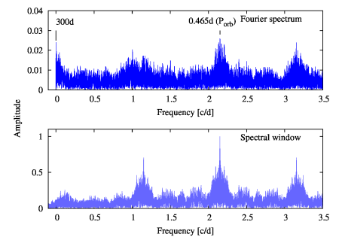
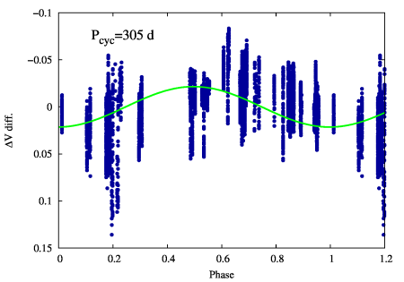
V405 And
grazing eclipsing binary
slowly evolving light curve
cycle of ~300 days

Slide 9
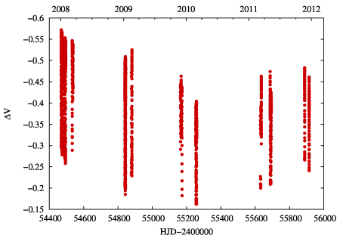
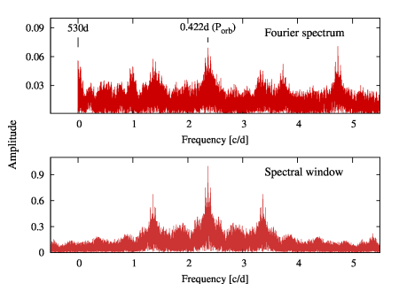
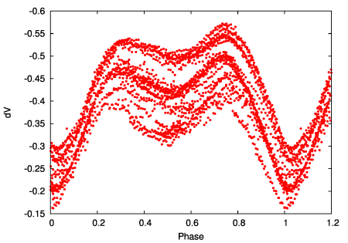
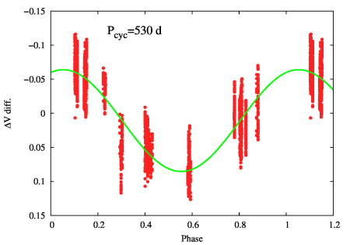
GSC 3377-0296
eclipsing binary with yet unknown parameters
small evolution
cycle of ~530 days

Slide 10
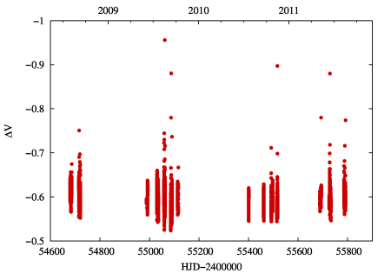
V374 Peg
ZDI measurements → poloidal, axisymmetric, stable magnetic field
Donati et al. 2006,
Sci, 311, 633

Slide 11
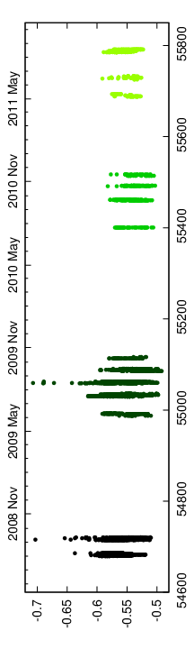
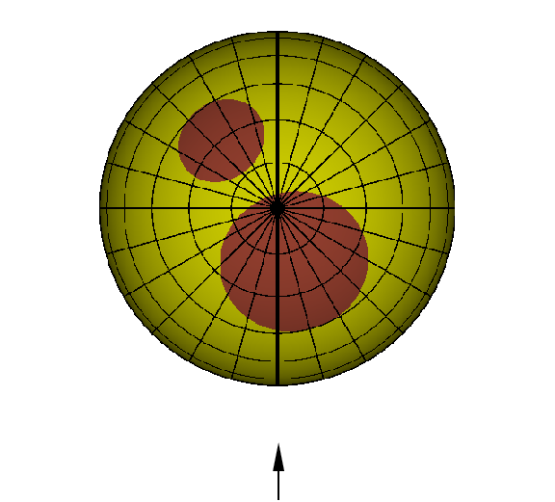
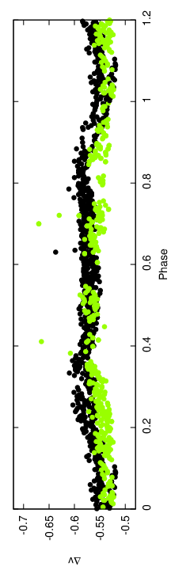
V374 Peg
ZDI measurements → poloidal, axisymmetric, stable magnetic field
The light curve is stable for ~3 years

Slide 12
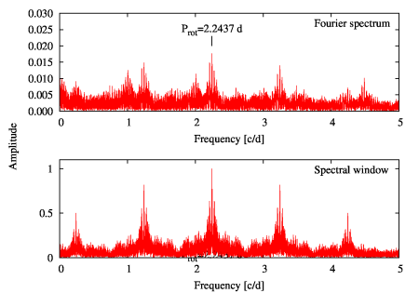
V374 Peg
ZDI measurements → poloidal, axisymmetric, stable magnetic field
The light curve is stable for ~3 years
No cycle observed
...but this is good, as these stars should have a different kind of dynamo, and no cycles

Slide 13
Summary

Slide 14
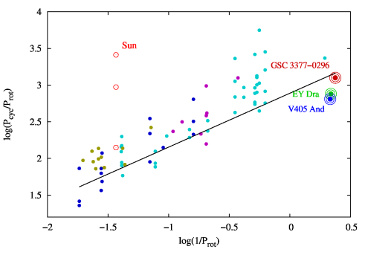
Summary

Slide 15
Thank you!

