Slide 1
Astrophysical Laboratory / Experimental Astrophysics
Roland Thissen
Institut de Planétologie et d’Astrophysique de Grenoble
France
6th workshop of Young researchers - Budapest 3-6 Septembre 2012

Slide 2
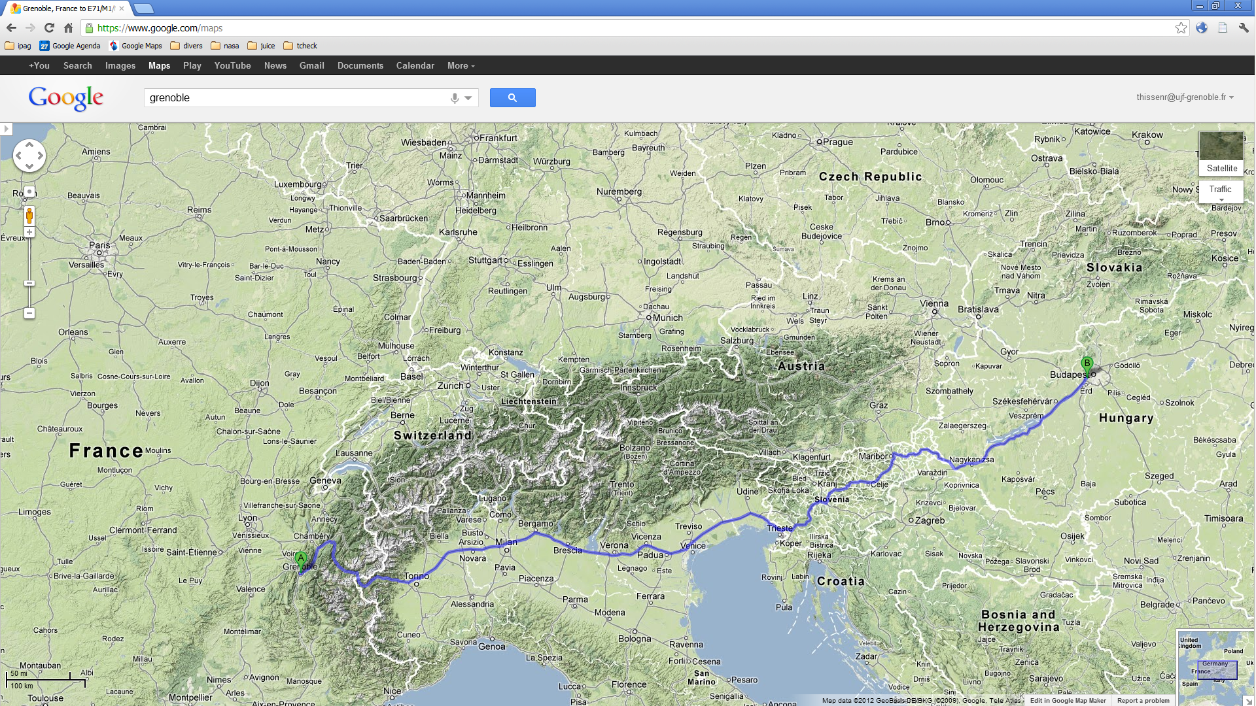
Budapest
Grenoble

Slide 3
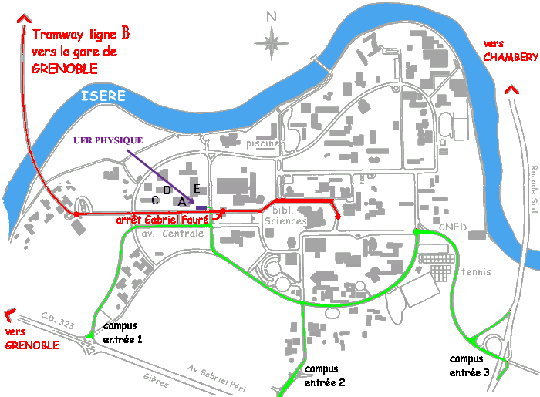
Insititut de Planétologie et Astophysique de Grenoble

Slide 4
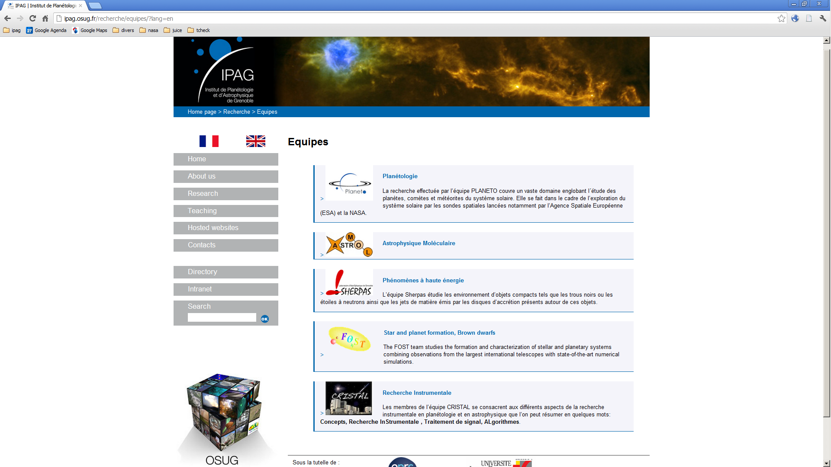

Slide 5
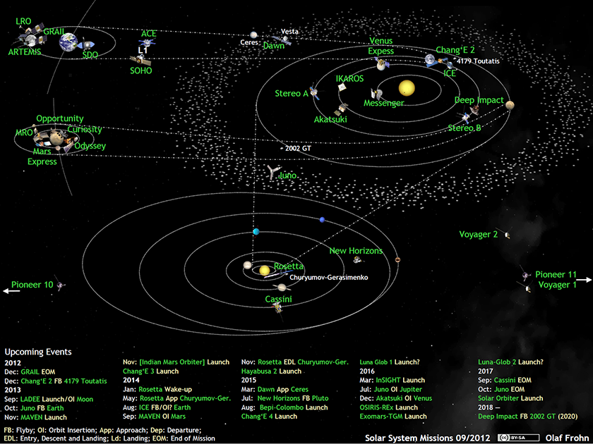

Slide 6
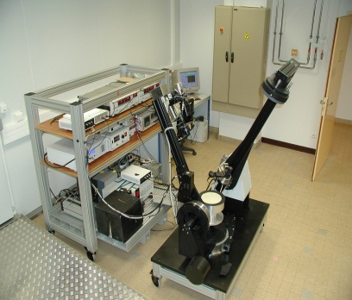
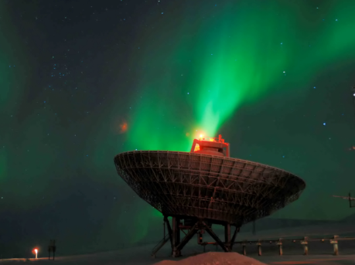
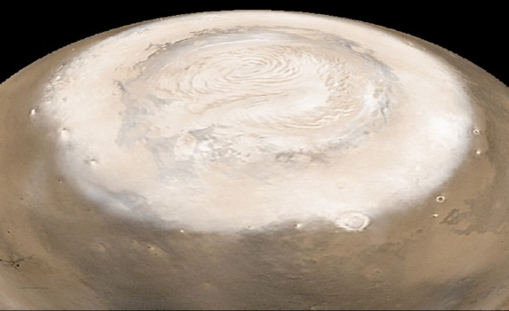
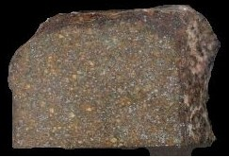
OUR Approach
  Experiments : spectroscopie vis-IR et de masse, photochimie, thermo
  Multi-instrumental analysis of materials (extraterrestrial, terrestres, synthétics)
  Numéric Models : transfert radiatif, diffusion chaleur/matière, Chemistry…
  Developpement of data analysis tools (spectroscopy, images, radar, database…)
  Analysis of space data (spectroscopy, spectro-imagery, radar, mass spectra)
spécificities of PLANETO
* Interdisciplinarity Astrophysics - Chemistry - ’’Géo’’physics
* Strong experimental activity
* Large implication in space missions (ESA / NASA /CNES / …)

Slide 7
Space Missions with Implications of IPAG
1995 1999 2003 2007 2011 2015 2019 2023 2025 2029
Cluster
Pitout, CoI on CIS, Ion Spectrometer
Earth
Swarm
Lathuillere, Associate scientist on ACC, accelerometers
R&D Sesame
Lilensten, PI on EUV photometer
NEO
Kofman, Hérique CoI on New Consert
Thissen, Quirico CoI on ILMA Mass spectrometer
Marco Polo
Mars Express
Schmitt, Douté, CoI on Omega, Spectro Imager
Kofman CoI on Marsis, Ground Penetrating Radar
Mars
Mars Reconnaissance Orbiter
Schmitt, Douté, CoI on CRISM, Spectro Imager
Kofman CoI on Sharad, Ground Penetrating Radar
ExoMars
Kofman, Hérique CoI on Wisdom Radar
Kofman, Hérique PI on Consert
Comet Rosetta
Schmitt, Quirico, CoI on Virtis spectro imager
Kofman, Hérique CoI on Radar
Thissen, CoI on Dust detector
Jupiter EJSM
Saturn / Titan Cassini
Thissen, Associate scientist on INMS, mass spectrometer
Pluto New Horizon
Schmitt, Associate scientist on Spectro Imager
1995 1999 2003 2007 2011 2015 2019 2023 2025 2029

Slide 8
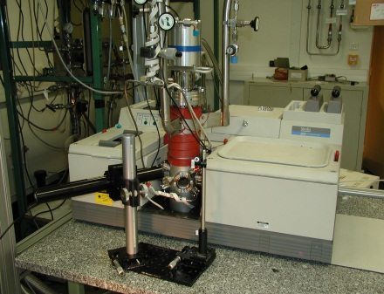
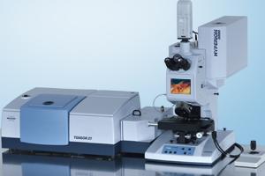
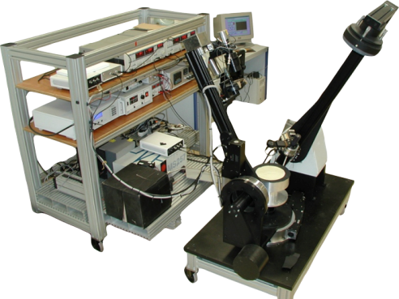
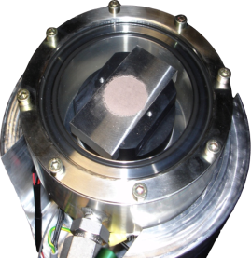
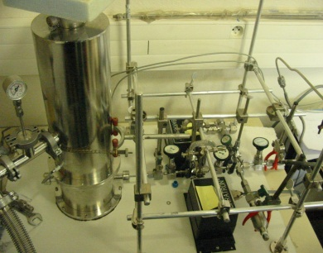
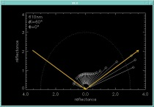
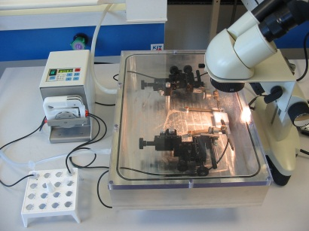
Experimental systems for the study of solids and des planetary surfaces
● FT IR Spectrometer
Spectroscopy in transmission (films et cristals, ices)
down to 5 K
production of specific mixtures
follow chemical kinetics
● IR Microscope
  Cartography in transmission, réflexion ou ATR
  Mineral and organic materials
  Pumped and heated cells
● Spectro-gonio radiometer
bidirectional spectral reflectance of granular/ice surfaces
● Environnemental Cells
Measure equilibrium pressures and kinetics (ices, clathrates)
+ spectroscopy ready
● Sample preparation (STARDUST/Hayabusa)
Extraction of organic matter

Slide 9
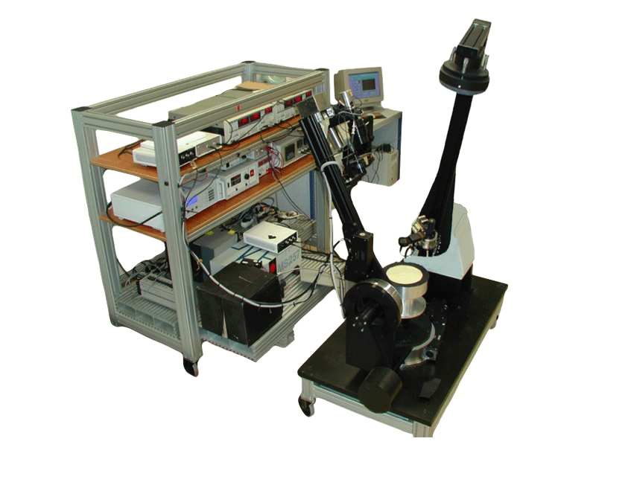
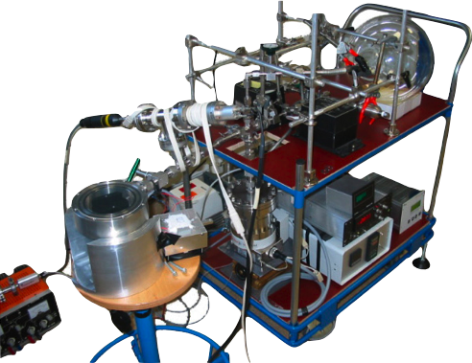
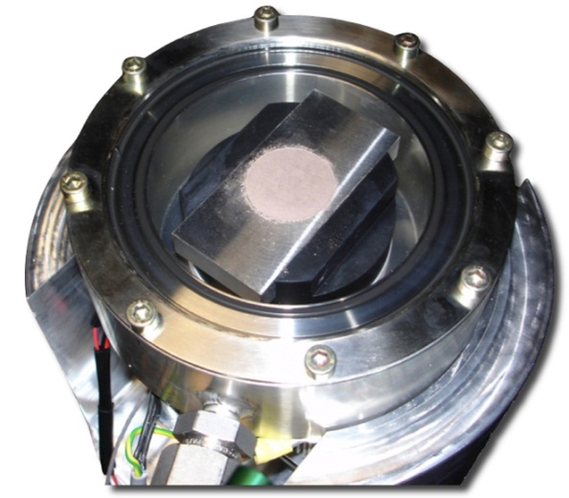
bidirectionnal Spectro-gonio radiometre
Thermo dynamics equilibrium
Simulation
Chambers

Slide 10
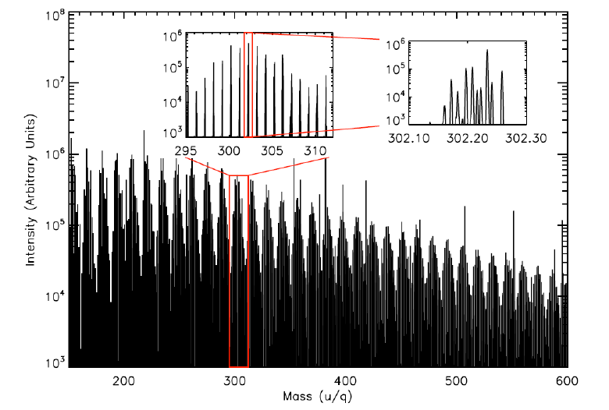
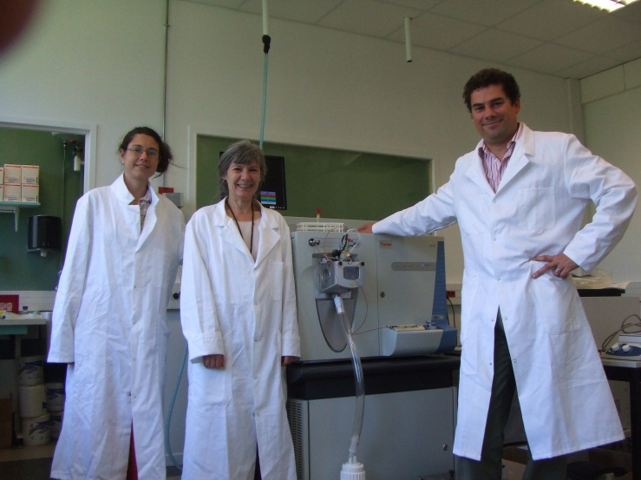
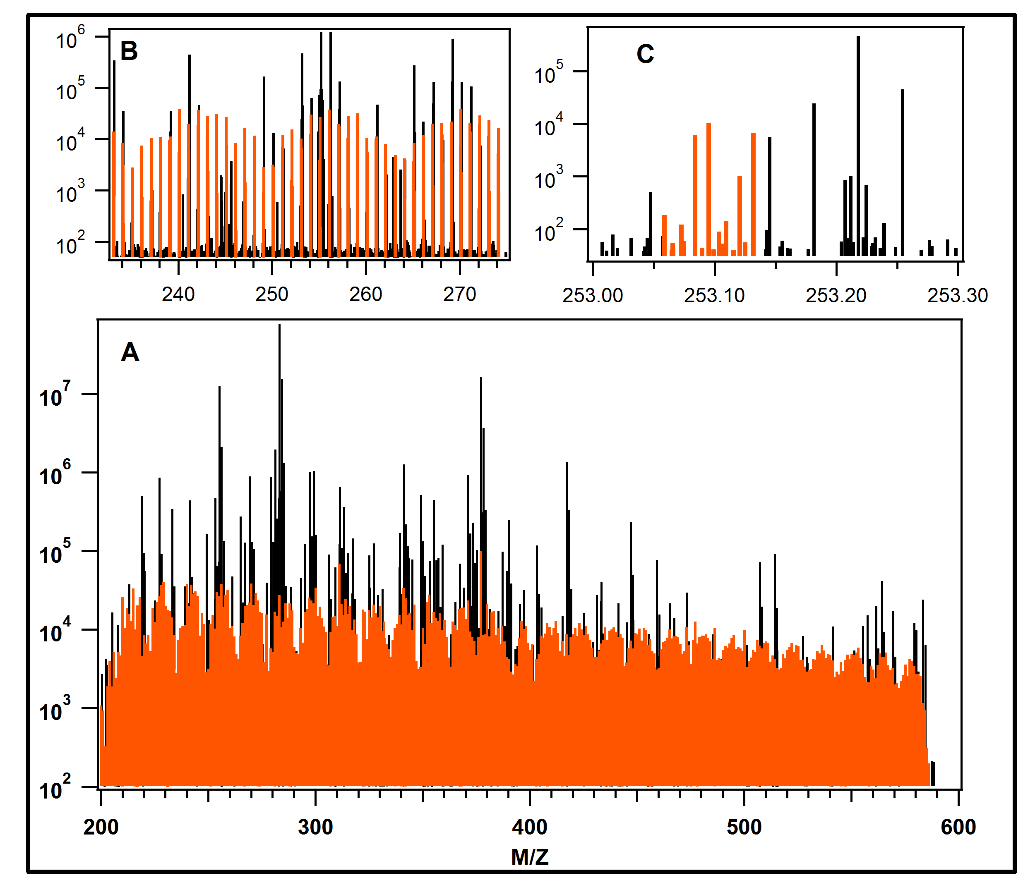
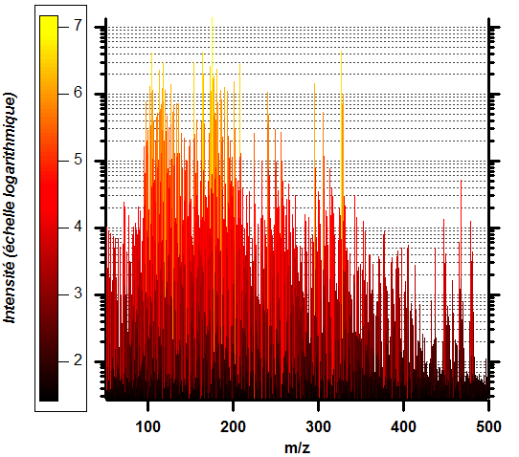
Chemical Analysis of natural or analog organic materials: ORBITRAP HRMS
● Titan Analog material
● Residue from irradiated primitive ices
● Soluble Organic Matter from meteorites

Slide 11
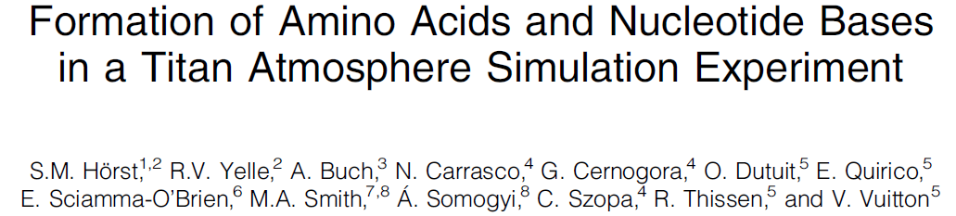
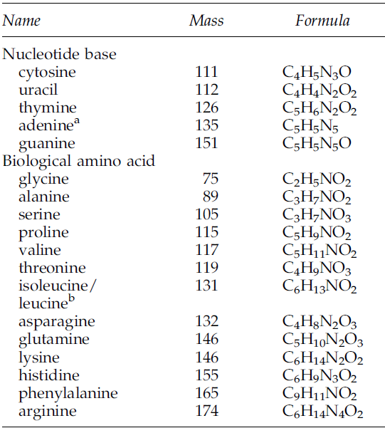
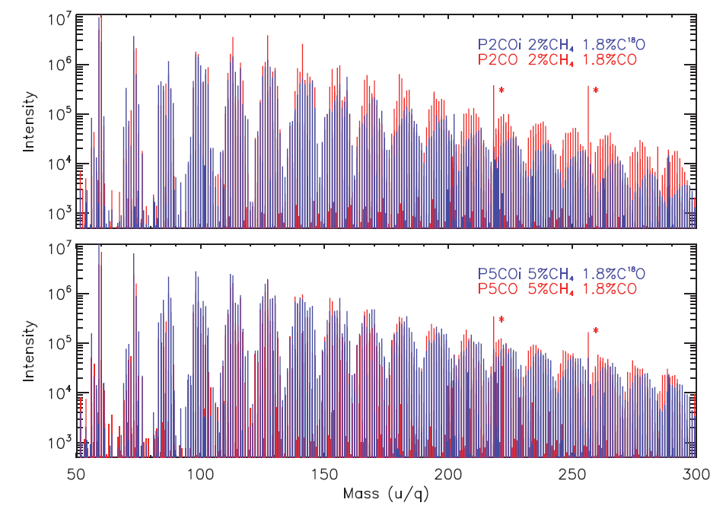
New paradigm for biomolecule production in Titan atmosphere
Astrobiology Septembre 2012

Slide 12
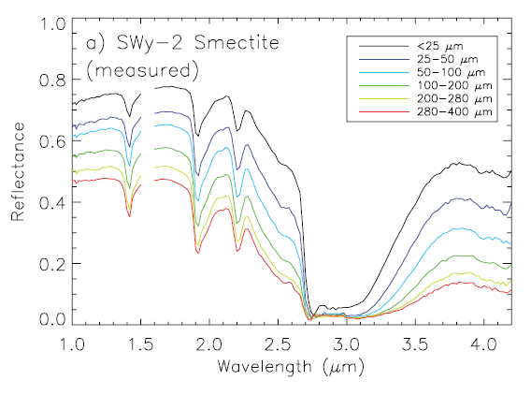
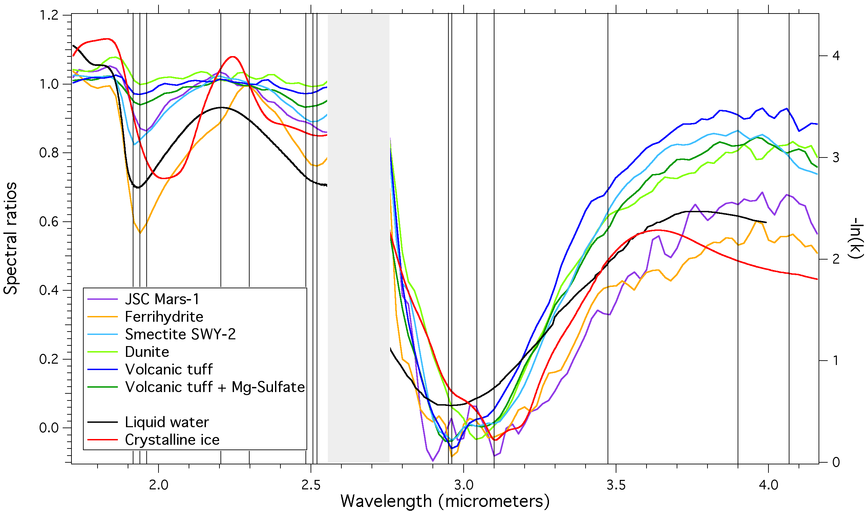
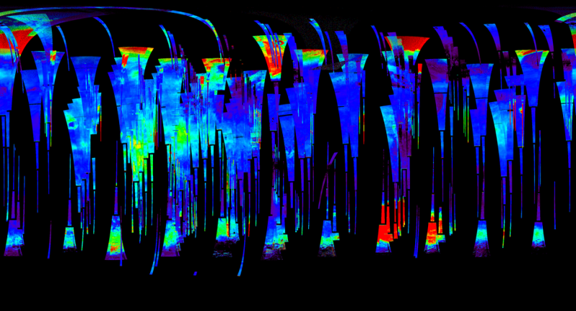
Mineral Hydratation on Mars by spectro-imagery
Simulations in laboratory
  Simulation observation satellitaire
  Simulation en conditions martiennes
  Signature spectrale de l’hydratation de structure et de surface (adsorbée)
  Cinétiques d'hydratation
  Echanges d'eau
Thermodynamic Models
  Diffusion de l'eau dans le régolite
➔ Analysis of space data
  Type d’hydratation
  Teneur H₂O des minéraux hydratés
  Variations spatiales et temporelles
- Omega & CRISM
- Phoenix : déssication pergélisol

Slide 13
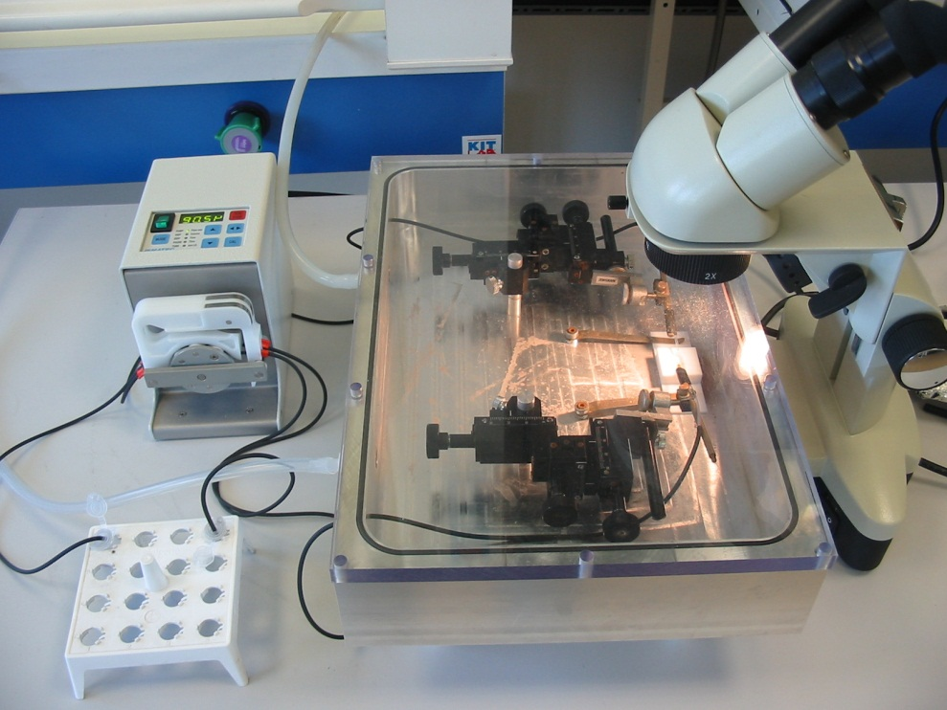
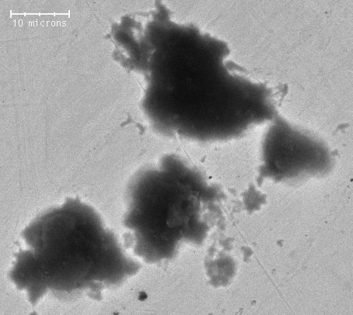
Cometary dust
STARDUST, Hayabusa
Caracterization of organic matter
- extraction of carbon.
- Spectrometries. Raman, Xanes, HRMS
➔ analysis
Spectral properties
- optical constants with IRmicroscope
➔ preparation of Rosetta mission
10 μm
Chondrites
IDP

Slide 14
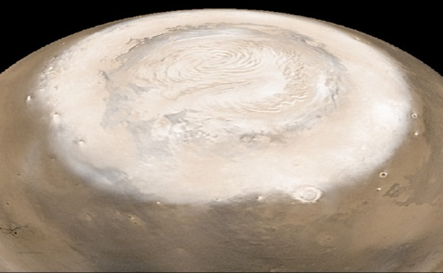
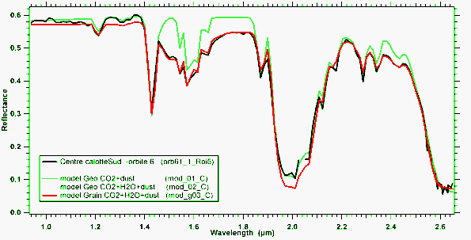
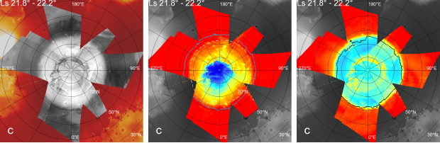
Cycle of volatiles on Mars by spectro-imagery
Missions spatiales :
- OMEGA / Mars Express
- CRISM / Mars Recon. Orbiter
Polar Caps
Seasonal Condensates
Analysis of space data
  H₂O vs CO₂
  dust
  Seasonal evolution
Simulations in laboratory
  spectroscopy
  Microphysics of CO₂ ice

Slide 15
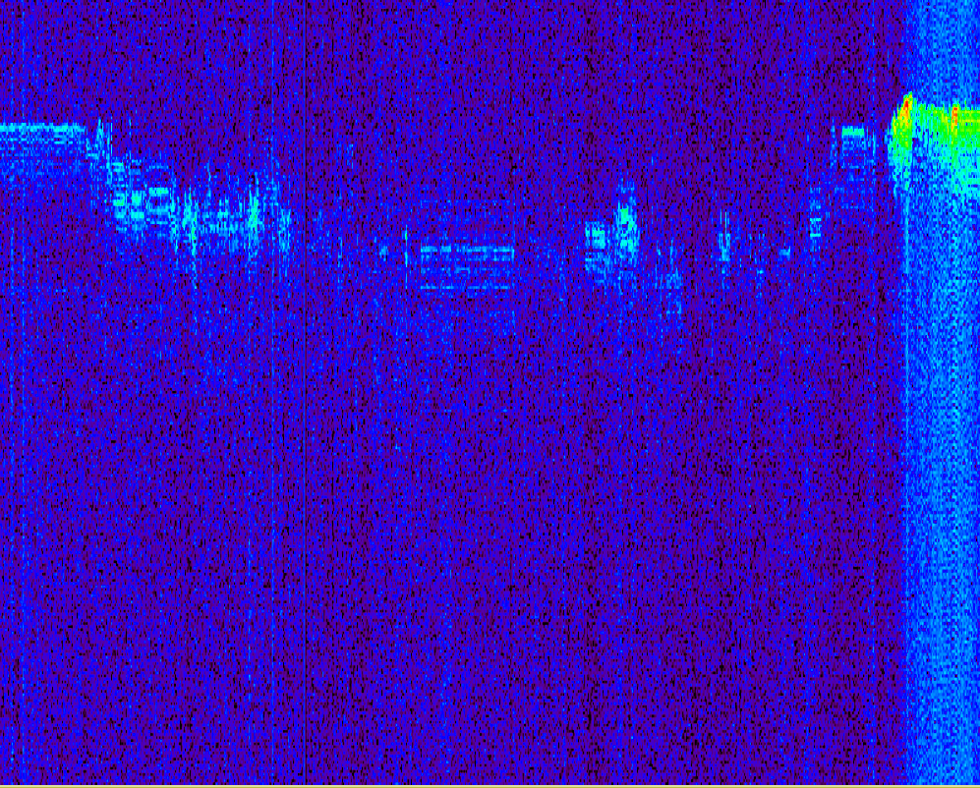
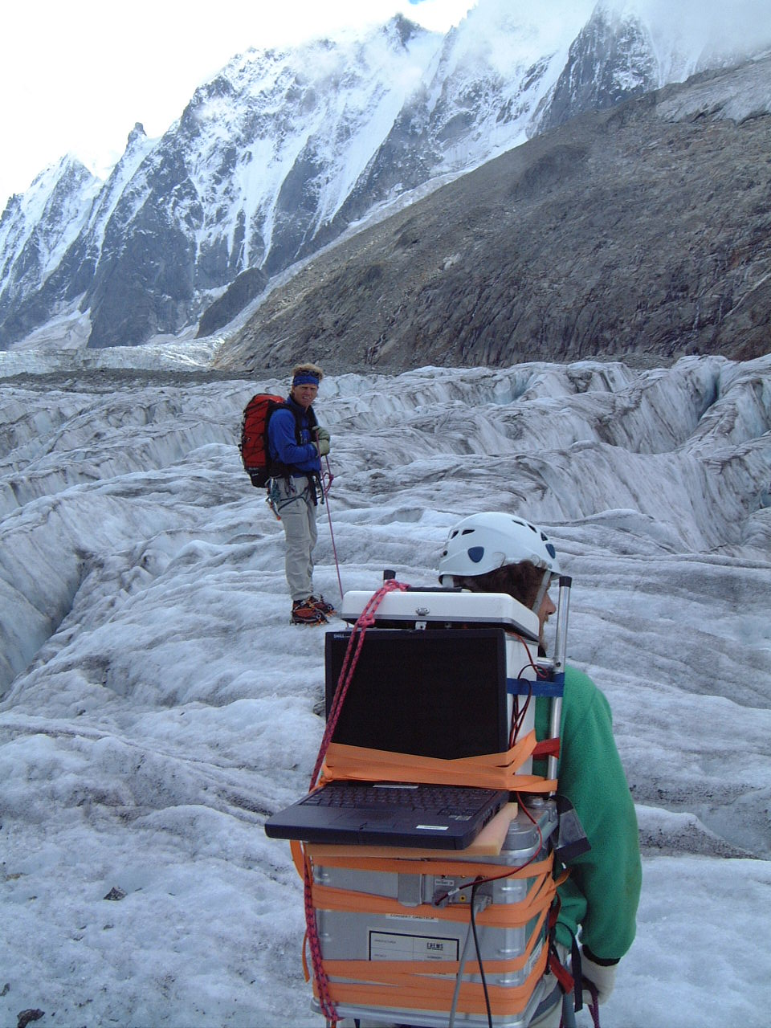
Sounding Radars to study sub surfaces
P
A
R
C
O
U
R
S
D
A
N
S
L
A
G
L
A
C
E
Displacement on glacier

Slide 16
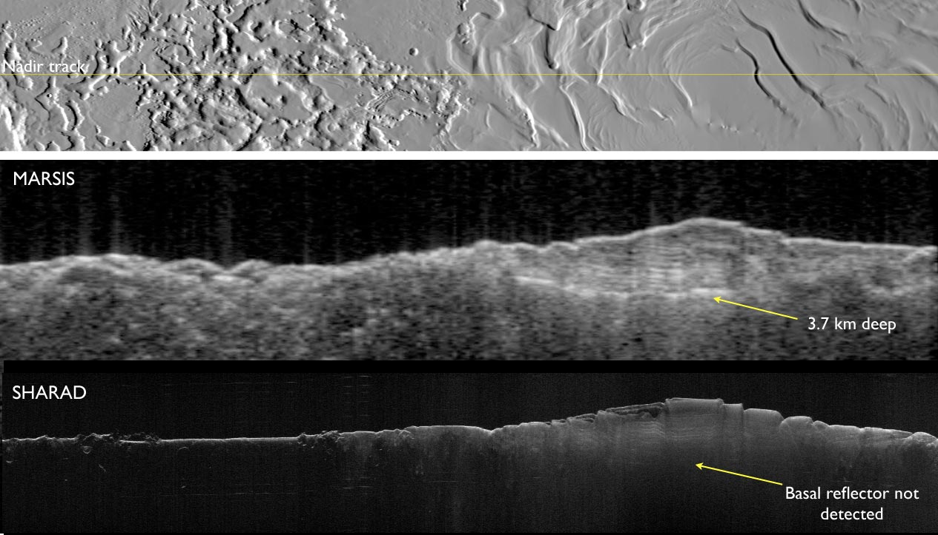
Mars Polar Caps as seen by Radars
Longueur: 900 km

Slide 17
Mars water content as seen by Radars
Mouginot et al,
GRL 2012
Global map of water content in the sub-surface of mars from MARSIS measurements

Slide 18
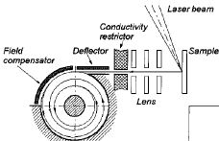
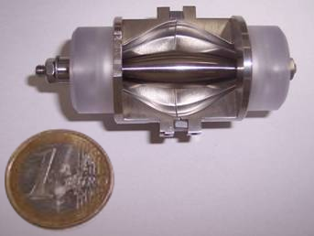
From Lab instruments to space instruments

Slide 19
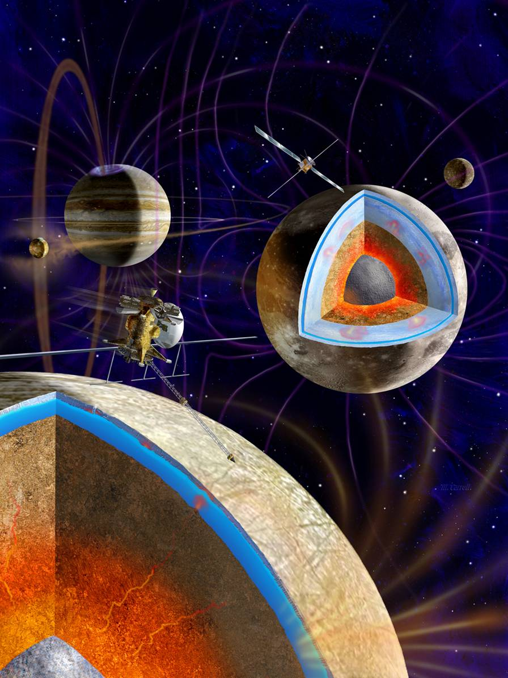
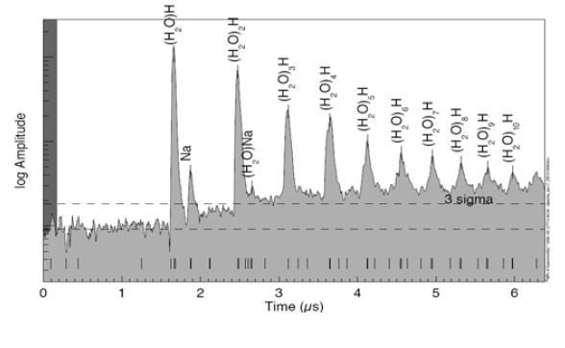
DUST detector - JUICE(PI Kempf, Boulder Co)
L class Cosmic Vision
Mesures Cassini
19 37 55 73 91 180
Mesures avec
Orbirtrap?
FFT
Spectra
I(t)
773 774 775

