Slide 1
Effective Density Dependence of Nuclear Interaction
in The Relativistic Hadron Field Theory
ME Kristian Petrík
SUPERVISOR Ing. Štefan Gmuca, CSc.
YouResAstro2012 3-6 September 2012

Slide 2
Motivation
Compact Stars
Ground state of dense matter
What is the composition of a compact star ?
Any problems ?
Indirect kind of observations – we can’t have a look inside the star
Compact stars are an application of QCD
strong coupling nature
Impossible to derive a low energy hadronic Lagrangian from QCD
Density dependence of nuclear interaction – under construction
Solution !
Effective hadron field theory

Slide 3
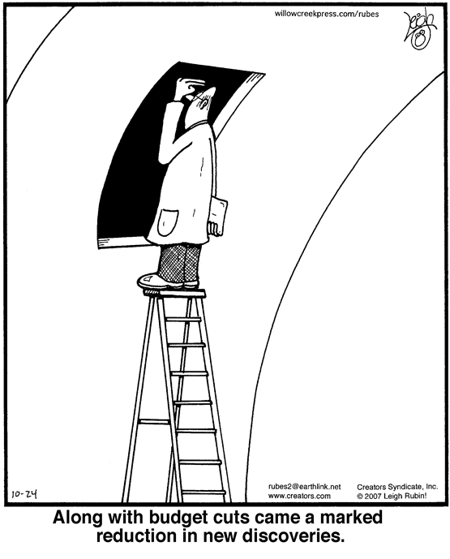
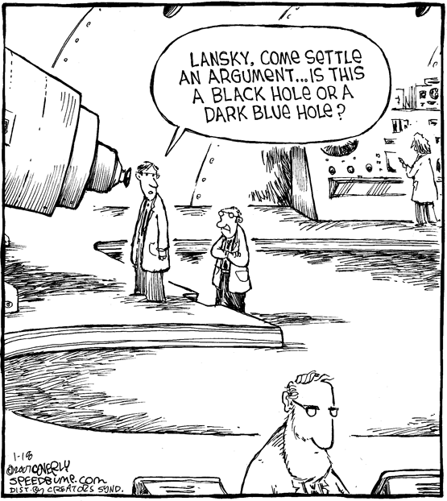
Difficulties and Problems
observation
interpretation

Slide 4
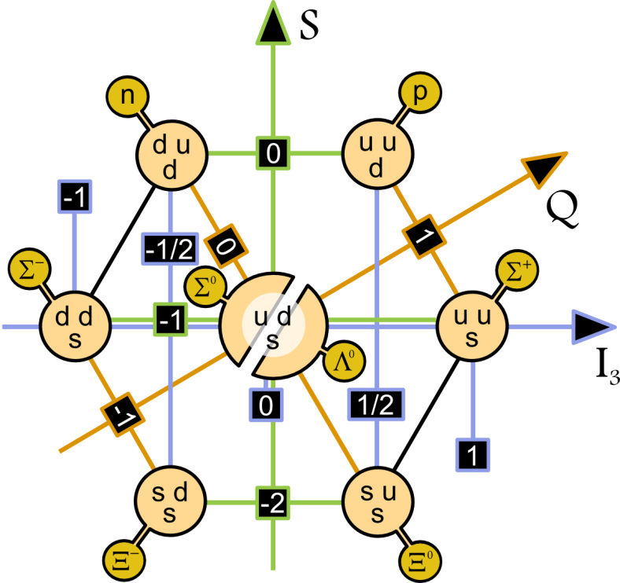
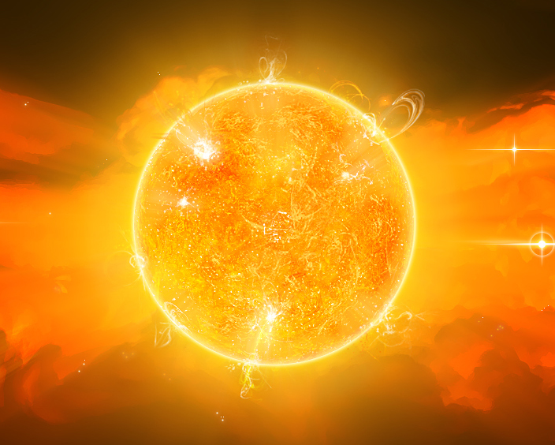

Slide 5
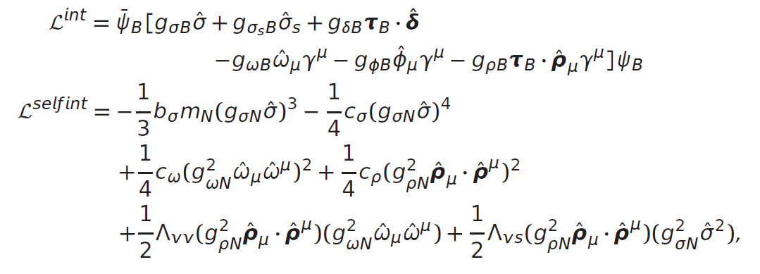
Blueprint
.density dependence.
non-linear hft
Density dependent hft
.Interaction.

Slide 6
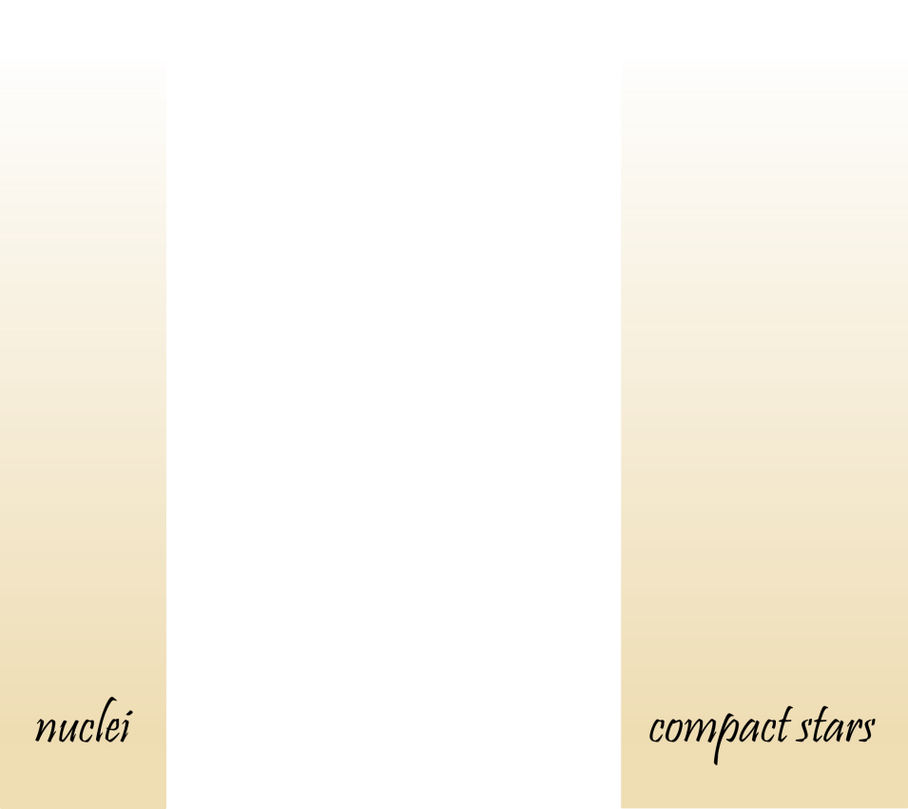
Blueprint
.Problem.

Slide 7
Blueprint
Nuclear
(p,n)
Lambda
(p,n L)
.To do list.
Symmetric
Compact Star Composition
Asymmetric
Equation of State
neutrons
protons
electrons
Neutron
muons
hyperons
Symmetric

Slide 8
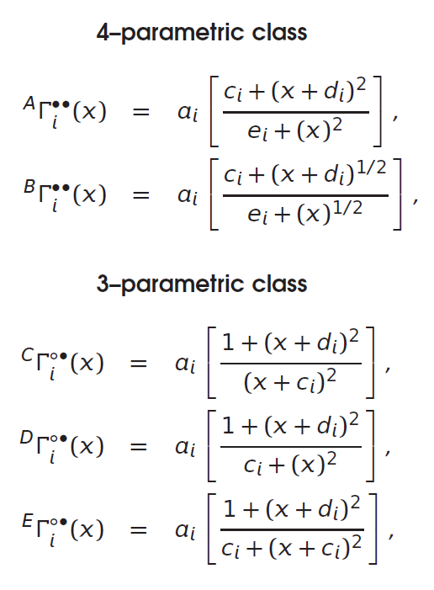
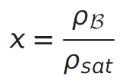
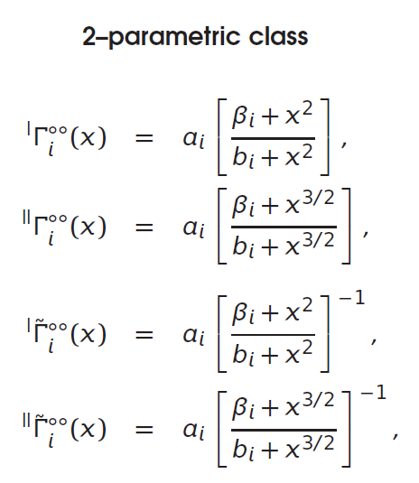
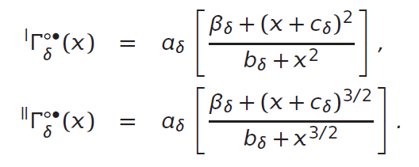
Model
.density dependence of vertex functions.
Typical choice
(density dependence)
5par
New functions
(density dependence)
4par
2 free parameters
1 beta factor
3par

Slide 9
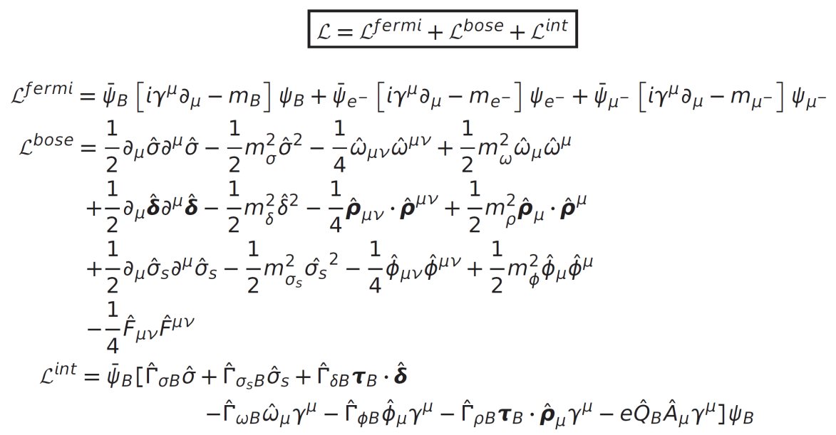
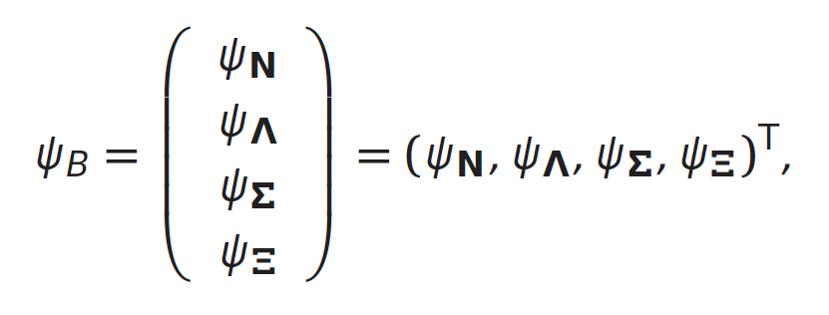
Model
.density dependent hadron field theory.
Lagrangian density
(baryons and mesons)
Baryon octet
(2 nucleons + 6 hyperons)
Density dependent couplings
(dd vertex functionals)

Slide 10
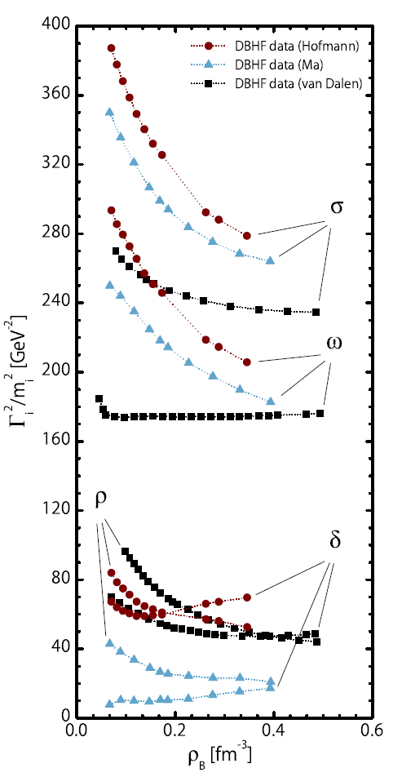
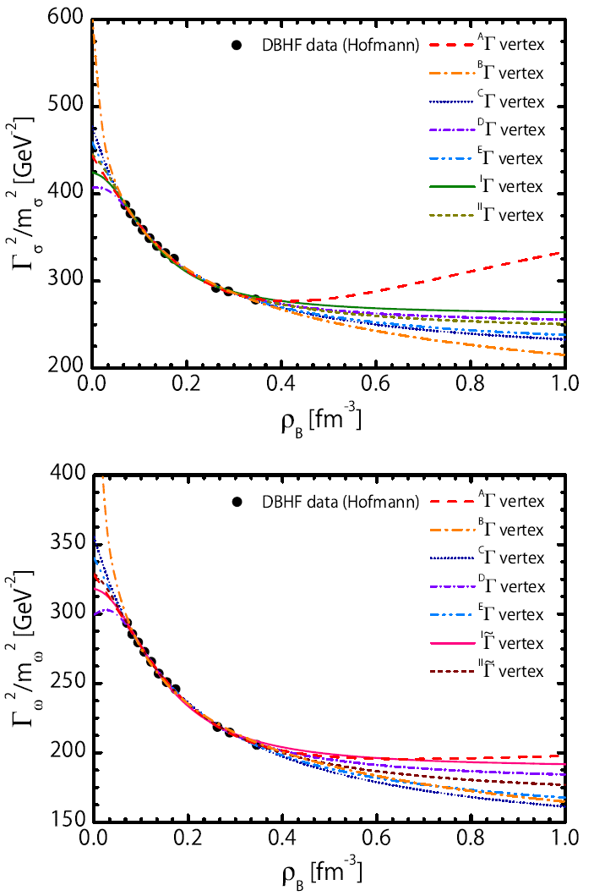
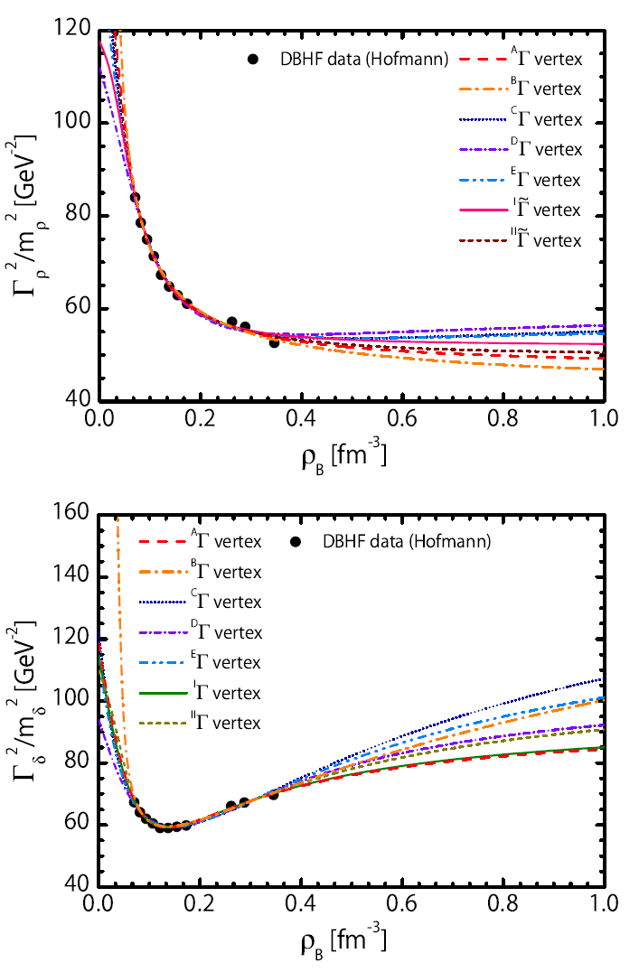
Results
.fits of vertex functionals.
Density dependent hadron field theory for asymmetric nuclear matter and exotic nuclei
F. Hofmann, C. M. Keil, H. Lenske
Phys. Rev C 64 (2001) 034314

Slide 11
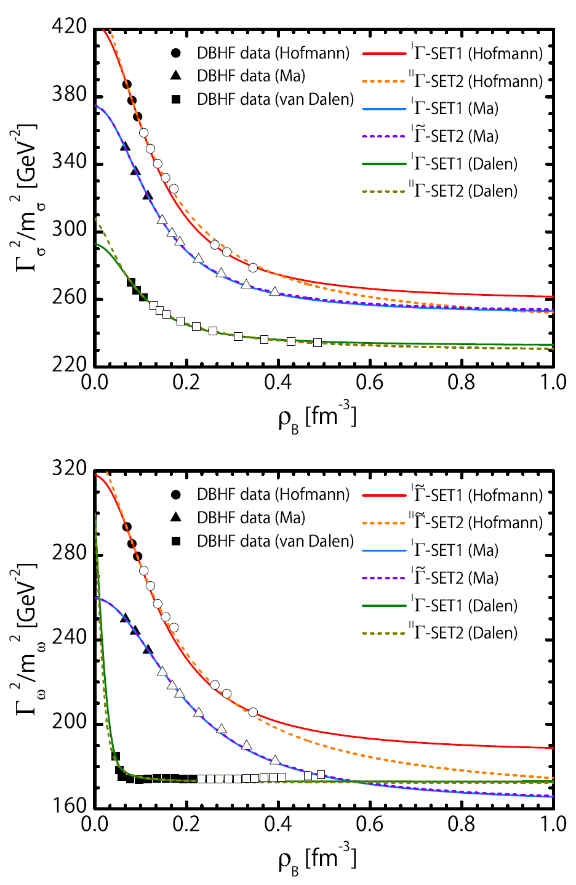
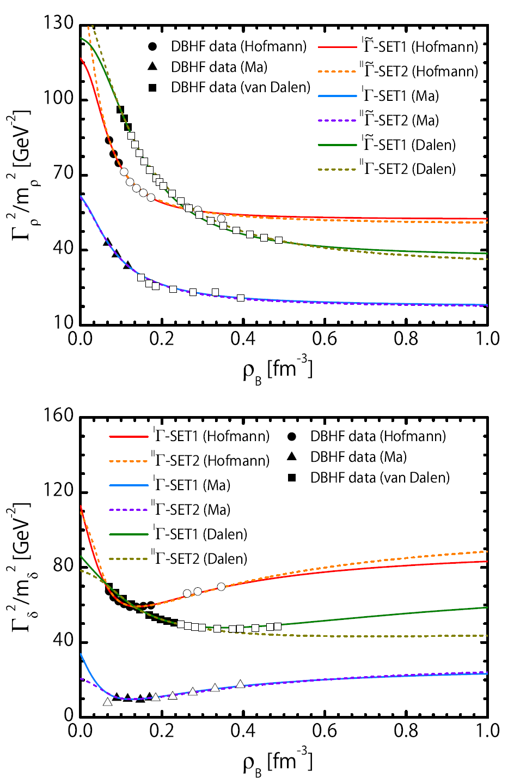
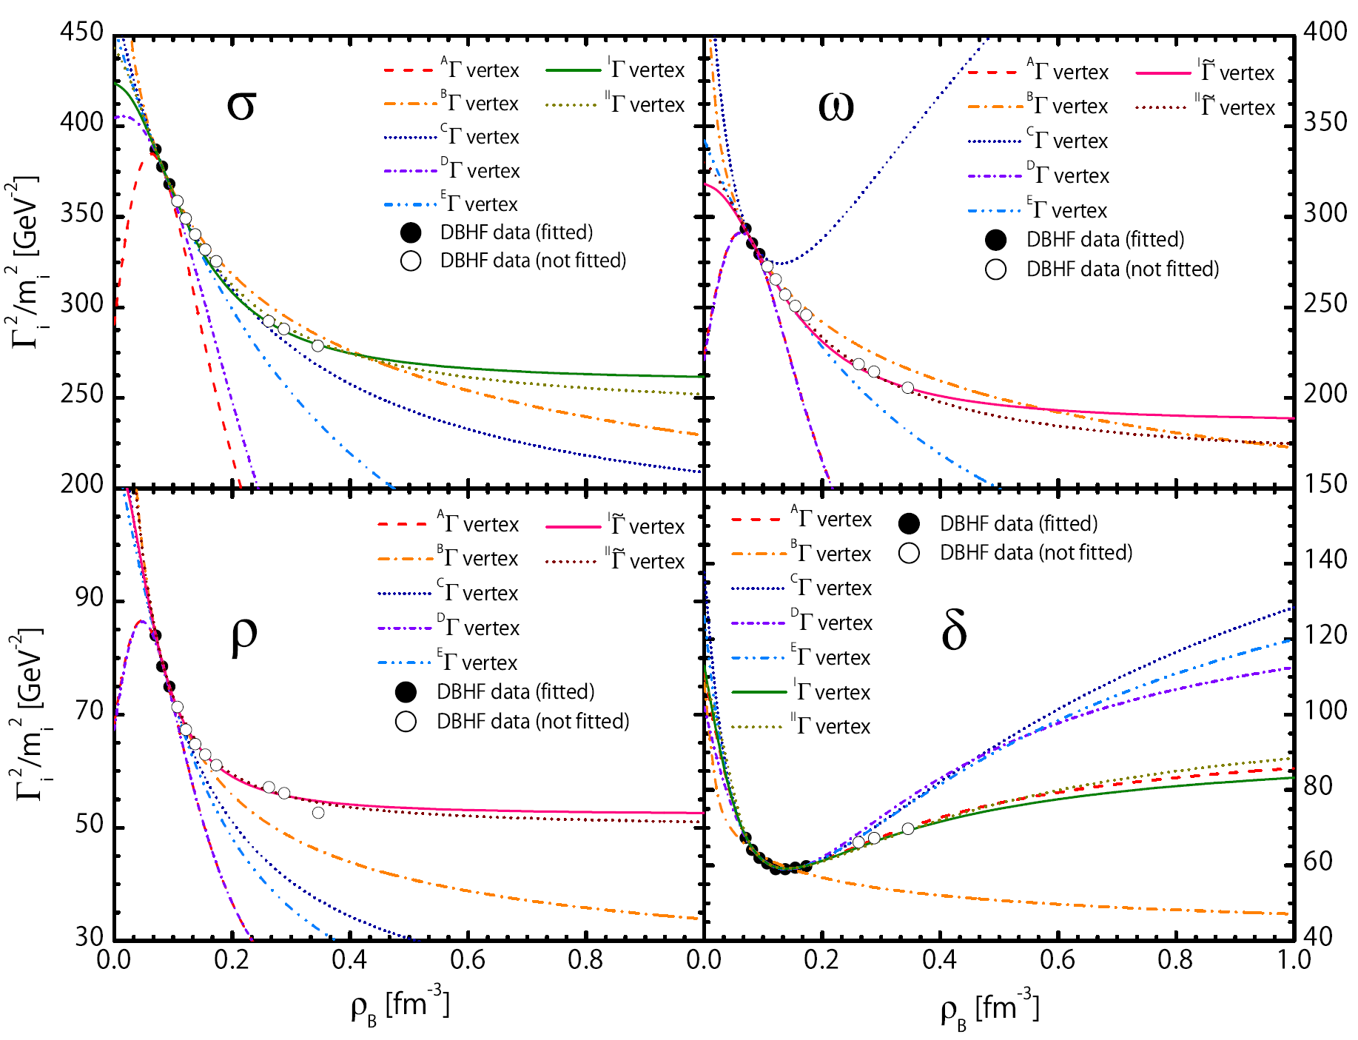
Results
.partial fits.

Slide 12
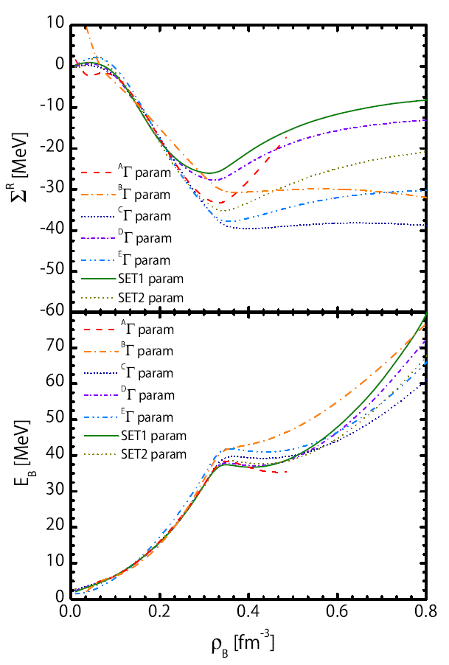
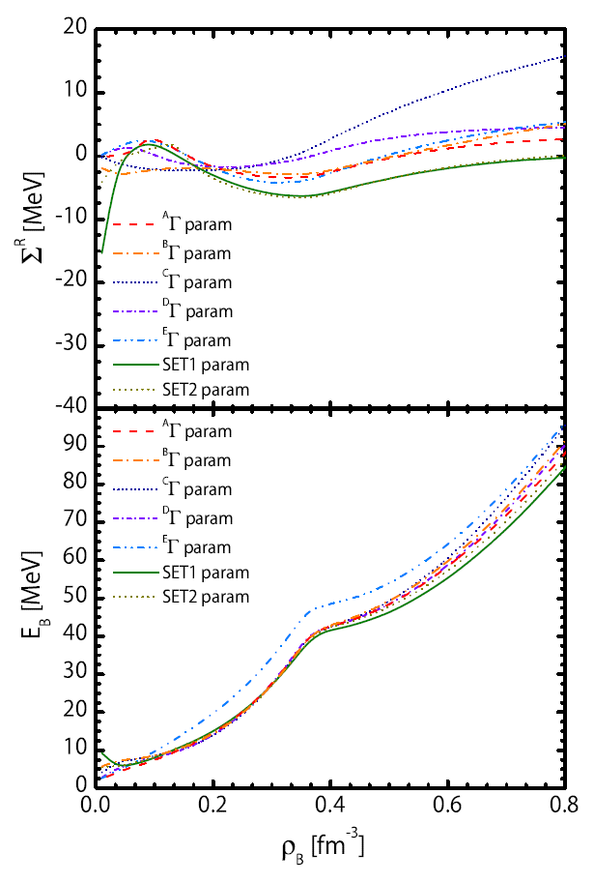
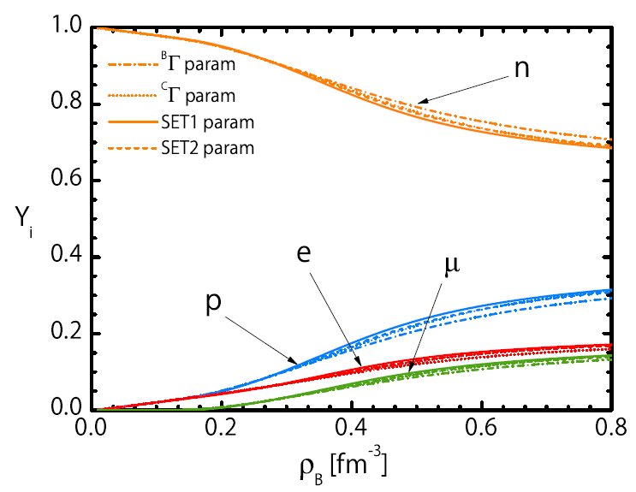
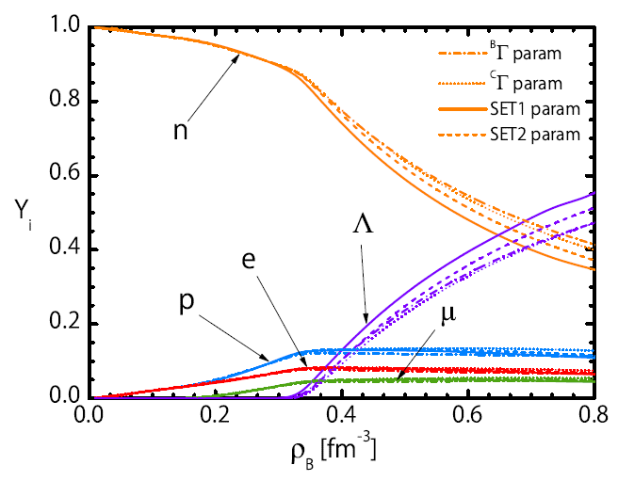
Results
.beta equilibrium.
Hofmann et al.
van Dalen et al.
nuclear matter
(nucleons)
Lambda matter
(lambda hyperon)

Slide 13
Conclusions
Compact Stars
Full baryonic octet - hyperons
What is the composition of a hyperon star
and how does it depend on the density ?
Density dependence
New reliable DBHF data
Exact Hartree-Fock density dependence
Constraints from astrophysics or heavy-ion collisions physics
Thank you !

