Slide 1
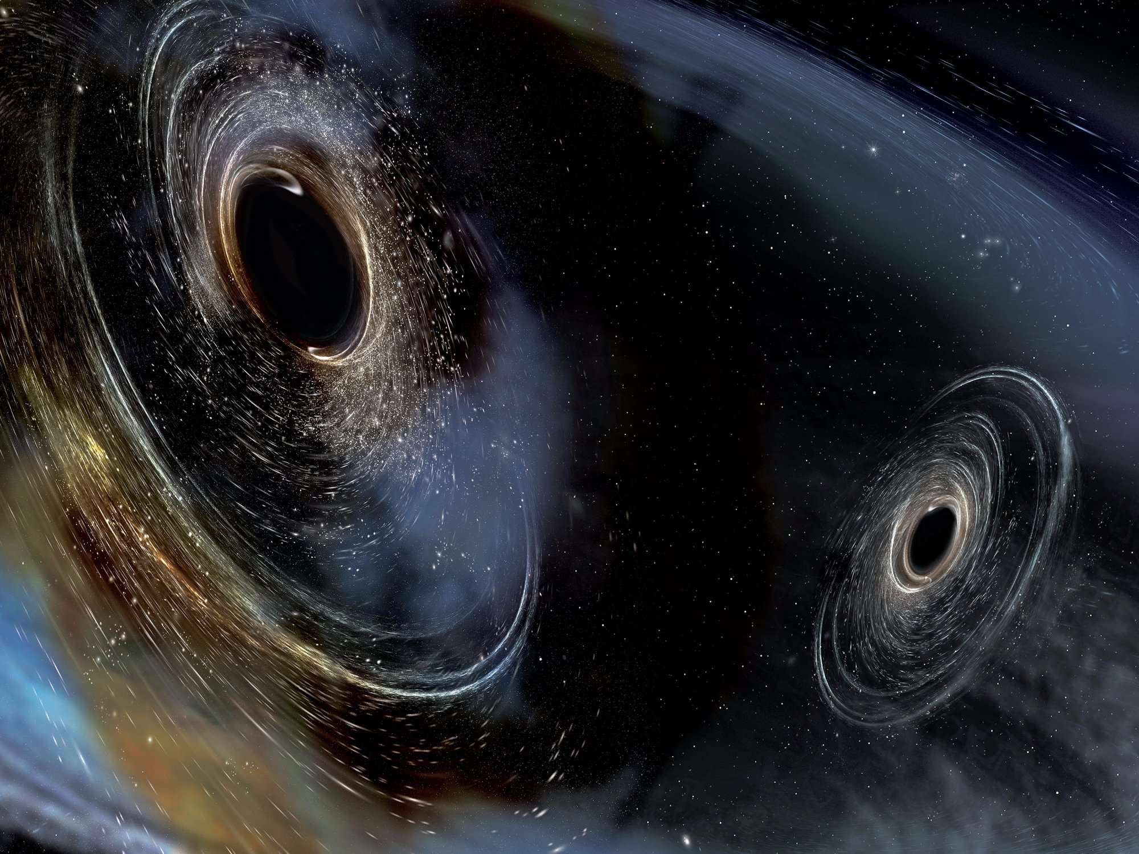
Spin evolution of compact binaries from post-Newtonian secular dynamics
Zoltán Keresztes,
Márton Tápai, László Á. Gergely
University of Szeged
Department of Theoretical Physics,
Department of Experimental Physics

Slide 2
Contents
Equations of motion
Shape and angle variables, Chameleon orbits
Secular evolution equations
Spin angle dynamics and Spin Flip-Flop
WIGNER seminar 06.01.2018.

Slide 3
Observed gravitational waves originated from compact binaries
https://www.ligo.org/detections/GW170817.php
WIGNER seminar 06.01.2018.

Slide 4
Post-Newtonian (PN) description
Landau-Lifschitz formulation of GR
E. Poisson, C. M. Will, Gravity: Newtonian, Post-Newtonian, Relativistic, Cambridge Univ. Press, Cambridge (2014)
Tensor densities from the metric:
Symmetries:
Einsten’s equation:
quadratic and higher order in
Field equation:
From the symmetries
Provided the Einstein equations are satisfied.
WIGNER seminar 06.01.2018.

Slide 5
Post-Newtonian (PN) description
Weak gravity!
Almost Lorentz coordinates satisfying harmonic conditions, i.e.
Potentials:
with
„Relaxed” Einstein equation:
with
Effective energy-momentum pseudotensor:
matter energy momentum-tensor
quadratic and higher order in h^{αβ}
Harmonic coordinate condition:
WIGNER seminar 06.01.2018.

Slide 6
Post-Newtonian (PN) description
Weak gravity regions!
Relaxed Einstein equation can be solved without enforcing the harmonic gauge condition.
Solution with iterations:
Iteration starts with:
Then h^{αβ} is expressed in terms of harmonic coordinates for a given distribution of matter.
Then the flow of the matter is determined by the harmonic coordinate condition:
The EOM for a non-spinning star is the same as for a point particle obtained from the geodesic equation immersed in „post-Newtonian environment”.
,
The motion of a spinning body deviates from the geodesic trajectory.
WIGNER seminar 06.01.2018.

Slide 7
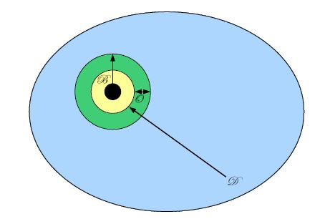
EOM for a Schwarzschild black hole immersed in PN environment
Black hole (BH)
S. Taylor, E. Poisson, PRD 78, 084016 (2008)
Strong gravitational field due to the BH
- Perturbed BH spacetime
Weak gravitational field of the sources described by post-Newtonian metric
Matching the metrics:
Determines
the free functions related to the gravitation field of the perturbed BH in the PN metric
EOM for the BH in the spacetime described by the PN metric
Weak field described by
perturbed BH
post-Newtonian metric
$$ε≡\frac{GM}{c^{2}r}≈\frac{v^{2}}{c^{2}}≪1$$
WIGNER seminar 06.01.2018.

Slide 8
Binaries; Relative acceleration
Almost Lorentzian coordinates (t,x¹,x²,x³) are used for the description of the metric, the origin is the centre of mass of two bodies. The PN metric is asymptotically flat.
Relative vector:
i=1,2,3
Relative distance:
Relative position:
L. E. Kidder, Phys. Rev. D 52, 821 (1995).
E Poisson, Phys. Rev. D 57, 5287 (1998).
LÁ Gergely, Z Keresztes, Phys Rev D 67, 024020 (2003).
G=c=1 units
$a=a_{N}+a_{PN}$+ $a_{SO}$+ $a_{SS}+a_{QM}+a_{2PN}$
with
WIGNER seminar 06.01.2018.

Slide 9
Relative acceleration
L. E. Kidder, Phys. Rev. D 52, 821 (1995).
E Poisson, Phys. Rev. D 57, 5287 (1998).
LÁ Gergely, Z Keresztes, Phys Rev D 67, 024020 (2003).
G=c=1 units
$a=a_{N}+a_{PN}$+ $a_{SO}$+ $a_{SS}+a_{QM}+a_{2PN}$
Notations:
w_{i}=1 for BH
dimensionless spin parameter
WIGNER seminar 06.01.2018.

Slide 10
Spin evolution equations
L. E. Kidder, Phys. Rev. D 52, 821 (1995).
E Poisson, Phys. Rev. D 57, 5287 (1998).
LÁ Gergely, Z Keresztes, Phys Rev D 67, 024020 (2003).
G=c=1 units
i,j=1,2
$$i≠j$$
Constant of motion: Total angular momentum
where
WIGNER seminar 06.01.2018.

Slide 11
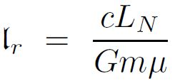
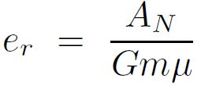
Variables
Shape variables:
Angle variables:
κ₂
,
L_{N}
α
J
S₂
Laplace-Runge-Lenz vector:
κ₁
S₁
Parametrization:
ζ₂
ζ₁
r
Conservative dynamics:
B. M. Barker, R. F. O’Connell, Phys. Rev. D 12, 329 (1975).
B. M. Barker, R. F. O’Connell, Gen. Relativ. Gravit. 11, 149 (1979).
L. E. Kidder, Phys. Rev. D 52, 821 (1995).
LÁ Gergely, Phys.Rev. D 82, 104031 (2010).
LÁ Gergely, Phys.Rev. D 81, 084025 (2010).
E Poisson, CM Will, Gravity: Newtonian, Post-Newtonian, Relativistic, Cambridge Univ. Press (2014).
χ_{p}
ϕ_{n}
x
ψ_{p}
l
A_{N}
WIGNER seminar 06.01.2018.

Slide 12
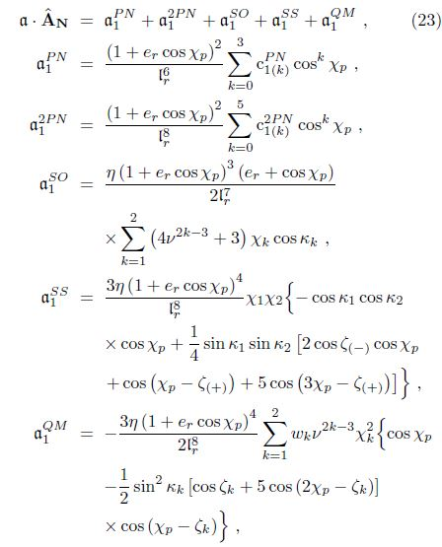
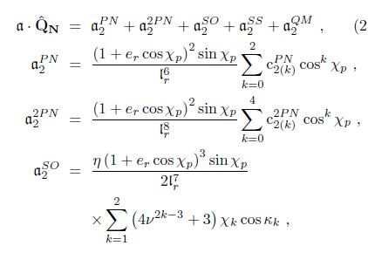
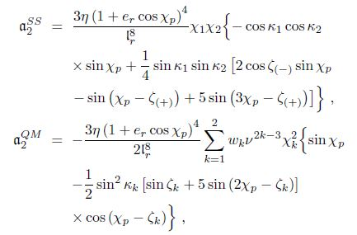
Evolution of the eccentricity
LÁ Gergely, Z Keresztes, PRD 91, 024012 (2015)
WIGNER seminar 06.01.2018.

Slide 13
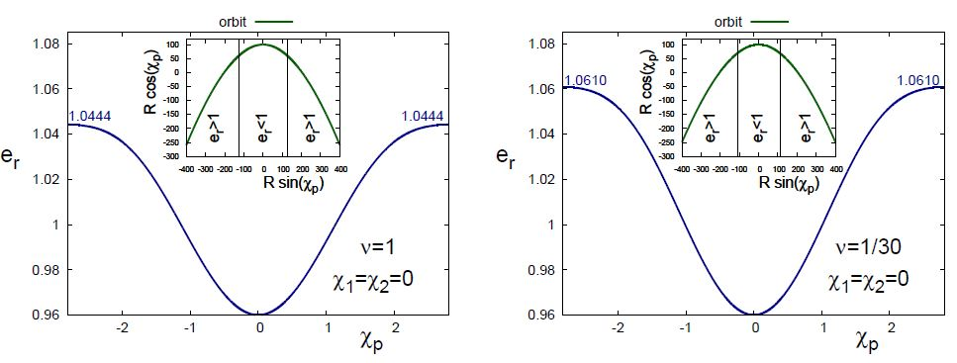
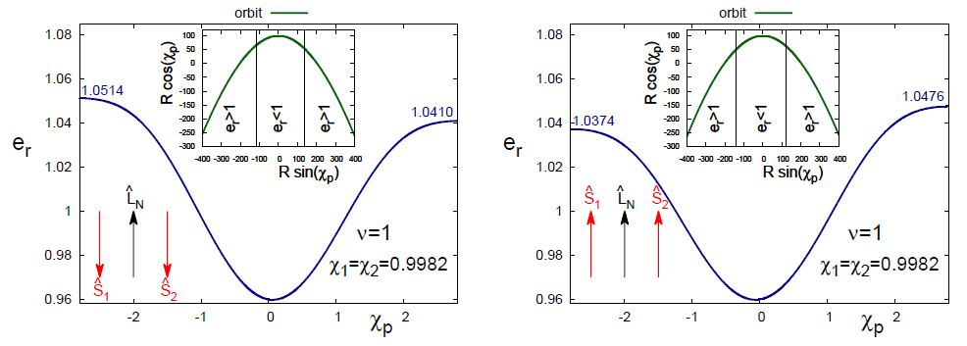
Chameleon orbits
LÁ Gergely, Z Keresztes, PRD 91, 024012 (2015)
WIGNER seminar 06.01.2018.

Slide 14
Timescales; secular evolution equations
Timescales in dimensionless units ( ):
κ₂
L_{N}
α
J
S₂
κ₁
S₁
Secular differential equations:
ζ₂
ζ₁
r
where
χ_{p}
ϕ_{n}
x
ψ_{p}
l
A_{N}
Examples:
Constraints:
WIGNER seminar 06.01.2018.

Slide 15
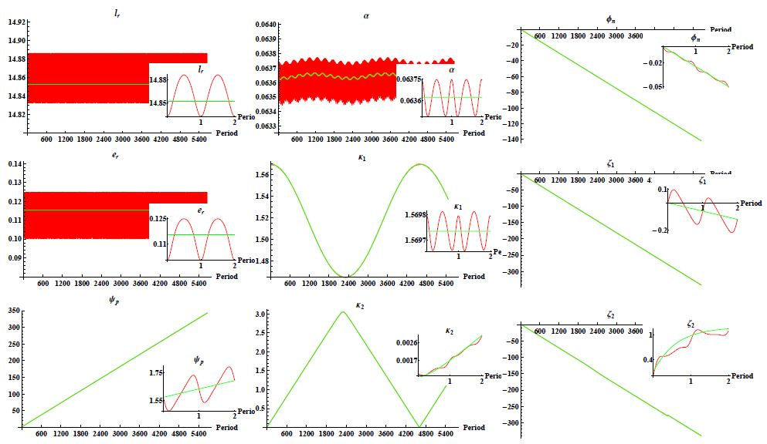
Secular vs momentarily evolutions
The maximal number of periods where roughly p% error occurs since we neglect the 2.5PN order GW radiation backreaction:
Angles are in radian.
L.Á. Gergely, Z. Keresztes, M. Tápai, Universe 2018, 4(2) (2018)
N
N
N
N
N
N
N
N
N
N
N
N
N
N
N
N
N
N
WIGNER seminar 06.01.2018.

Slide 16
Spin angle dynamics
κ₂
Small dimensionless spin parameter ratio.
L_{N}
J
t:
S₂
κ₁
S₁
Δζ
Fix point:
,
r
Quasi constant coefficients:
x
l
A_{N}
Solution:
Integration constants,
with
integr
WIGNER seminar 06.01.2018.

Slide 17
Spin angle dynamics
κ₂
Solution:
L_{N}
J
S₂
κ₁
S₁
Δζ
Quasi constant coefficients:
r
x
l
A_{N}
Smaller spin vector evolves through the axis of L_{N} :
Change in the polar angle of the smaller spin vector:
Large Flip-Flop:
1)
Quasi circular orbits:
CO Lousto, J Healy, Phys. Rev Lett. 114, 141101 (2015)
2)
$$w_{1}≠1$$
neutron stars ?
WIGNER seminar 06.01.2018.

Slide 18
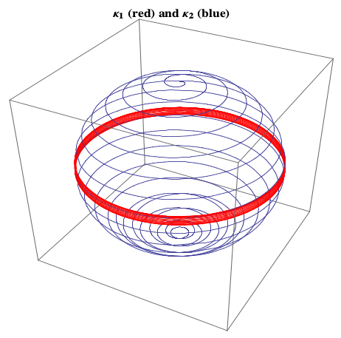
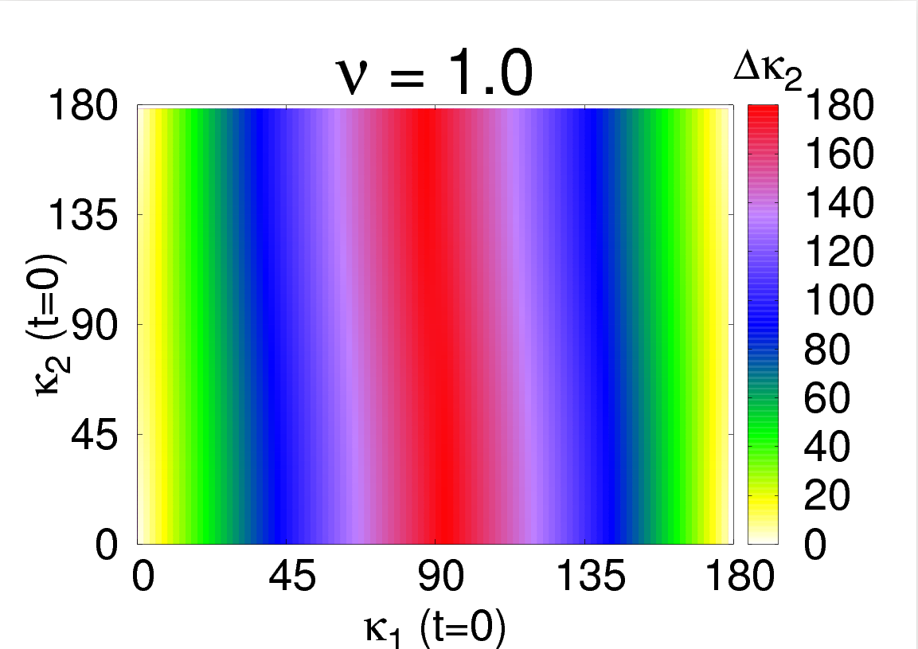
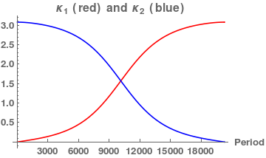
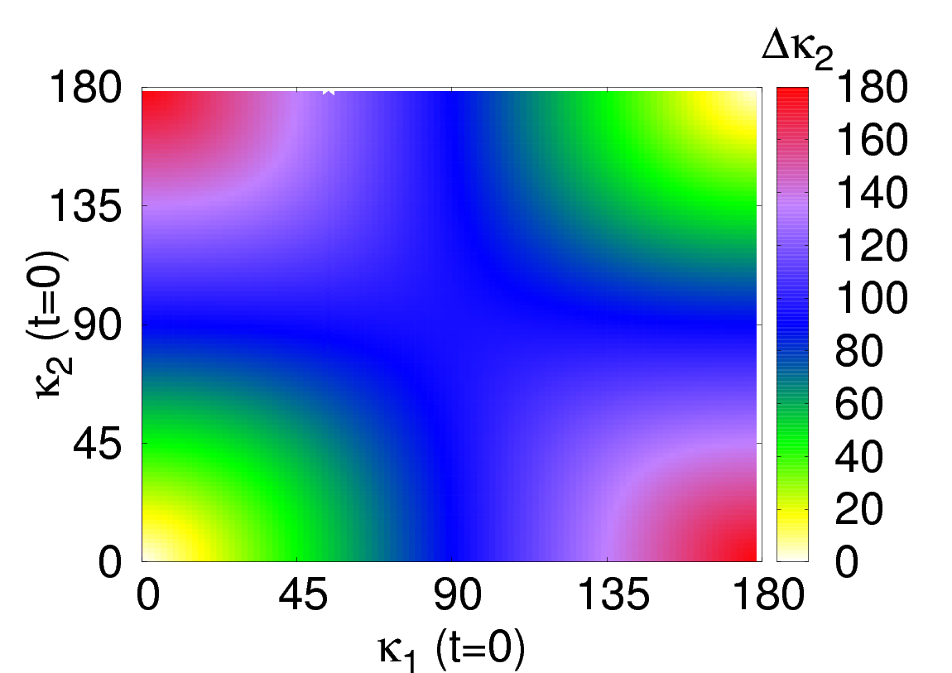
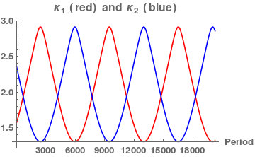
Standard results are reproduced with small eccentricity
S₂
Evolutions of the spin unit vectors.
L_{N} determines the z-direction.
For circular orbits:
χ₁=19χ₂
S₁
CO Lousto, J Healy, Phys. Rev Lett. 114, 141101 (2015)
D Gerosa, M Kesden, R O’Shaughnessy, A Klein, E Berti, U Sperhake, D Trifirn, Phys. Rev. Lett. 115, 141102 (2015)
CO Lousto, J Healy, H Nakano, Phys. Rev D 93, 044031 (2016)
CO Lousto, J Healy, Phys. Rev D 93, 124074 (2016)
(in radian)
(in degree)
Δζ(0)=π/2
e_{r}=0.1,
χ₁=χ₂
ν=1
Δκ₁=Δκ₂
N
(in radian)
(in degree)
N
WIGNER seminar 06.01.2018.

Slide 19
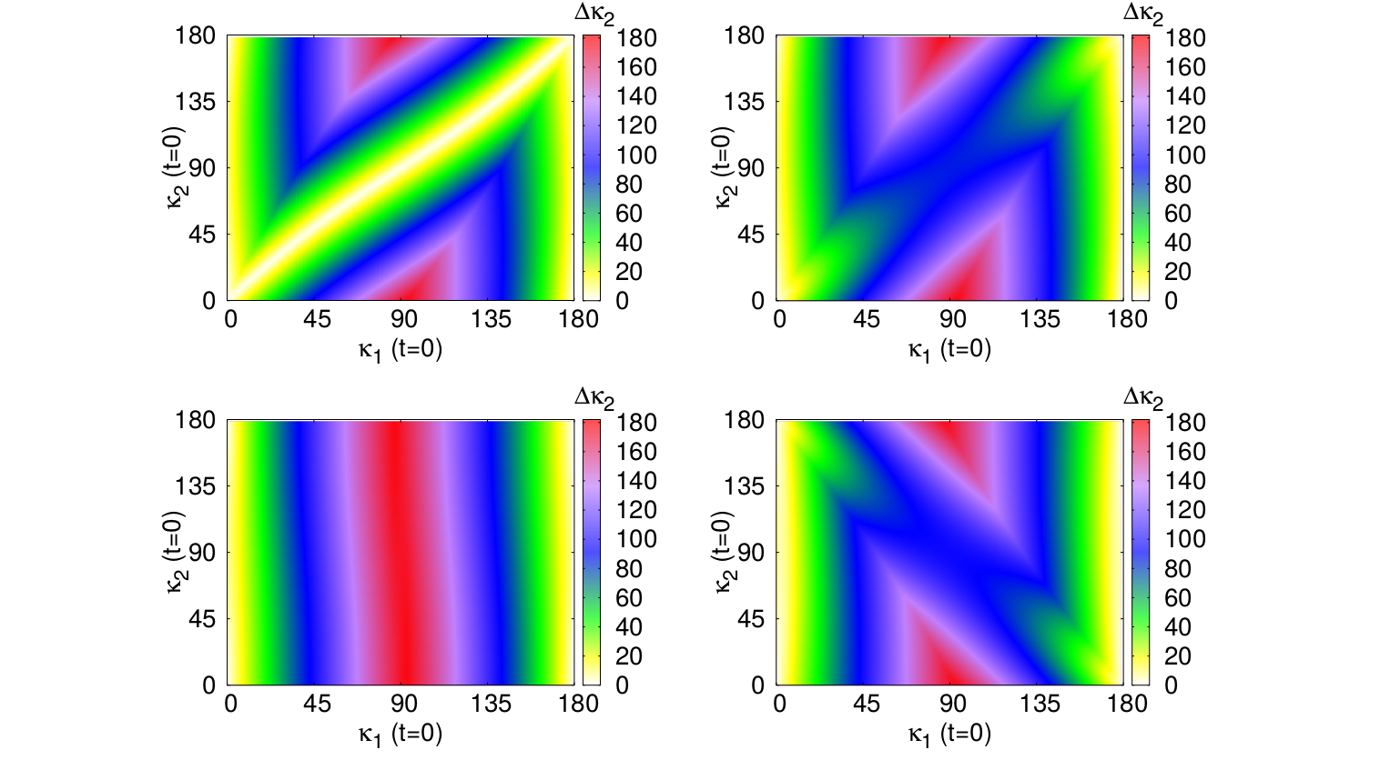
Spin evolution with small eccentricity and spin parameter ratio
e_{r}=0.1,
χ₁=19χ₂
ν=1
Δζ(0)=0
Δζ(0)=π/4
Δζ(0)=π/2
Δζ(0)=3π/4
WIGNER seminar 06.01.2018.

Slide 20
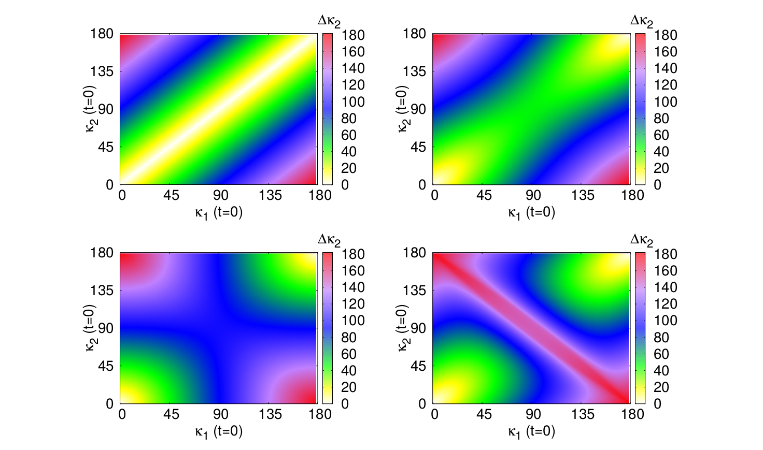
Spin evolution with small eccentricity and equal spin parameters
e_{r}=0.1,
χ₁=χ₂
ν=1
Δζ(0)=0
Δζ(0)=π/4
Δζ(0)=π/2
Δζ(0)=3π/4
WIGNER seminar 06.01.2018.

Slide 21
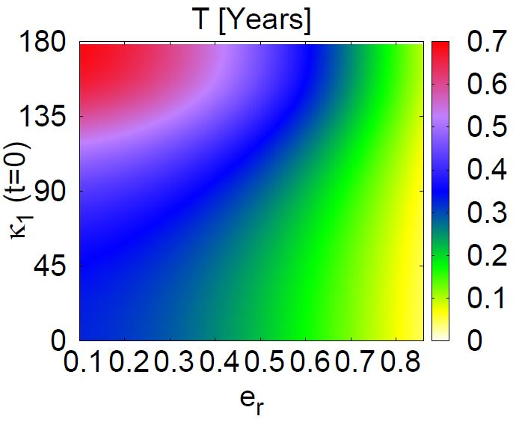
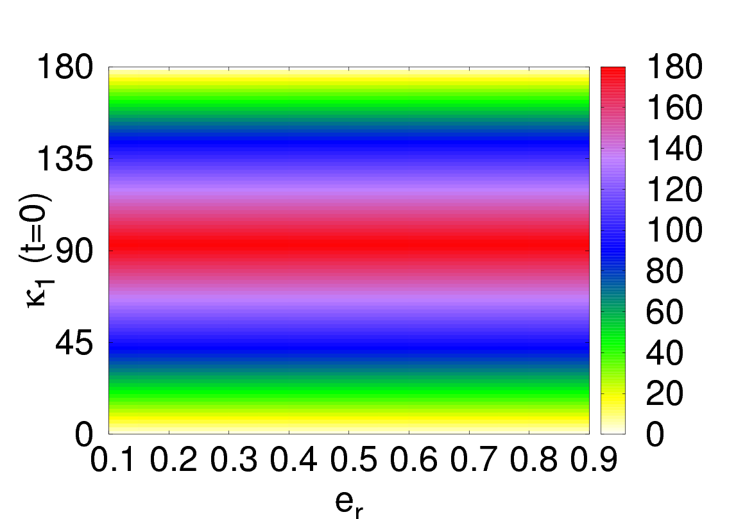
Effects of eccentricity
χ₁=19χ₂
Δζ(0)=π/2
ν=1
Magnitude of the Flip-Flop effect
Period of the Flip-Flop effect
Δκ₂
(in degree)
WIGNER seminar 06.01.2018.

Slide 22
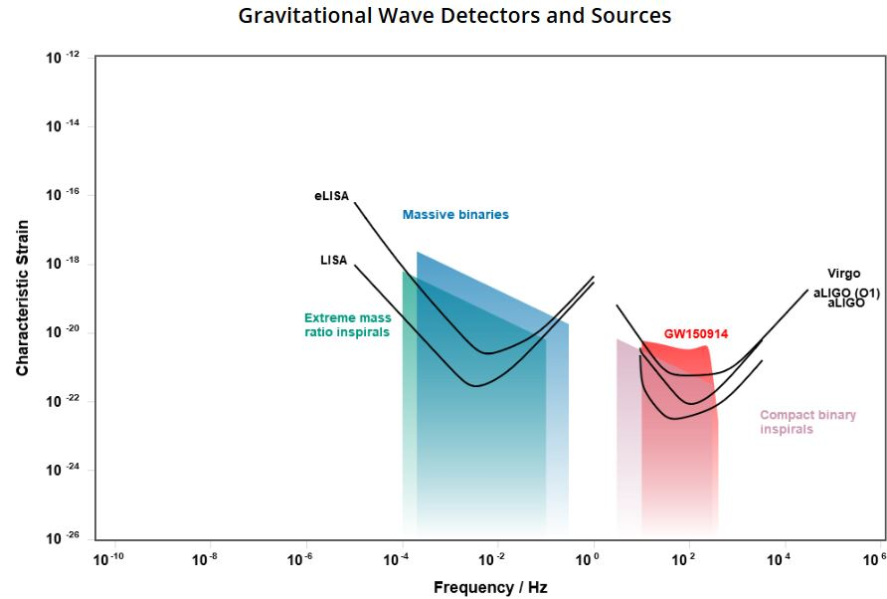
(e)LISA
CJ Moore, RH Cole, CPL Berry, CQG 32, 015014 (2015)
GW frequency – PN parameter:
The time spent between these frequencies:
Δτ ≈ 4.3 years
WIGNER seminar 06.01.2018.

Slide 23
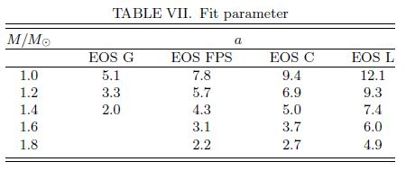
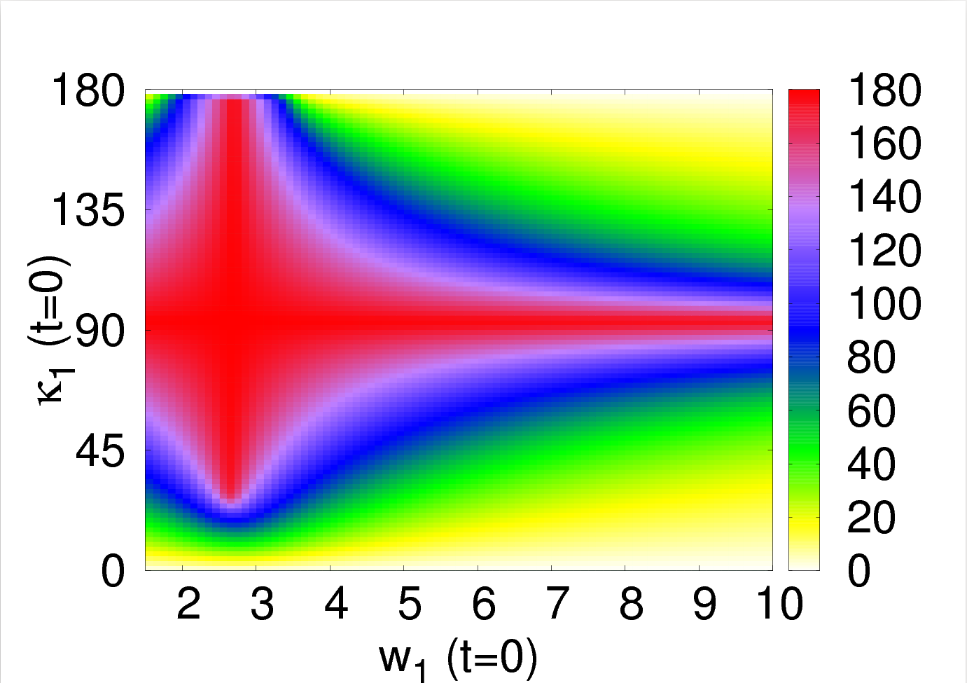
Effects of quadrupole parameter
WG Laarakers, E Poisson, Astrophys. J. 512, 282 (1998)
=w(EOS,M)
e_{r}=0.1,
χ₁=19χ₂
Δκ₂
(in degree)
WIGNER seminar 06.01.2018.

Slide 24
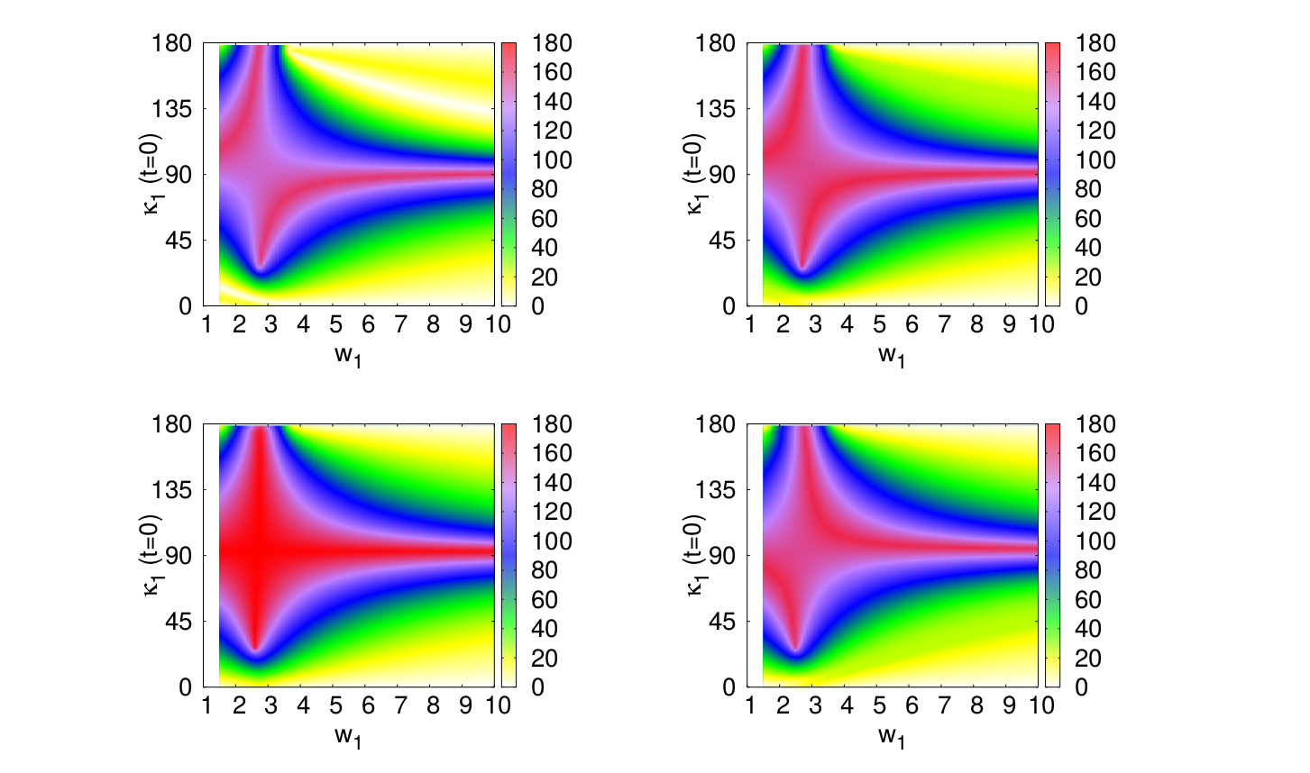
Effects of quadrupole parameter (small spin parameter ratio)
e_{r}=0.1,
χ₁=19χ₂
Δκ₂
(in degree)
Δκ₂
(in degree)
Δζ(0)=0
Δζ(0)=π/4
Δκ₂
(in degree)
Δκ₂
(in degree)
Δζ(0)=π/2
Δζ(0)=3π/4
WIGNER seminar 06.01.2018.

Slide 25
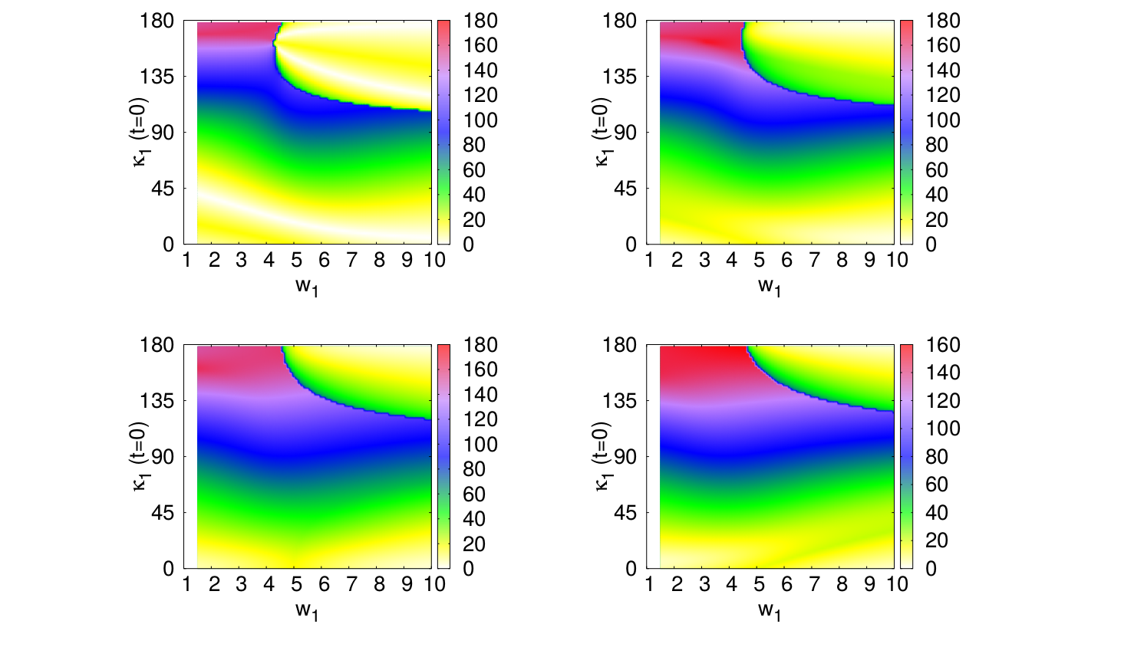
Effects of quadrupole parameter (equal spin parameters)
e_{r}=0.1,
χ₁=χ₂
w₂=5
Δκ₂
(in degree)
Δκ₂
(in degree)
Δζ(0)=0
Δζ(0)=π/4
Δκ₂
(in degree)
Δκ₂
(in degree)
Δζ(0)=π/2
Δζ(0)=3π/4
WIGNER seminar 06.01.2018.

Slide 26
Conclusions
The eccentricity has no influence on the magnitude of the flip-flop effect.
The eccentricity has influence on the period of the flip-flop effect.
The quadrupole parameter can have significant influence on the magnitude of the flip-flop effect through the quadrupole-monopole coupling.
Acknowledgments: This work was supported by NKFI-123996. The work of Z.K. was also supported by the UNKP-17-4 New National Excellence Program of the Ministry of Human Capacities.
WIGNER seminar 06.01.2018.

