Slide 1

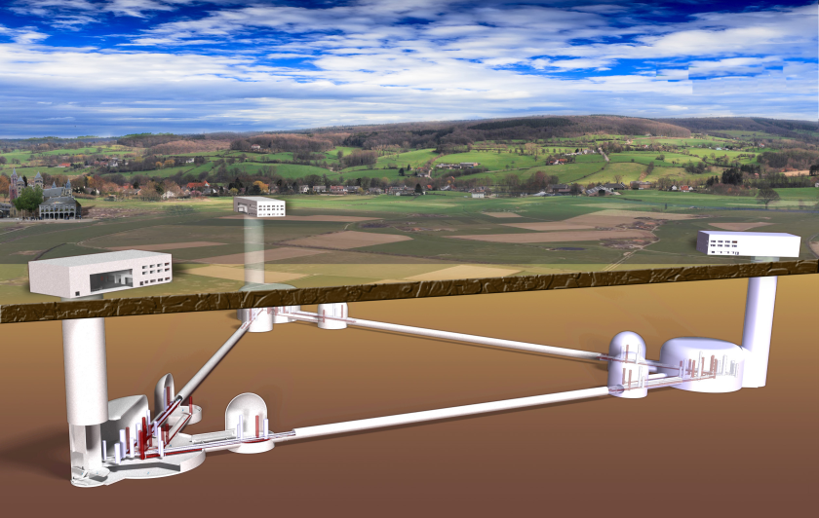
ET: the Einstein Telescope
Harald Lück
Wigner111 September 12, 2013, Budapest
Designing the third Generation of Gravitational Wave Detectors
Image by Nikhef

Slide 2
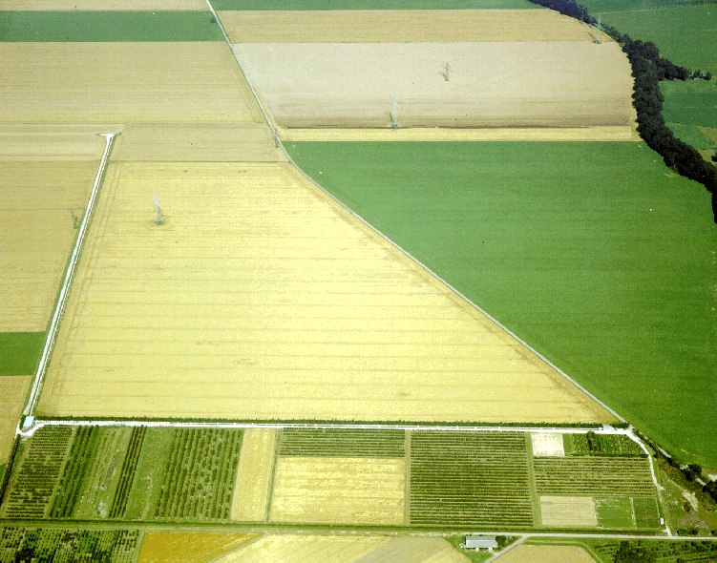
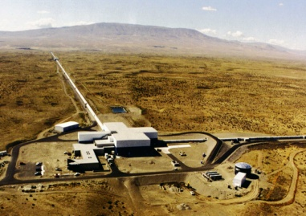


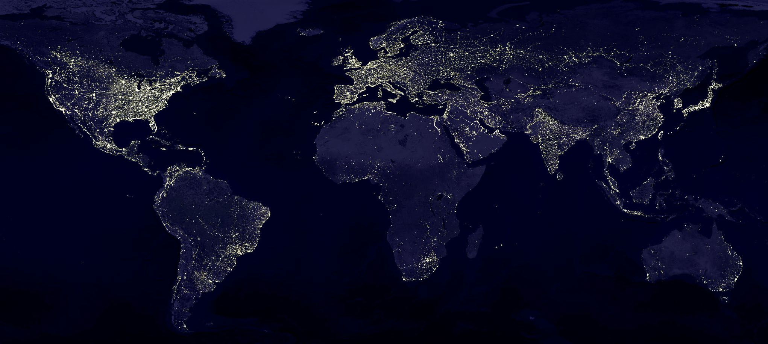
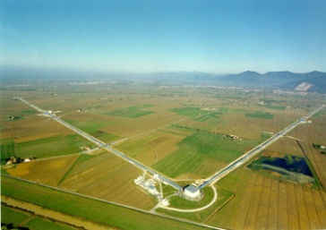
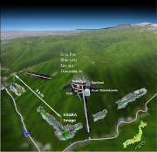


The advanced GW Network
GEO600, Hannover, 600 m
aLIGO Hanford, 4 km
aLIGO
INDIA
4km
Adv. Virgo, Cascina, 3 km
KAGRA 3km
aLIGO Livingston, 4 km
LIGO and Virgo are being upgraded now to advanced versions and KAGRA is being built
Notes:
KAGRA the former LCGT detector, a 3km cryogenic interferometer is being constructed in Japan in the Kamioka mine.
One of the LIGO Hanford detectors will most likely be transferred to India.

Slide 3
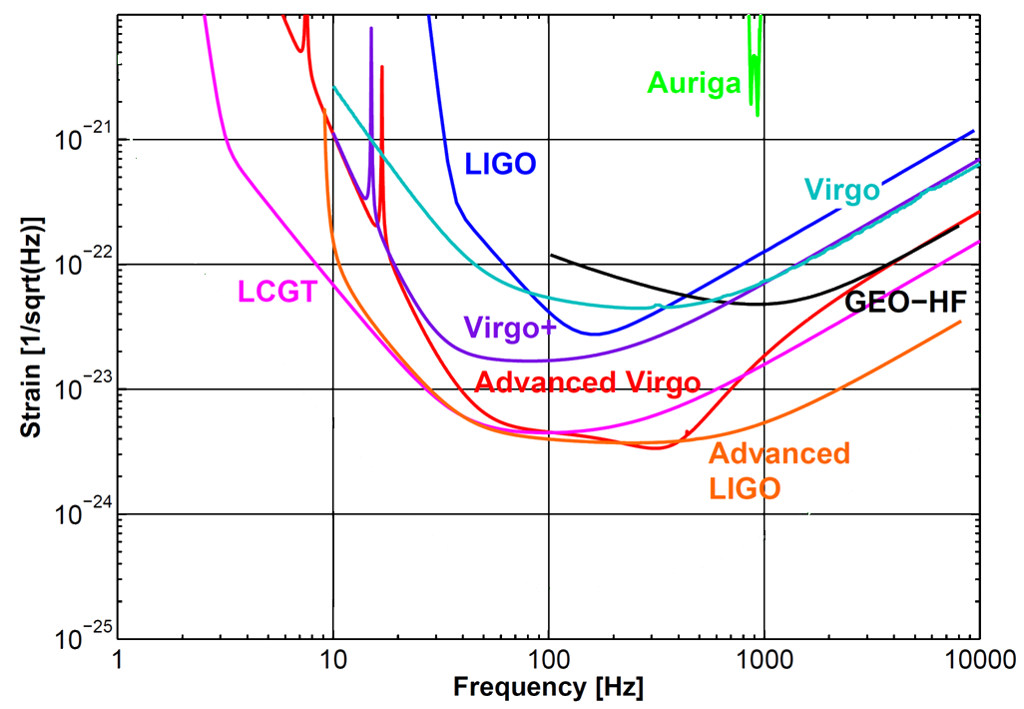
Sensitivites: 1st and 2nd Gen.
KAGRA

Slide 4

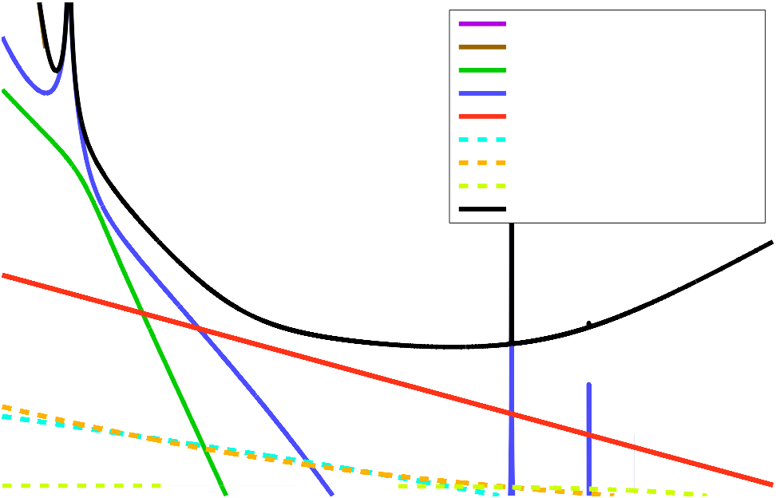
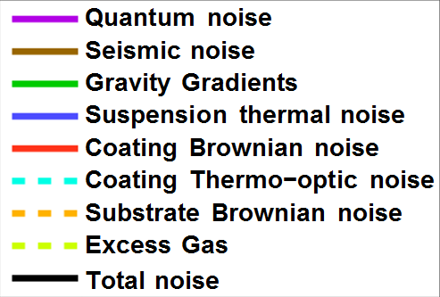
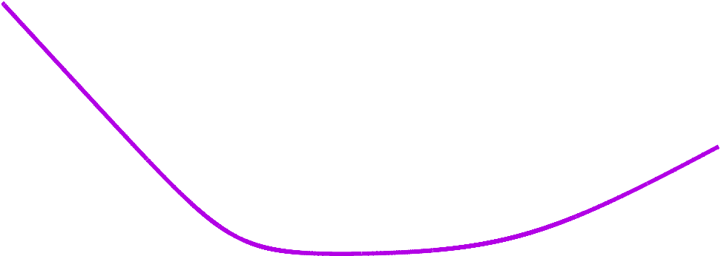
Noise sources limiting advanced detectors (example aLIGO, broadband)
AdvLIGO Noise Curve: P
in
= 125.0 W
10
−22
Strain [1/√Hz]
10
−23
10
−24
10
1
10
2
10
3
Frequency [Hz]
LIGO-T070247

Slide 5
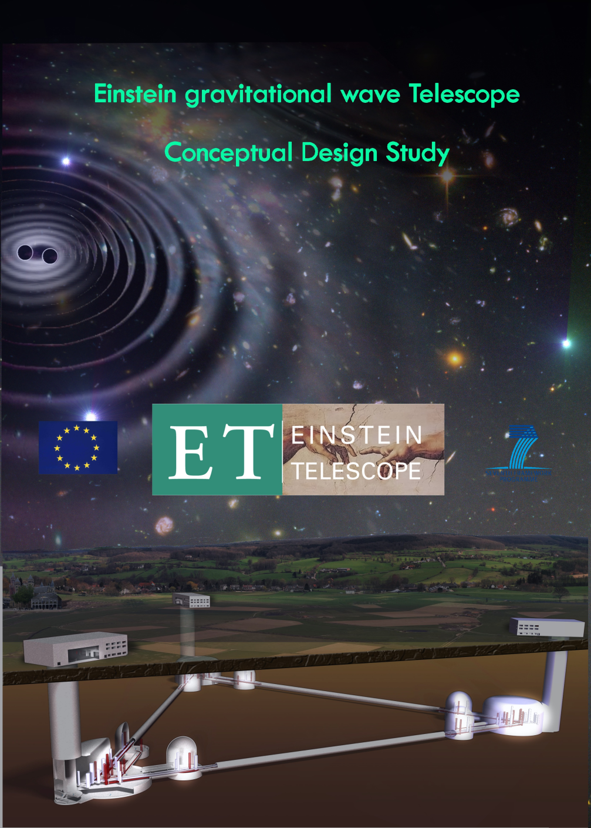
Einstein Telescope Conceptual Design Study
supported by the European Commission under the FP7-design studies framework
May 2008 – May 2011
Pan European effort
Science Team = ca. 250 members
http://www.et-gw.eu/etdsdocument
Notes:
Going beyond what is possible with the current infrastructure
Underground and larger in size

Slide 6

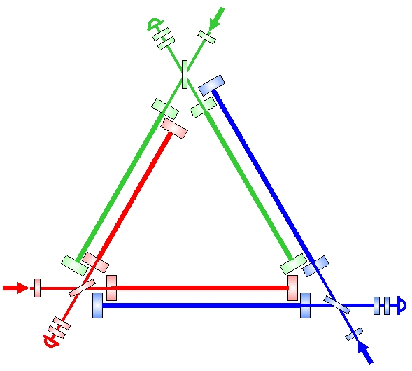
The Size
The Einstein Telescope will have 10 km arms
→ gain a factor 2.5 w.r.t. advanced LIGO
Einstein Telescope
10 km
LASER
Advanced LIGO
4 km

Slide 7

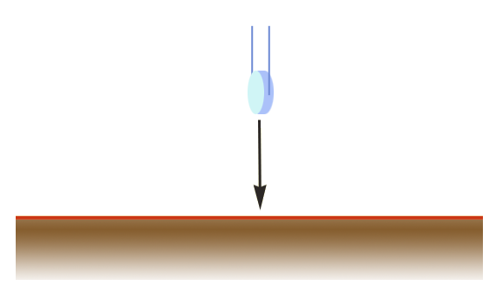
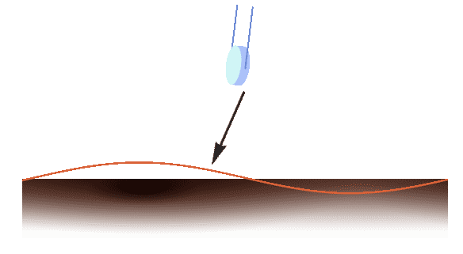
Low frequencies
Newtonian Noise
Virgo and advanced Virgo seismic filtering is already close to the required performance
  Longer suspensions to improve low frequency isolation
Gravity gradient noise bypasses the seismic filtering
SEISMIC NOISE
NEWTONIAN NOISE
SEISMIC WAVE
7
Credit M.Lorenzini

Slide 8
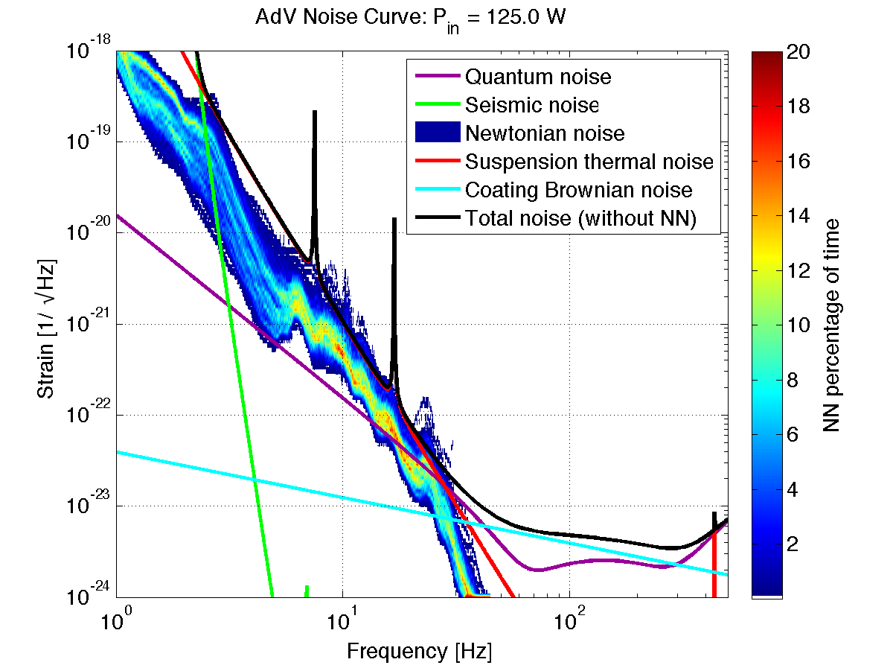
Gravity Gradient noise in AdV
The GGN noise can limit the AdV sensitivity during days with high seismic activity:
M. Punturo (VIR-0073B-12)
M.Beker (GWADW 2012

Slide 9
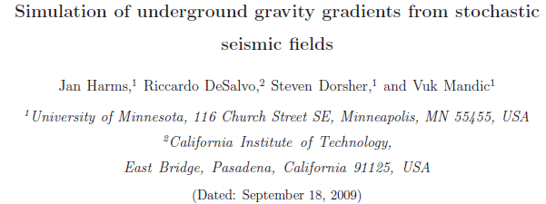
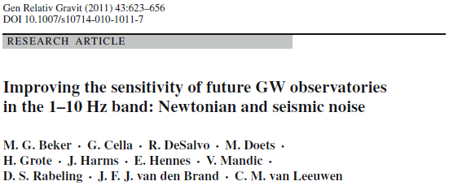
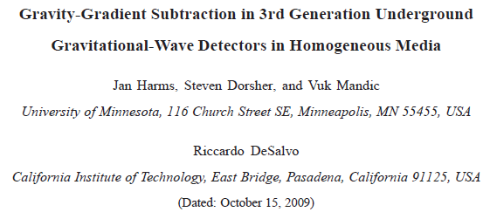
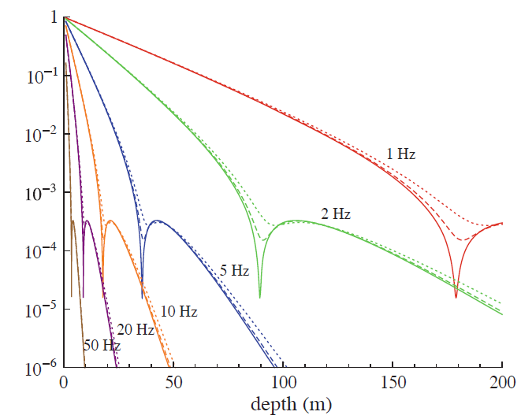
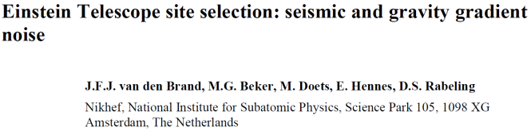
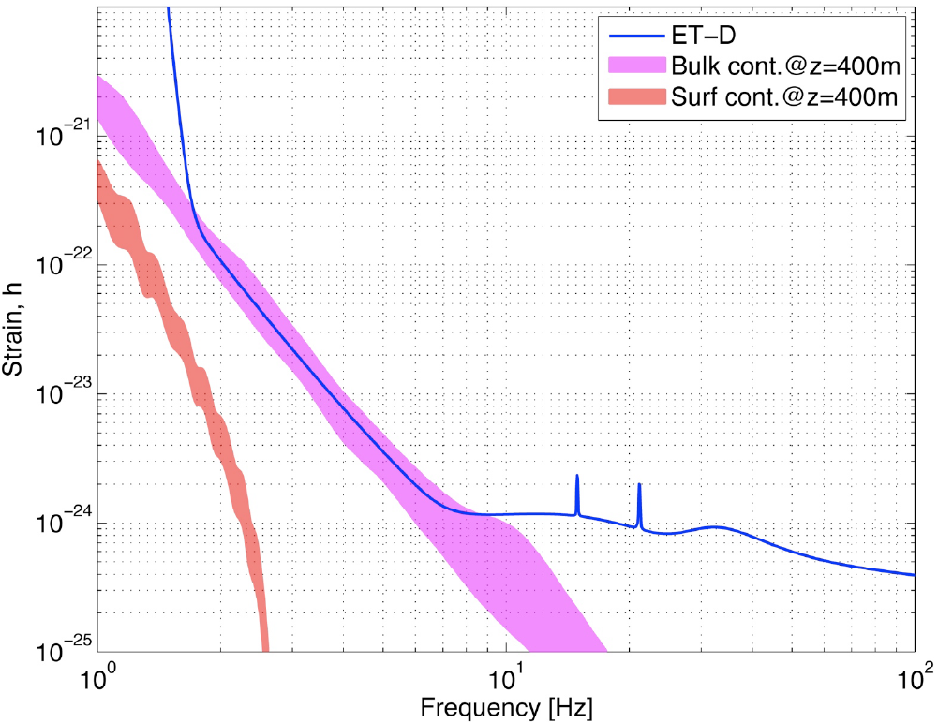
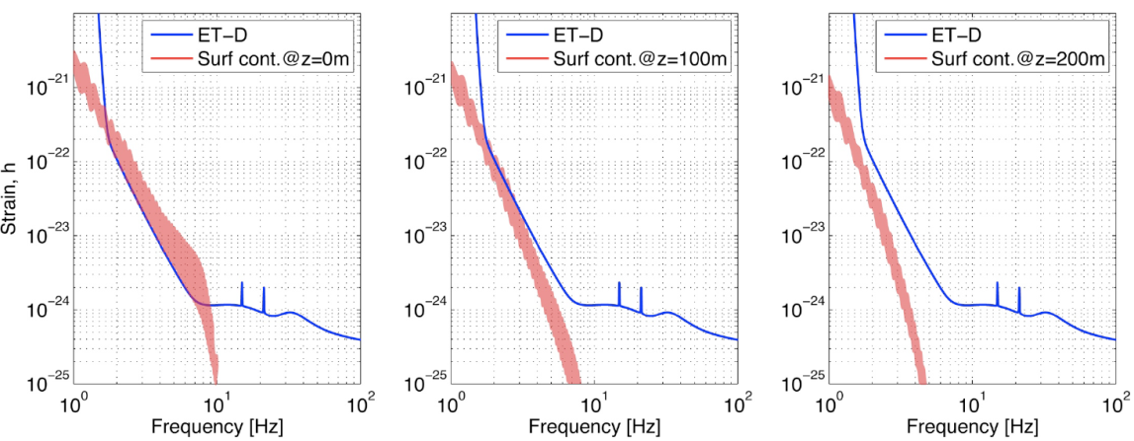
GGN analytical and FEA studies
Slide: Jo v.d. Brand
  Analytical studies
  Giancarlo Cella
  Jan Harms
FEA modeling
  Mark Beker
  All wave types
  GGN drops slightly
  Little geometric
  suppression
Conclusions
  Challenge at low frequency
  Low seismic velocity is beneficial
  Studies for homogeneous media
Giancarlo Cella (2011)

Slide 10
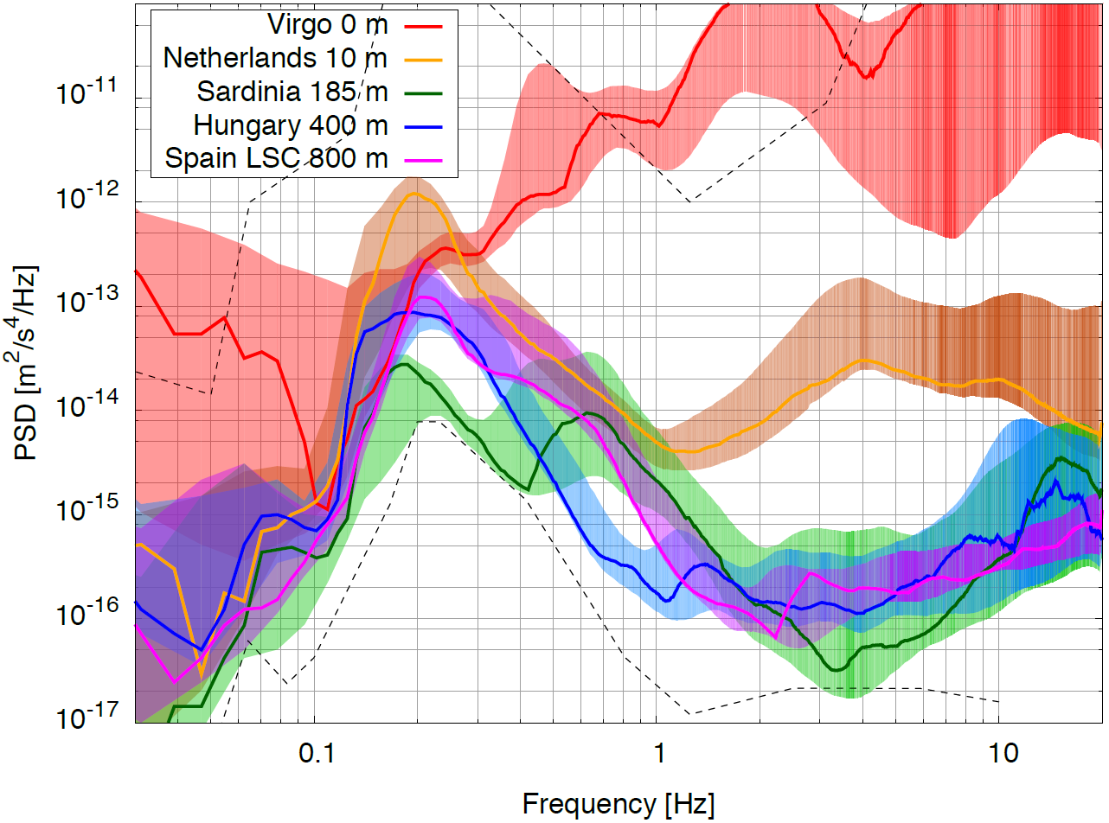
Low Frequencies
Seismic Noise
ET seismic requirements
  5 x10⁻¹⁰ m/f²
→Underground sites
  Several 100 m
Location w.r.t. oceans
Population density
Geology
Mark Beker, David Rabeling, Nikhef
Fulvio Ricci et al., Roma1

Slide 11
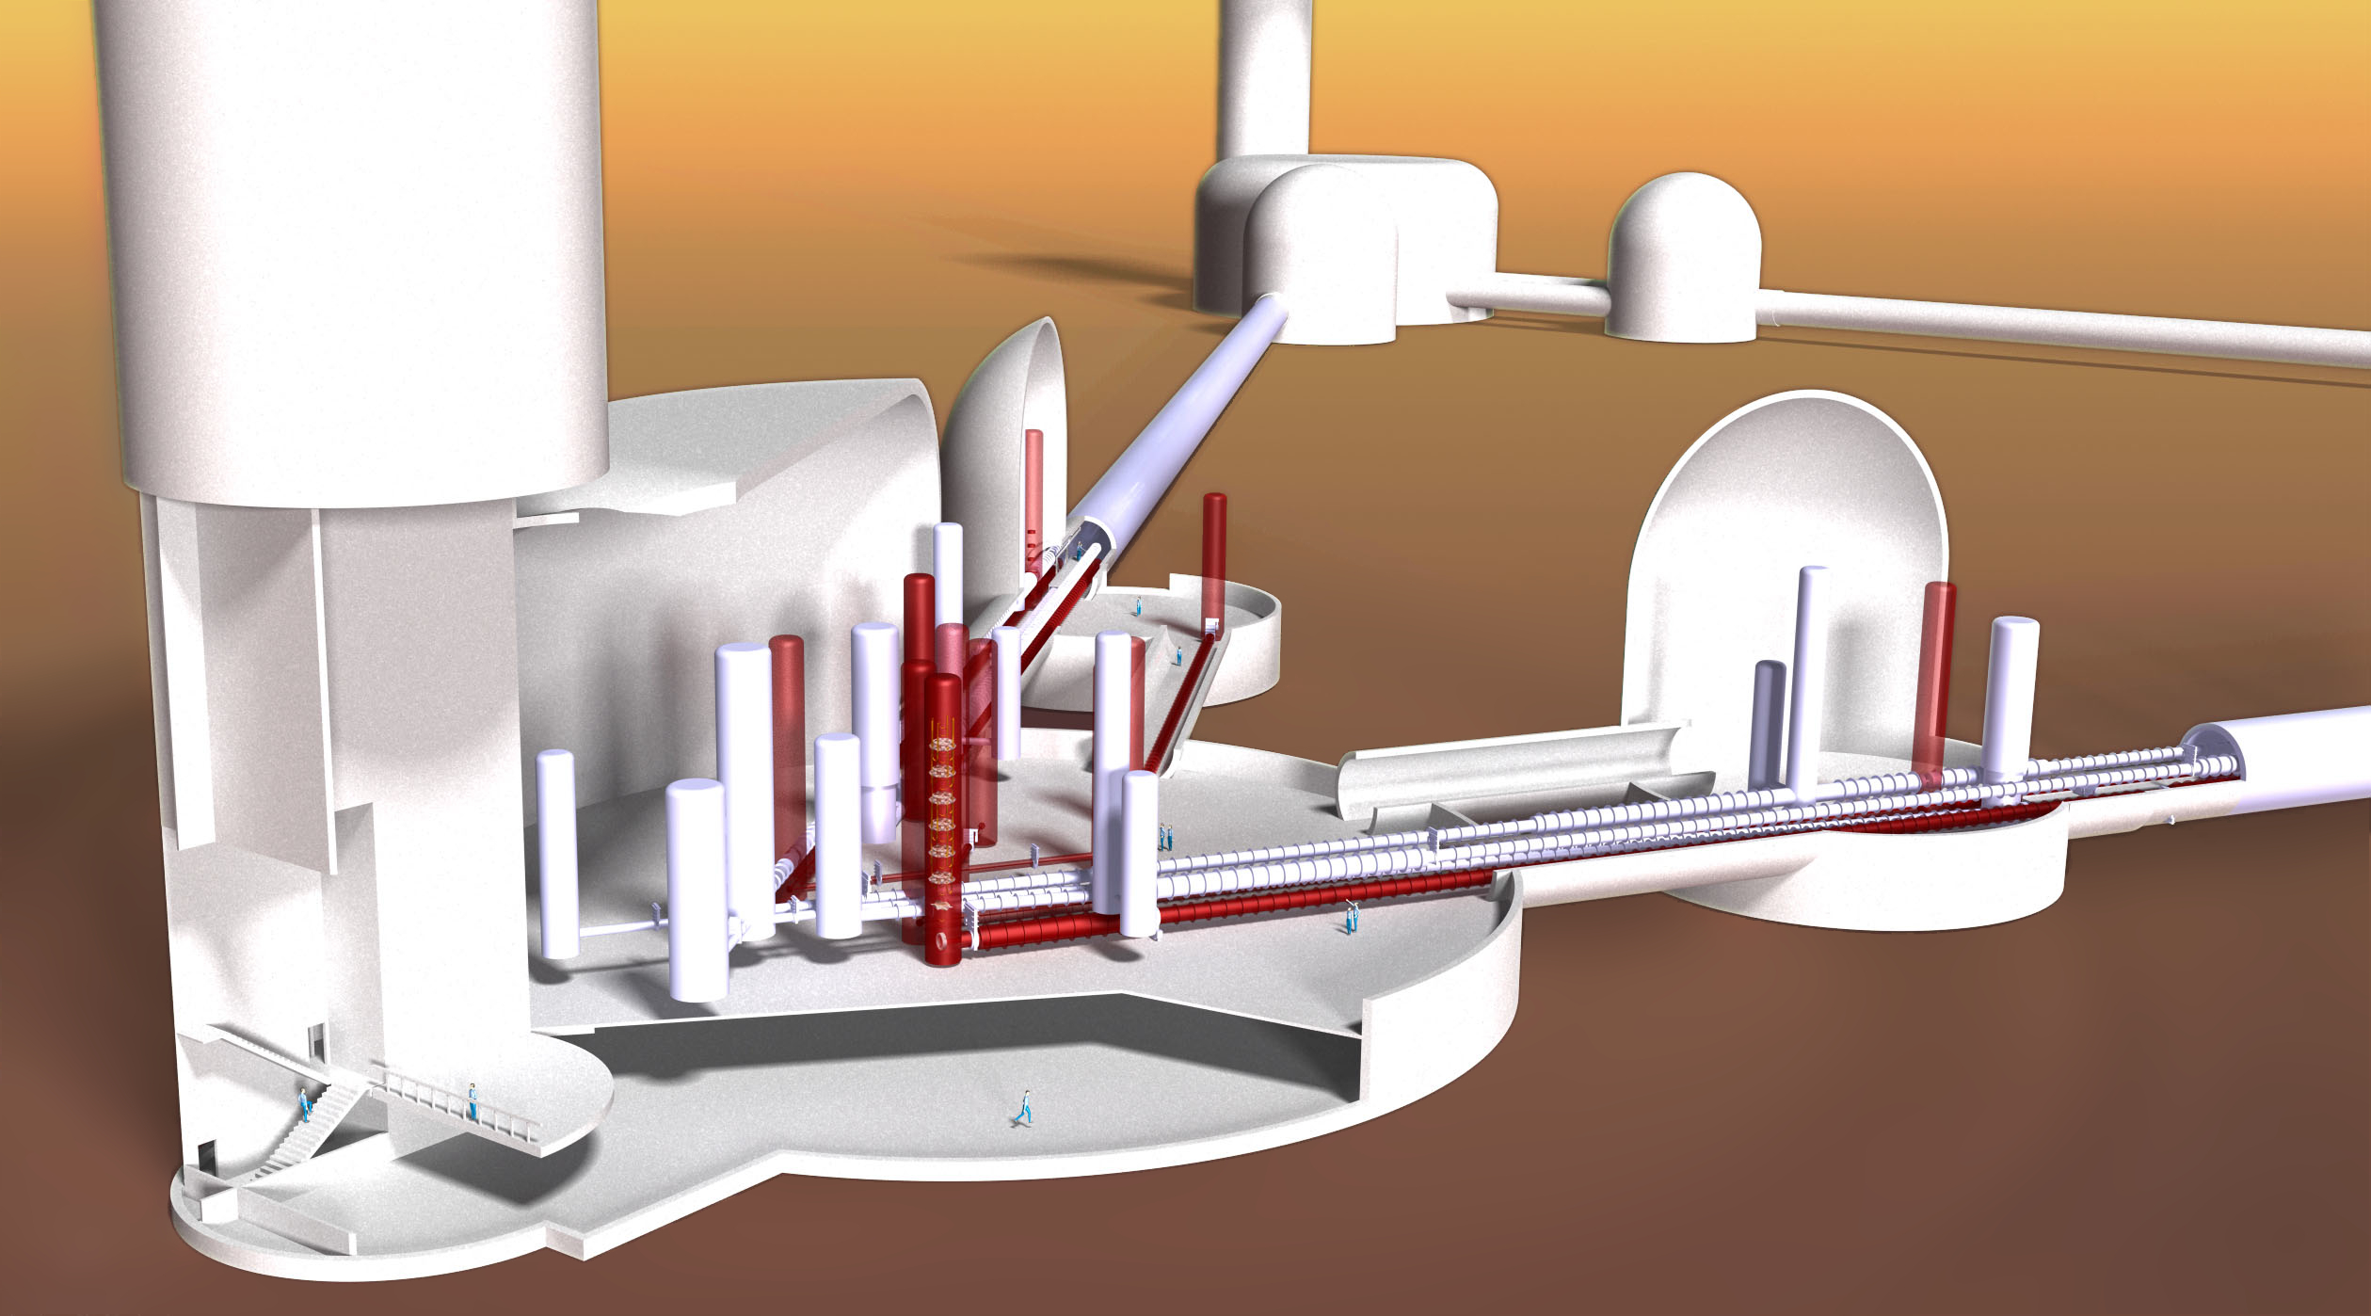
Go Underground
Credit: Nikhef
ET Baseline: Build 200m under ground

Slide 12
Mid- and high Frequencies
Shot Noise (high power) and Thermal Noise (low temperature)
AdvLIGO Noise Curve: P
in
= 125.0 W
10
−22
Strain [1/√Hz]
10
−23
10
−24
10
1
10
2
10
3
Frequency [Hz]
LIGO-T070247

Slide 13
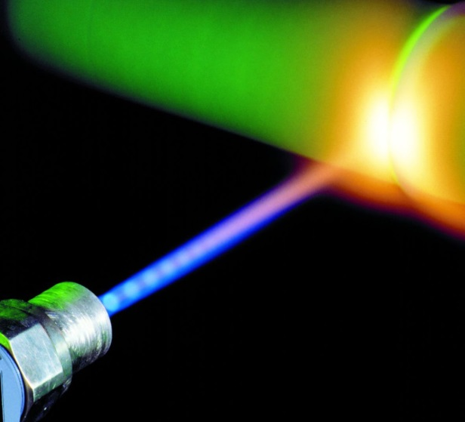

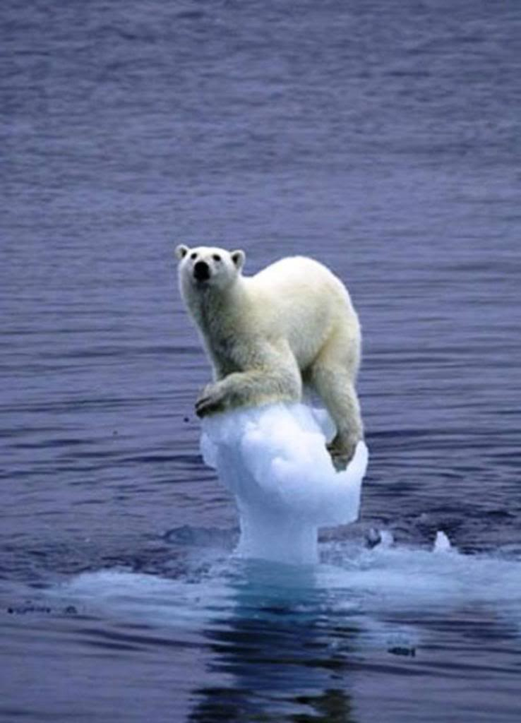
Mid- and High frequencies
Need High Power for Shot Noise
3MW
jgindo.wordpress.com
Need Cryogenics for Thermal Noise
10K
http://s658.photobucket.com
Notes:
High Power disagrees with Cryo requirements

Slide 14
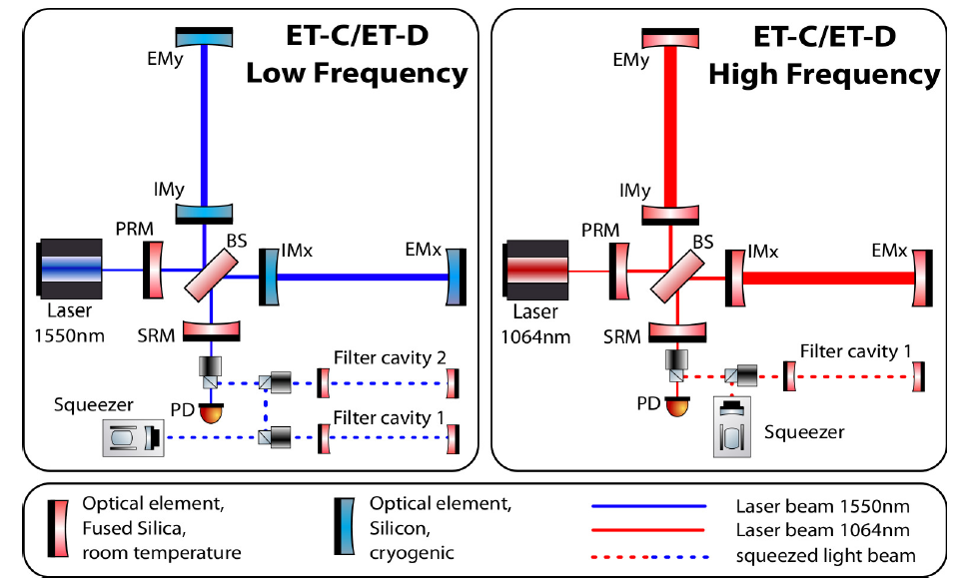
ET Xylophone STrategy
Split detector into two interferometers optimised for
Low Frequencies
and
High Frequencies
10K, 18kW, 1550nm
300K, 3MW, 1064nm

Slide 15
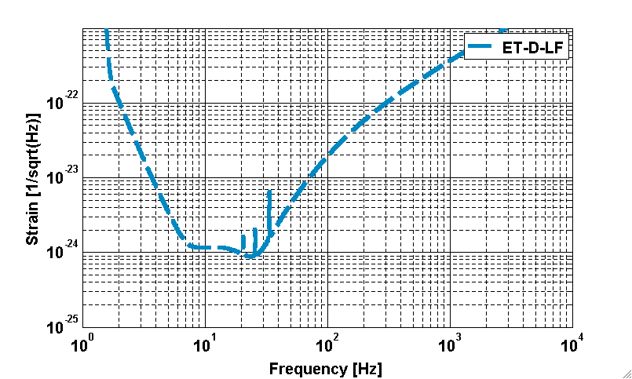
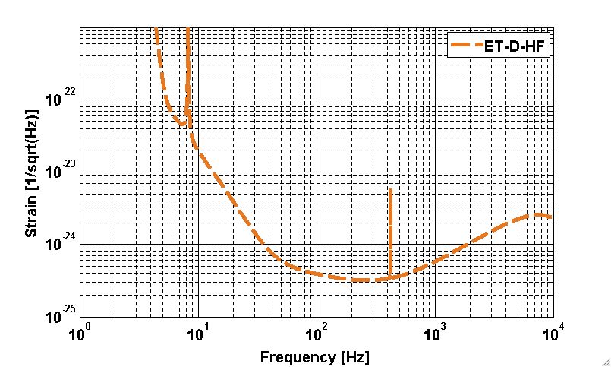
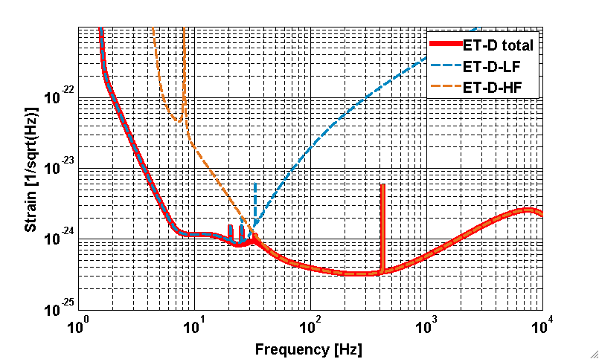
ET-D Xylophone sensitivity
Combining the two interferometers
ET-D-LF
ET-D-HF

Slide 16
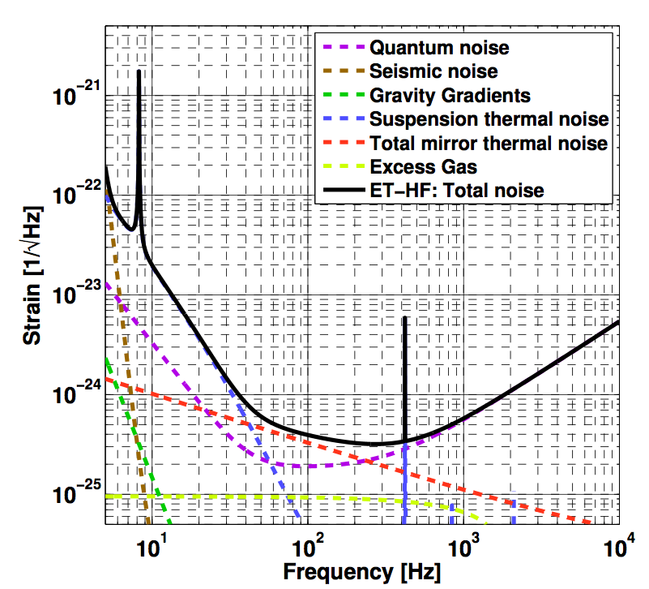
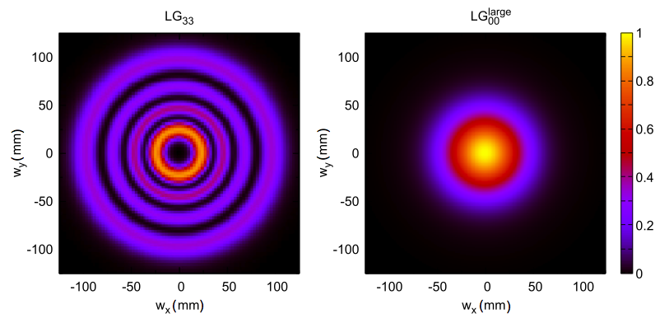
ET-D high frequency detector
Quantum noise: 3MW, tuned Signal-Recyling, 10dB Squeezing, 200kg fused silica mirrors.
Suspension Thermal and Seismic: Superattenuator (standard Virgo)
Gravity gradient: No Subtraction needed
Thermal noise: 290K, 12cm beam radius, fused Silica, LG33 (reduction factor of 1.6 compared to TEM00).
Coating Brownian reduction factors (compared to 2G):
3.3 (arm length), 2 (beam size) and 1.6 (LG33) = 10.5
Shot Noise reduction factors (compared to 2G):
1.6 (arm length), 1.9 (power), 3.2 (squeezing (10dB)) = 9.7

Slide 17
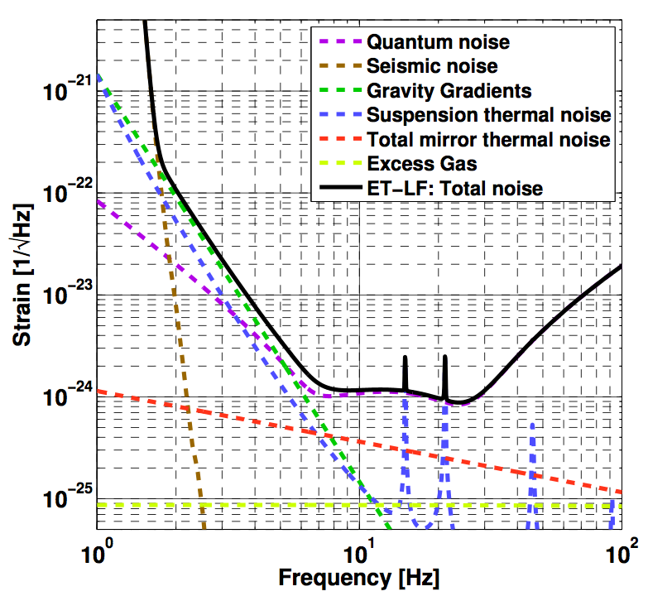
ET-D low frequency detector
Slide: Christian Gräf, ET Symp., 2013; modified
Quantum noise: 18kW, detuned Signal-Recyling, 10 dB frequency dependent Squeezing, 211kg mirrors.
Seismic: extended Superattenuator, 17m tall
Gravity gradient: no subtraction assumed in noise curve
Mirror thermal : 10K, Silicon, 12cm beam radius, TEM00.
Suspension Thermal: penultimate mass@2K, 3mm diameter silicon fibres, 2m long; limiting noise contribution from 1Hz-10Hz
As mirror TN is no longer limiting, one could relax the assumptions on the material parameters and the beam size…

Slide 18
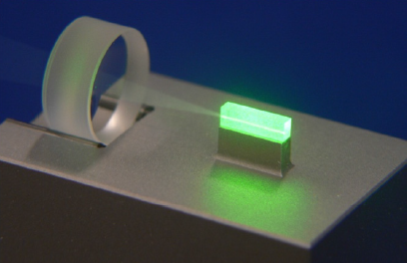
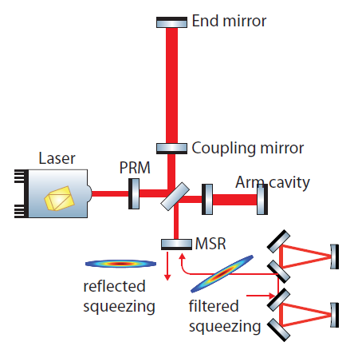
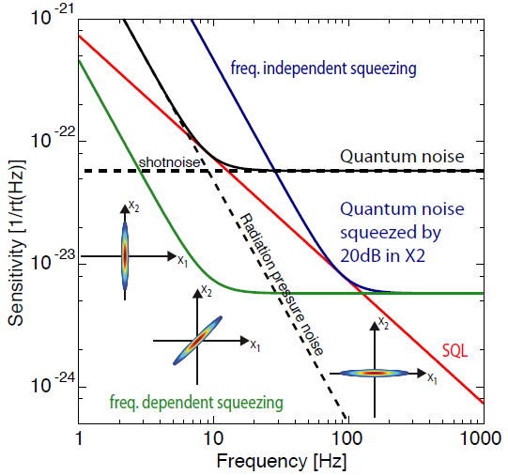
SQUEEZING
(10 dB)
Add filter cavities to have benefit at high AND low frequencies
Squeezing
10 dB Squeezing (baseline ET) is a challenge in terms of optical losses:
Starting with 20dB the overall losses from the crystal to the photo diode, including filter cavities, must be less then 9%.

Slide 19
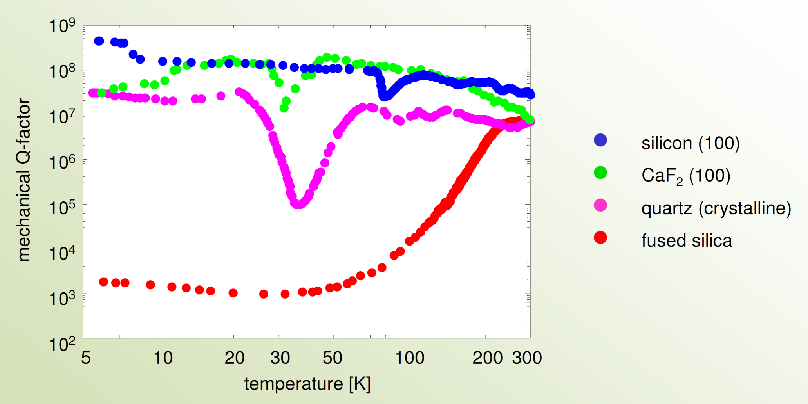
Mechanical losses of substrates
• High Q-factor at both room temperature and cryogenic temperatures
ET Baseline
Credits: Ronny Nawrodt

Slide 20
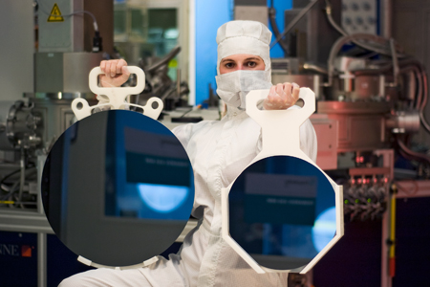
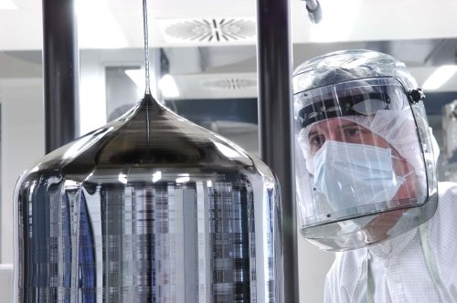
Large Silicon Substrates
Large Silicon Substrates are available but only in CZ grown Crystals.
Whether the purity reachable is sufficient is currently being tested
450 mm
300 mm
Source: http://www.iisb.fraunhofer.de/content/dam/iisb/de/images/geschaeftsfelder/halbleiterfertigungsgeraete_und_methoden/gadest_2011/
Source: http://www.quora.com/Semiconductors/How-do-silicon-boules-not-break-off-during-semiconductor-fabrication

Slide 21
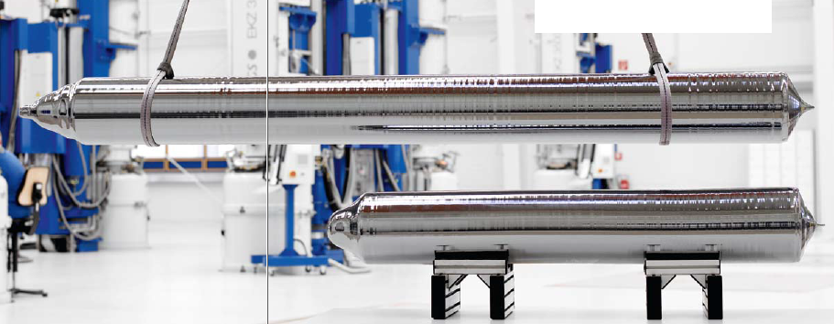
Heavy Silicon Boules
Silicon Boules can be grown to a weight of 450kg
Source: www.pvatepla.com

Slide 22
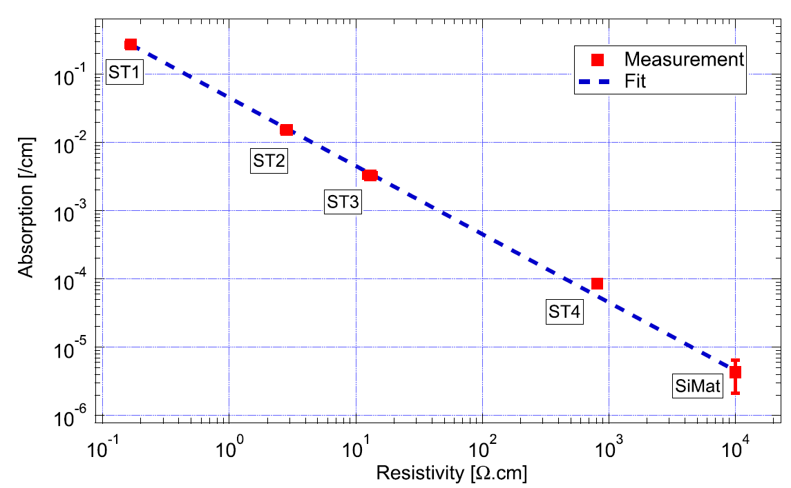
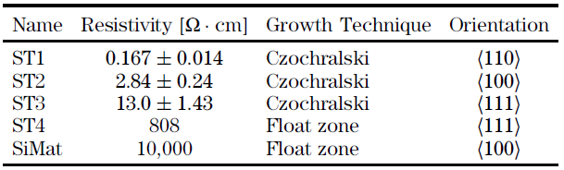
Silicon absorption
4ppm/cm
OPTICS LETTERS / Vol. 38, No. 12 / June 15, 2013
Requires pure (float zone) material
Inconsistent measurements across groups
Indications for enhanced absorption close to surfaces
Under investigation

Slide 23
Coating Research
Standard SiO₂/Ta₂O₅ dominate Thermal Noise
Amorphous coatings (Tantala dominated)
  Research for improving at room temperature
    Understanding loss mechanisms
    Empirical studies, doping with other materials
    Annealing
    Researching alternative materials (e.g. Zirkonia, Hafnia, Niobia)
Crystalline Coatings
  AlGaAs
  GaP/AlGaP
Waveguide structures

Slide 24
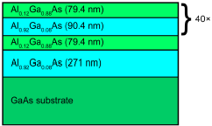
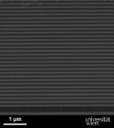
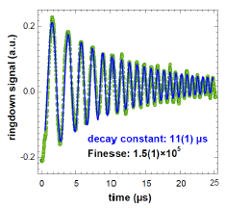
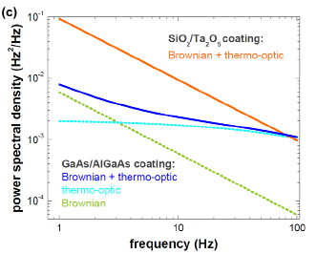
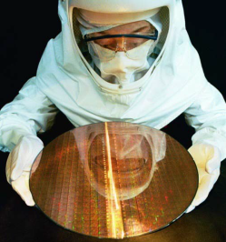
AlGaAs Coatings
Promising results at cryogenic temperature
Graphics credit: G. Cole
Need many, thin layers
Same overall thickness as standard
Reach low optical absoprtion
Finesse ca. 100.000
Need to be grown on GaAs and then transferred to Si substrate
Potential for large substrates demonstrated
Risk of detaching
Thermo-optic (=Thermoelastic + refractive) noise at high frequencies

Slide 25
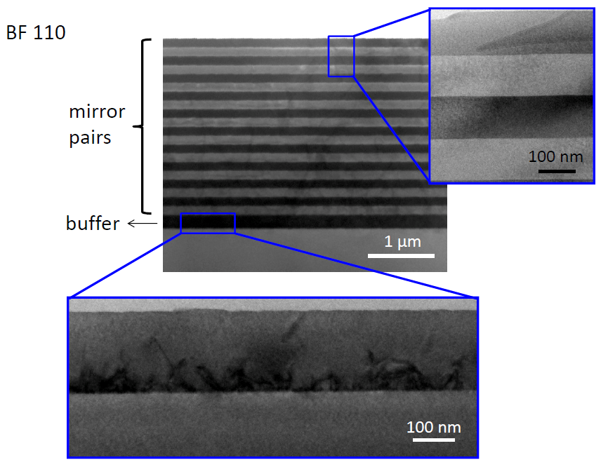
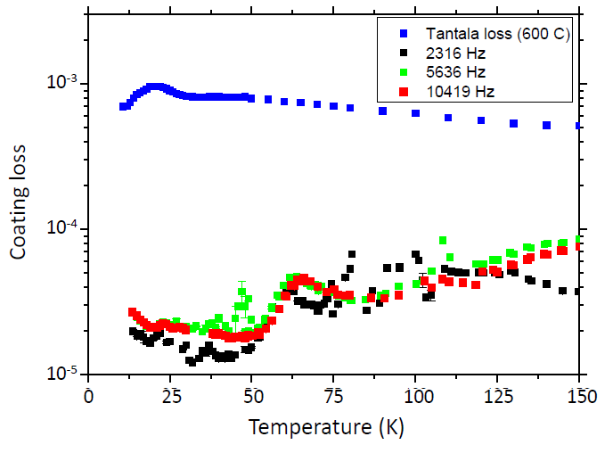
GaP/AlGaP Coatings
GaP/AlGaP mirrors can be grown directly on Si
Need a buffer layer GaP for lattice matching
Tantala
GaP -layer
Promising first results: Low losses @ Cryo T
Upper limit of loss for GaP on Si, Credit: A. Lin
45x lower than undoped SiO2/Ta2O5

Slide 26
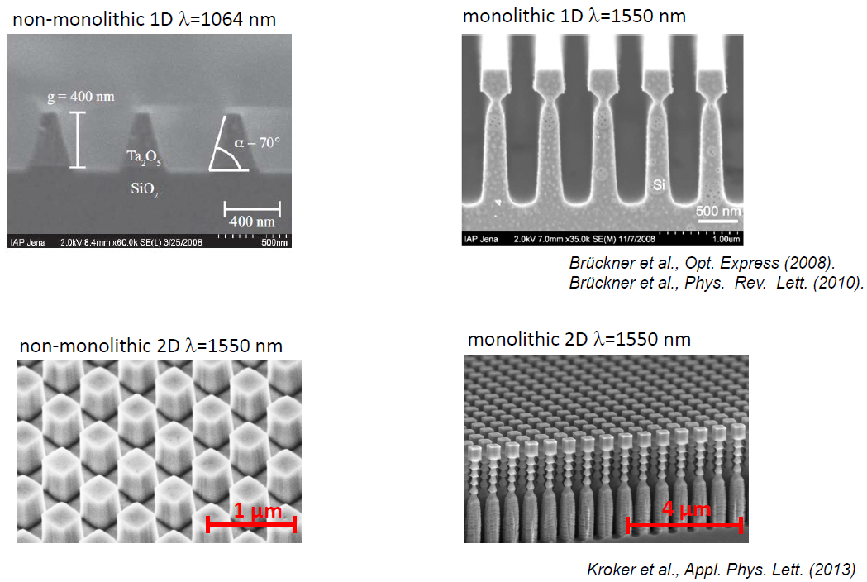
Waveguide coatings
Avoid lossy thick coating
Have not reached required reflectivity yet
Mechanical losses look promising

Slide 27

Sensitivites: 1st, 2nd and 3rd Gen.
KAGRA

Slide 28
Sensitivites: 1st, 2nd and 3rd Gen.
KAGRA
LIGO 3G
Notes:
Assumption is that basically the same infrastructure will be used

Slide 29
GW Timelines
You are here
 | ´06 | ´07 | ´08 | ´09 | ´10 | ´11 | ´12 | ´13 | ´14 | ´15 | ´16 | ´17 | ´18 | ´19 | ´20 | ´21 | ´22 | ´23 | ´24 | ´25
Virgo
GEO
LIGO
KAGRA
E.T.
´26
´27
Virgo+
Advanced Virgo
GEO 600
Hanford
E-LIGO
Advanced LIGO
LIGO 3G?
Livingston
India
DS
PCP
Site Prep.
Construction
Comm.
data
1st Generation
2nd Generation
3rd Generation

Slide 30
Einstein telescope
New technologies
ET is based mostly on mature proven technology
  Longer arms („1.5“x10km) & underground
  Higher power than advanced detectors (3 MW)
  Cryogenic optics for low thermal noise
  Split into two (Xylophone) to make Cryo and MW compatible
  Larger, heavier optics; HOM (LG33) beams;
  Laser Wavelength (Silicon:1550nm; fused Silica: 1064nm)
  Frequency dependent squeezing
  No new coatings in baseline concept, but will be used as state of the art allows

Slide 31

Einstein Telescope

Slide 32

1st, 2nd 2+, and 3rd generation
LIGO 3G

Slide 33




http://www.et-gw.eu/descriptionelites
UWS
Uni Glasgow
FOM
MPG
FSU
EGO
UniRoma
UniSannio
ICRR

Slide 34
WP1, "Cryogenics and suspensions",
  Measure of the performance of designed cryogenic suspension system in a practical interferometer from the point of seismic and vibration isolation
  Design and test of auxiliary attenuation system for thermal link
WP2, "Mirror thermal noise and cryogenics
  Investigation of the mechanical loss in both silicon and sapphire bulk materials;
  Performance of suitable optical coatings on sapphire substrates for the development of the mirrors for LCGT and to share the complimentary expertise contained within the LCGT and ET groups (e.g. Japanese expertise in studying low temperature properties of sapphire, European expertise in studying low temperature coatings)
  Assessment of the properties and suitability of silicate bonding for bonding sapphire, and comparison with the properties of bonded silicon, to develop techniques for constructing sapphire suspensions for use in LCGT and as a possible alternate suspension material for use in ET
  Characterisation of the thermal and mechanical properties of suspension elements (fibres, bond areas, etc.)
WP3, "Large-scale cryogenic infrastructure for LCGT and ET“
  Specifying noise sources arising from cooling system quantatively and qualitatively
  Optimum design of raditation shield
  Prevention of possbile contamination of clean surface of mirrors

Slide 35
ET R&D Project
http://www.et-gw.eu/etrddescription
Germany
Netherlands
Russia
Poland
United Kingdom
Italy
France
Hungary
MSU
INR RAS
UWS
UGla
Bham
Cardiff
FOM
MPG
Bialistok
FSU
Zielona
UW
WUT
PAoS
Baksan
KFKI
LMA
INFN Pisa
ARTEMIS
EGO
UniRoma
Napoli
Notes:
MSU-SAI: Sternberg Astronomical Institute (lead)
MSU-PD: Physics Department
INR RAS: Institute of Nuclear Research Russian Academy of Science
University of Warsaw (lead),
University of Zielona Gora,
University of Bialystok,
Warsaw University of Technology,
Polish Academy of Science (Inst. of Mathematics),
PAoS(Nicolaus Copernicus Astronomical Centre)
KFKI Research Institute for Particle and Nuclear Science
Geodetic and Geophysical Research Institute

Slide 36
ET R&D Project
Working Projects
WP1, "ET’s scientific potential"
  Mock ET data and science challenges of increasing complexity
  Explore how well astrophysical models of GW sources could be tested with ET
  Investigate possible strong field tests of GR with ET
  Probe ET’s potential for understanding the geometry and dynamics of the Universe
WP2, "Long term seismic and GGN studies of selected sites“
  Studies at candidate sites
  Sensor and network development
  Modeling of seismic and GGN noise
WP3, "Optical properties of silicon at cryogenic temperatures"
  Stress induced birefringence of silicon-based optic
  Homogeneity of optical properties within larger samples
  Investigation of Whispering Gallery Mode Oscillators made of silicon to probe absorption and scattering
WP4, "ET Control systems“
  Mitigation scheme for radiation pressure effects for the ET-HF interferometer.
  Control scheme for the injection of frequency dependent squeezed light.
  Low-frequency control scheme for the ET-LF interferometer.
  Mitigation scheme for correlated noise in co-located interferometers.
  Contamination of potential null stream signals by technical noises.

