Slide 1
Operational Geometry on de Sitter Spacetime
Chryssomalis Chryssomalakos
Instituto de Ciencias Nucleares
UNAM
Joint work with P. Aguilar, Y. Bonder, and D. Sudarsky (ICN)

Slide 3
Operational Geometry:
(quantum) particles/fields as probes
Classical geometry fuzzyfied
|ψ|
A
B
s

Slide 4
Quantum probes are hard:
no NR limit QFT
Quantum delocalization + interference
Study classical extended probes first

Slide 5
Extended classical probe
Effective trajectory

Slide 7
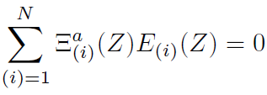
CM in GR
p
p
U
Ξ
y
x

Slide 8
Not associative (never mentioned):
AB
A
ABC
B
C

Slide 9
CoM worldline not geodesic
Effective geometry?
No effective metric
CoM worldline
same?
CoM worldline
ξ
Problems:
probe “sameness”
Observer attached to object
(ok in SR, but not here)

Slide 10
Relacional CoM (generalized centroid):
observer worldline dependent
Associative
observer
worldline
CoM
worldline

Slide 11
Sectional curvature a la Jacobi
T
J

Slide 12
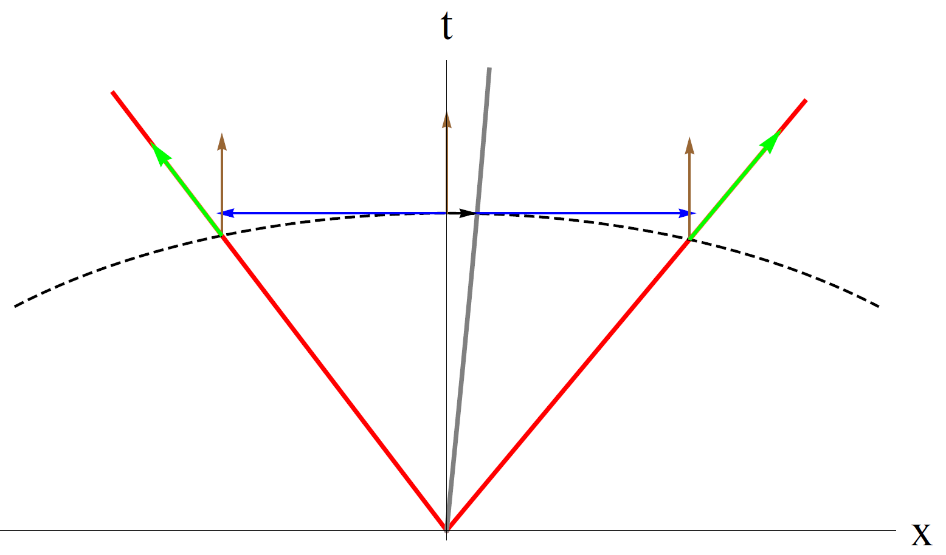
Point “hot” probe

Slide 13
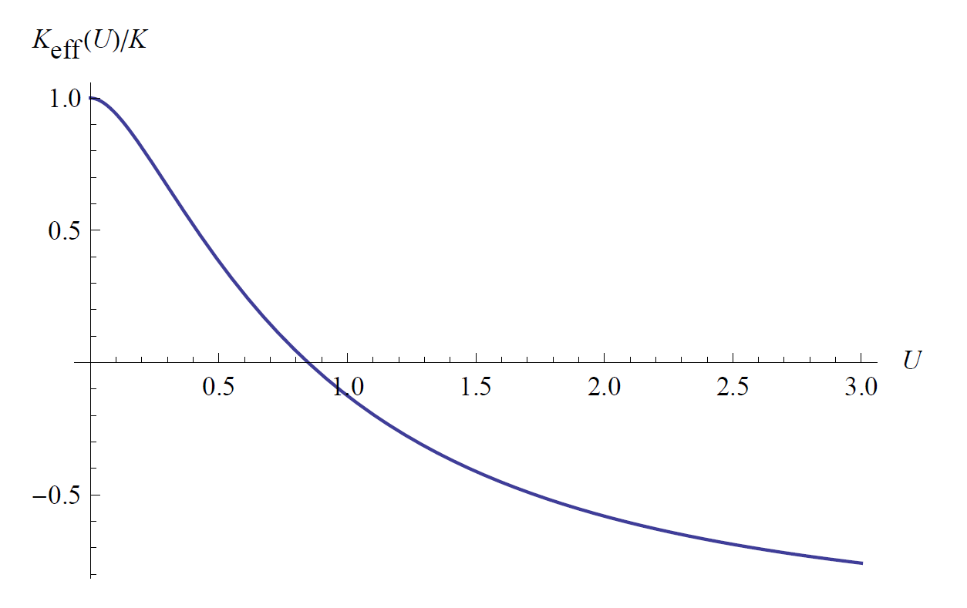

Slide 14
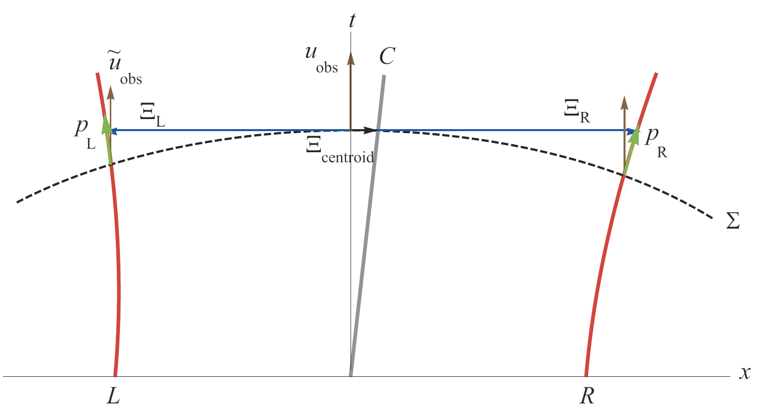
Extended “cold” probe

Slide 15
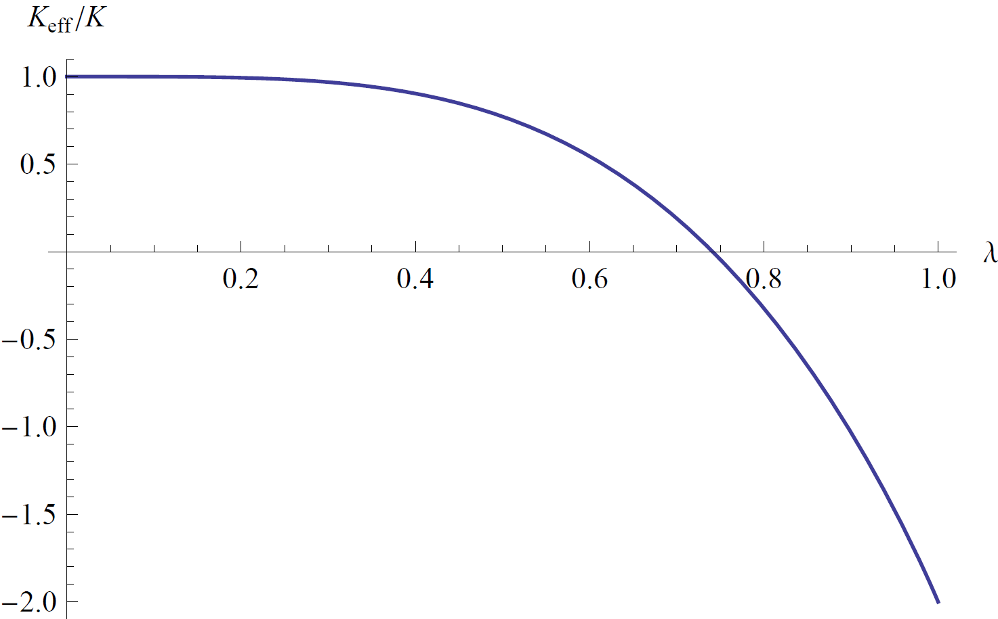
Extended “cold” probe

Slide 16
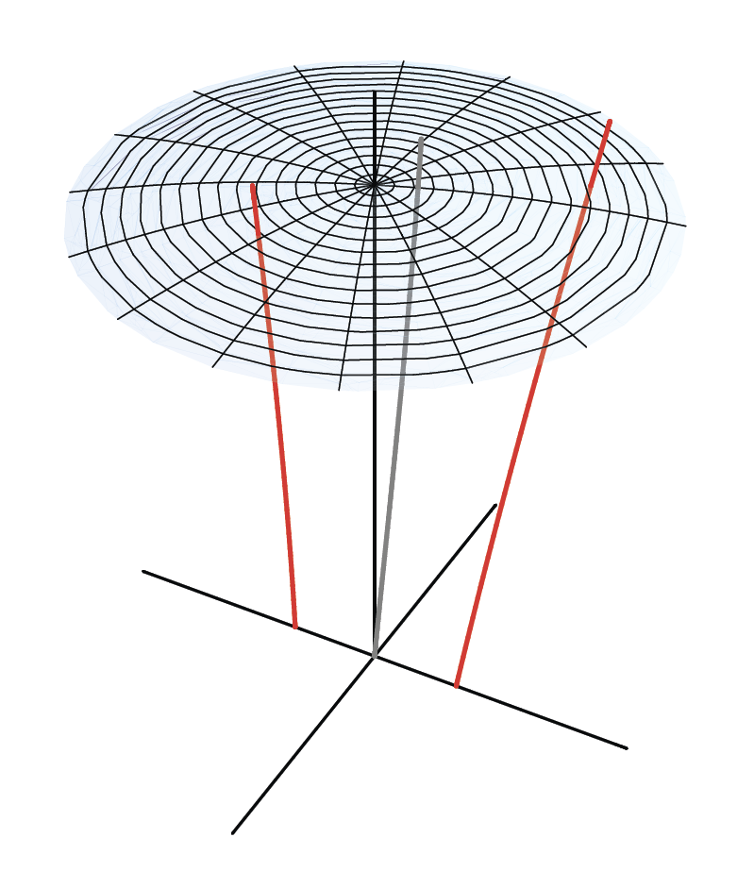
Spinning probe

Slide 17
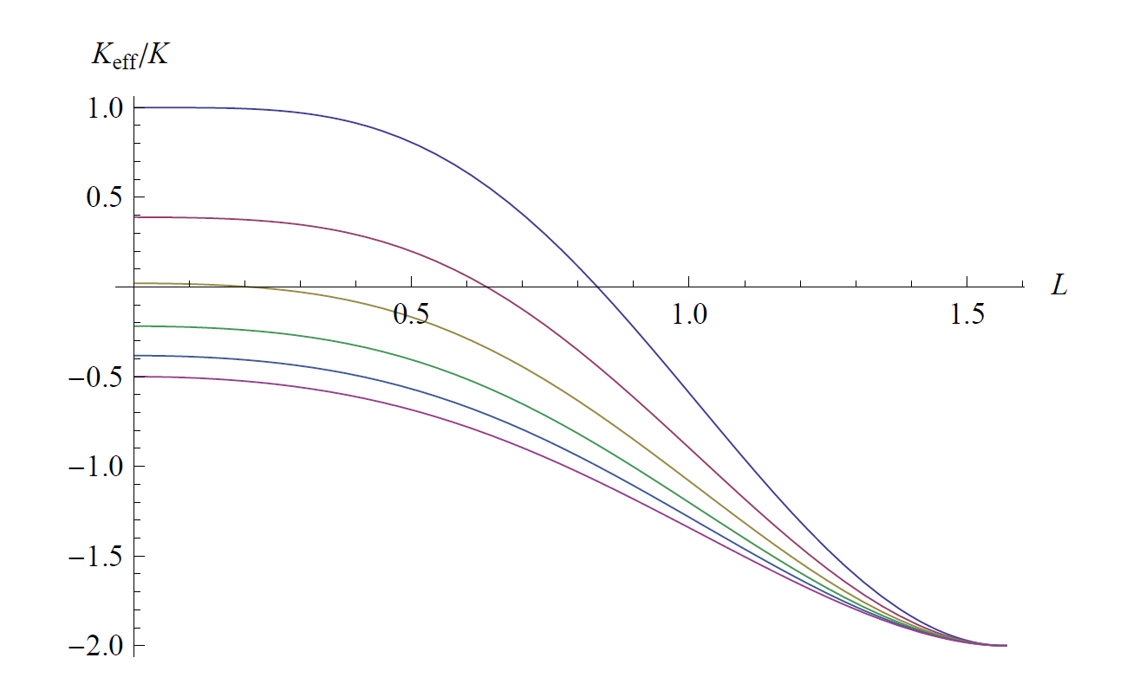
Spinning probe

Slide 18
Summary
Relativistic QM implies NC position ops for extended objects
Classical extended objects as probes: effective geometry
Standard GR CoM nonassociative, nothing works
Proposal: relational CoM (generalize centroid to GR)
Point “hot”, extended “cold”, spinning probe: effective sectional curvature
(observer, probe, experiment dependent)
P. Aguilar, Y. Bonder, CC, D. Sudarsky, Mod. Phys. Lett. A 27/23 (2012) 1250130
P. Aguilar, CC, H. Hernandez Coronado, E. Okon, to appear in IJMPA

