Slide 1
Wigner 111 - Budapest, Hungary, Nov. 11-13, 2013
EFDA Power Plant Physics and Technology
Overview of EU DEMO
Design and R&D Activities
J. Harman on behalf of G. Federici and the PPPT Team
(with contributions of many EU Associations involved in the PPPT Programme)
The Roadmap toward a Demonstration Fusion Power Plant
DEMO Physics & Technology Challenges
DEMO Concept Design Approach
Highlights of some achievements (2011-2013)
Organisational Outlook & Summary

Slide 2
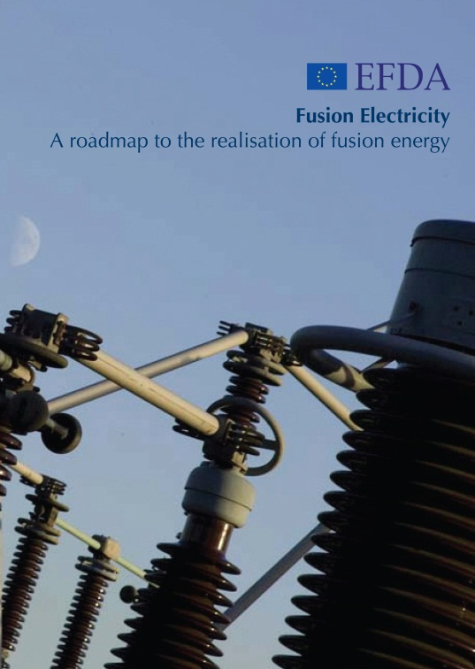
New EU Fusion Roadmap
Published in November 2012
An ambitious yet realistic roadmap to fusion electricity by 2050
  8 Strategic Missions to tackle the critical challenges for Fusion:
    Plasma Operation
    Heat Exhaust
    Neutron resistant Materials
    Tritium-self sufficiency
    Safety
    Integrated DEMO Design
    Competitive Cost of Electricity
    Stellarator
  Central role of ITER
  Industrial Partnerships
  Can be downloaded at:
http://www.efda.org/

Slide 3
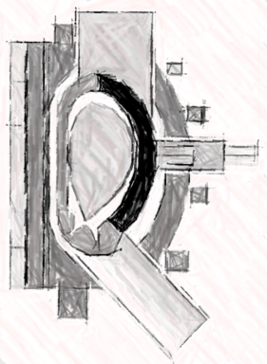
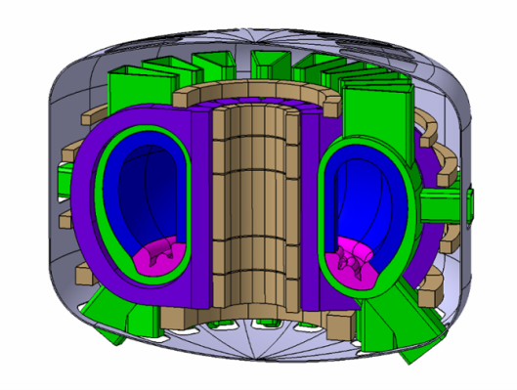
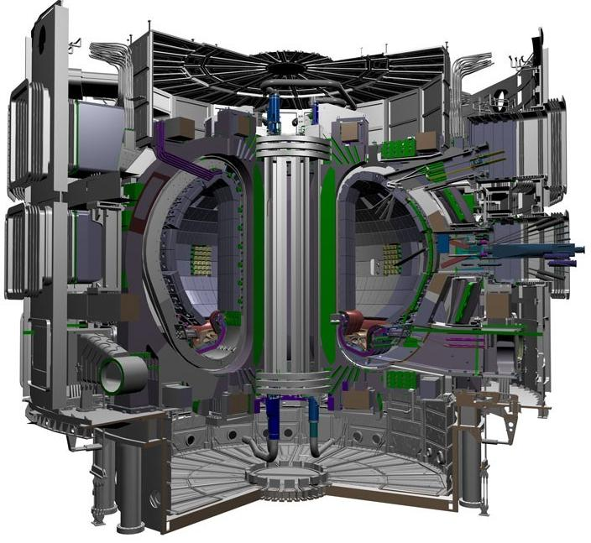
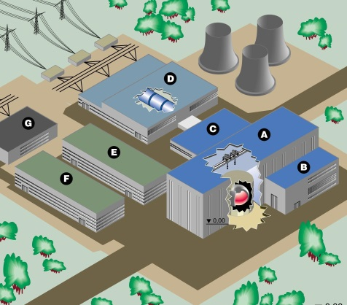
DEMO Programme Timeline
The target to generate a few hundred MWe before 2050 is expected to drive much of the design and R&D.
2014
2020
2030
2037
2013
2014
2015
2016
2017
2018
2019
2020
2021
2022
2023
2024
2025
2026
2027
2028
2029
2030
2031
2032
2033
2034
2035
2036
2037
2038
2039
2040
2041
2042
2043
2044
2015
2020
2025
2029
2031
2037
2041
SRR
CDR
PDR
FDR
MRR
TRR
PAR
CDA
PCA
EDA
Construction
Commissioning/ Operation

Slide 4
Part 2:
Physics & Technology Challenges

Slide 5
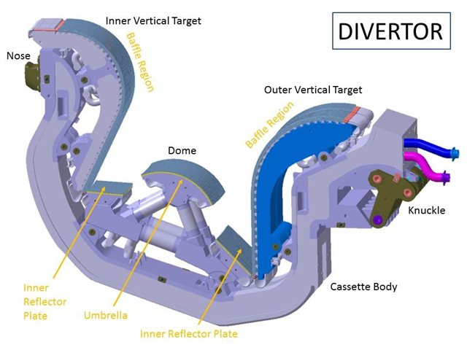
Divertor Power Exhaust in DEMO
A reliable Divertor solution is one of the main challenges for DEMO
A risk exists that the baseline ITER design cannot be extrapolated to DEMO
  R_{DEMO}/R_{ITER} ~ 1.4 but P_{DEMO}/P_{ITER} ~ 4
Scrape-off layer thickness (λ_{q}) does not scale with major radius
  λ_{q} ~ 1mm at outer midplane → 2cm at the divertor
Peak power flux density (without radiation)
  q_{max,DEMO1} = 200MW/m² !!
Therefore, high core radiation levels are needed
    At P_{rad,tot}/P_{loss}=90%, q_{max,DEMO1} < 20MW/m²
But…..
  Achieving sufficient radiation at reasonable dilution
  Thermal stability
Establish operational experience at high core radiation levels
compatible with divertor protection and fusion performance
Notes:
One of the key physics and technology challenges for DEMO is the Divertor…..
When one considers that the major radius ratio between DEMO and ITER is 1.4 yet the fusion power ratio is 4
Unfortunately, the scrape-off layer thickness does not scale with major radius meaning that the power is deposited on the divertor over a 2cm wide band.
To get around the predicted unacceptably high peak power flux density; unprecedented ‘core’ radiation levels of >90% will be needed.
This could be achieved via impurities in the plasma however issues such as dilution and thermal stability need to be checked.

Slide 6














Tritium Breeding Blankets
Tritium Breeding Blankets - the most important & novel parts of DEMO
Large knowledge gaps will exist even with a successful ITER TBM programme
Feasibility concerns and Performance uncertainties → Selection now is premature
Concerns | HCPB | HCLL | WCLL | DCLL
Tested in ITER TBM |  | ☺
Suitability for Eurofer
FW heat flux capability
Safety issues of coolant
Technology readiness BoP
Potential for high coolant outlet temperature
Coolant pumping power
Shielding efficiency/ n-streaming void space
Activation products in coolant (water)
Breeding efficiency
Tritium extraction from breeder
Tritium extraction from coolant
Tritium permeation through heat exchanger
Nobody’s Perfect !!!
Notes:
Another equally challenging area is the Breeding Blankets, whose primary functions of:
Breeding sufficient Tritium to sustain fusion operations
Absorbing neutrons and extracting the thermal energy for use in electrical production
are really at the core of the DEMO Plant functionality.
Only HCPB and HCLL will be tested as part of the ITER TBM programme: but, even following a successful TBM prog, large knowledge gaps will remain due to the much lower n-fluence of ITER.
Here we can see a qualitative comparison of 4 breeding blanket concepts currently under assessment in the DEMO CDA phase. Clearly, each blanket concept has a mixture of strengths and weakness and much more R&D, design and analysis is required at both a system and component level in order to make an objective selection by 2020.

Slide 7
Materials for DEMO Components
Materials R&D affect many DEMO systems and components
EUROFER (8-9%Cr RAFM) – Baseline structural steel from DEMO In-vessel components
Use of EUROFER poses some risks for the DEMO mission:
  Low temperature radiation embrittlement
  Unknown effect of He embrittlement
  Decline in strength above 550°C
  Creep-rupture limits operation to <550°C for >12x10³ hrs
  Lack of Design-code development
  Incompatibility with Water-cooled blanket/PWR Balance of Plant
Needs a risk mitigation programme on blanket advanced steels.
  EUROFER development to lower temperatures
  Evidence of some EUROFER steels with superior low temp performance + new JA F82H mod3 data (Shiba, Tanigawa et al)
  High temperature FM steels from the non-Fusion programme
  Oxide Dispersion Strengthened (ODS) RAFM or Ferritic Steels (Fusion programme)
  Note: each ‘back-up’ already on its 10-15 years of development

Slide 8
Part 3:
DEMO Concept Design Approach

Slide 9
DEMO Top Level Requirements
According to several studies undertaken in Europe
Net electricity production
  Several 100 MWs (500 MW)
  Low recirculating power ⇒ maximise overall H&CD efficiency η_{CD}γ_{CD}
Tritium self sufficiency – DEMO makes its own fuel
  Restrictions on port space for sensors and H&CD. Local TBR ~ 1.1-1.2
  PFC armor must be much thinner to achieve TBR > 1
  Disruptions and ELMs must be reliably eliminated!
A robust solution of all physics and technical issues
  Divertor exhaust loads, PFCs
  Materials & Technology
  Current drive systems
Adequate availability/reliability operation over a reasonable time span
  Fast Remote Maintenance schemes – to be developed and demonstrated
  Simplified designs (with margins)
  Technologies and materials with established industrial manufacturing feasibility (high TRL!)
Safe operation and minimization of radioactive waste

Slide 10
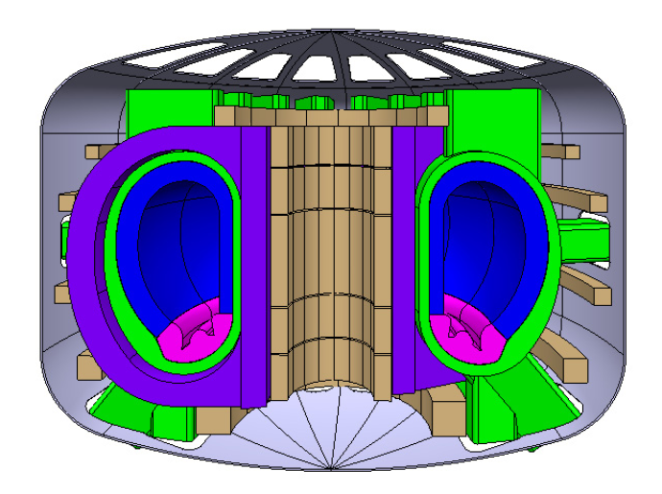
DEMO Concept Design Approach
Initial phase effort to be broad and not focussed on developing a single “design point”
Some flexibility in the approach to the CDA with focused R&D on outstanding issues
  DEMO1: a large, modest power density, pulsed device with a conventional plasma scenario.
Conservative design
Based on expected performance of ITER
Commence build in 2030’s
  DEMO2: a higher power density, high non-inductive CD fraction, steady-state operat.
Optimistic Design
Based on more advanced assumptions
Deliverable in the longer term
System Codes
0D/Full System
Plasma Physics Models
>0D
Subsystems
Engineering Models
>0D
Subsystems
density profile (density limits, peaking)
temperature profile (critical gradients)
plasma dilution and contamination by impurities
radiation compatible with divertor protection and fusion performance
core/pedestal compatible w. beta limits and MHD instabilities
Analysis of working points and exploration of scenario using more sophisticated codes

Slide 11
Provisional Design Assumptions
Goal-Setting Approach
Use of realistic assumptions for physics and technology: e.g. limiting divertor heat load.
Optimize the device for a purely inductive scenario with a minimum pulse duration (2 hrs) For steady state, minimize size whilst limiting rec (CD) power -> realistic f_{BS} & η_{CD}γ_{CD}
Technology Assumptions (near-term DEMO)
Single-null, water-cooled divertor
LTSC magnets (Nb₃Sn), max field on conductor 12 T
RAFM (EUROFER) as blanket structural material
n-damage calculations [Gilbert/CCFE 2012]:
  ~10 dpa/fpy: FW midplane armour; 6-7 dpa/fpy: divertor W; 2-3 dpa/fpy Cu near strike points
Lifetime operation:
  20 dpa “Starter” blanket, gives 1.33 fpy operation
  50 dpa 2nd blanket
  5 dpa divertor
Safety approach to follow the ITER experience
Vertical Blanket RH schemes to be integrated from the outset
Application of mature BoP technology

Slide 12
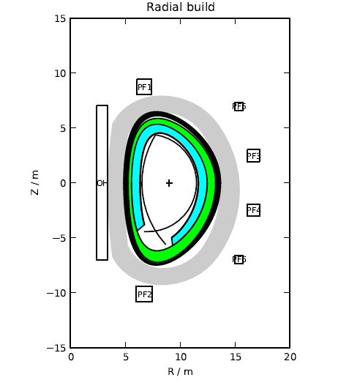
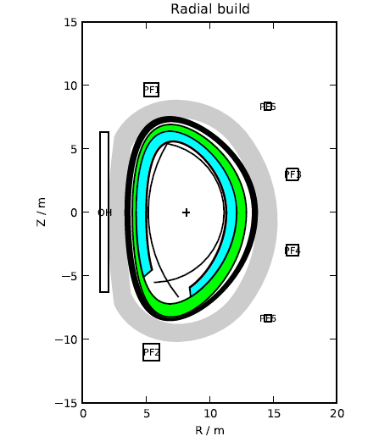
Provisional DEMO Design Parameters
 | DEMO1 | DEMO 2
Operation Mode | Pulsed | Steady state
P_{th} (GW) | 2.2 | 2.7
P_{rec} (MW) | 385 | 594
Ro (m) | 9.0 | 8.15
A | 3.6 | 2.7
B_{t}(T) | 6.5 | 5.0
<n_{e,line}>/n_{G} | 1.2 | 1.2
I_{p} (MA) | 16.8 | 19.8
f_{BS} | 36% | 0.56
γ_{CD} | 0.3 | 0.4
P_{aux} (MW) | 50 | 135
H, (H*) | 1.1, (1.0) | 1.3 (1.1)
β_{N,} (β_{N,th}) | 2.5, (2.2) | 3.4 (2.8)
P_{NW} (MW m⁻²) | 1.1 | 1.2
Lifetime n-fluence (MW*yr/m²) | <10
DEMO1
DEMO2
Sensitivity studies underway cover
DEMO 1: blanket properties, fuel cycle, superconductors, divertor, and aspect ratio effects
DEMO 2: H-factor, current-drive efficiency, divertor, aspect ratio, and startup flux swing modelling.

Slide 13
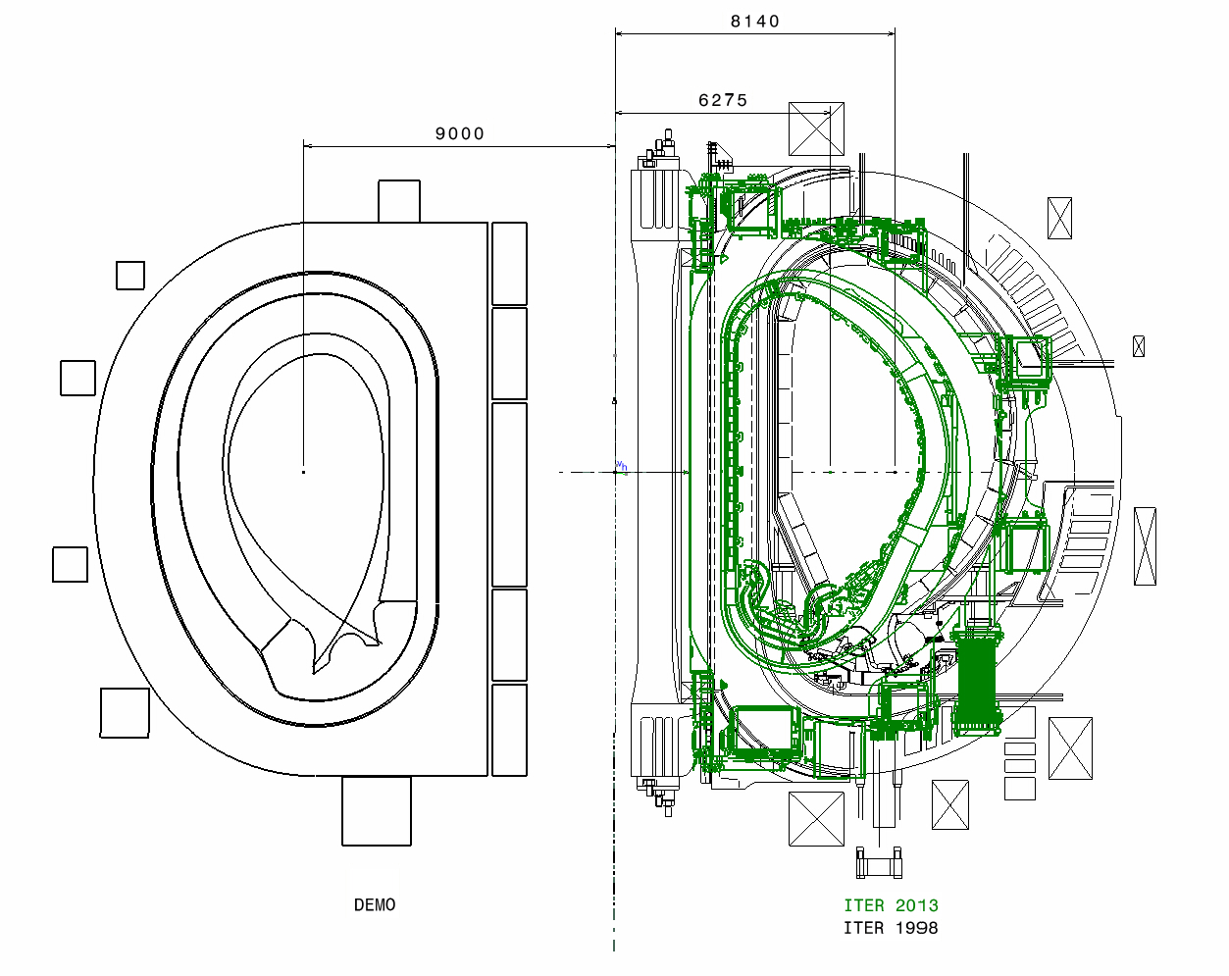
Comparison between ITER and DEMO
ITER 2013
DEMO Reference
Geometry 2013
ITER 1998
Initial geometry based on System Code Studies
Cross Sections through vertical axis

Slide 14
Part 4:
Highlights of some achievements (2011-2013)

Slide 15
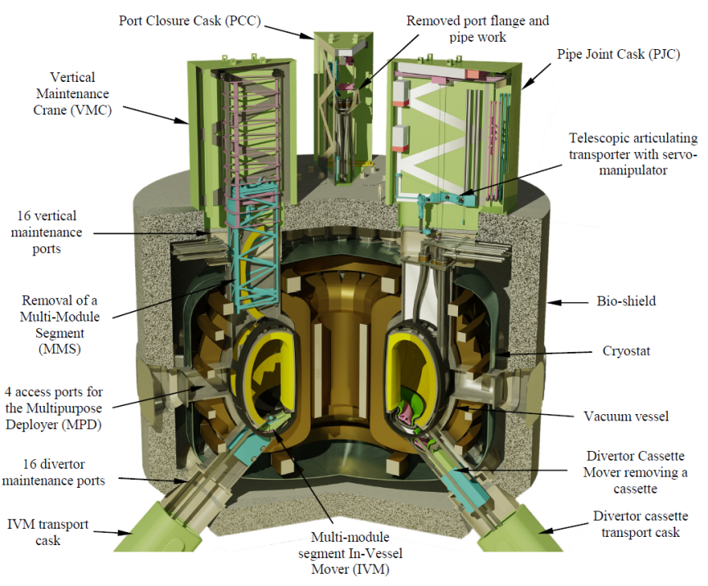
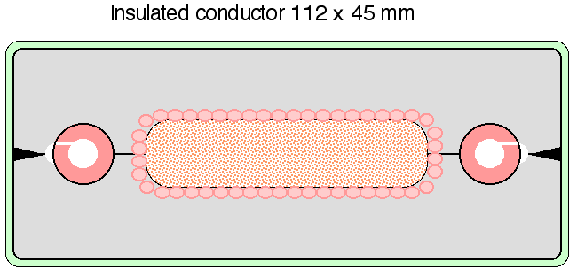
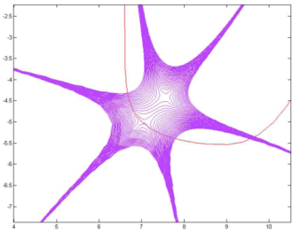
Highlights of some Achievements
(2011 to 2013)
Magnets:
Proposed LTSC cable designs for DEMO TF Coils
Proposed layered, graded winding pack approach
Parallel programme of HTS R&D for fusion applications
TF Coil CICC
Prototype
Remote Maintenance:
Further developed kinematics / mechanisms for vertical blanket maintenance
CAD-based simulations of maintenance procedures
Initial scoping of Active Maintenance Facility
CRPP, Switzerland
CCFE, UK
Novel Divertor Configurations:
On-going investigations of magnetic coil requirements, design integration and engineering constraints for SnowFlake and Super-X divertors
Snowflake (SF)
Quasi Snowflake (QSF)
CREATE/ ENEA Italy

Slide 16
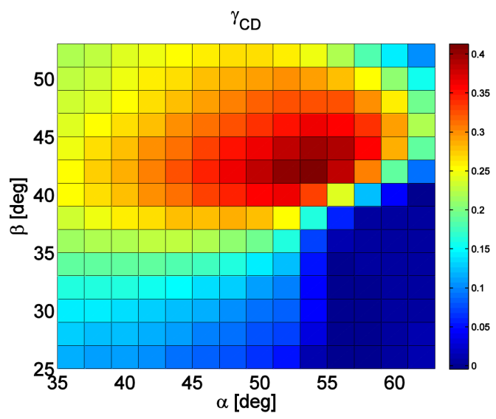
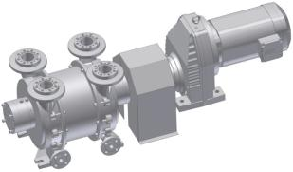
Highlights of some Achievements
(2011 to 2013)
H&CD systems:
An assessment was recently conducted to determine the CD efficiency for a DEMO case
  NBI: based on ITER technology (1 MeV) + ion source R&D for Cs elimination
  ECRH: gyrotrons up to ~230-250 GHz, with step-tunability and broadband window R&D + top-launch injection
  Both ECCD and NBCD are able to synthesize the required current profile
ECCD efficiency w.r.t. toroidal and poloidal injection angle
E. Poli et. al. IPP Garching)
H. Zohm et al., EPS Finland 2013.
Vacuum Pumps:
Proof-of-principle testing of continuous operation pumps:
  Liquid Metal Diffusion Pump
  Liquid Metal Ring Pump
  Metal Foil Pump
Liquid Metal Ring Pump
C. Day, KIT 2013.

Slide 17
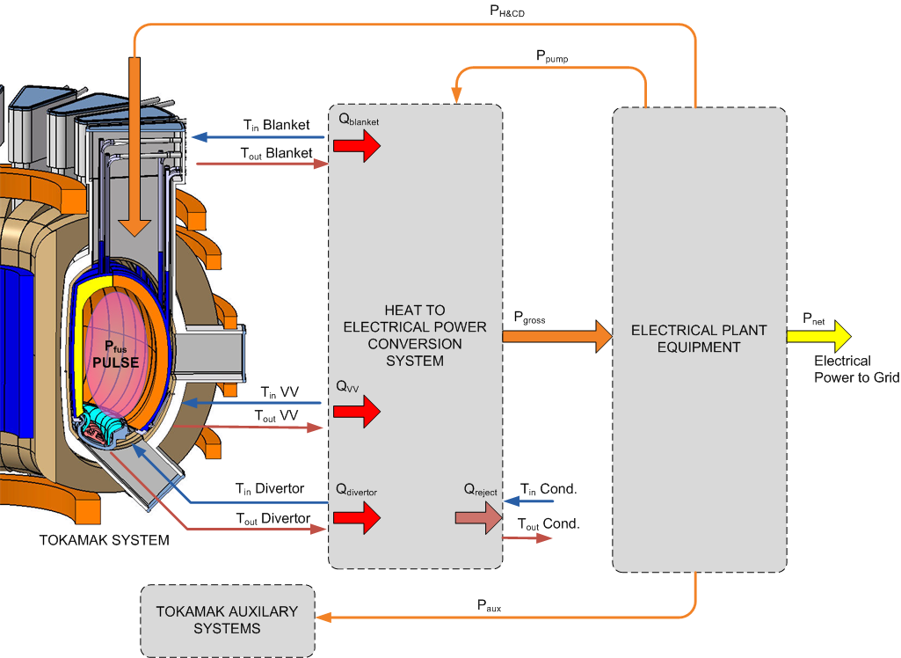
Heat Transfer & Balance of Plant Options
Primary Loop Coolant Options:
System | Coolant | Tin (C) | Tout (C) | P (bar)
Blanket | Helium | 300 | 500 | 80
 | Water | 290 | 320 | 150
 | LiPb | ~350 | ~500 | ?
Divertor | Water | 150 | 250 | 65
Vessel | Water | 95 | 105 | 11
Secondary Loop Coolant Options:
Water / Steam Rankine
Supercritical CO₂ Rankine
Organic Fluids Rankine
Helium Brayton (T_{out} too low!)
Etc.
Energy Storage System considered:
To mitigate fatigue effects of pulsed operation
To smooth grid loading / transients
Tokamak Energy Flow Schematic
Current Assumption is Indirect Balance of Plant System
Notes:
Another key technology area for DEMO is the Primary Heat Transfer and Balance of Plant System.
Assuming an indirect Balance of Plant cycle and driven by the blanket and divertor concepts currently under consideration, we are looking at a number of options for both primary
and secondary coolants.
The use of a Thermal Energy Storage system is also under investigation to mitigate the effects of pulsed operation (DEMO1) and to smooth grid loading.

Slide 18
Part 5:
Organisational Outlook & Summary

Slide 19
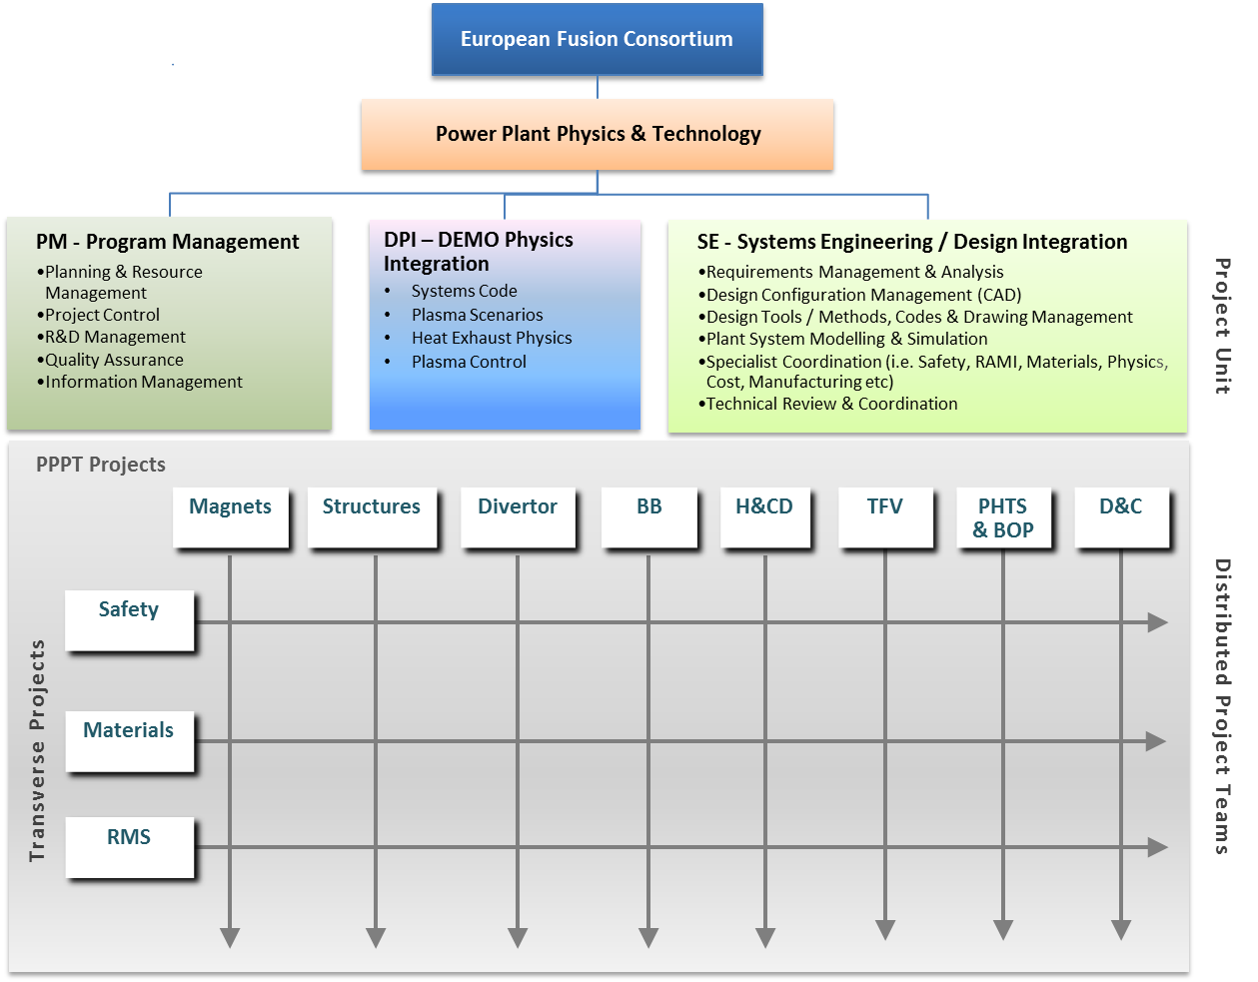
Organisation for 2014 and beyond…
EFDA shall expire on 31st December 2013
EFDA will be replaced by a European Fusion Consortium “EuroFusion” made up of all EU Associations with a coordinating association, to provide financial, legal and administrative functions
The first phase of the roadmap (CDA phase) will be implemented by a number of projects to be executed in the period 2014 to 2020.
Roadmap to be implement through 12 projects
Some directly delivering DEMO systems
Others ensuring system-wide integration of certain aspects
Central project unit necessary for overall technical coordination

Slide 20
Summary
The demonstration of electricity production before 2050 in a DEMO Fusion Power Reactor that produces its own fuel is the primary objective of EU fusion program.
The approach was outlined here together with a preliminary description of the design solutions being considered.
ITER is the key facility in this strategy and the DEMO design/R&D is expected to benefit largely from the experience gained with ITER construction.
Nevertheless, there are still outstanding gaps that need to be overcome requiring a pragmatic approach especially to evaluate and improve through dedicated R&D the readiness of the foreseeable technical solutions.
A system engineering approach is needed and industry must be involved early in the DEMO definition and design.
Availability of sufficient resources and an adequate implementing organization are prerequisite to success.
Europe should seek all the opportunities for international collaborations.

