Slide 1
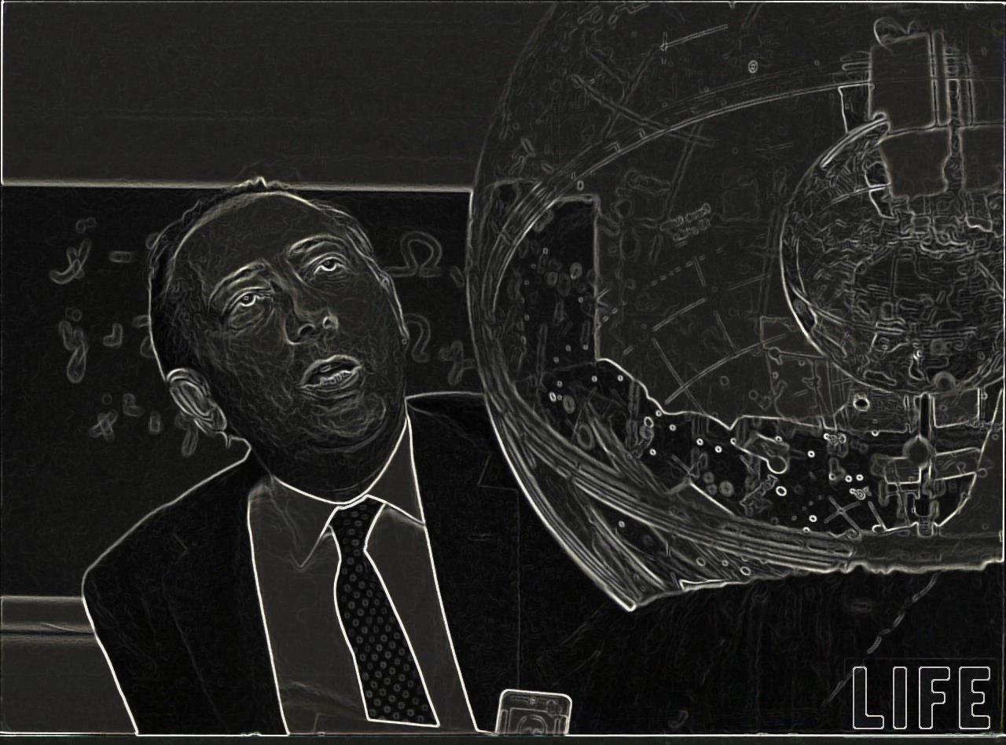
Carbon,
From Red Giants to White Dwarfs
Carbon,
From the Sun to White Dwarfs
In honor of the 111. Birthday
of Eugene P. Wigner
The Breit-Wigner Formula, the
Wigner Limit, and the Wigner-Seitz Radius
Michael Wiescher
Joint Institute for Nuclear Astrophysics
University of Notre Dame

Slide 2
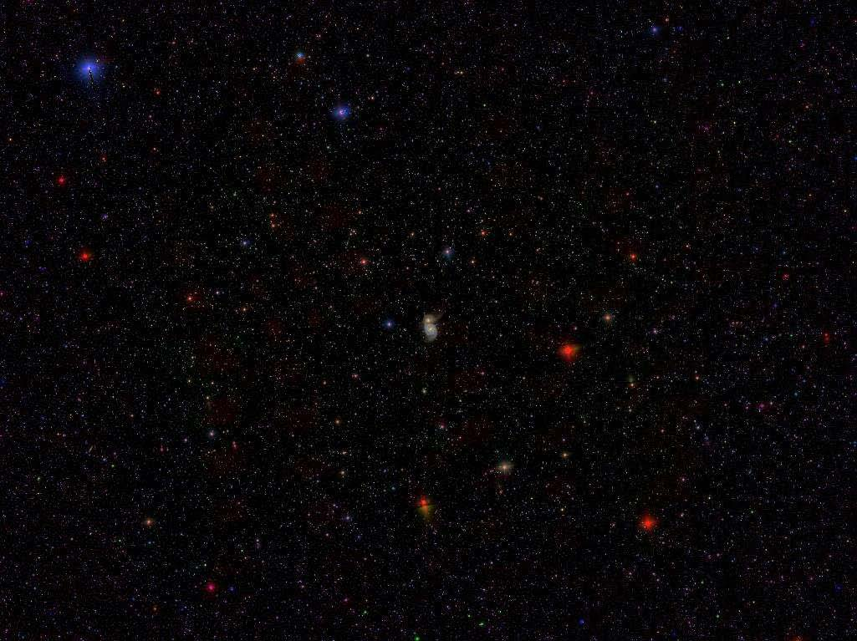
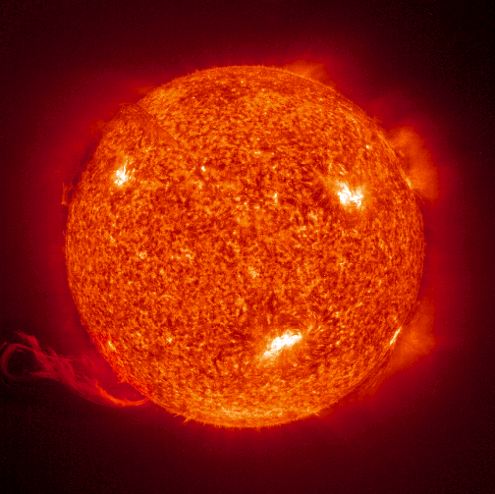
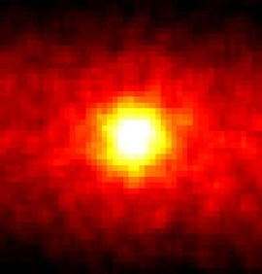
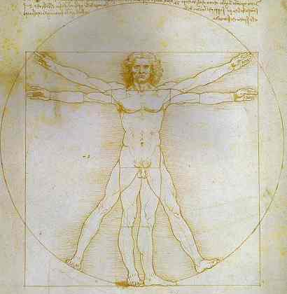
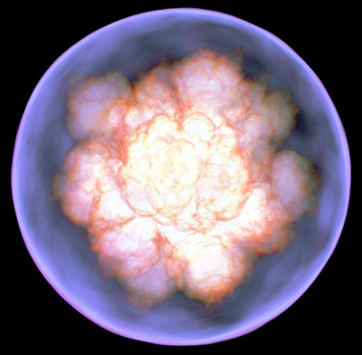
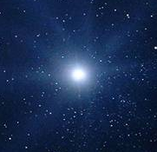
Carbon Topics in Nuclear Astrophysics
Solar neutrinos as probe for the conditions in the solar interior
Carbon oxygen origin and abundances in us & our universe
Ignition conditions of type Ia supernovae as standard candles

Slide 3
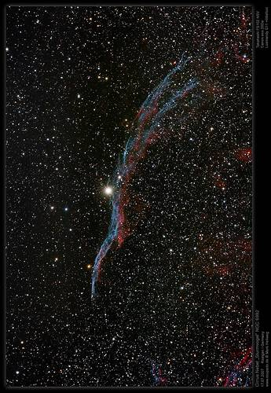
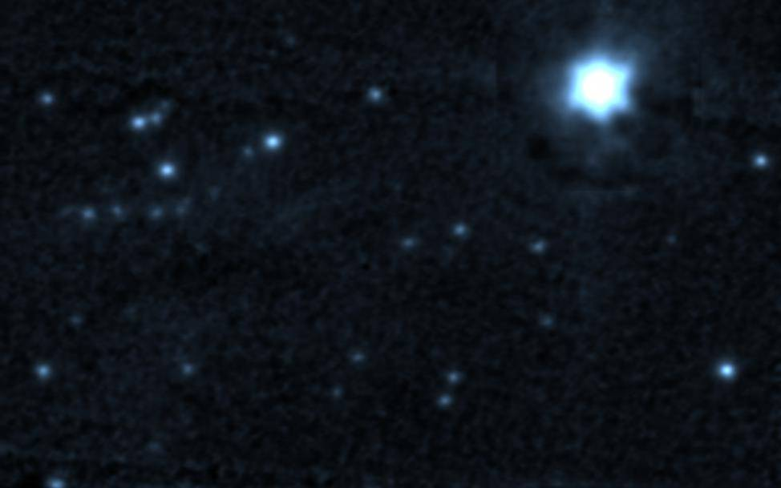
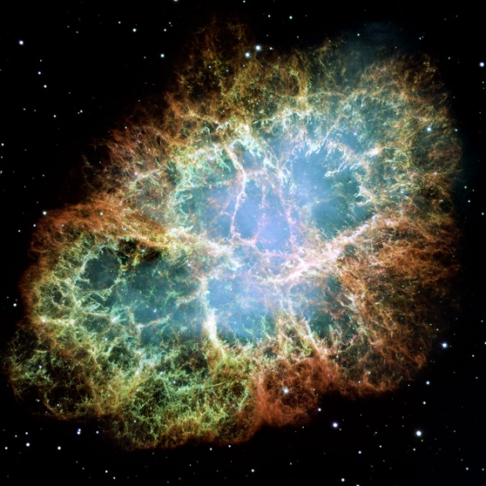
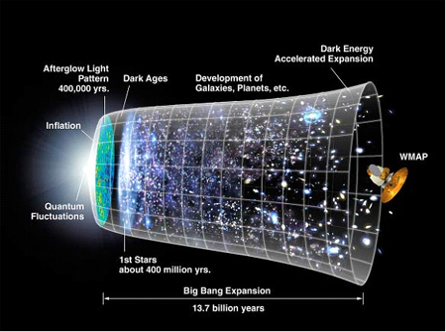
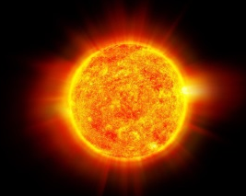
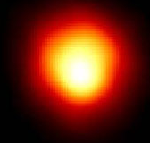
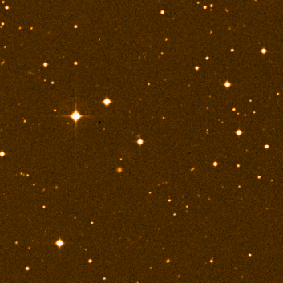
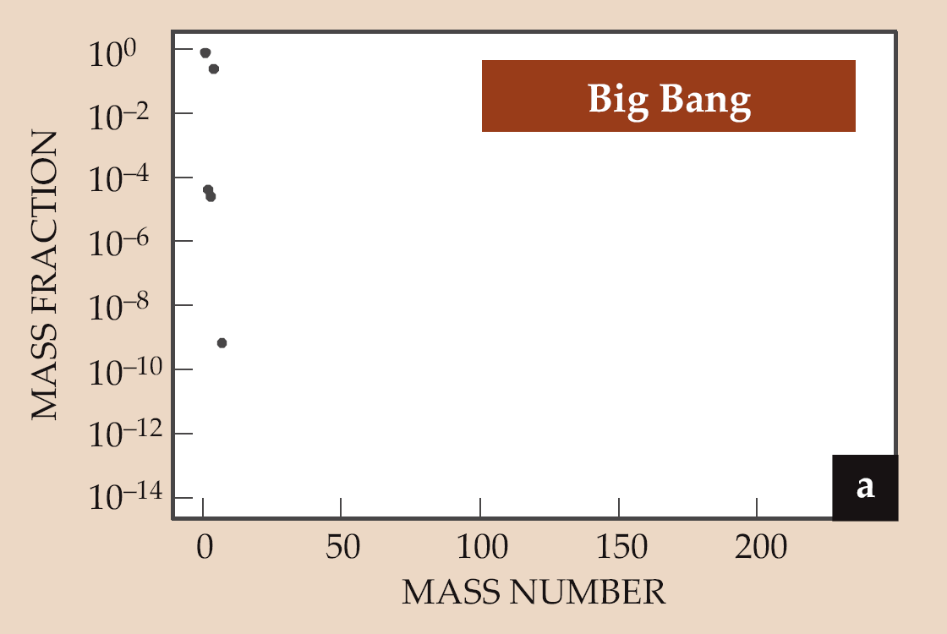
Galactic Chemical Evolution
Sr

Slide 4
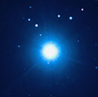
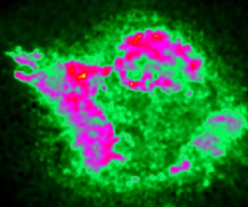
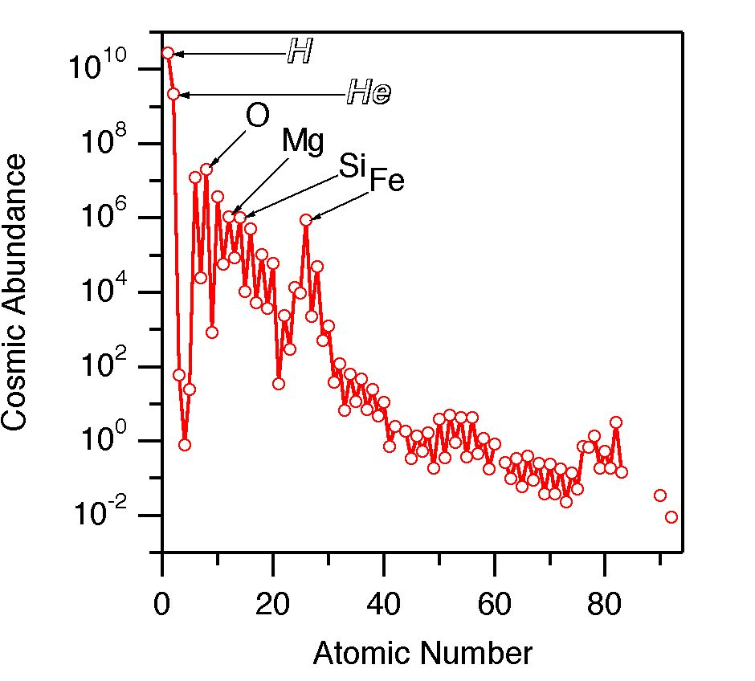
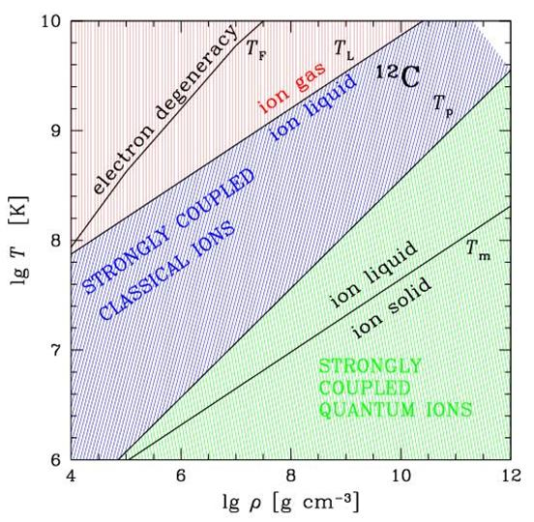
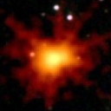
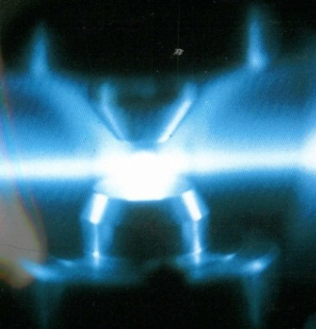
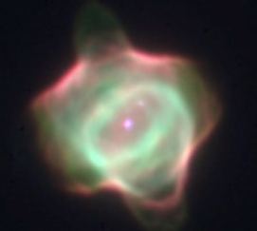
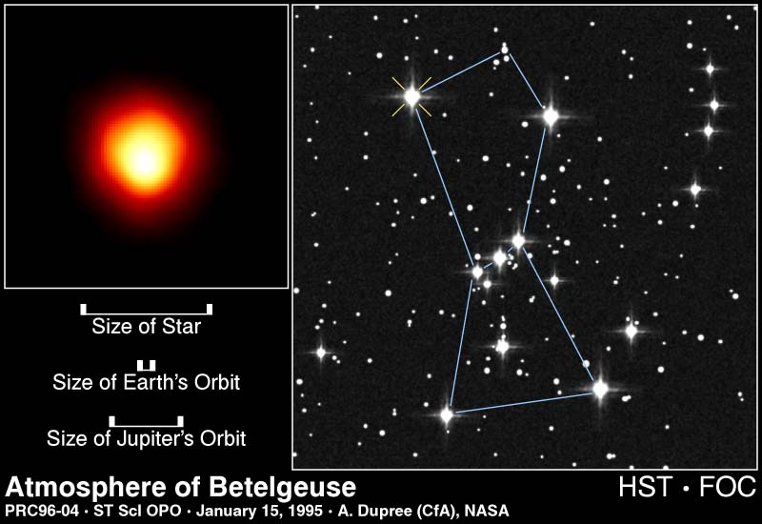
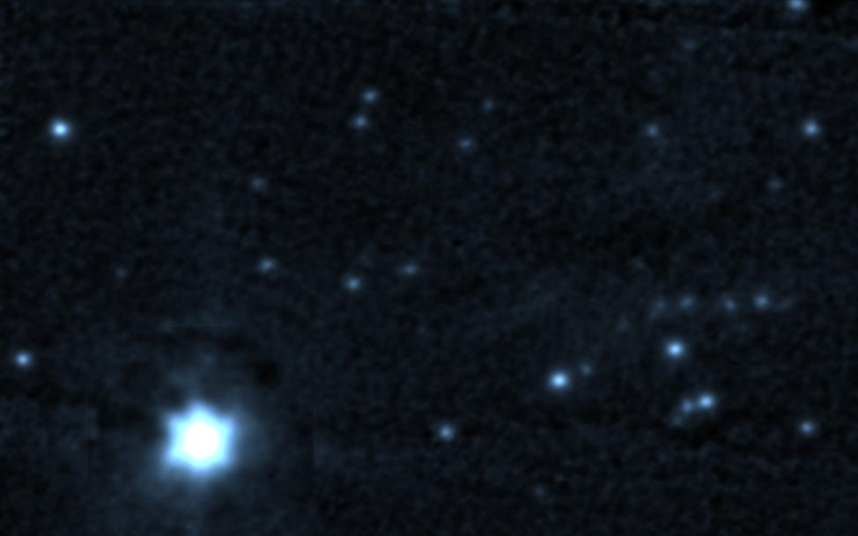
Nucleosynthesis in Stars
Hydrogen Burning: ⁴He, ¹⁴N
Helium Burning: ¹²C, ¹⁶O, ²²Ne, n, s-nuclei
Carbon Burning: ¹⁶O, ²⁰Ne, ²⁴Mg ... s-nuclei
Ne-, O-, Si-Burning: ⁵⁶Fe core-collapse
10
Si-ignition
C
O-ignition
Ne-ignition
9
C-ignition
Galactic abundances distribution of elements with high C, O composition !
log (T_{c})
He-ignition
8
H-ignition
7
0
2
4
4
6
8
10
log (ρ_{c})

Slide 5
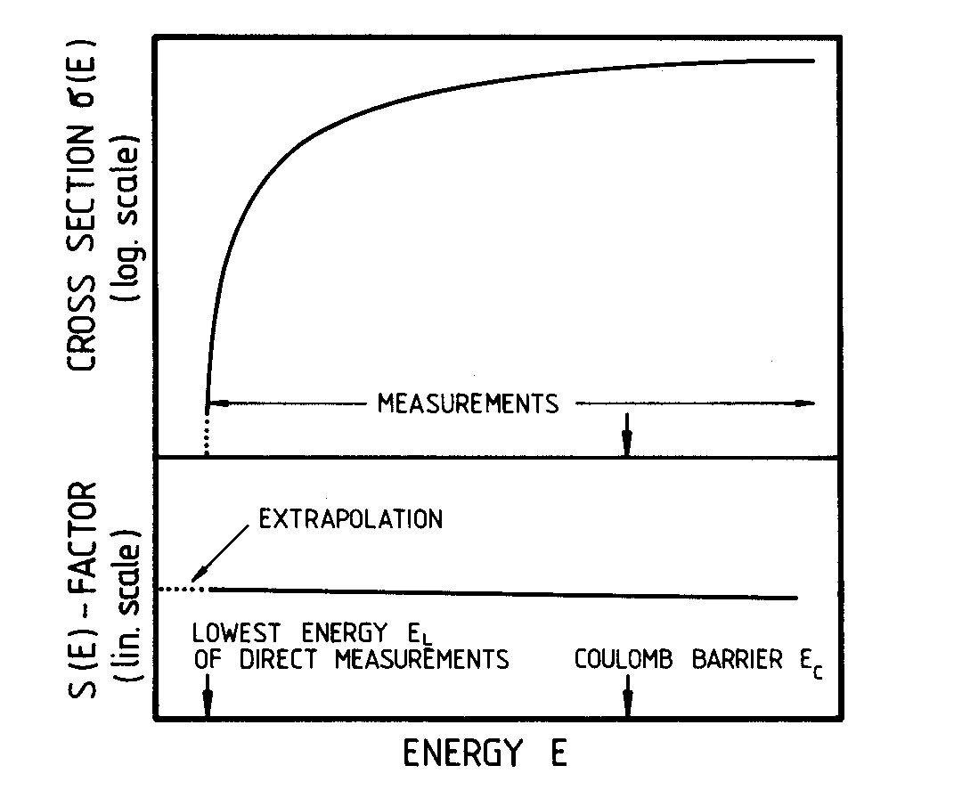

Stellar Reaction Rates
Characterize the engine of stars; determine the energy production, provide the fuel for next burning stage and generate the seed for explosive stages towards the end of stellar life. Also important for identifying observation signatures.
MB distribution
background

Slide 6
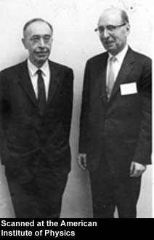
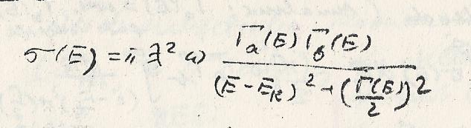
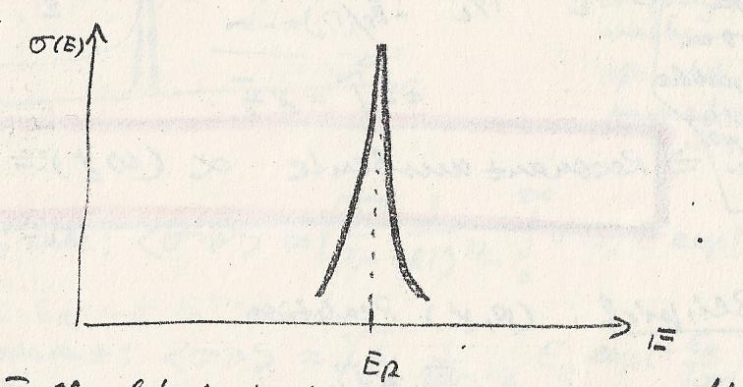
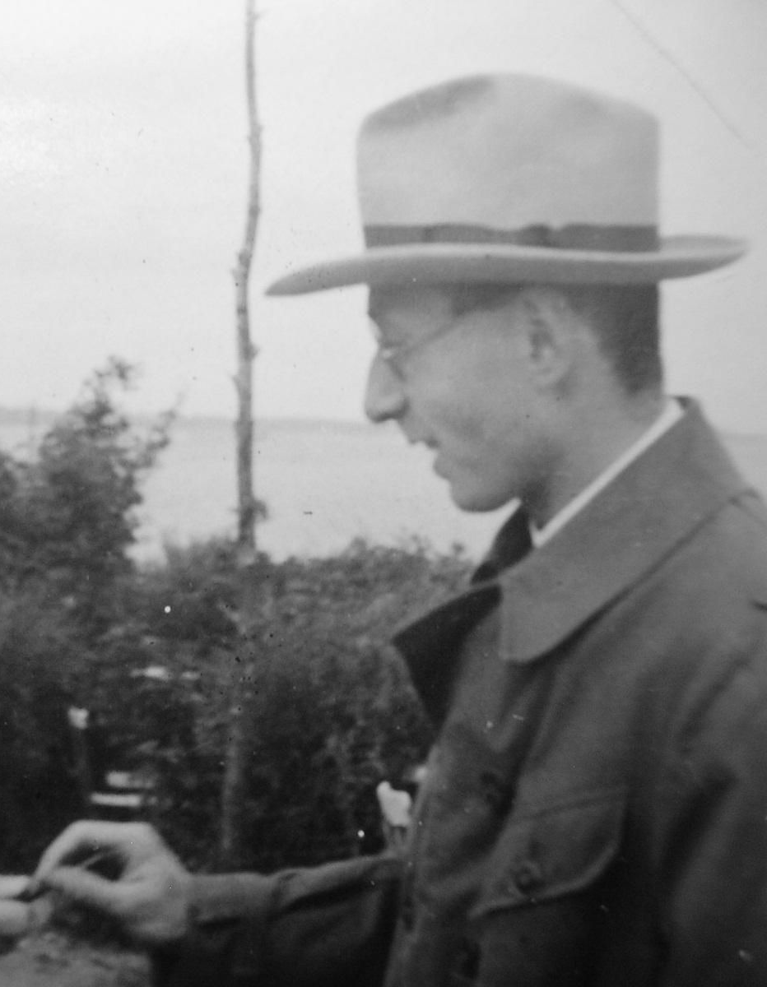

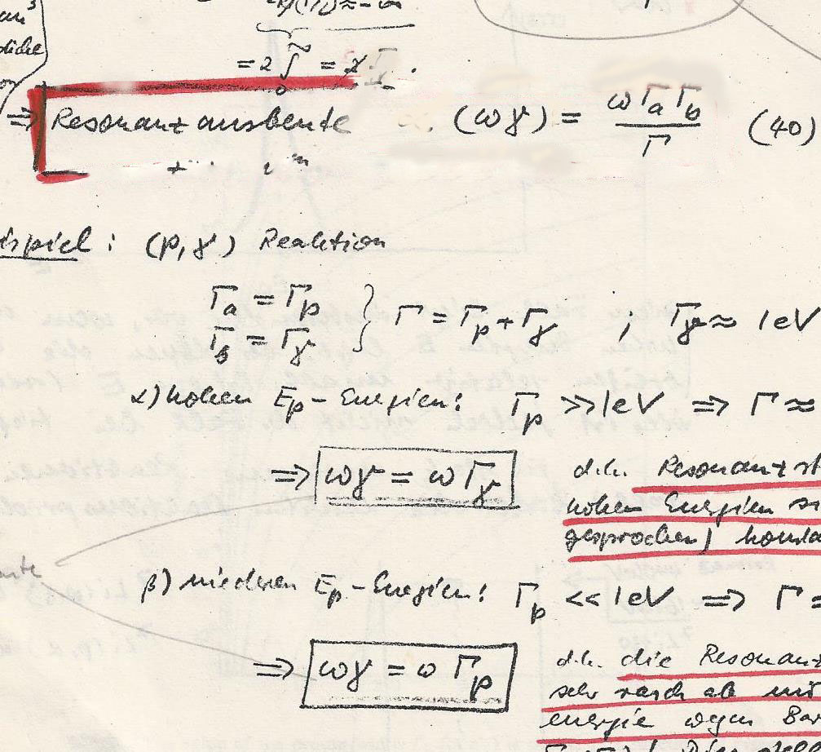
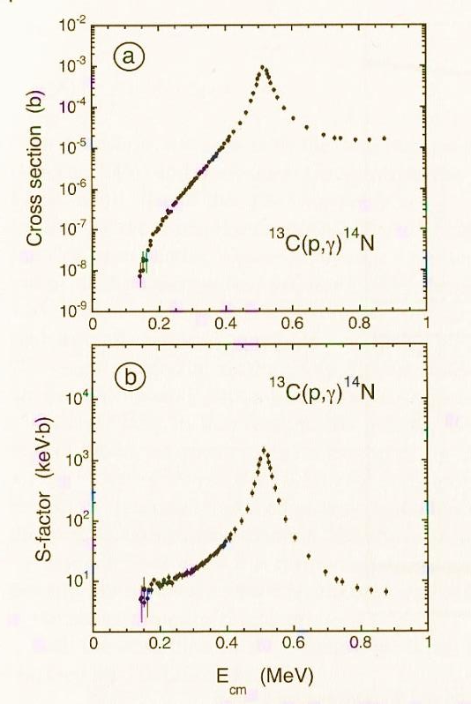
Resonances
G. Breit & E. Wigner Phys. Rev. 49 (1936) 519
with Γ_{a}(E) representing the decay probability into one reaction channel
The strength of the resonance depends on the partial channels
The Breit-Wigner single resonance approach is key method for modeling nuclear reactions between light nuclei that characterize stellar burning modes such as hydrogen burning in main sequence stars and helium burning in red giant stars. Pronounced resonant structures determine the nuclear cross section σ(E) and the stellar reaction rates N_{A}⟨συ⟩!

Slide 7
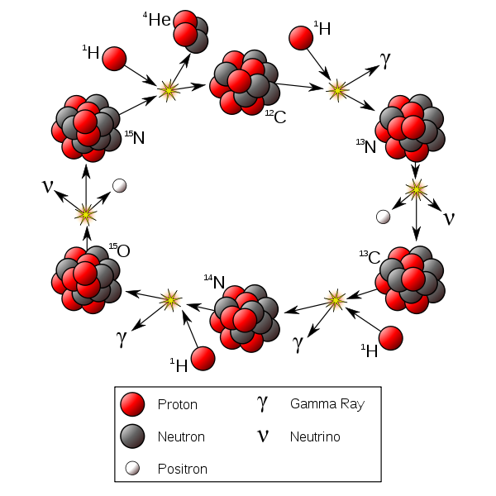
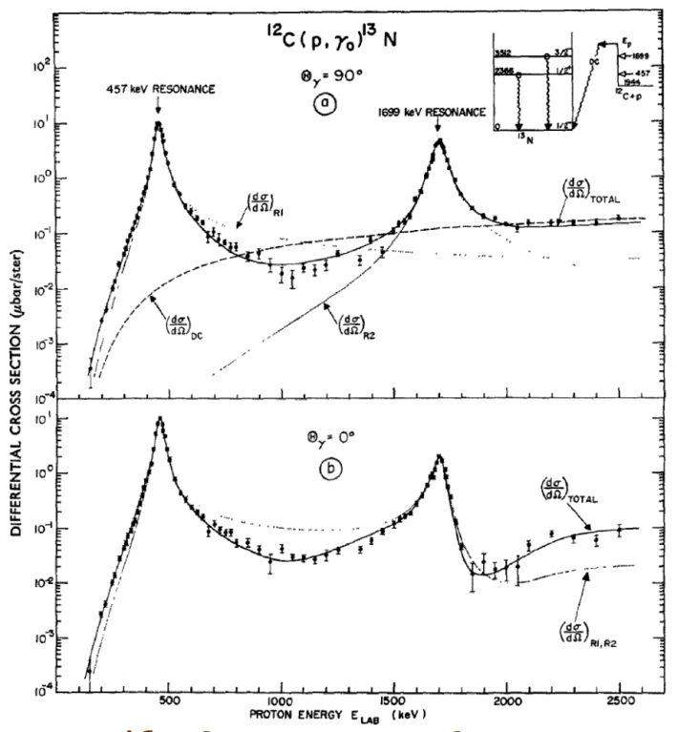
The CNO Cycle
The ¹²C(p,γ)¹³N reaction opens the CNO burning cycle on carbon fuel and provides CNO neutrinos via ¹³N(βν)¹³C, whose detection may provide a new way to probe solar core metallicity!
¹⁶O
Rolfs & Azuma 1974
Cross section is determined by two interfering BW resonances and a direct capture component!

Slide 8
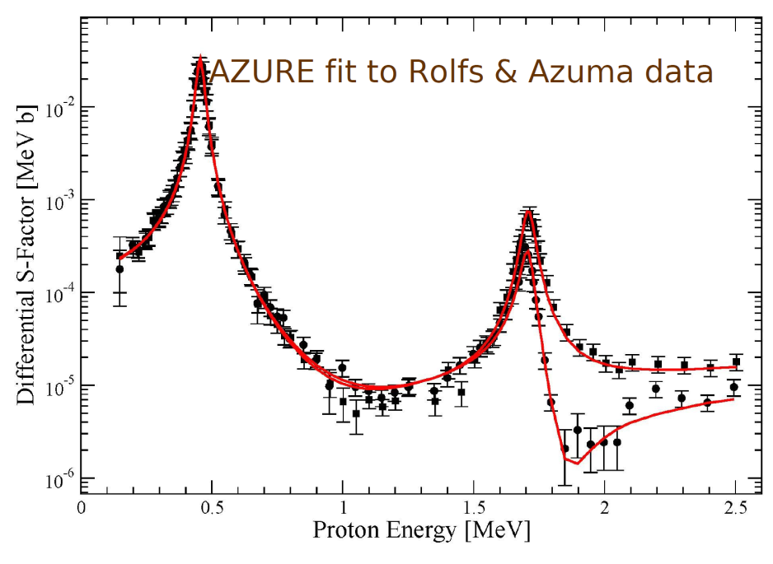
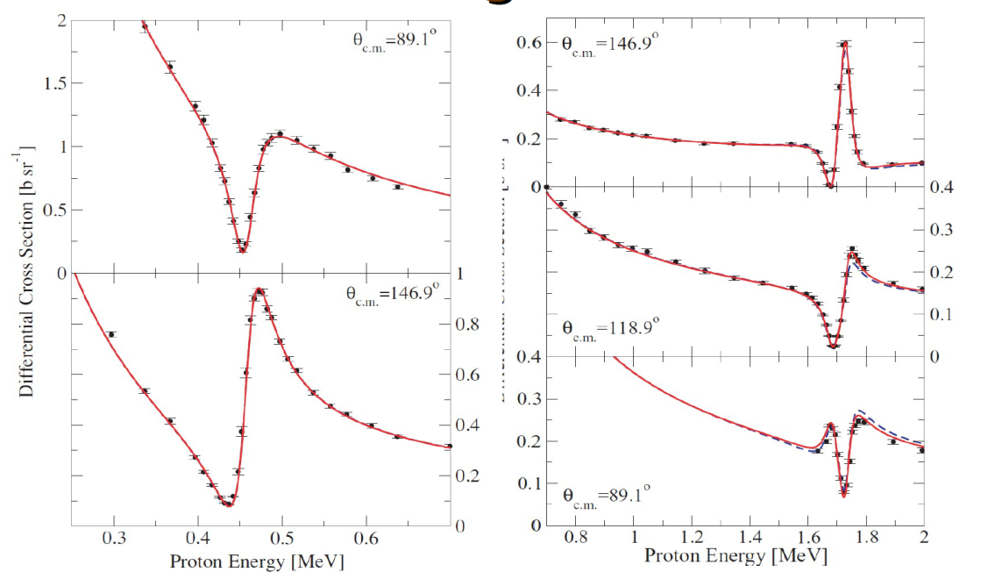
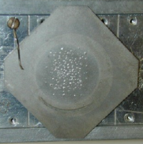
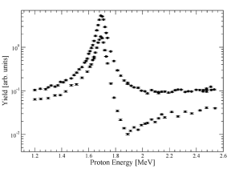
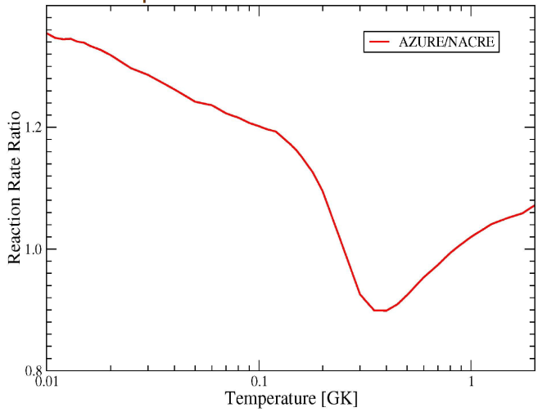
The R-matrix as generalized Breit-Wigner approach
T. Teichmann & E.P. Wigner, Phys. Rev. 87 (1952) 123
Multi-level multi-channel fit of reaction process: ¹²C(p,γ)¹³N, ¹²C(p,p)¹²C
Joint fit combined with new data from Notre Dame facility translates into a new reaction rate which is 30% higher than predicted by the “standard NACRE rate”, that will yield a higher ¹³N neutrino flux. This translates into a 10% higher CNO neutrino flux!

Slide 9
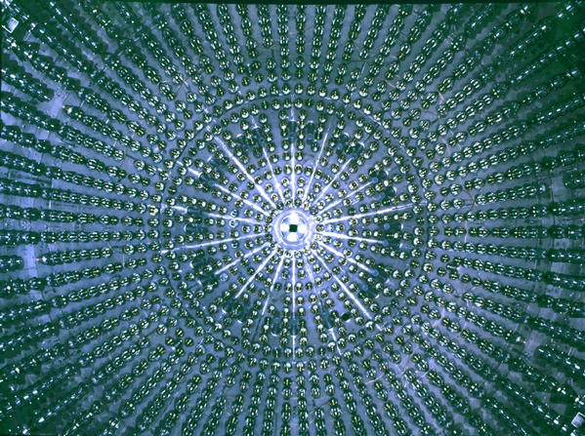
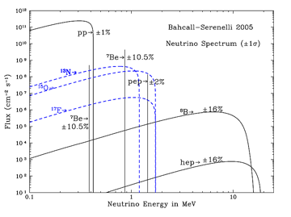
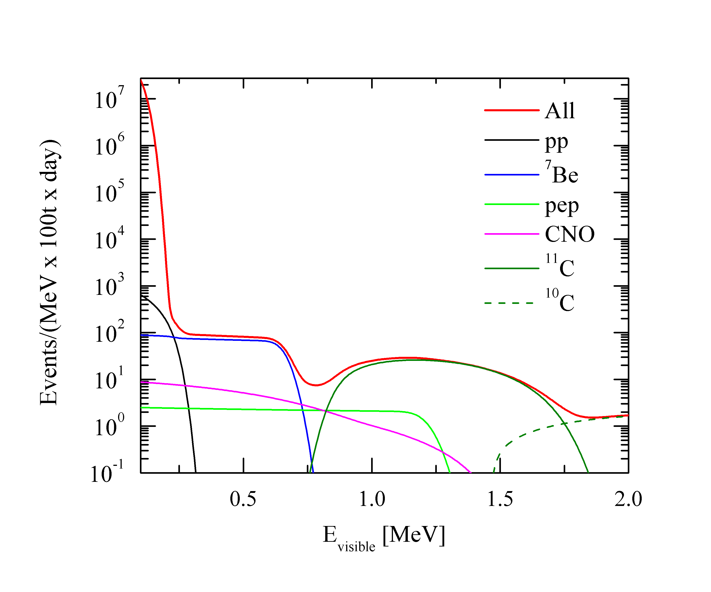
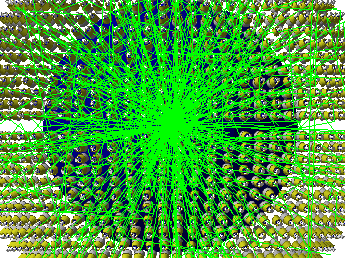
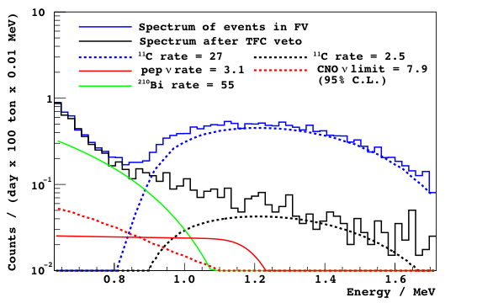
BOREXINO expectations
Enhanced flux in ¹³N neutrinos
Reduction of ¹¹C background will be necessary!
Reduction in ²¹⁰Bi is next goal!

Slide 10
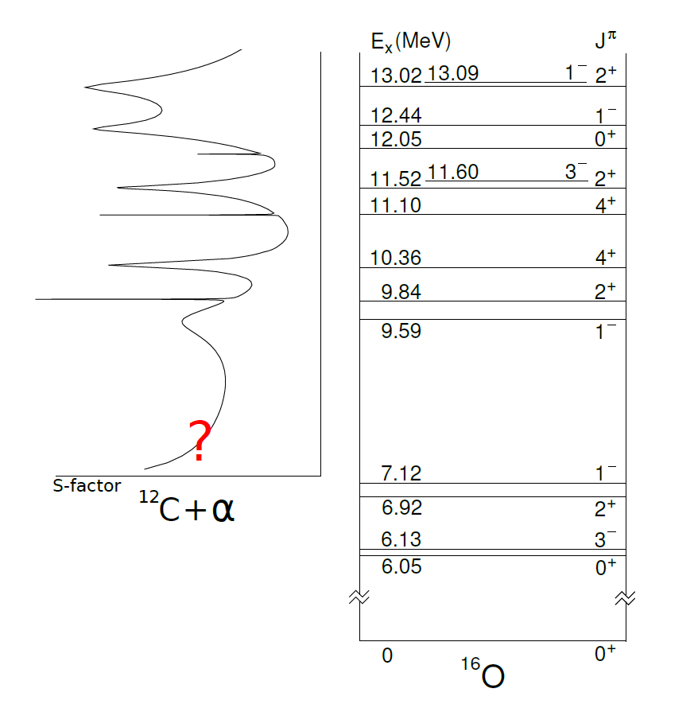
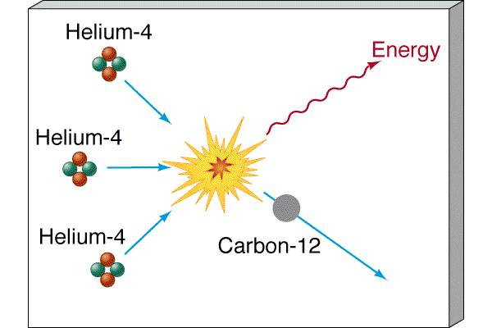
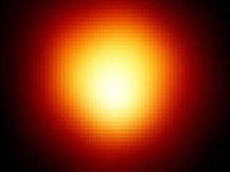
Origin of Carbon & Oxygen
Oxygen-16
In Red Giant helium burning stars
The reactions determine the ¹²C/¹⁶O ratio in our universe! The ratio defines late stellar evolution of massive stars, it determines white dwarf matter, & the ignition of supernovae type Ia, the standard candle for cosmological predictions.

Slide 11
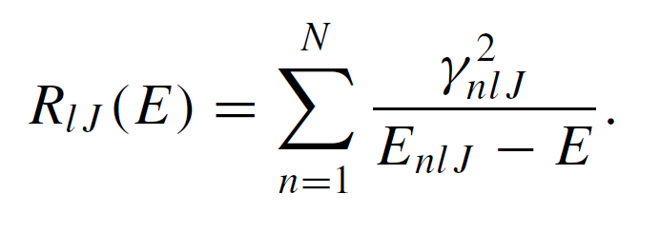
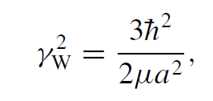


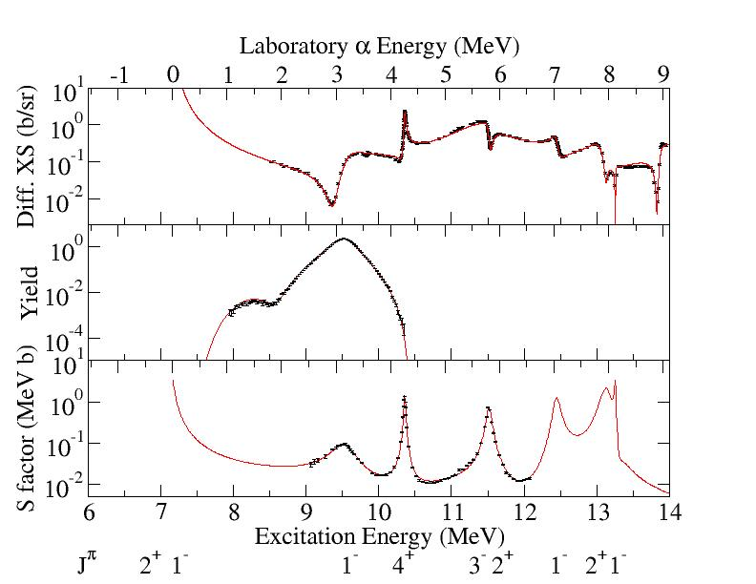
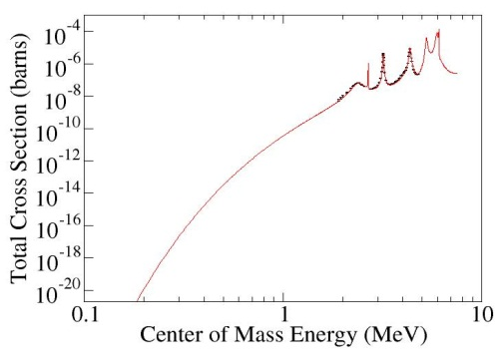

The R-matrix analysis of all existing data feeding the ¹⁶O compound nucleus
T. Teichmann & E.P. Wigner, Phys. Rev. 87 (1952) 123
¹²C(α,α₀)¹²C
Notre Dame
¹⁶N(β)¹⁶O*(α)¹²C
Argonne,
Notre Dame,
TRIUMF
ERNA & many groups
¹²C(α,γ)¹⁶O

Slide 12




Counting with Separators
Separation ratio of reaction products to primary beam 10⁻¹⁸ !
Strong Gradient Electro-magnetic Online Recoil separator for capture Gamma ray Experiments

Slide 13
Nucleosynthesis in He burning
¹²C(α,γ)¹⁶O
Total cross section data only
The extent of the uncertainty in the extrapolated S-factor determines the uncertainty of the predictions for the ¹²C/¹⁶O ratio in our universe!

Slide 14

The ¹²C/¹⁶O ratio in our Universe
The ratio defines the late stellar evolution of massive stars (carbon burning versus oxygen burning), and determines the carbon abundance in White Dwarf matter!
The ignition of supernovae type Ia, the standard candle cosmological predictions, is driven by the ¹²C+¹²C fusion and the conditions depend sensitively on the abundance of pre-ignition White Dwarf matter.

Slide 15


Accretion on C-O White Dwarf to type Ia Supernova Explosion
causes increase in temperature and density until ¹²C+¹²C ignition conditions are reached! These conditions depend on:
The ¹²C+¹²C fusion cross section and rate
The environmental conditions at ignition point

Slide 16



The Nuclear Component S(E) in the ¹²C+¹²C Cross Section
Different potential models lead to different ways to extrapolate the low energy cross section (S-factor).
E_{G}
standard potential model
hindrance potential model
Caughlan & Fowler ADND 1988
Gasques et al. PRC 2005
Yakovlev et al. PRC 2006
Jiang et al. PRC 2007

Slide 17




Resonances towards lower energies
Much speculation about possible resonances at ~ 1.5 & 2.1 MeV
Resonance strength corresponds to width of the fusion channel!
The Wigner limit sets the limit for the strength of the partial channel Γ_{12C} !
E. P. Wigner, Am. J. Phys. 17 (1949) 99

Slide 18


Impact on ¹²C+¹²C fusion
The width of the ¹²C partial channel and the estimated resonance strengths ωγ corresponds to the Wigner limit; it would represent a pronounced molecular ¹²C-¹²C configuration for that specific resonance in the compound nucleus ²⁴Mg
Resonance

Slide 19

Dynamic Molecular Model Approaches
A. Torres-Diaz, in preparation

Slide 20




Core Conditions for C-O White Dwarfs
Extreme high densities of ~10⁸ g/cm³ compress nuclei to solid ¹²C-¹⁶O lattice
a free uniform electron cloud shields the deflective Coulomb potential between ions
The Wigner Seitz formalism (1934) was applied by Salpeter (1961) to determine the Coulomb energy for each ion in a lattice embedded in a homogeneous electron distribution. This gives crystallization conditions and the screening of Coulomb forces as function of density
E. Wigner & F. Seitz, Phys. Rev. 46 (1934) 509

Slide 21



From Thermo- to Pycno-Nuclear Fusion
Accretion gradually increases core density and temperature until ignition occurs through ¹²C+¹²C fusion when ε_{(12C+12C)} > ε_{(ν-cooling)}
Temperature density trajectory in accreting WD environment
¹²C+¹²C fusion as function of density & temperature in WD environment

Slide 22



Supernova type Ia Ignition
in White Dwarfs
thermonuclear
burning
reduced
rate
standard
rate
pycnonuclear burning
Nuclear uncertainties in ignition conditions for type Ia standard candle supernovae: But more realistic model simulations are required! An increase in rate by additional resonant contributions lowers the ignition conditions!

Slide 23

Summary and Conclusions
Breit-Wigner Resonance concept plays important role in determining reaction cross sections
Wigner limit defines the strength of resonances as function of their internal shell or cluster configuration
Wigner-Seitz cell emerged as important tool for the treatment of White Dwarf and Neutron Star crust materials

Slide 24
Thermonuclear fusion rates
Fusion at hot & dense conditions
n_{i} is particle density
Screening part depends on the plasma characteristics approximated by a plasma screening potential V_{plasma}
Yakovlev et al. PRC 74 (2006) 035803

