Slide 1




Sectoral Operational Programme
„Increase of Economic Competitiveness”
“Investments for Your Future”
Extreme Light Infrastructure – Nuclear Physics (ELI-NP) – Phase I
Project co-financed by the European Regional Development Fund
EUROPEAN UNION
GOVERNMENT OF ROMANIA
Structural Instruments
2007-2013
Towards experiments at the new ELI-NP facility
Dimiter L. Balabanski
Wigner 111 Scientific Symposium November 12th, 2013

Slide 2

Where is ELI-NP ?
Bucharest 4km
Φ = 800 m
IFIN-HH
Magurele
ELI-NP

Slide 3
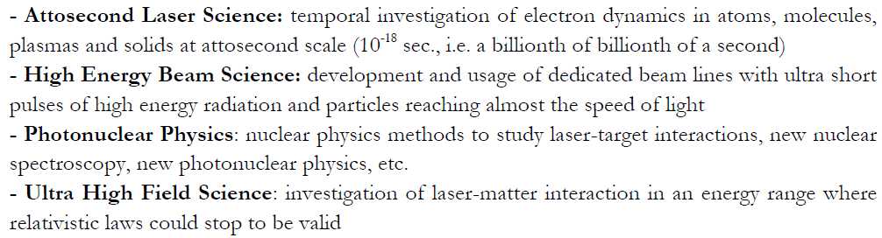
Time-line of the project
2005: Initiation of the ELI project, aiming at the generation of the most intense light pulses;
2007: The ELI project was identified by ESFRI as top priority research infrastructure for Europe;
November 2007: A 36-month ELI Preparatory Phase project supported by EC;
May 2009: Four main branches of research and applications were identified:
February 1st – 2nd , 2010: ELI-NP Workshop, Bucharest;
March 21st, 2010: ELI-NP White Book (http://www.eli-np.ro/eli-np-presentations.php);
July 4th, 2012: ELI-NP was approved by the Romanian government;
September 18th, 2012: ELI-NP was approved by the European Commission;
2012: Public tender procedures for civil construction, gamma-beam and high-power laser systems were open;
2017: ELI-NP is expected to start operations !

Slide 4
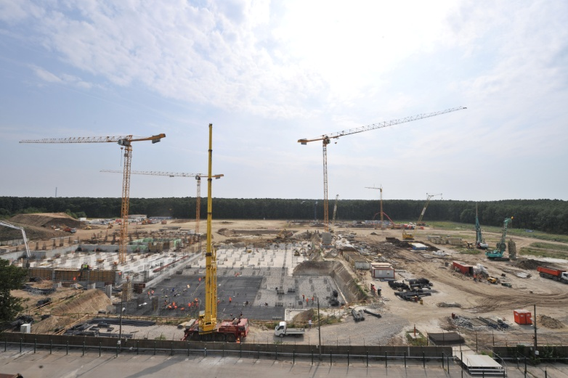
Status of Extreme Light Infrastructure – Nuclear Physics

Slide 5
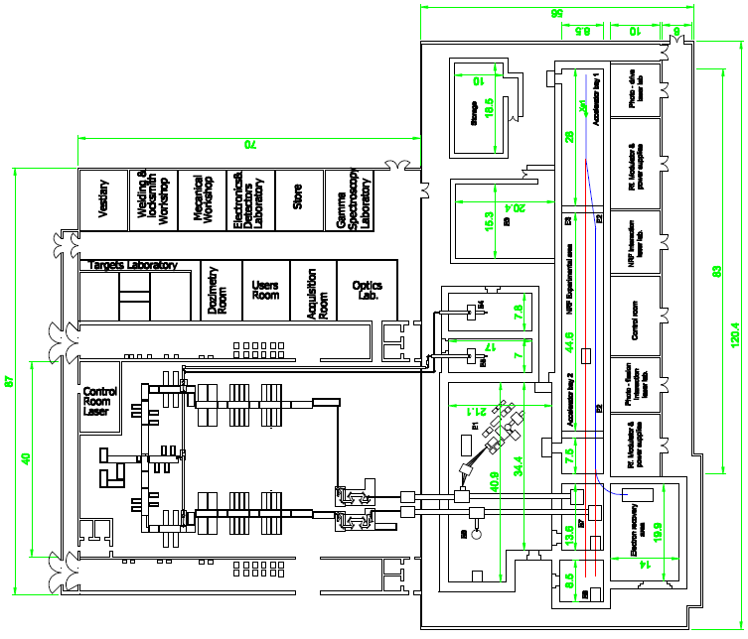
Two 10 PW lasers
Brilliant up to 20 MeV
γ beam of 10^{–3} BW

Slide 6
Science Case
Basic Science
High-field QED
pair production, high-energy γ rays, birefringence of vacuum
Nuclear Spectroscopy
(γ, γ’), (γ,n), (γ,p), (γ,α), (γ,f),
(e,e’), (e,e γ’), etc.
Nuclear Astrophysics
r-, s- and p-process nucleosynthesis
Applications
Nuclear Resonance Fluorescence
control of nuclear materials, radioactive waste monitoring
Brilliant γ, n, e⁺ beams
material and life science
Laser acceleration of heavy ions
http://www.eli-np.ro/documents/ELI-NP-WhiteBook.pdf

Slide 7
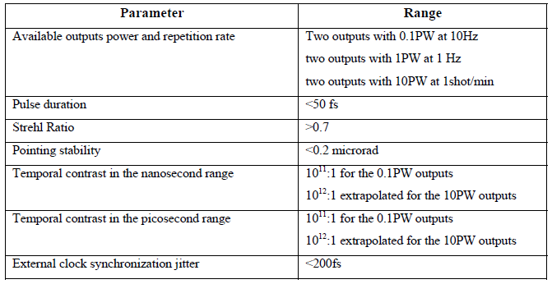
High-power laser source

Slide 8
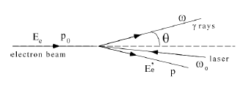
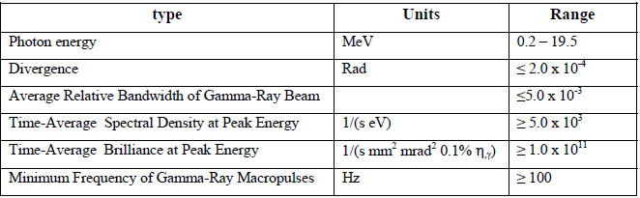
brilliant γ beam
700 MeV LINAC
Parameters of the gamma-beam

Slide 9
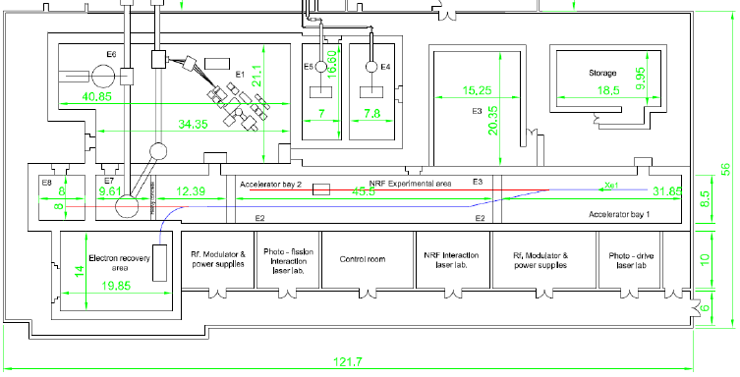
Experimental areas

Slide 10

ELI-NP: the F-I-UK European proposal
European Collaboration for the proposal of the gamma-ray source:
  Italy: INFN,Sapienza
  France: IN2P3, Univ. Paris Sud
  UK: ASTeC/STFC
  ~ 80 collaborators elaborating the CDR/TDR

Slide 11
ELI-NP requirements:
State of the art
Compact
S-band Photoinjector
+
C-band linac
+
=

Slide 12
Thomson/Compton Sources are electron-photon Colliders,
based on the concept of Spectral Luminosity,
i.e. Luminosity per unit bandwidth
negligible diffraction
0 crossing angle
Scattered flux
Luminosity as in HEP collisions
  Many photons, electrons
  Focus tightly
  ELI-NP
f
electrons
laser
  cfr LHC 10³⁴ SuperB-fac 10³⁶

Slide 13
A r.t. RF linac vs pulsed laser source
Electron beam parameter at IP
Energy (MeV) | 180-750
Bunch charge (pC) | 25-400
Bunch length (µm) | 100-400
ε_{n}__{x,y} (mm-mrad) | 0.2-0.6
Bunch Energy spread (%) | 0.04-0.1
Focal spot size (µm) | 15-30
# bunches in the train | 31
Bunch separation (nsec) | 16
energy variation along the train | 0.1 %
Energy jitter shot-to-shot | 0.1 %
Emittance dilution due to beam breakup | < 10%
Time arrival jitter (psec) | < 0.5
Pointing jitter (μm) | 1
Yb:Yag Collision Laser | Low Energy Interaction | High Energy Interaction
Pulse energy (J) | 0.2 | 0.5
Wavelength (eV) | 2.4 | 2.4
FWHM pulse length (ps) | 2-4 | 2-4
Repetition Rate (Hz) | 100 | 100
M² | 1.2 | 1.2
Focal spot size w₀ (µm) | > 25 | > 25
Bandwidth (rms) | 0.05 % | 0.05 %
Pointing Stability (µrad) | 1 | 1
Sinchronization to an ext. clock | < 1 psec | < 1 psec
Pulse energy stability | 1 % | 1 %

Slide 14
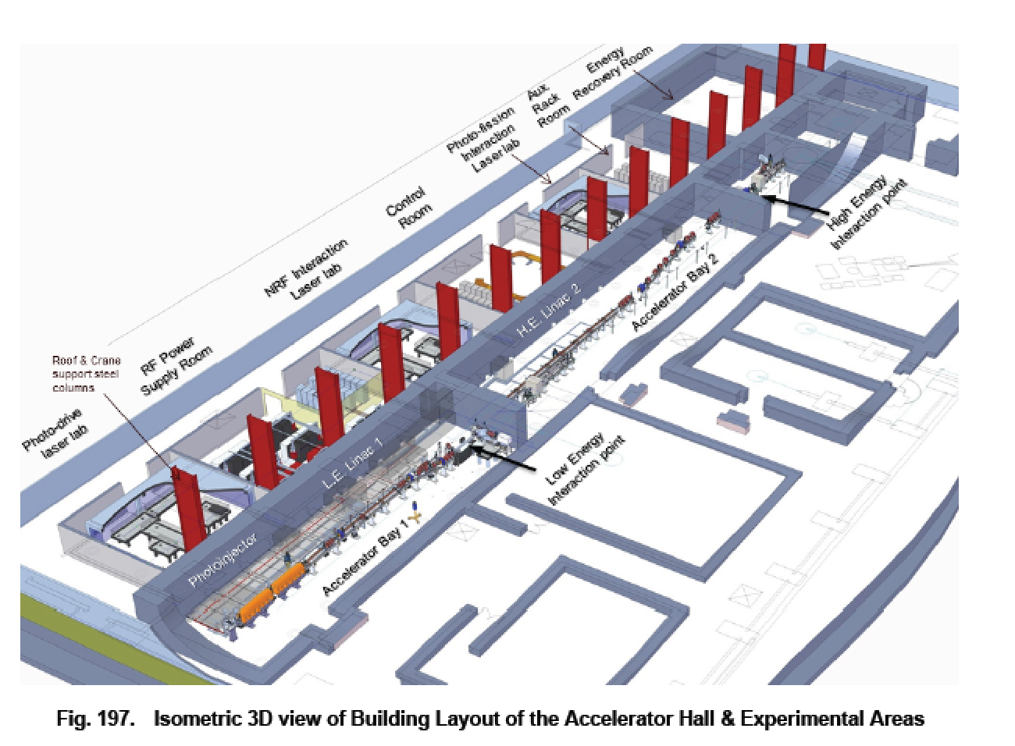
Accelerator and Equipments
in ELI-NP Building
ELI-NP-GS

Slide 15

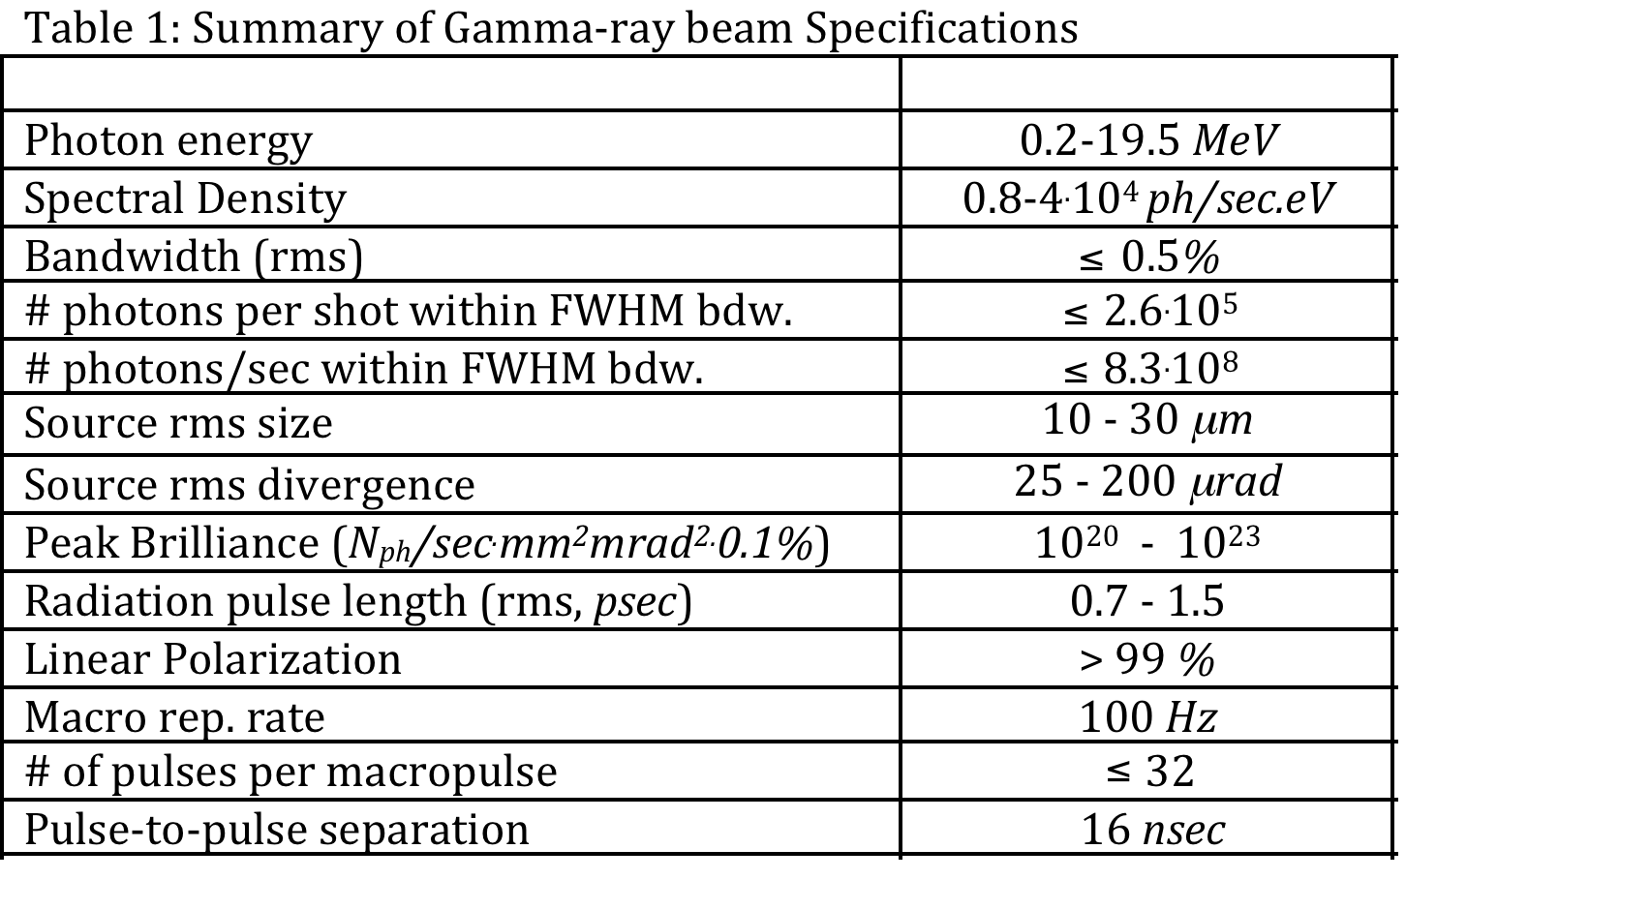
Main Parameter Tables of ELI-NP-GBS

Slide 16
Photonuclear Reactions
Separation
threshold
~ 8 MeV
Absorption
γ
γ´
γ´
β
^{A´}Y
β
gs
^{A}X
Nuclear Resonance Fluorescence (NRF)
Photoactivation
Photodesintegration
Photofission
(-activation)

Slide 17
TDR working groups and instruments
Gamma-beam TDR working groups
Excitations above the threshold (conveners: Hiroaki Utsunomiya, Franko Camera,
              ELI-NP liaison: Dan Filipescu)
Nuclear Resonance Fluorescence (convenor: Norbert Pietralla, liaison: Calin Ur)
Photo-fission (conveners: Fadi Ibrahim, Attila Krazsnahorkay, liaison: Dimiter Balabanski)
Charged-particle experiments (convener: Moshe Gai, liaison: Ovidiu Tesileanu)
Gamma-beam transport (ELI-NP liaision: Calin Ur)
Positron beams (ELI-NP liaision: Cristian Teorurescu)
Laser-beam TDR working groups
Laser-beam delivery (convener: Gilles Cheriaux, liaison: Daniel Ursescu)
Fission fusion experiments (convener: Markus Roth, liaison: Florin Negoita)
Strong-filed QED (conveners: Paul MacKenna, Dino Jaroszynski, liaison: Edmond Turku)
Combined laser-gamma experiments (convener: Kensuke Homma, liaison: Daniel Ursescu)
Laser control system (ELI-NP liaison: Mihai Cernaianu)

Slide 18
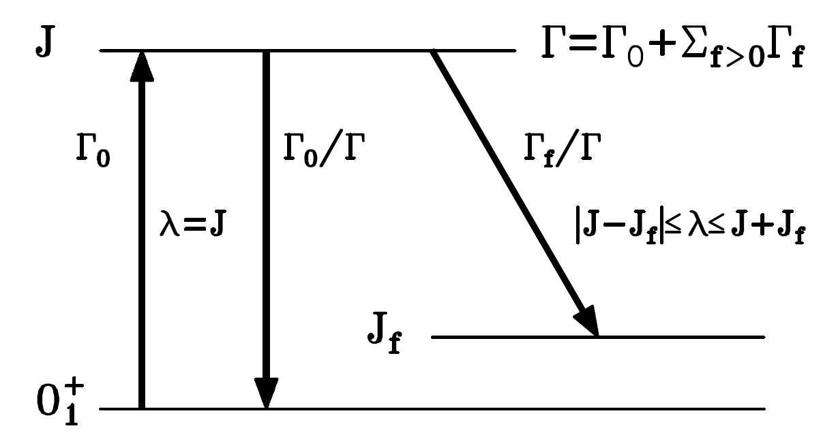
Nuclear Resonance Fluorescence
Observables
Excitation Energy E_{r}
Spin J
Parity π
Decay Energies E_{γ}
Partial Widths Γ_{i}/Γ₀
Multipole Mixing δ
Decay Strengths B(πλ)
Level Width Γ (eV)
Lifetime τ (ps – as)
Separation
threshold

Slide 19
Sample NRF Spectra

Slide 20
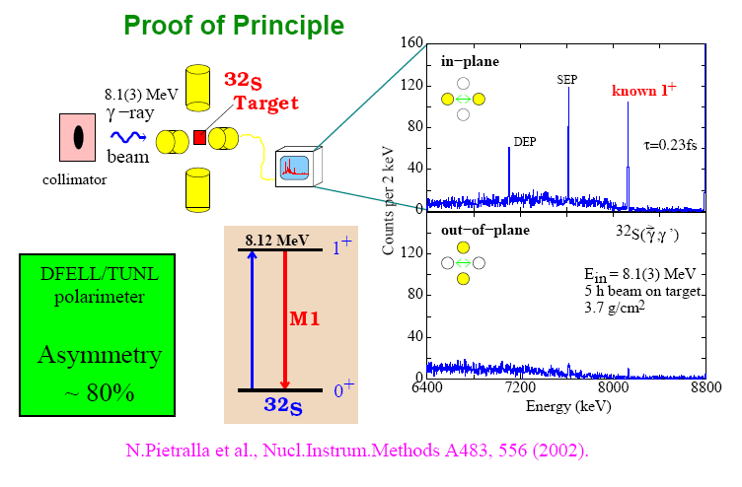
NRF Proof of Principle

Slide 21
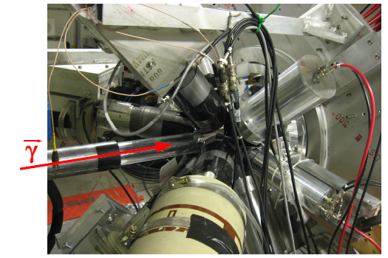
NRF Setup γ³ @ HIγS
The γ³ setup installed @ HIγS in summer of 2012.
4 x 60% HPGe
4 x 3”x 3” LaBr₃
4 x 1.5” x 1.5” LaBr₃

Slide 22
Photo-fission @ ELI-NP
Attila Krasznahorkay
Fadi Ibrahim
Dimiter Balabanski

Slide 23
Working group composition
Conveners: Attila Krasznahorkay (ATOMKI) and Fadi Ibrahim (IPNO)
Liaison: Dimiter Balabanski (IFIN-HH/ELI-NP)
Yield calculations: Phan Viet Cuong (Hanoi)
Photo-fission set-up (Exp1): Attila Krasznahorkay (ATOMKI)
  Design, simulations, detector characterization: Lorant Csige, Tomas Toruy (ATOMKI), Tudor Glodariu, Ioana Gheorghe (IFIN-HH)
IGISOL set-up (Exp2): Fadi Ibrahim (IPNO)
  IGISOL ion guide (Leuven vs. Carubu type): Piet Van Duppen (Leuven), Guy Savard (ANL), Dan Ghita (IFIN-HH)
  Mass separator (IPNO expertise): Luc Perrot (IPNO), Tiberiu Sava (IFIN-HH)
  Ion optics, ion guide coupling, beam transport: Serge Franchoo, Luc Perrot (IPNO), Tiberiu Sava (IFIN-HH)
  Laser ion source, atomic ionization schemes: Valentin Fedosiev (CERN), Raluca Marginean (IFIN-HH)
  Measurement stations (together with the fusion-fission working group)
  Collinear laser spectroscopy (not first priority): Deyan Yordanov (IPNO)
Spectroscopy set-up (Exp3): Dimiter Balabanski (IFIN-HH/ELI-NP)
  Detector arrangement, simulations (together with NRF working group)
  Ancillary detectors for lifetime and moment measurements: Georgi Georgiev (CSNSM)

Slide 24
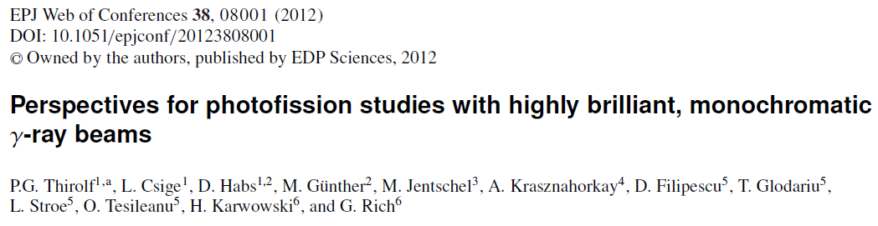

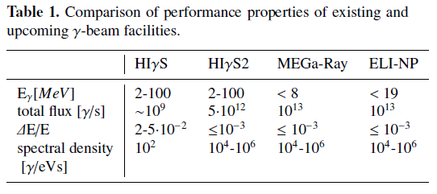

Slide 25
Photo-fission experiments
Physics goals
High-resolution photofission studies in actinides → investigation of 2nd, 3rd potential minima, angular and mass distribution measurements.
measurements of absolute photofission cross sections:
→ (monochromatic photons with variable energy required)
limited photon source intensity:
→ target thickness limited by finite range of fission fragments (ca. 8 mg/cm² in uranium)
→ multiple target-detector arrays needed
A. Krazsnahorkay, TDR γ-beam WS

Slide 26
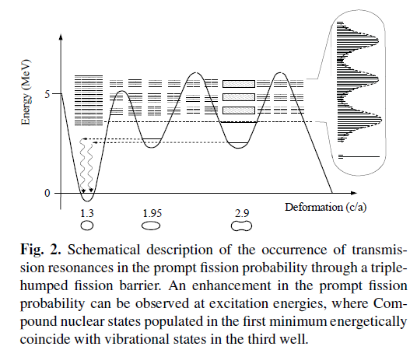

Slide 27
Let’s see what else we can squeeze from photofission?
In fission fragments share about 200 MeV and have angular momentum of 20ħ. The nuclear spin ensemble has oblate orientation with respect to the beam axis. The ions are emitted in a charge state around 20⁺.
Optional experiments
High-spin physics of exotic nuclei
ISOL studies of exotic nuclei

Slide 28
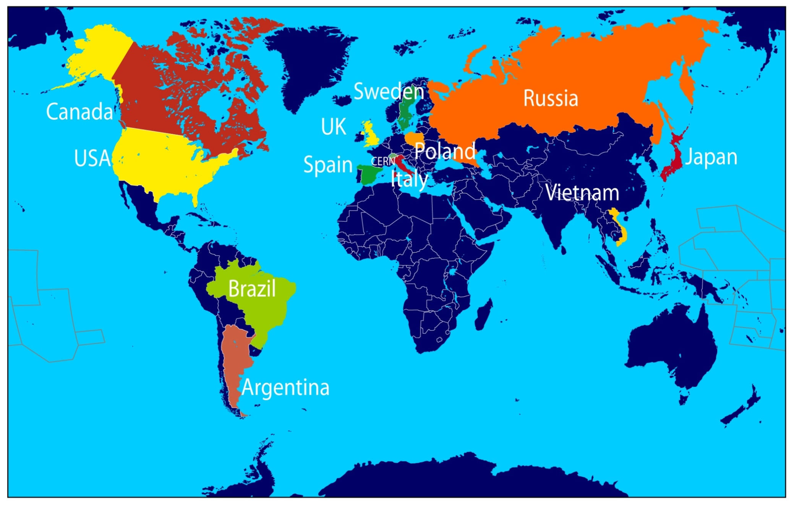
Niche: Studies of isotopes of refractory elements
Available
Projects
Dubna
Vancouver
Orsay
Riken
Kolkata

Slide 29
Elements of an IGISOL facility
Large acceptance ion guide
Laser ion source
Mass separator
Measurement stations
  β-decay station (also β-delayed neutrons)
  collinear laser spectroscopy
  mass measurements (multi-reflection trap)

Slide 30

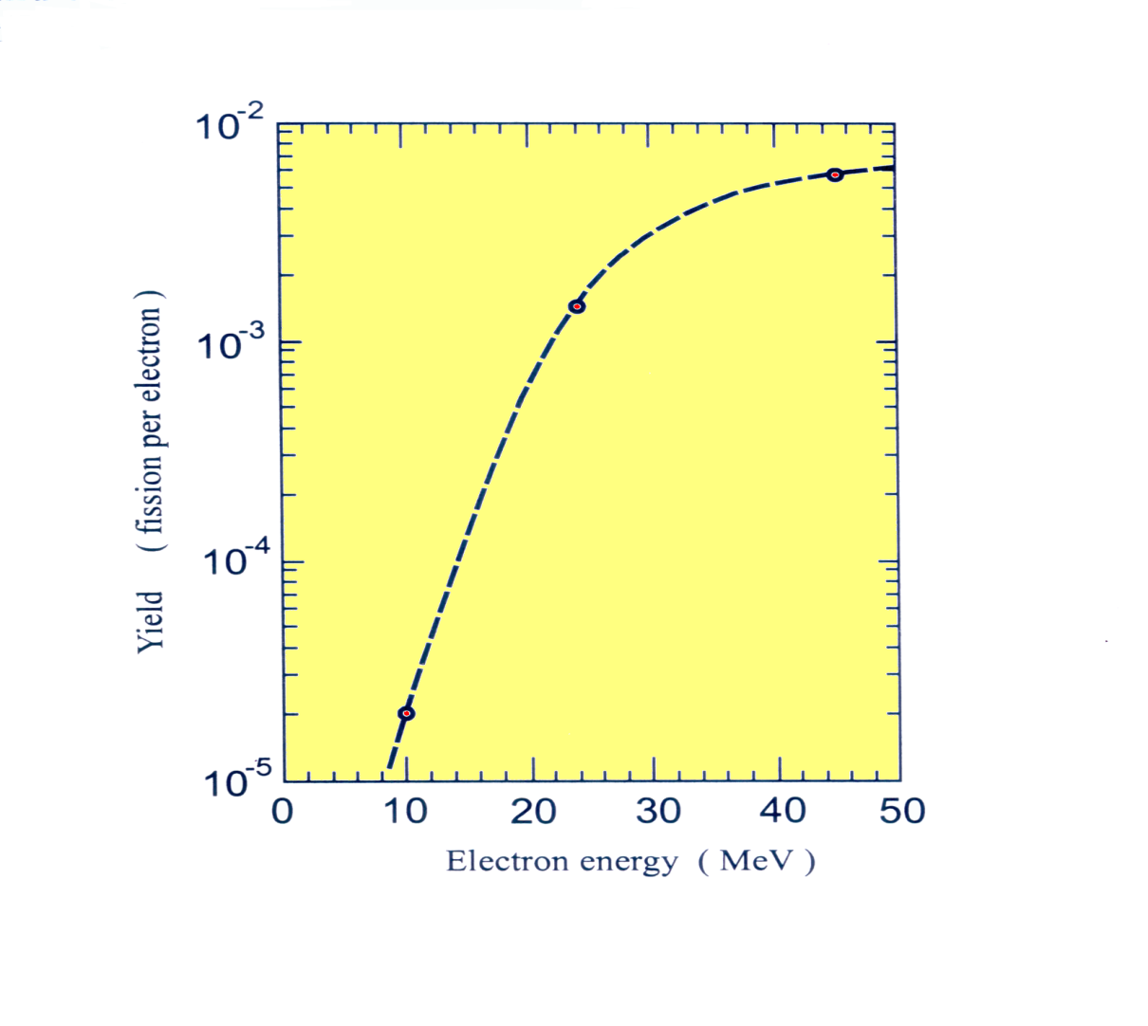
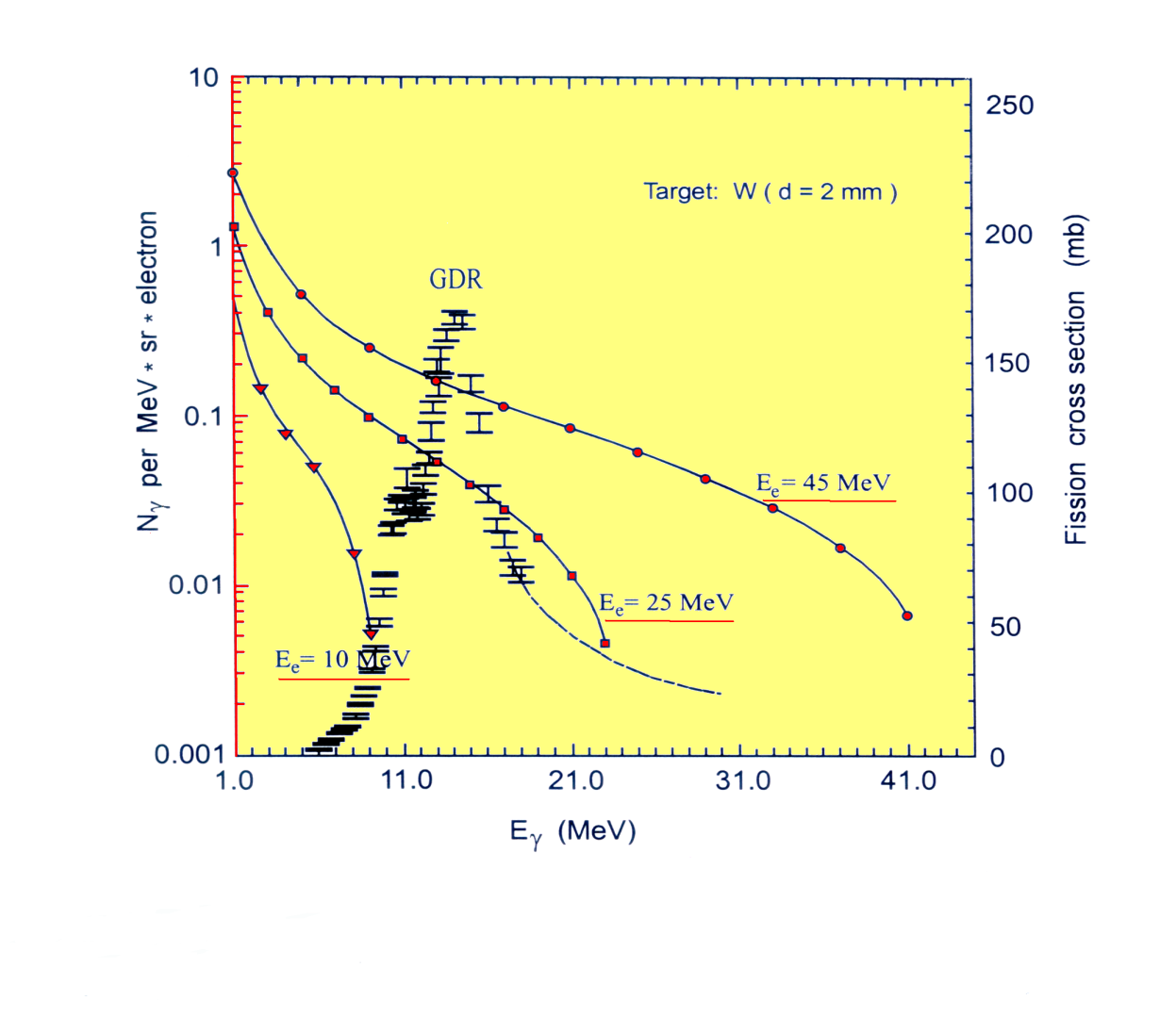
Production of fission fragments
by photo-fission ALTO
e– beam convertor target
With 10 µA electrons at 50 MeV at ALTO they have 1.6 10¹³ γ at 15 MeV

Slide 31

Production of fission fragments
by photo-fission at ELI
γ beam target
Φ = 1.4·10¹² γ/s
Will there be enough yield of fission fragments? Back-of-envelope calculation says that the yield is ≈10¹⁰ f/s.
Φ. s. N= Φ.6,4 10⁻³ f/s

Slide 32
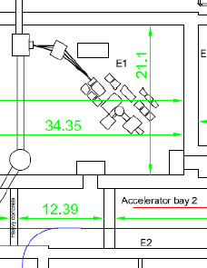

In-beam spectroscopy on a thick fissile target
IGISOL photo-fission facility
Common decay stations with laser fusion-fission experiment: β-decay , collinear spectroscopy and mass measurements

Slide 33

Nuclear Astrophysics at ELI-NP
Scope of the CPWG
Requirements for detection:
  Light Ions, A < 12, “0” – 10 MeV, up to a kHz.
  Photofission product, high Z, <10 MeV/u
  Total Energy (DE ~ 1%), Particle ID, Angle (DΘ < 5°)
  Position sensitive
  Tracking
  Diagnosis system
  4π
Three options of detectors:
  Bubble chamber
  [O]-TPC
  4π Silicon Strip Detector

Slide 34
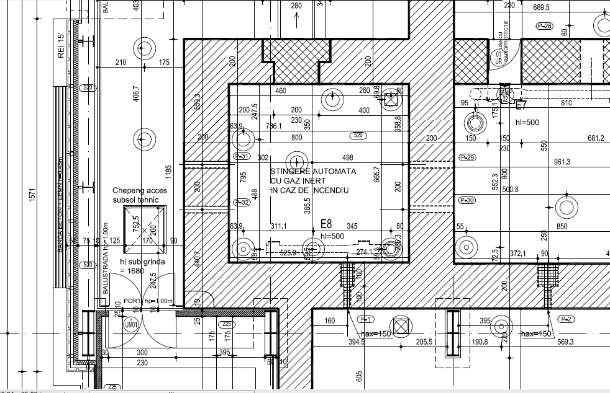
Footprint
BC
SSD
TPC
Total: about 14±4 m²

Slide 35
Finally
There are many scientific and technical challenges ahead of us. However, time is short and we need to find solutions now.
ELI-NP is open for collaborations. We are building a user community. Formal collaborations to be established through MoUs.
Cooperation between nuclear and laser physicists needs to be established, e.g. first unify the language (!)

Slide 36


