Slide 1
Single (few)-copy entanglement detection
Borivoje Dakić
A. Dimić and B. Dakić, Single-copy entanglement detection, njp Quantum Information 4, 11 (2018),
V. Saggio et al., Experimental few-copy multi-particle entanglement detection, arXiv:1809.05455, 2018.
Entanglement Days 2018, 26 -28 September, Budapest

Slide 2
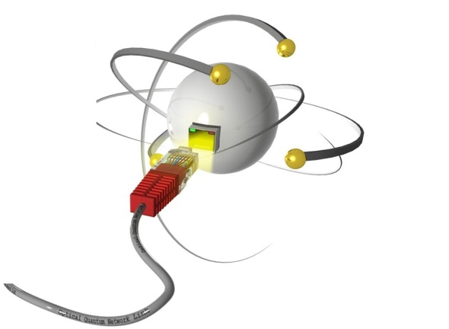
Benchmarking quantum devices
100110100011…
Classical
input
….1100101110
Classical
output
Coherent processing
Is the device functioning in the anticipated fashion?
Very improtant for developing scalable QIP
......
desirable

Slide 3
Typical questions
Does the prepared state contain desired quantum resource (e.g. entanglement)?
How far is the actual preparation from a target state?
Is there an efficient way to do a quantum state tomography?
Is the quantum device performing a correct information task?
Verification problem
THIS TALK
entanglement
property testing
state certification
tomography
quantum computing
quantum simulations

Slide 4
Conventional methods
Most popular: witness methods (Guhne&Toth2009)
STATE IS ENTANGLED IF $\left\langle W\right\rangle <0$
Source
Measurement
click
Measurement statistics: 0111011000001010100010101100....
Calculate relative frequency to estimate mean values
(or higher moments) of observables.

Slide 5
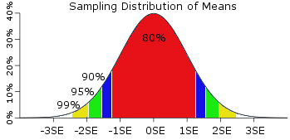
Conventional methods
Convergence to probability is guaranteed by the law of large numbers
The central limit theorem provides the error estimate (i.e. $\sim 1/\sqrt{N}$)
Requirement: large ensemble of independent and identically distributed (i.i.d.) copies of a quantum state.
Example (coin flip):
$ε=0.01$with 95% confidence
approx. N=2500 runs

Slide 6
But...
Large-scale quantum systems are very far from an idealized situation
Problem #1: Low production rate
EXAMPLE: 10-photon experiment, coincidence recorded every 5 min. in average (Wang et al, 2016)
Problem #2: IID assumption
Extremly hard to achieve due to lack of control and manipulation (e.g. source drift, decoherence)
Problem #3: Local accesability
EXAMPLE: Witness is usually a non-local operator and needs a local decomposition, i.e.
heavy demand on required resources
Problem #4: Statistical analysis
Growing number of parameters for modeling post-processing is hard
Size of system
Resources & control
Fundamental question:
How to perform reliable verification?
How to perform desired QIP?

Slide 7
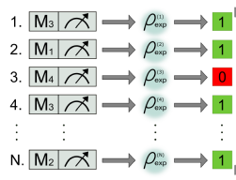
Probabilistic detection
Finite number of copies prob. detection
Reliable framework that:
detects entanglement with an exponentially growing confidence in the number
of copies of the quantum state,
is implemented via local measurements only, and
does not require the assumption of I.I.D. experimental runs.
Chose the set of local binary observables: {M₁, M₂, M₄,….}, i.e. M_{k} =0,1
Random sampling with prob. $ε_{k}$
Repeat N times and count # of successes (1’s)
Bound on probability of success:
$p_{s}$ for all separable states and $p_{e}$ for some
entangled (target) state
$$p_{e}−p_{s}>0$$
Observed deviation from the separable bound

Slide 8
Translating entanglement witnesses into the probabilistic framework
Given a finite # of detection events, what is the statistical evidence that $\left\langle W\right\rangle >0$ is violated?
Equivalent form:
Sep. condition:
Local dec.:
Equiv. transformation: ${W′}_{k}^{}→W_{k}+a 1≥0$
Ent. value:
with
Eigen decomposition:
Binary observables
Non-negative numbers
Probability of success:
Renormalize to get sampling prob.
Sampling prob.:

Slide 9
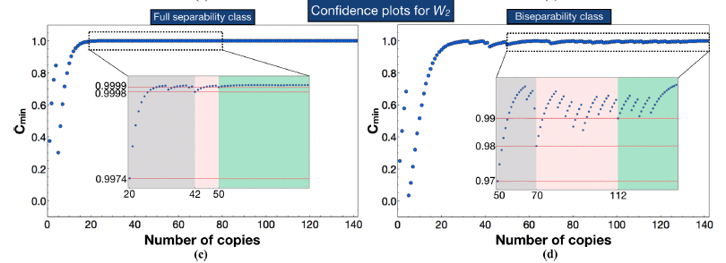
Examples
Graph state:
Sep. bound:
Ent. value:
Local dec.:
Binary obser.:
Uniform sampling:
To achive the confidence of 99% we need 16 copies of the graph state only!
Experimental 6-qubit photonic graph state:
SOME ENTAGLEMENT | GENUINE 6-QUBIT ENTANGLEMENT
$$≈20 copies$$ | $$≈100 copies$$

Slide 10
Single-copy regime
What do we learn from a single exp. run?
„0“
One bit of information
(M. Zukowski: given result „1“,
we can say that the system
was not prepared in „0“)
1 qubit
„1“
N qubits
….
N bits of information: 1 1 0 1 0 0 ….
Still chance to say something non-trivial (provided that N is large)!
Sufficient data to do statistical tests, e.g. : Is #1>#0?

Slide 11
Classical Example
Fair coin:
1
0
50%
50%
Tossing large # of coins simultaneously (e.g. 10 coins)
Analogy to entanglement: Are the coins correlated?
1
1
1
1
1
1
1
1
1
1
0.1% chance for all heads with independent fair coins!
Certify correlations with 99.9% from a single run!

Slide 12
Cluster states
Linear cluster state (LCS):
ZXZ=1
ZXZ=1
ZXZ=1
Unique property:
….
ZXZ=1
ZXZ=1
ZXZ=1
Ground state: $H=Z_{1}X_{2}$ $Z_{3}+Z_{2}X_{3}$ $Z_{4}+Z_{3}X_{4}$ $Z_{5}+…$
Via generators:

Slide 13
Cluster states
4-qubit cluster
LCS state:
Separable state:
$$P[G_{2}=G_{3}=G_{2}G_{3}=+1]≤\frac{2}{3}$$
Locally incompatible
Random partitioning into 4-qubit clusters:
Overlap on border qubit is allowed
G2 G2 G3 G2 G2G3 G3 G2G3….
Random sampling from {G2,G3,G2G3}
IF G=+1 „success“
Overall cost function:
$$IF \#Success≥\left(\frac{2}{3}+δ\right)N$$
„SUCCESS“
Never happens for separable states
Target-state preparation: One copy of 24-qubit LCS suffcies to verify entanglement with >95%!

Slide 14
Summary
Translation of the witness method into resource-efficient prob. verification
Scalability issues?
“Single-copy” entanglement detection (cluster states in any dimension, ground states of local Hamiltonians)
Framework can be used for quantum state verification
Extension to a broader class of quantum states
Mean value extraction
Operational meaning of entanglement in a „single-copy“ regime
Thank you for
your attention!
Aleksandra
Dimić
Valeria Saggio

