Slide 1
Quantum randomness caused by chaotic dynamics of detectors
Nonlinear unitary quantum collapse model with self-generated noise
J.Phys.A 51, 175308 (2018)
Tamás Geszti, Eötvös University, Budapest
Entanglement Days 2018 Budapest

Slide 2
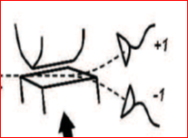
Quantum phenomena, as we see them, are nonlinear
Schrödinger equation is linear
?????
MEASUREMENT: randomness, Born’s rule - nonlinear
Copenhagen interpretation
is an extremely successful phenomenology – anything behind it?

Slide 3
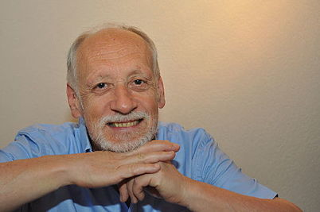
Ghirardi-Rimini-Weber 1986 CSL
randomness put in by hand:
external noise
or measurement everywhere (Diósi)
Nicolas Gisin: SIGNALING
caused by nonlinearity
CSL finds a way to treat nonlinearity

Slide 4
Looking for an all-deterministic ”psi-ontic” approach, but…
Bell – CHSH tests:
Local realism is excluded
„LOCAL” means: measurement outcomes determined by the state of the incoming particles
Way out: multi-local realism:
outcomes determined by the initial state(s) of incoming particles AND detectors!
Philosophically inconvenient but unavoidable…

Slide 5
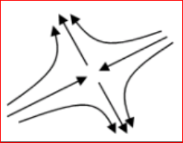
Deterministic, but unpredictable:
commonplace in CLASSICAL CHAOS
Hyperbolic fixed points of nonlinear dynamics –
„God’s simplest DICE”

Slide 6
THE FRAMEWORK:
Incoming particles
after strong separation into state
on measurement-defined basis
…

Slide 7


meets detector setup
in initial waiting state
After quick particle-detector interaction:
entangled state vector of all detectors
constant, if linear;
pumping, if not!

Slide 8

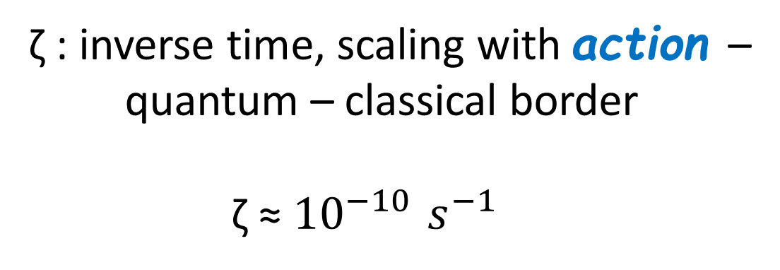
Pumping is needed to describe collapse
while preserving unitarity.
This can do it:
ζ : inverse time, scaling with action –
quantum – classical border
ζ ≈ ${10}^{−10 }s^{−1}$
avalanche photon detector: charge, voltage, firing time

Slide 9

UNITARITY!
Just look: no decoherence!
Chaotic looks random: stochastic modeling…
Pearle 1982: „gambler’s ruin” game
Born’s rule
ONLY IF FAIR GAME!

Slide 10
Brunner et al. (Gisin school) RMP 2014:
whatever reproduces Born’s rule is
non-signaling
-- as far as statistics concerned
(Bell, GHZ etc are OK).
Individual events ????

Slide 11
So, everything happens locally?
No: are global factors!

Slide 12
OUTLOOK
Nanomechanics – including non-measurement situations
Superconducting circuits with superconducting nanowire photodetectors…
1/f noise ….
Semiclassical gravity…

Slide 13
CONCLUSIONS
Deterministic-chaotic nonlinear quantum dynamics can give account of randomness in measurement,
obeying Born’s law.
Local events are controlled by global weights
STILL SPOOKY, ISN’T IT?
NON-MEASUREMENT situations?
Randomness yes, Born’s rule no
unlike in CSL
1/f noise?

Slide 14
Moral: be cautious, don’t be afraid
In physics, axioms are prejudices.
Thanks Lajos Diósi, Lev Vaidman

