Slide 1

Phi, fa, virág
Egy csokor gyorsító
Lehoczki Gábor
Silicon Computers Kft.
www.silicon.hu

Slide 2






SGI Strategy and Focus
Business
Applications
Big
Data
High Performance Computing
Business Computing
HPC
Redundancy
Speed & Scale

Slide 3
Nvidia Tesla sorozat
Features | M2075 | M2090 | K10 | K20 | K20X
Number and Type of GPU | 1 Fermi GPU | 1 Fermi GPU | 2 Kepler GK104s | 1 Kepler GK110
Peak double precision floating point performance | 515 Gigaflops | 665 Gigaflops | 190 Gigaflops | 1.17 Tflops | 1.31 Tflops
 |  |  | (95 Gflops per GPU)
Peak single precision floating point performance | 1030 Gigaflops | 1331 Gigaflops | 4577 Gigaflops | 3.52 Tflops | 3.95 Tflops
 |  |  | (2288 Gflops per GPU)
Memory bandwidth | 150 GBytes/sec | 177 GBytes/sec | 320 GB/sec | 208 GB/sec | 250 GB/sec
(ECC off) |  |  | (160 GB/sec per GPU)
Memory size (GDDR5) | 6 GB | 6 GB | 8 GB | 5 GB | 6 GB
 |  |  | (4 GB per GPU)
CUDA cores | 448 | 512 | 3072 | 2496 | 2688
 |  |  | (1536 per GPU)

Slide 4
Intel® Xeon Phi™ Coprocessor
 | 5110P | 3120A | 3120P | 7120P | 7120X | 5120D
Code Name | Knights Corner
Launch Date | Q4'12 | Q2'13 | Q2'13 | Q2'13 | Q2'13 | Q2'13
# of Cores | 60 | 57 | 57 | 61 | 61 | 60
Clock Speed | 1.053 GHz | 1.1 GHz | 1.1 GHz | 1.238 GHz | 1.238 GHz | 1.053 GHz
Peak double precision floating point performance |  |  |  |  |  | 1.011 TFlops
Peak single precision floating point performance |  |  |  |  |  | 2.022 TFlops
Cache | 30 MB | 28.5 MB | 28.5 MB | 30.5 MB | 30.5 MB | 30 MB
Max TDP | 225 W | 300 W | 300 W | 300 W | 300 W | 245 W
Max Memory Size | 8 GB (16 channels) | 6 GB | 6 GB | 16 GB | 16 GB | 8 GB
Max Memory Bandwidth | 320 GB/s | 5 GB/s | 5 GB/s | 5.5 GB/s | 5.5 GB/s | 5.5 GB/s

Slide 5
CPU - GPU - MIC

Slide 6
Processzor ellátása adatokkal
Cache
RAM
SMP
PCI
Sebesség (log)
IB
SAS
SATA
Ethernet
kapacitás (logaritmikus skála)

Slide 7
Processzor ellátása adatokkal
GPU/MIC
Cache
RAM
SMP/ccNUMA
SMP
PCI
cluster
Sebesség (log)
IB
SAS
SATA
Ethernet
kapacitás (logaritmikus skála)

Slide 8
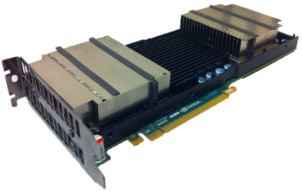
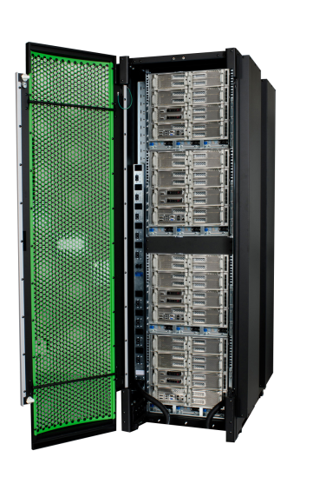
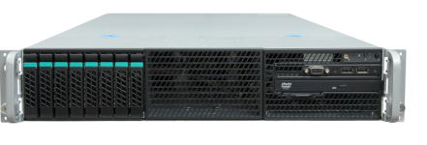
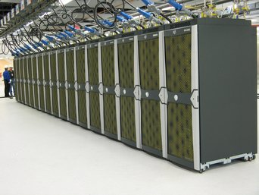
Adatelérési sebesség vs. kapacitás
GPU
MIC
2/4 slot
server
sebesség
ccNuma
(SMP)
cluster
kapacitás
5-16GB 386GB 64TB ….PB

Slide 9


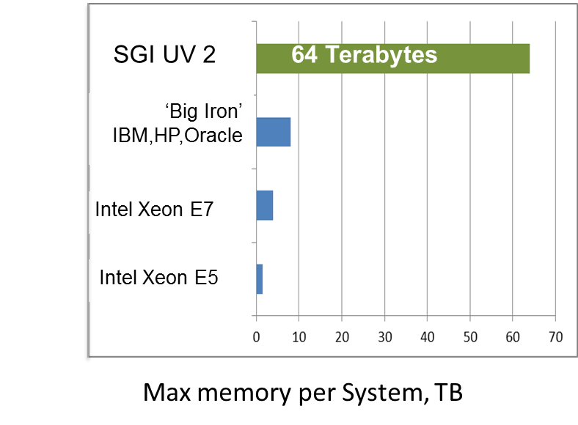



SMP/ccNUMA vs cluster/GPU/MIS

Slide 10
Program fejlesztési költség
GPU
„standard”
MIC
Cluster
MPI
GPU
MIC
2 slot
XEON box
sebesség
ccNuma
(SMP)
cluster
kapacitás

Slide 11
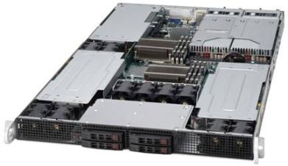
SGI Rackable® C1104G-RP5
Chassis Profile | 1U standard-depth
Servers/System | One dual-socket
Chipset | Intel® C600
Max. Processors | Two Intel® Xeon® E5-2600 Two Intel® Xeon® E5-2600 v2
Max. CPU TDP | 115W
Memory Slots | 8 DIMM slots
Memory Type | 1866/1600/1333/1066/800 MHz DDR3 ECC Reg
Max. Hard Disk Drives | 4 x 2.5" drives
Expansion Slot | Three PCI-E 3.0 x16 (two internal and one external) double-width slots One external PCI-E 3.0 x8 low-profile slot
Networking (Onboard) | Dual-Port GigE controller (Intel® I350)
IPMI Remote Management | Integrated IPMI 2.0
Power Supply | 1800W Redundant* Platinum Level
Compute GPU/ Co-processor support:
Tesla M2075, M2090**, K10, K20, Xeon PHI
NVIDIA graphics GPU support:
Quadroplex 7000
**130W standard Max CPU TDP. 135W CPU TDP with ambient temp. restrictions
*Redundant per configuration

Slide 12
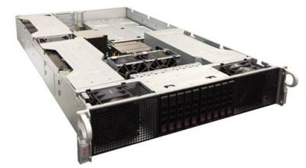
SGI Rackable® C2110G-RP5
Code Name | “Pyramid 2U”
Chassis Profile | 2U standard-depth
Servers/System | One dual-socket
Chipset | Intel® C600
Max. Processors | Two Intel® Xeon® E5-2600 Two Intel® Xeon® E5-2600 v2
Max. CPU TDP | 130W
Memory Slots | 8 DIMM slots
Memory Type | 1866/1600/1333/1066/800 MHz DDR3 ECC Reg
Max. Hard Disk Drives | 10 x 2.5” drives
Expansion Slot | Four internal PCI-E 3.0 x16 double-width One external PCI-E 3.0 x8 low profile and one PCI-E 2.0 x4 full height
Networking (Onboard) | Dual-Port GigE controller (Intel® I350)
IPMI Remote Management | Integrated IPMI 2.0
Power Supply | 1800W Redundant** Platinum Level
Compute GPU/ Co-processor support:
Tesla M2075, M2090, K10, K20, Xeon PHI
NVIDIA graphics GPU support:
Quadroplex 7000
**Redundant per configuration

Slide 13
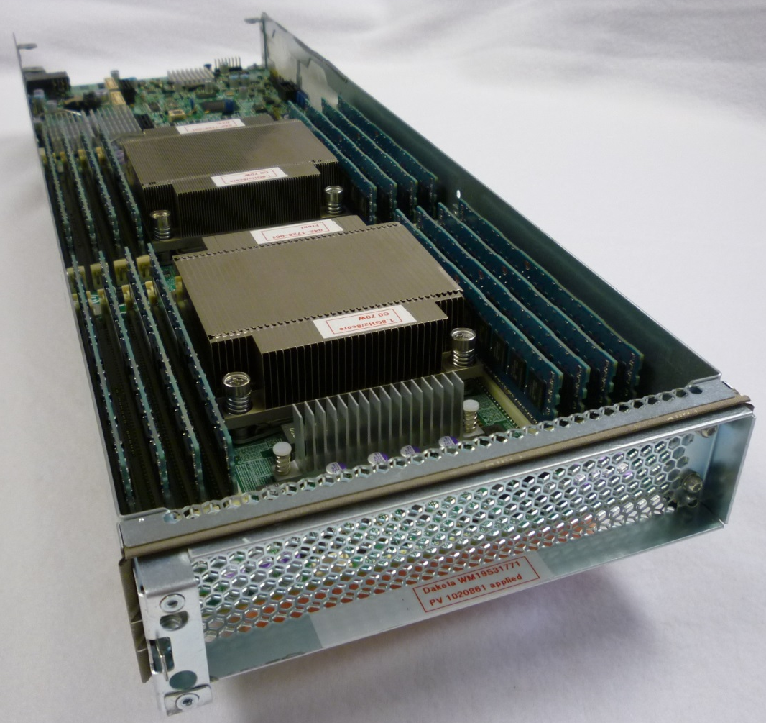
SGI Altix ICE X (cluster)

Slide 14
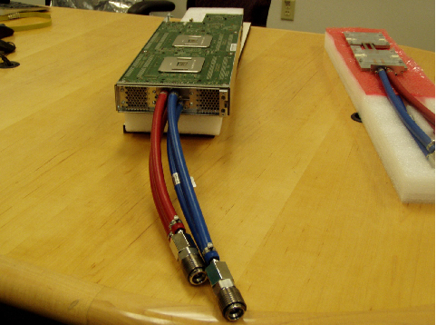
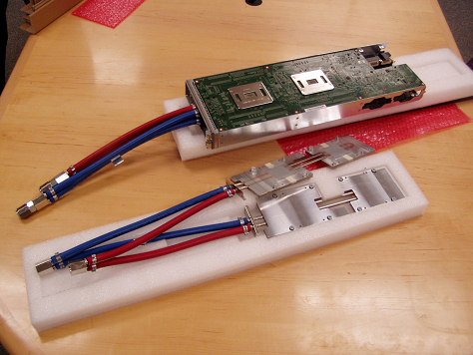
SGI ICE vízhűtéses XEON+PHI blade

Slide 15
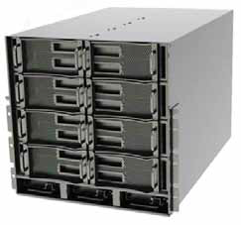
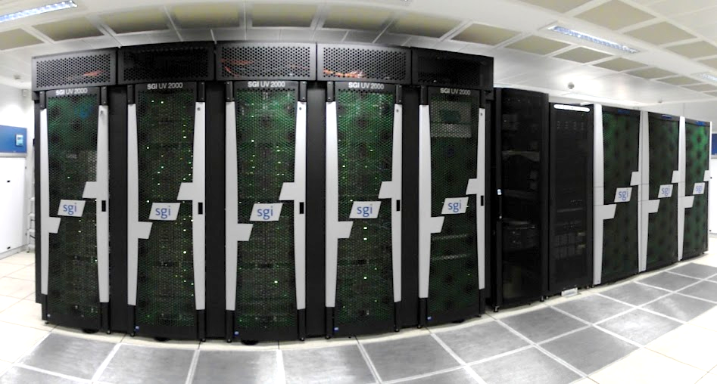
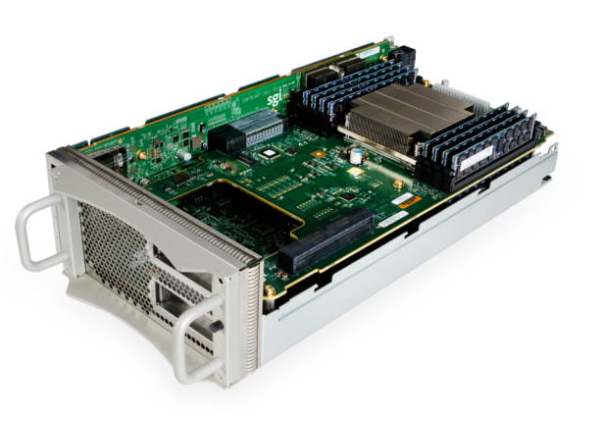
SGI UV2000 – az egyetlen „nagygép”
Az egyetlen SSI (single system image)
géptípus 4 processzor felett
4-256 XEON slocket
1-64TB ram
Linux o.s.

Slide 16
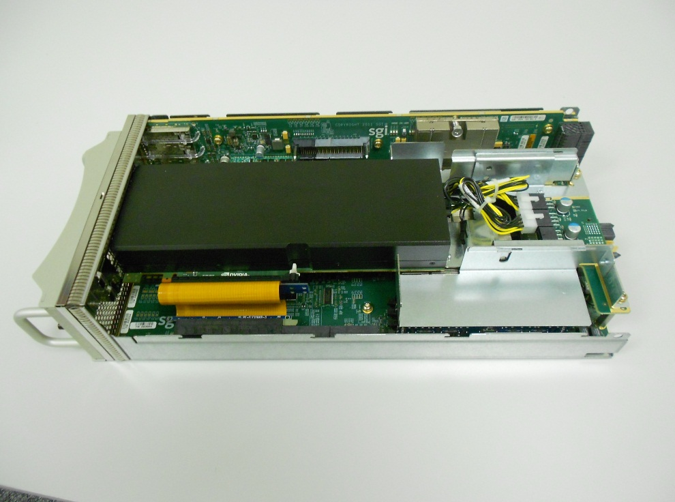
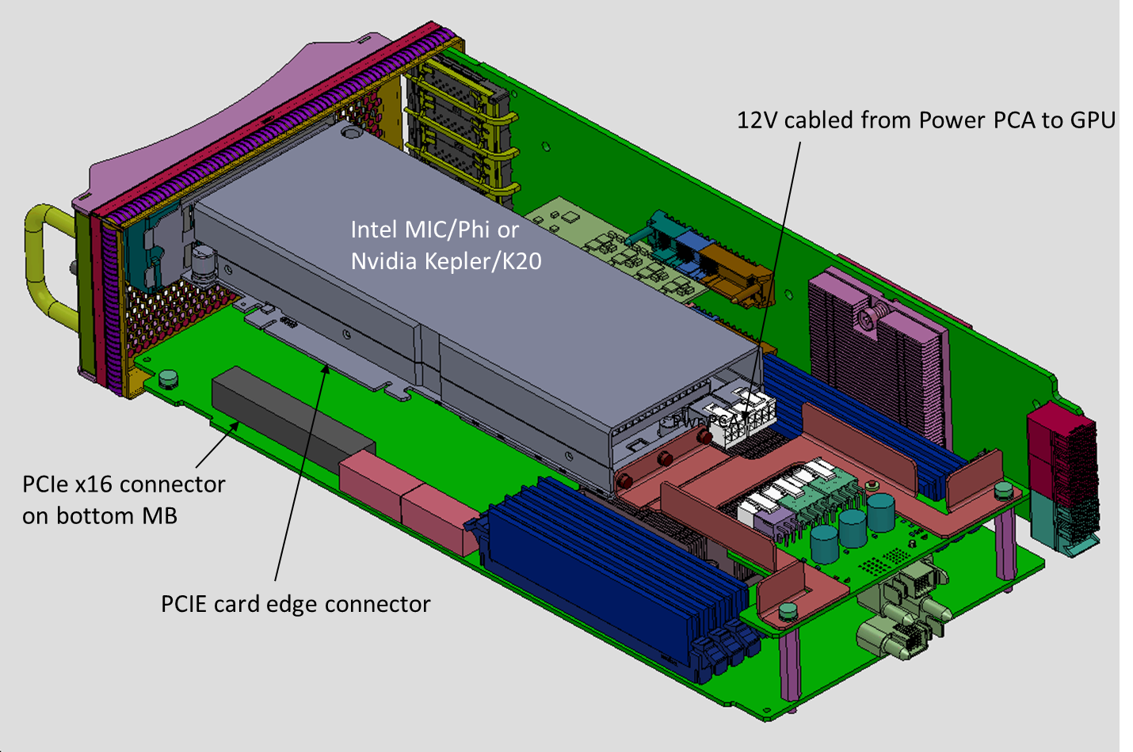
UV 2000 “MG” Blade
Skálázhatóság:
Phi: 32 kártya
K20: 8(16) kártya

Slide 17
Próbálja ki!
A hazai felsőoktatás és kutató intézetek számára a NIIF által biztosított nagygépek:
Cluster: SGI ICE
Debrecen (18TFlops, 1536 core; 6TB ram)
Cluster + GPU: HP
Szeged (14TFlops, 2304 core; 5,6TB ram, 6xM2070)
SMP/ccNUMA: SGI UV
Pécs (10TFlops, 1152 core, 6TB ram)
http://www.niif.hu/szolgaltatasok/szuperszamitastechnika/altalanos_ismerteto

