Slide 1
Turning software into computer chips - Hastlayer
Zoltán Lehóczky @ Lombiq
AIME18 29.10.2018

Slide 4
Warning
Hastlayer is currently in alpha stage!

Slide 5
What’s Hastlayer?

Slide 6
computer program → computer chip (hardware)

Slide 7
logic expressed as software → logic expressed as hardware

Slide 8
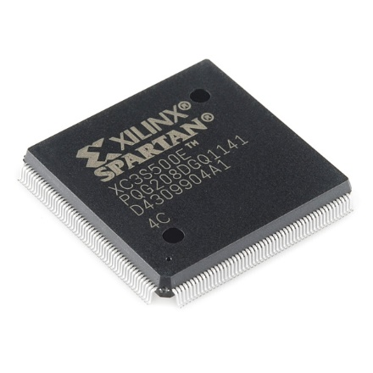
…with FPGAs
Field-Programmable Gate Array
Can behave like any other chip (with limitations)
Can dynamically be „re-wired”
Image by SparkFun Electronics, Boulder, USA

Slide 9
computer program → FPGA logic

Slide 10
.NET (C#, VB, C++, F#, Python, PHP, JavaScript…) → FPGA logic

Slide 11
What’s the point?

Slide 12
CPU vs GPU vs FPGA

Slide 13
But!

Slide 14
The benefits of FPGAs for us all
Performance increase for parallel compute-bound algorithms
Higher power efficiency
Still only software development

Slide 15
Demo: Hands-on Hastlayer

Slide 16
Wrapping up

Slide 17
What’s next?
Posit floating point (https://hastlayer.com/arithmetics)
More use-cases, also scientific ones with Wigner
HPC-ready (also with Wigner)
FPGAs in every datacenter (AWS, Azure, Intel)

Slide 18
I like this, how do I start?
Check out the SDK: https://github.com/Lombiq/Hastlayer-SDK/
Be ready for an FPGA-filled future!

Slide 19
Are you ready to *be* the hardware?
zoltan.lehoczky@lombiq.com
https://hastlayer.com
https://github.com/Lombiq/Hastlayer-SDK/
https://lombiq.com

