Slide 1
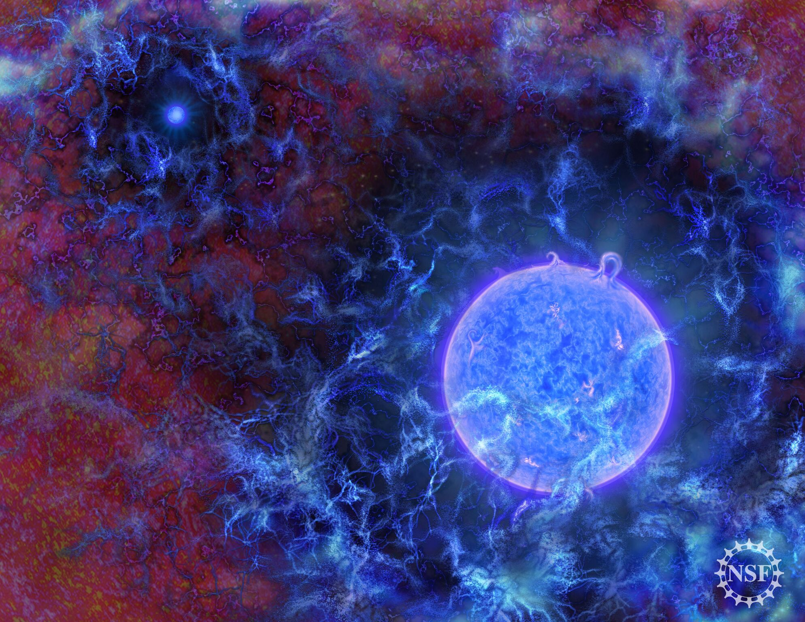
The Nucleosynthesis of First Stars
Primordial Elements
First Star Nucleosynthesis
Experimental Needs & Tools
First Model Results
Michael Wiescher
University of Notre Dame
Joint Institute for Nuclear Astrophysics –
Center for the Evolution of the Elements JINA-CEE
Credit: NSF

Slide 2
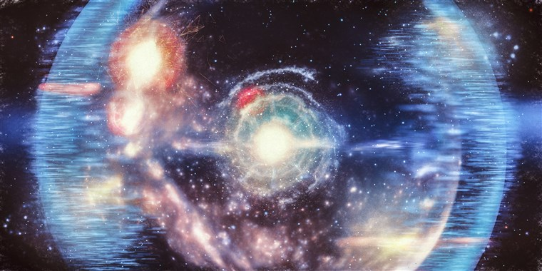
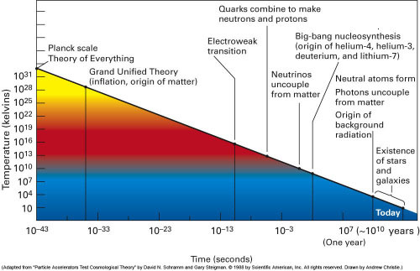
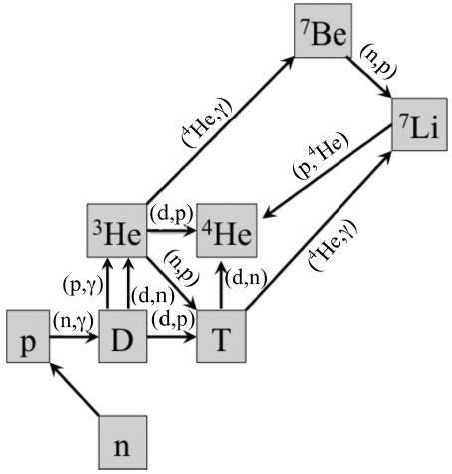
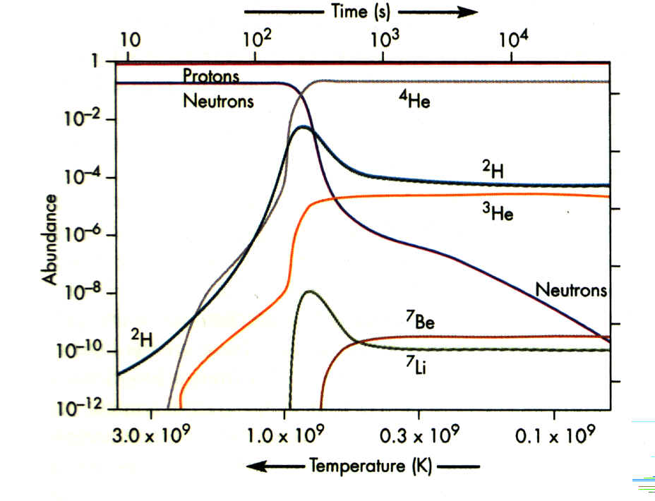
Big Bang Nucleosynthesis
Plank time
Neutrino decoupling
Onset of nucleosynthesis with the freeze out of deuterium photo-dissociation
Inflation
Quark confinement
deuterium freeze-out
Photon decoupling
stars

Slide 3
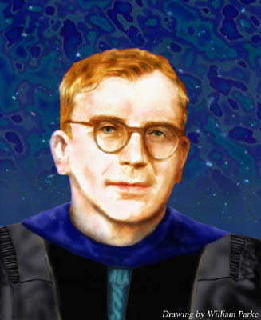
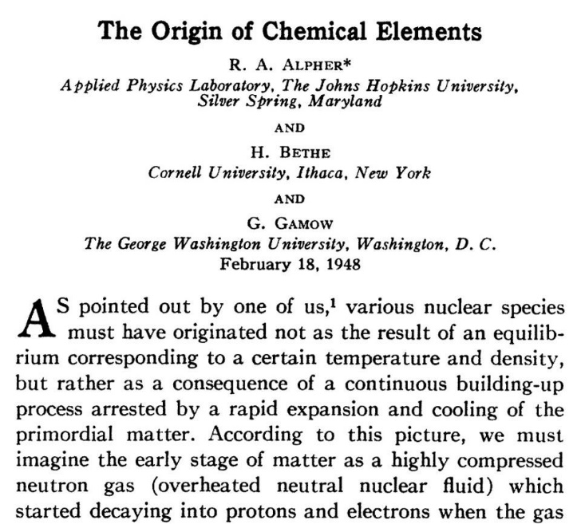
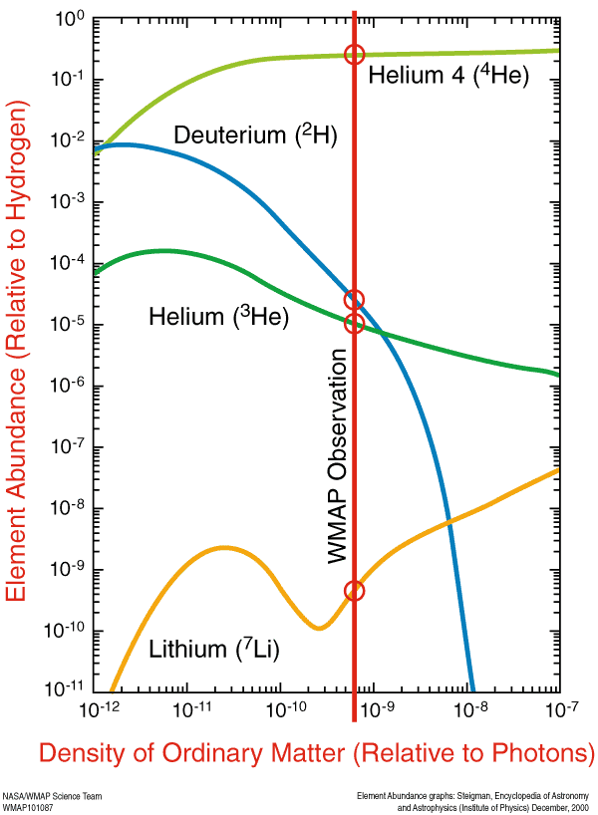
Gamow Big Bang inhibited
up to Uranium
by the mass 5 and mass 8 gap which cannot be bridged by charged particle capture (p, d, τ, α) reactions in a rapidly expanding environment of temperature and density conditions!

Slide 4
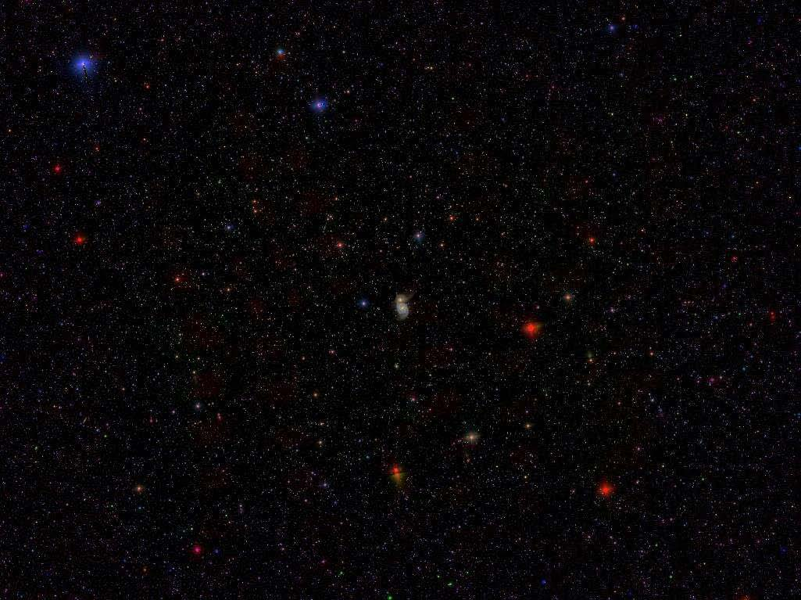
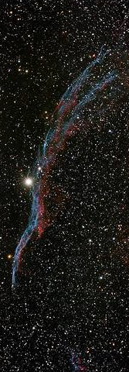
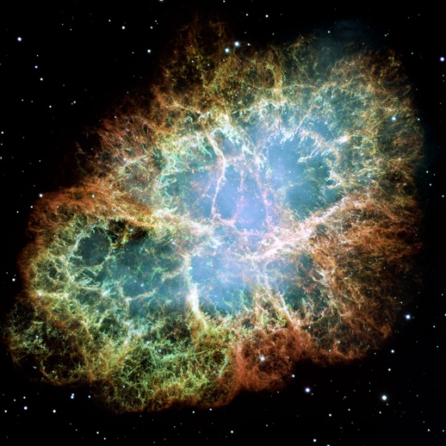
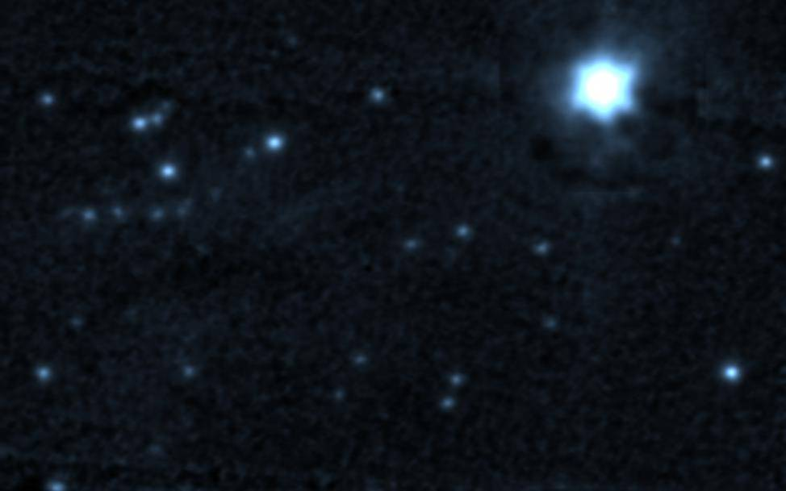
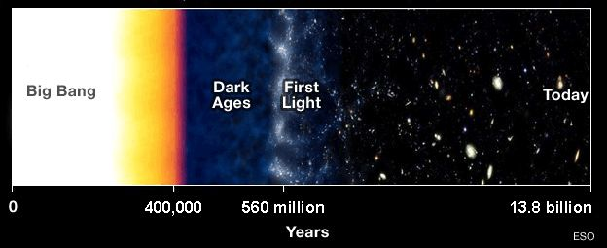
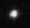
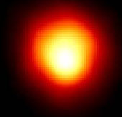
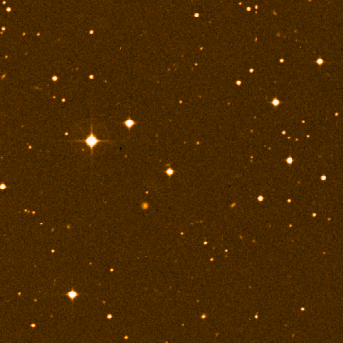
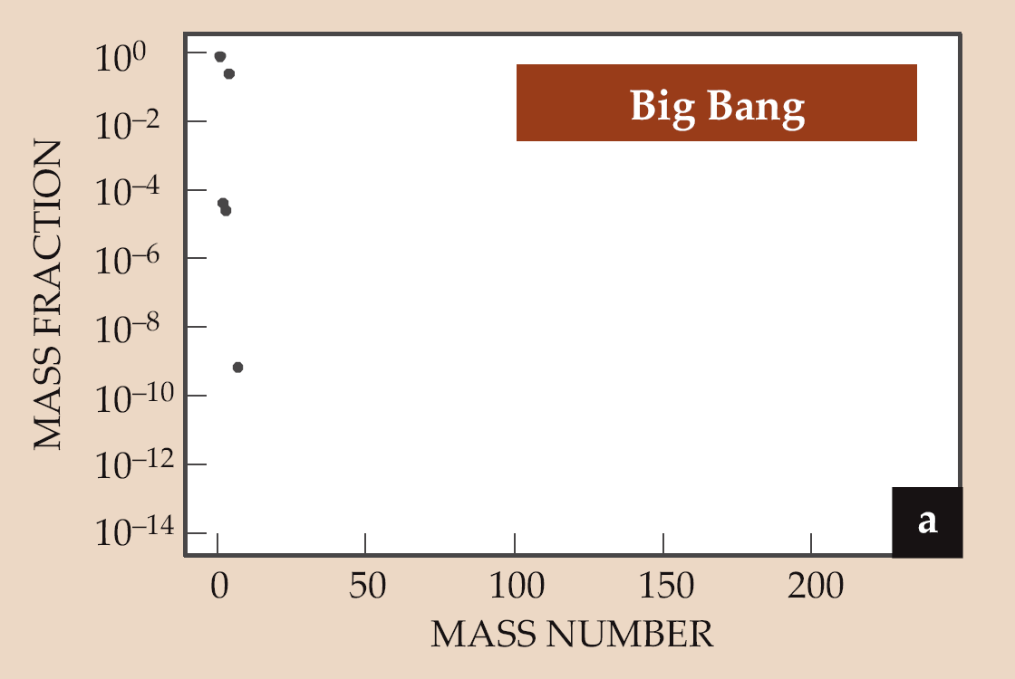
Galactic Chemical Evolution
First Stars

Slide 5
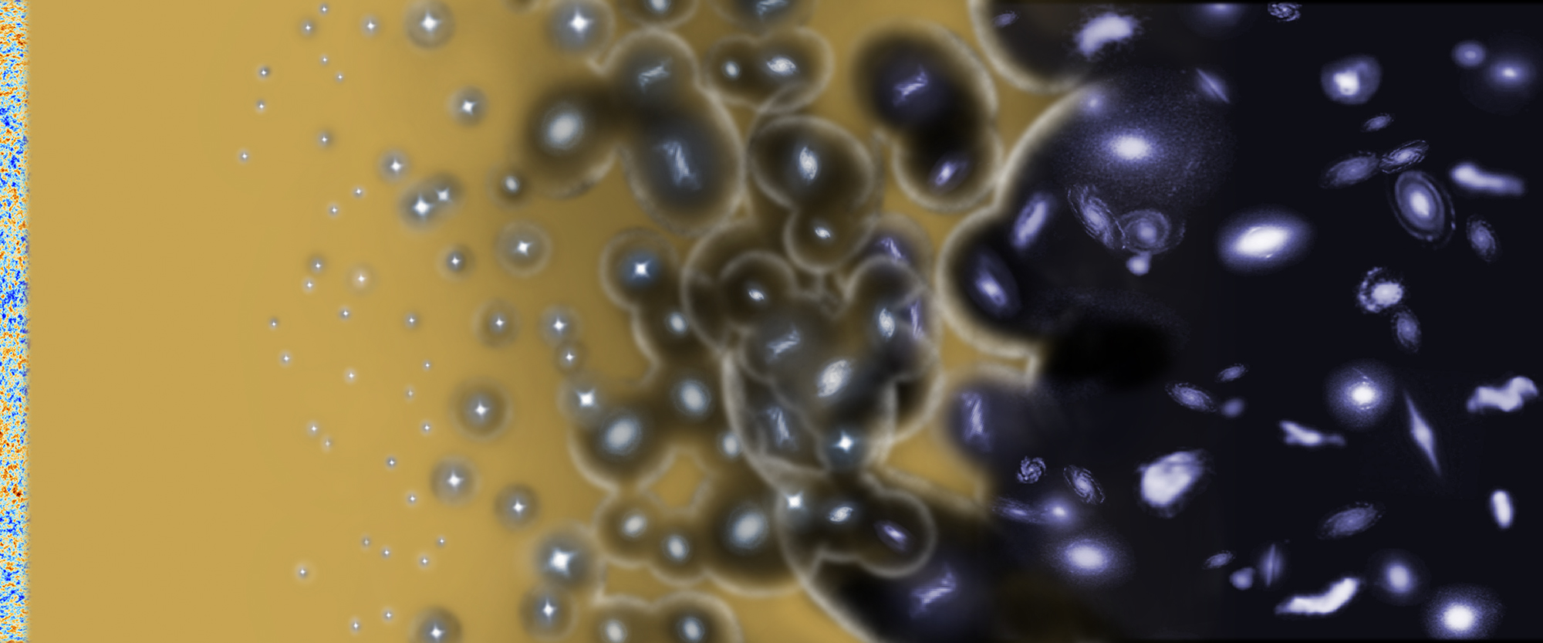
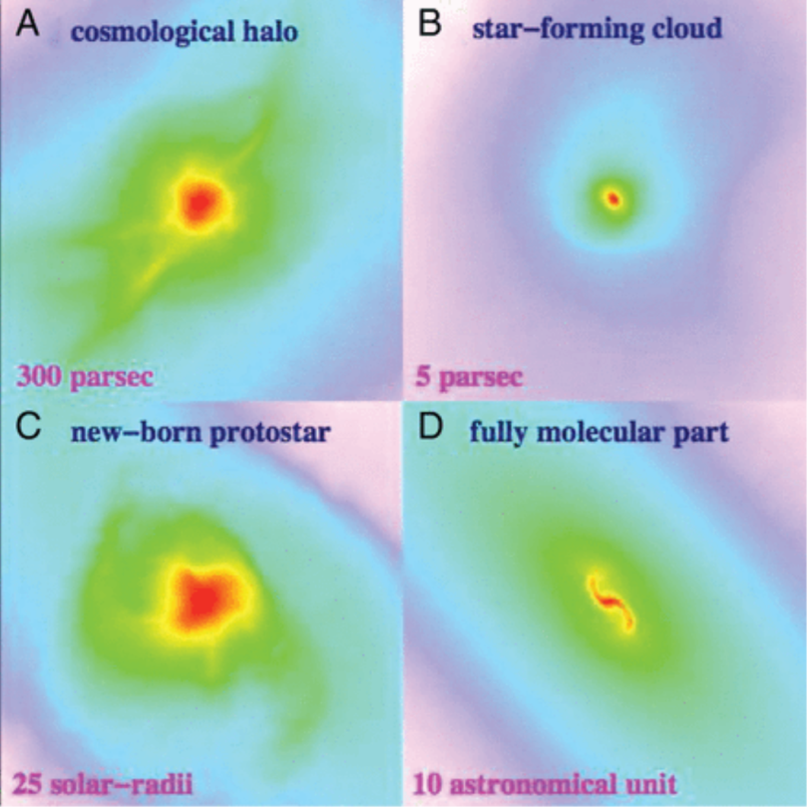
Emergence of First Stars

Slide 6
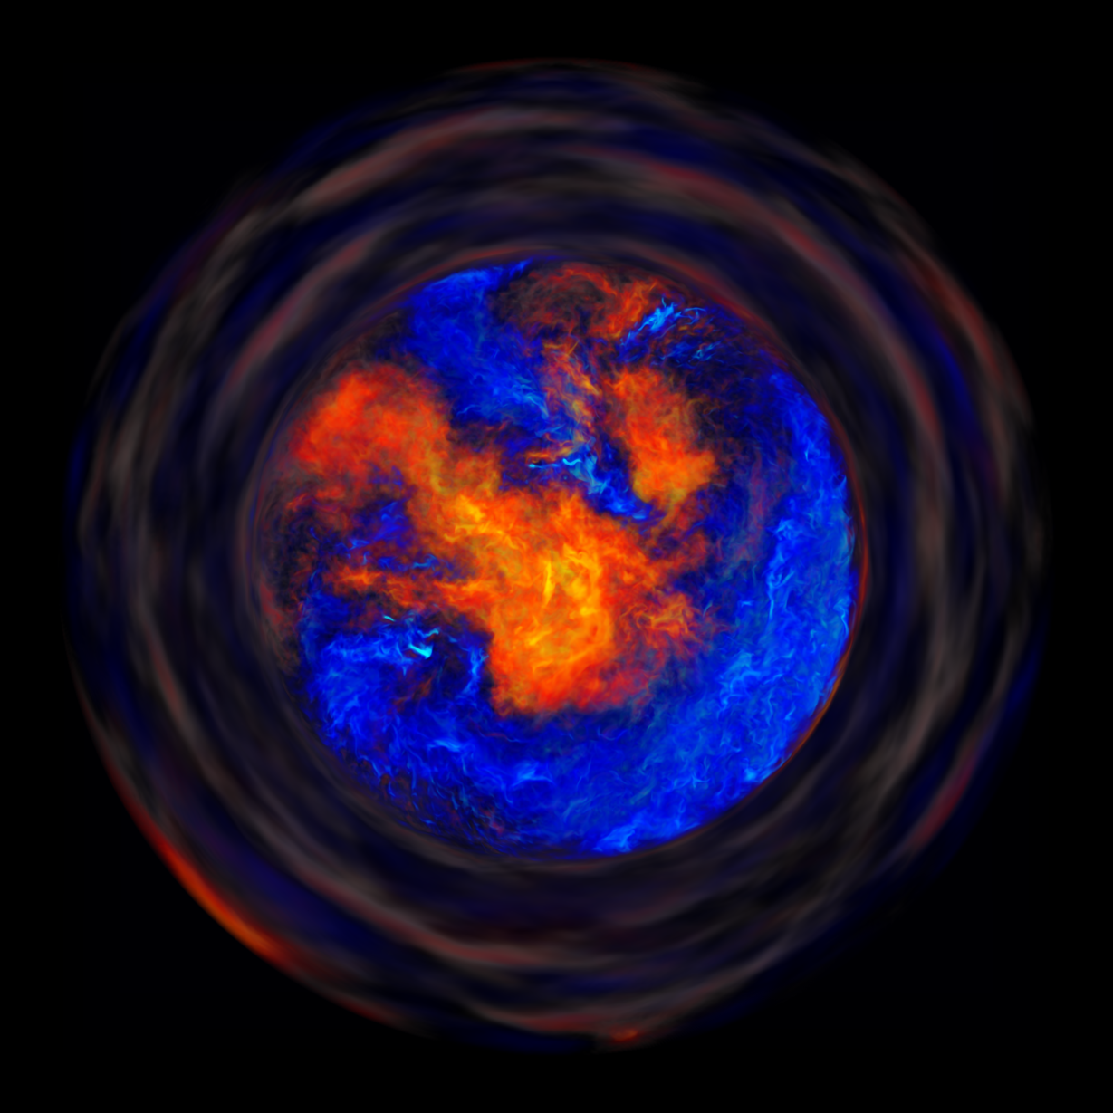
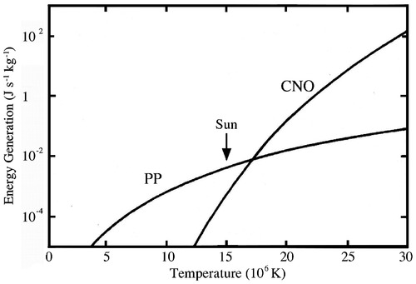
First generation stars
They are made of primordial material
They are very massive (100-1000 M)
They contract under gravitational force
No CNO cycle to generate the energy release and internal pressure for stabilization
Collapse to form first supernovae
How can carbon be formed?
NuGrid model, courtesy Falk Herwig

Slide 7
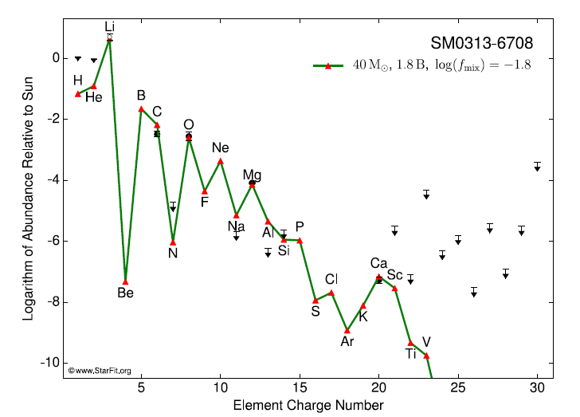
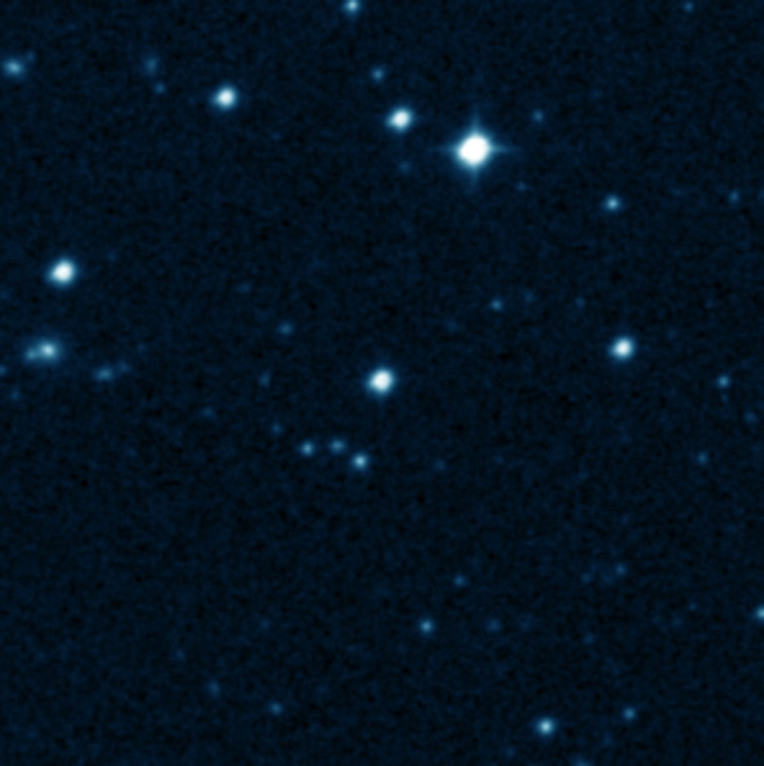
Early Stars and Early Element Synthesis
The element abundance pattern for SMSS 0313–6708 compared
to model values.
SC Keller et al. Nature 000, 1-4 (2014) doi:10.1038/nature12990
How are the first heavy elements being formed, what are the subsequent steps in the cosmo-chemistry in first stars?

Slide 8
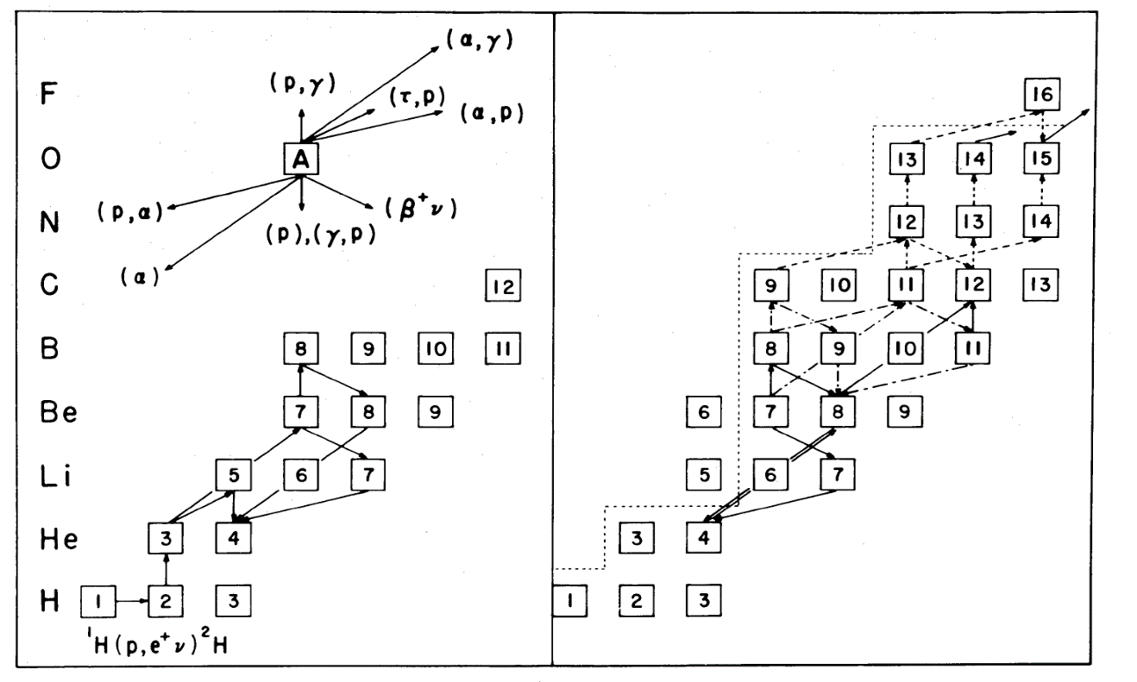
Modes of converting primordial isotopes
The pp chains are too slow (no ¹²C, no CNO ) for stabilizing a massive
1st generation star → hot pp-chains, deuteron cycle, triple alpha process!
Three ways to by-pass the mass 5 and mass 8 gaps:
hot pp-chains
⁴He(2α,γ)¹²C
Alpha clusters as catalytic
compound structure
⁴He(d,γ)⁶Li(α,γ)¹⁰B(α,d)¹²C
pp-chains
Deuterons as catalyst isotope
³He(α,γ)⁷Be(α,γ)¹¹C(p,γ)¹²N(β⁺ν)¹²C
High temperature density advantage

Slide 9
Experimental Challenge
Gamow range

Slide 10
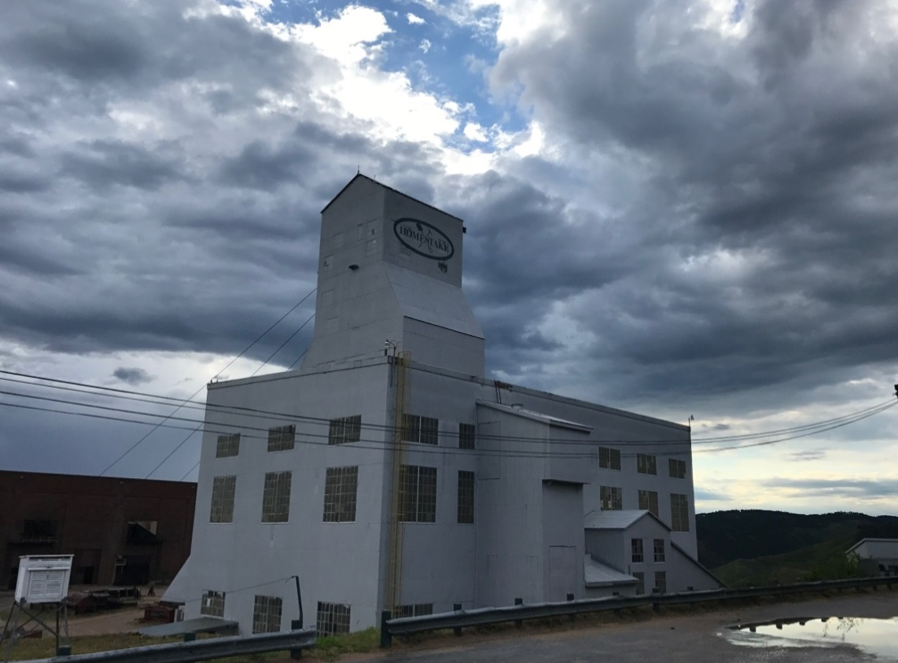






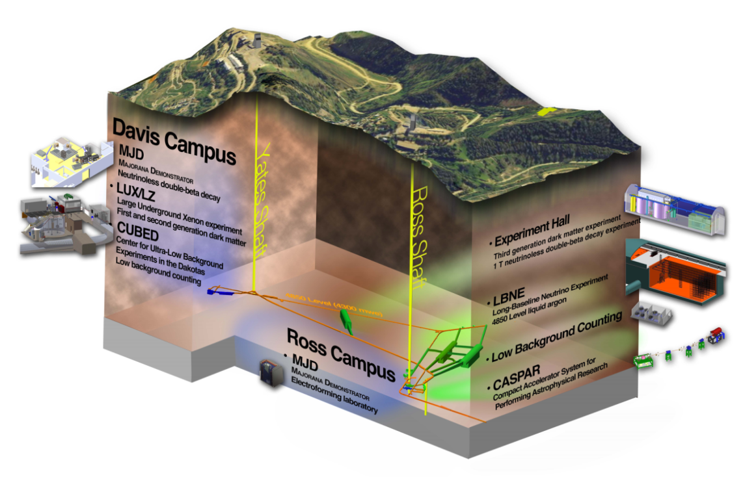

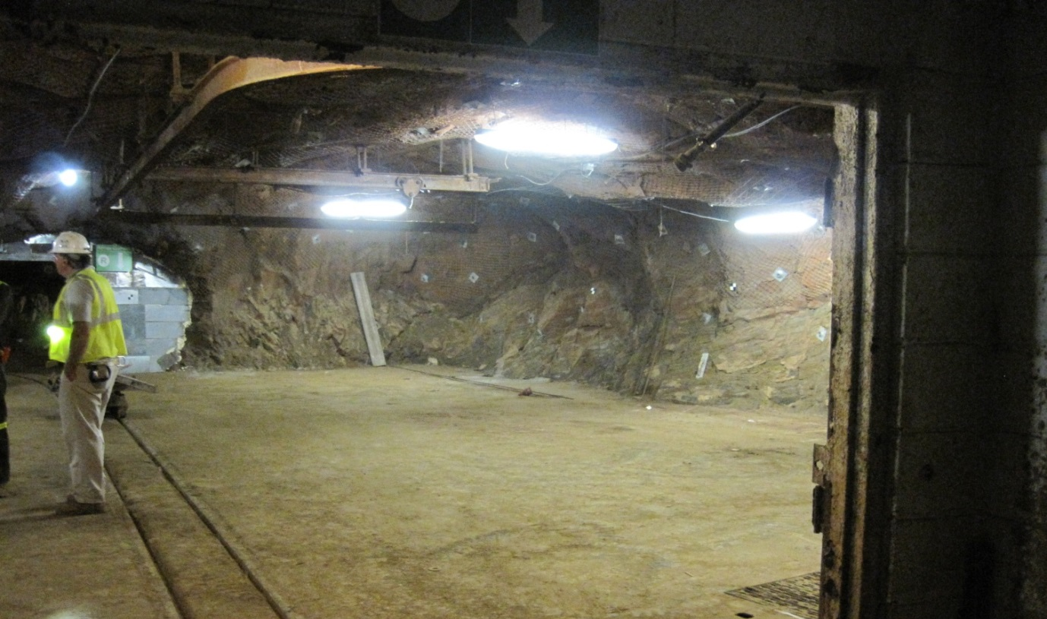
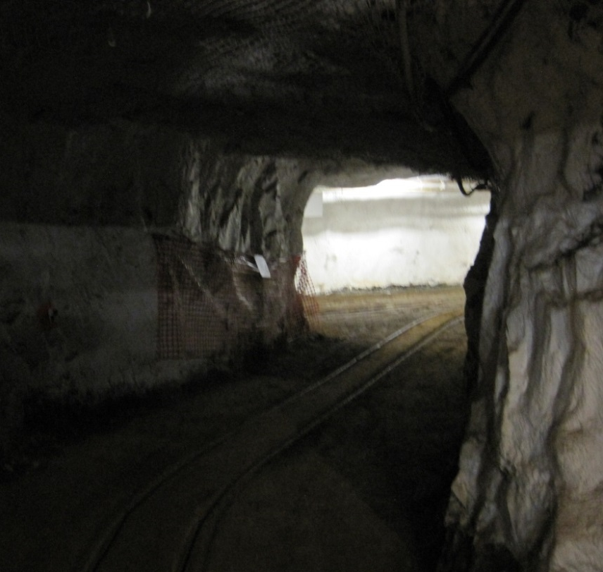
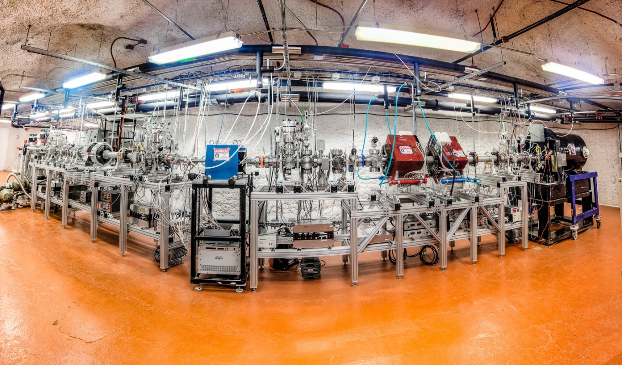
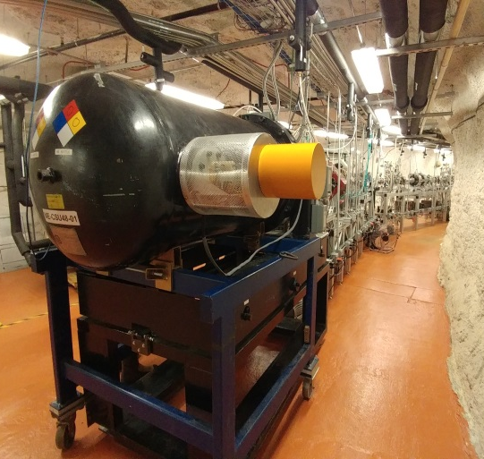
CASPAR Facility one mile under ground
First projects: ¹⁰B(α,n), ¹³C(α,n), ²²Ne(α,n), ^{25,26}Mg(α,n),

Slide 11
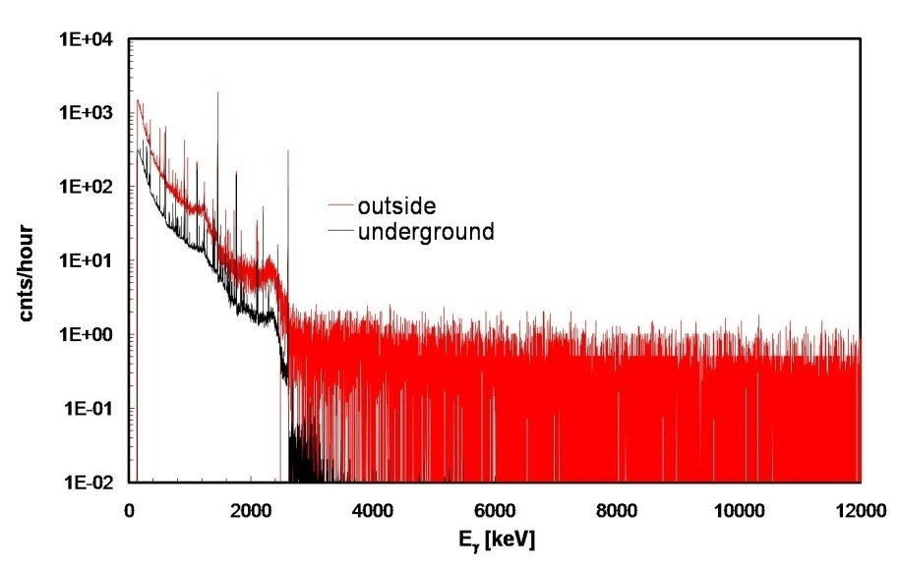
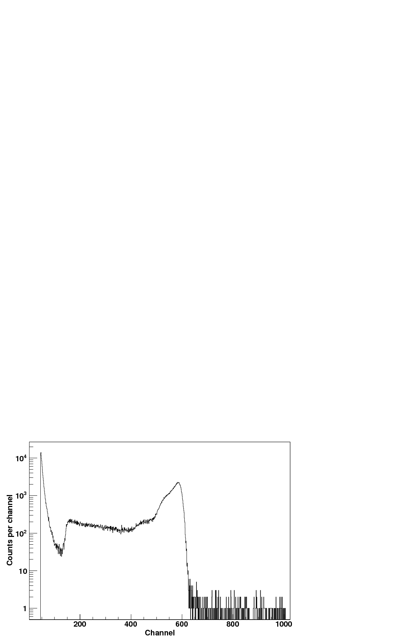
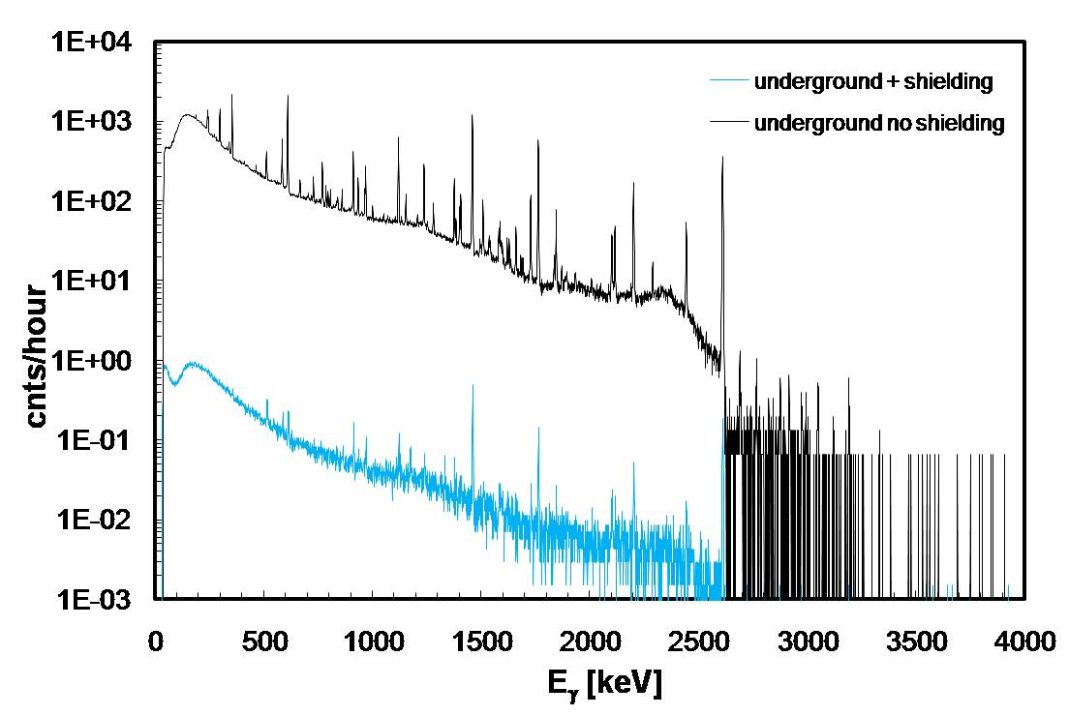
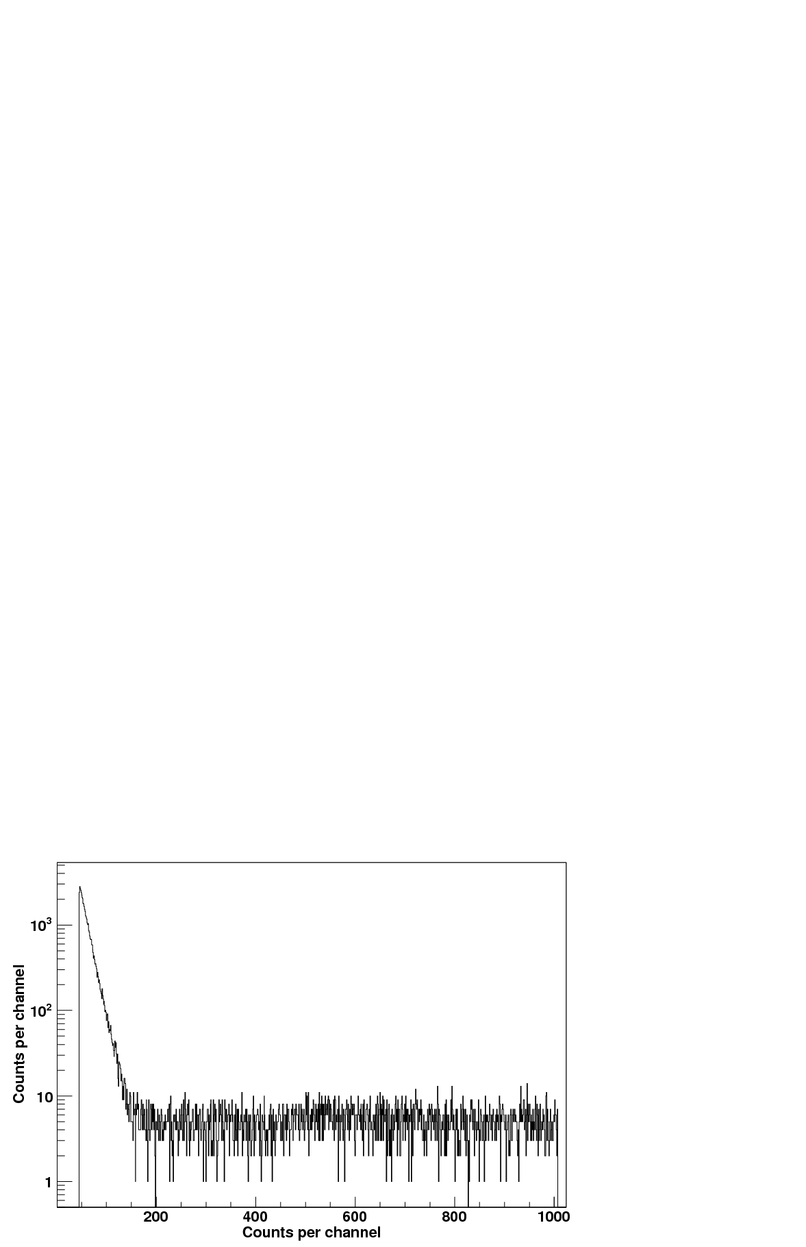
Advantage of underground physics
CR induced neutron spectrum
Environmental Radioactivity
CR induced γ spectrum
underground gamma spectrum
(LNGS Gran Sasso)
underground neutron spectrum (KURF, LNGS, Soudan, SURF, WIPP)
up to 5 orders of magnitude reduction

Slide 12
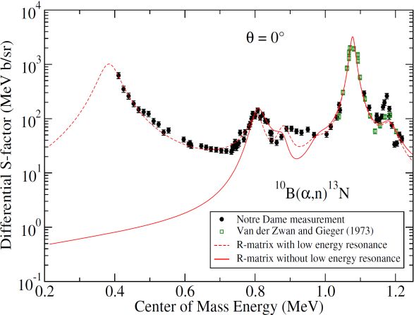
First experimental results
Further studies towards lower energies planned for January 2019!
Neutron background sources are:
Cosmogenic neutrons
Radiogenic neutrons
Beam induced neutrons

Slide 13
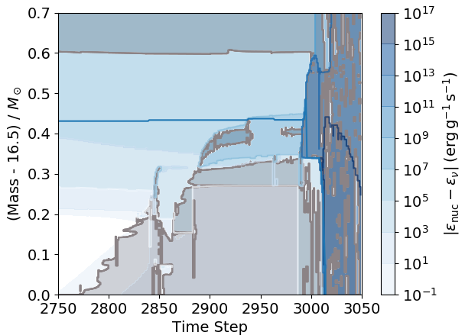
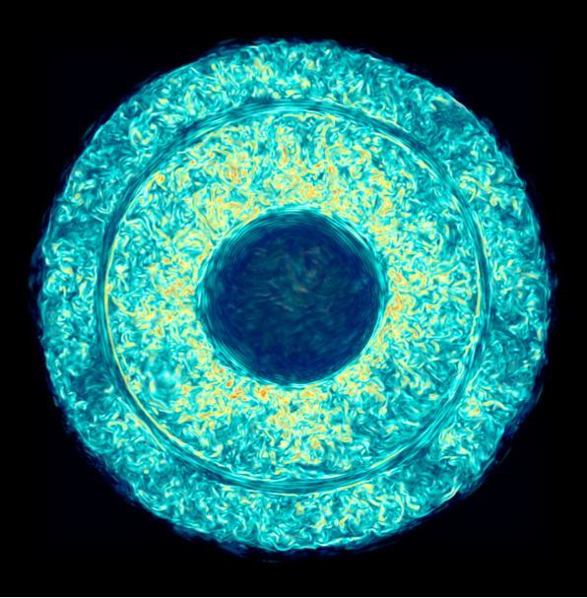
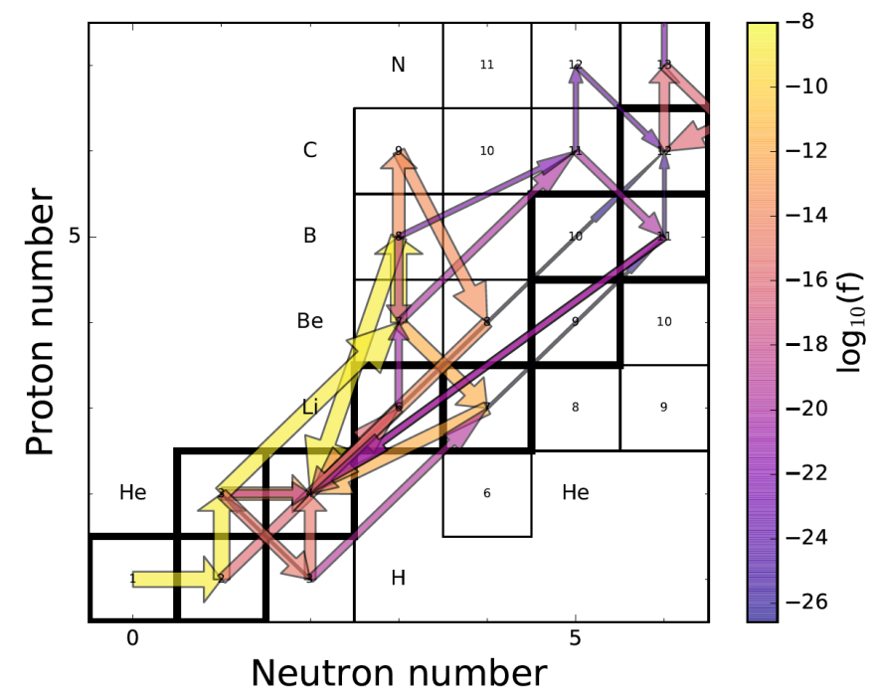
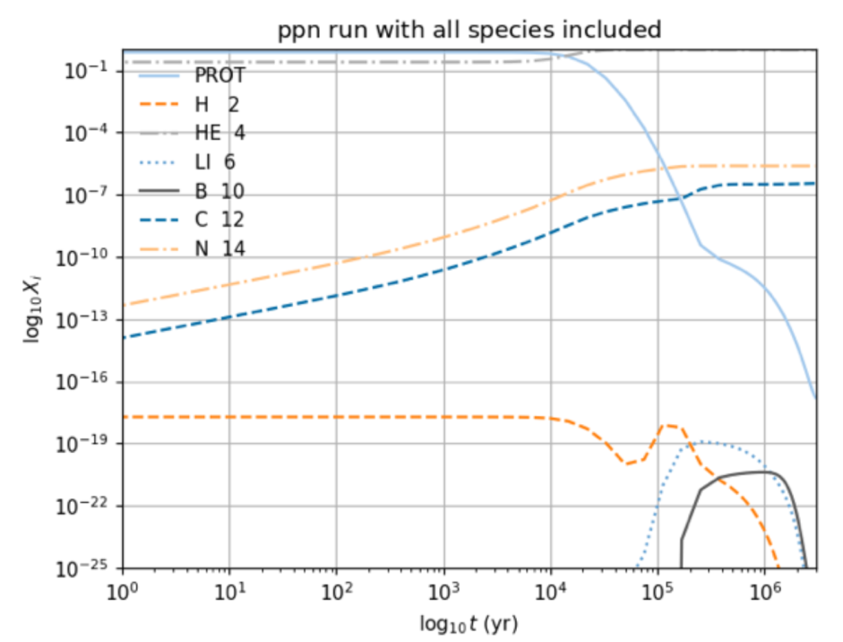
NuGRID results in simulating first stars
mass fractions X_{i}
time [yr]
Notes:
Figure 1 Top: Pop III massive star mass evolution of convection zones (Kippenhahn diagram) as a function of time step showing the moment when the two shells approach (2900) and eventually interact (3000) in a strong energetic convective-reactive outburst. The blue line denotes the mass coordinate of the essentially H-free core. Bottom: Vorticity rendering of exploratory 768³-grid 3D simulation of the radial stratification shown in time step (model number) 2890 shown in top panel. As in the top panel the He-burning shell at the bottom is separated by a gap of 25,000km from the bottom of the H-burning convective shell.

Slide 14
Conclusion
Formation of first stars appears to be a random mechanism
Primordial Elements provide fuel for first stars
Several ways to bridge the A=5,8 gaps
Efficiency depends on fuel supply and fuel cycling
Additional data and additional simulations are needed to come to a conclusive picture

