Slide 1
Quantum electron liquids
and fractional quantum Hall effect
Arkadiusz Wójs
Dept. of Theoretical Physics, Wrocław University of Science & Technology (Poland)
Outline
correlated electrons in quantum dots
quantum Hall effect
incompressible quantum liquids
composite fermions
nonabelian anyon statistics

Slide 2
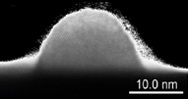
Quantum dots
Nanoscale objects containing small and controlled number of electrons (also called „artificial atoms”)
e⁻
e⁻
often made of semiconductors (various methods)
∅ from few to 100 atoms (different shapes)
N ≤ a few tens of electrons
coupling to environment (electric, magnetic,optical, mechanic)
e⁻
e⁻

Slide 3
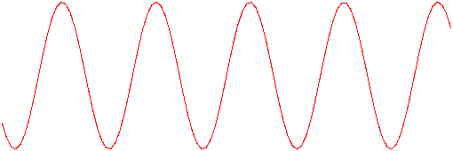
Quantum dots
spatial confinement
& electron wave character
→ quantization
(discrete energy levels)
a
shape/symmetry
→ shell degeneracy → Hund rules (e.g. max L)
size, magnetic field,
light (electrons & holes)
→
strong & nontrivial correlation effects
d
p
s

Slide 4
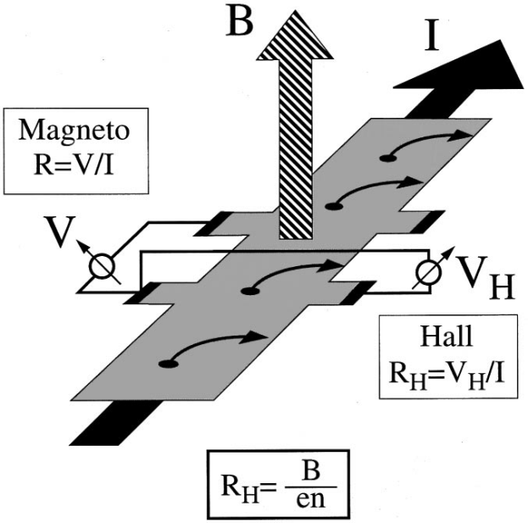
Hall effect
in magnetic field: Hall effect (1879)
Ohm’s law
$$j=σE$$
$$E=ρj$$
$$j=\hat{σ}E$$
$$E=\hat{ρ}j$$
$$\left[\begin{matrix}j_{x} \\ j_{y}\end{matrix}\right]=\left[\begin{matrix}σ & {−σ}_{H} \\ σ_{H} & σ\end{matrix}\right]\left[\begin{matrix}E_{x} \\ E_{y}\end{matrix}\right]$$
$$\left[\begin{matrix}E_{x} \\ E_{y}\end{matrix}\right]=\left[\begin{matrix}ρ & ρ_{H} \\ {−ρ}_{H} & ρ\end{matrix}\right]\left[\begin{matrix}j_{x} \\ j_{y}\end{matrix}\right]$$

Slide 5
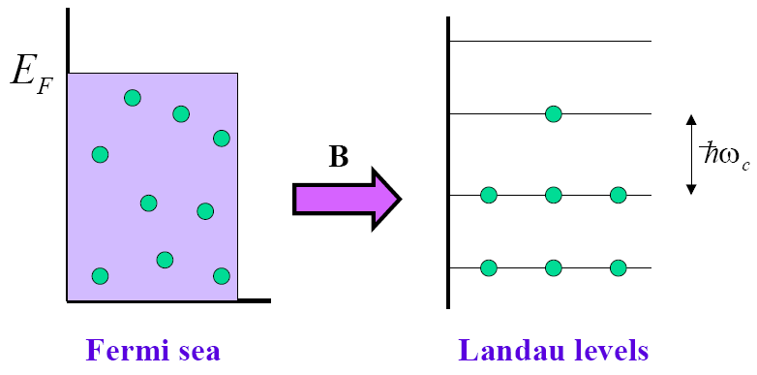
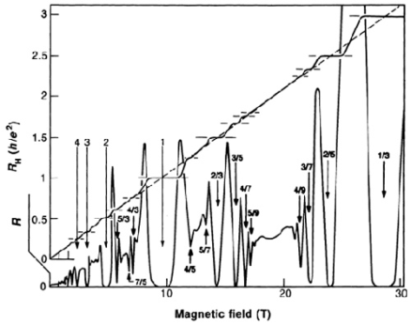
Quantum Hall effect
2D
low T
high B
low/approp. n
weak disorder
extreme cond’s
Ohm/Hall law
cyclotron energy: ${ℏω}_{c}={ℏeB}/{mc}$
filling factor: $ν=N/{N_{φ}}=n/{n_{φ}}$
$$j=\hat{σ}E$$
$$E=\hat{ρ}j$$
Quantization:
$$σ_{xy}={υe^{2}}/h; σ_{xx}=0$$
$$σ=\frac{υ}{R_{K}}\left[\begin{matrix}0 & −1 \\ 1 & 0\end{matrix}\right]; ρ=\frac{R_{K}}{υ}\left[\begin{matrix}0 & 1 \\ −1 & 0\end{matrix}\right]$$
$$R_{K}≡\frac{h}{e^{2}}=25812.807557(18) Ω$$

Slide 6
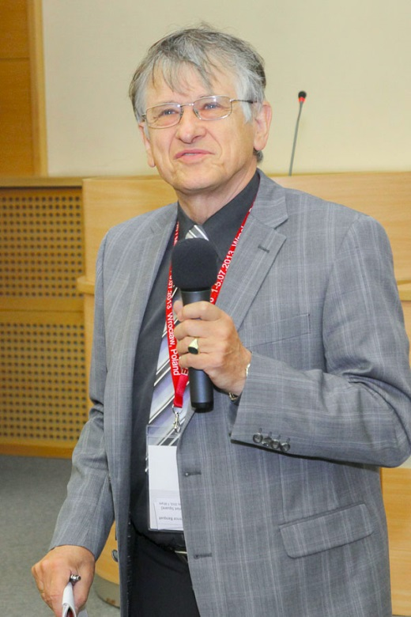
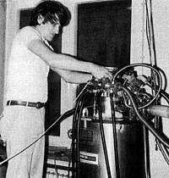
Quantum Hall effect
Klaus von Klitzing ’80
Klaus von Klitzing
High Magnetic Field Laboratory, Grenoble (France)
5 February 1980, 2am – topological phase of matter
other/related topological states : - topological insulators (HgTe, Bi₂Se₃) - topological superconductors (Sr₂RuO₄)
$$σ=\frac{υ}{R_{K}}\left[\begin{matrix}0 & −1 \\ 1 & 0\end{matrix}\right]; ρ=\frac{R_{K}}{υ}\left[\begin{matrix}0 & 1 \\ −1 & 0\end{matrix}\right]$$
$$R_{K}≡\frac{h}{e^{2}}=25812.807557(18) Ω$$

Slide 7
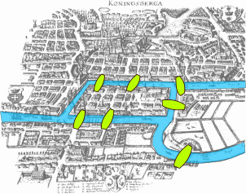
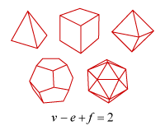
Topology
branch of mathematics concerned with properties of figures unchanged under continuous deformation
7 bridges of Königsberg
(Leonhard Euler, 1735)
Euler's polyhedron formula
v, e, f = numbers of vertices,
edges, and faces
Can one cross each bridge exacty once and return to origin?
Knots (Peter Guthrie Tait, 1885)

Slide 8
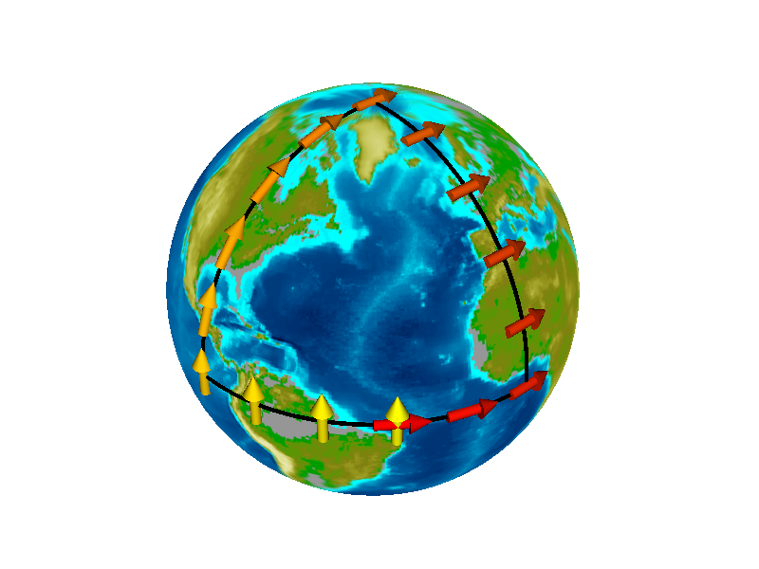
Quantum Hall effect as topological effect
Quantization of quantum Hall effect is topological
Phase transition not described by spontaneous symmetry breaking
In contrast, at low temperature (ground state) symmetry is higher
Order parameter: non-local, Chern number (topological invariant) ↔ geometry/curvature of Hilbert space

Slide 9
Quantum Hall effect as topological effect
Quantization of quantum Hall effect is topological
Phase transition not described by spontaneous symmetry breaking
In contrast, at low temperature (ground state) symmetry is higher
Order parameter: non-local, Chern number (topological invariant) ↔ geometry/curvature of Hilbert space
Stokes theorem: $$∮A_{m}{ ds}_{k}=∬ℱ_{m }d^{2}k$$
Chern number (~total curvature): $$n_{m}={\left(2π\right)}^{−1}∬_{occ} ℱ_{m}{ d}^{2}k$$
TKNN (Thouless, Kohmoto, Nightingale, den Nijs) 1982: $σ_{xy}={ne^{2}}/h$ (over occup. LLs)
Gauss & Bonnet (1848): $$∬KdA+∫k_{g}ds=2π χ_{M}$$
For a closed surface: $${\left(2π\right)}^{−1} ∯K dA=2 \left(1−g\right)$$
For torus (2D Brillouin zone): $$g=1 ⇒ n=0$$
Wave vector $k$ in closed loop → Berry phase of Bloch w-fun $u_{m}\left(k\right)$: $∮A_{m} {ds}_{k}$; $A_{m}≡i \left\langle u_{m} | ∇_{k} | u_{m}\right\rangle$
Berry curvature: $ℱ_{m}=∇_{k}×A_{m}$

Slide 10
Quantum Hall effect as topological effect
Quantization of quantum Hall effect is topological
Phase transition not described by spontaneous symmetry breaking
In contrast, at low temperature (ground state) symmetry is higher
Order parameter: non-local, Chern number (topological invariant) ↔ geometry/curvature of Hilbert space
properties depend on topological invariant (Hall conductance σ_{xy} ~ Chern number)
Effect (exact quantization) is independent of:
material
type of structure
sample geometry
disorder
magnetic field
temperature
…
V
V_{H}
A
A

Slide 11
Fractional quantum Hall effect
Störmer, Tsui, Gossard ’82
Integral QHE: quantization of R_{H} near exact filling of Landau levels
Fractional QHE: similar behaviour near certain fractional fillings new physics: quantum liquid, fractional excitations, anyon statistics
$$\frac{1}{3}$$
2
1

Slide 12
Quantum liquid
electrons in two dimensions (very thin layer) in high magnetic field (motion further restricted/quantized to LLs) interacting with one another via Coulomb forces at approprate (low) density
become strongly correlated and condense into a liquid
B
new phase of matter: quantum¹ liquid²
¹ made of quantum particles (electrons)
² isotropic and incompressible

Slide 13
Fractionally charged (quasi)particles
additional electron entering the liquid splits into 3 fractionally charged quasiparticles
(the extra electron blends into the liquid, and the excessive local charge shows as 3 new quasiparticles, moving independently)

Slide 14
Fractional and non-Abelian (quasi)particles
in 3D:
double exchange (P²):
Identity
Loop
single exchange:
$P=−1$: fermions → Pauli exclusion principle
$P=+1$: bosons → Bose-Einstein condensation
in 2D:
above argument fails, $P=e^{iθ}$ (anyons) or matrix (non-abelions)
→ topological quantum computation

Slide 15
Particles with „memory of trajectory”
braiding non-Abelions (particles with non-Abelian braid group)
time
braid/exchange „counter-clockwise”
braid/exchange „clockwise”
final quantum state depends on past trajectories (not only on final positions) → application as protected element of quantum memory

Slide 16
Composite fermions
Jain ’89
2D electrons + magnetic field → degenerate energy levels (Landau)
interactions → correlations (complicated behavior) → incompressible quantum liquid, FQHE (quantization of R_{xy} & vanishing of R_{xx}) at particular conditions
simpler description/understanding in terms of a new (hypothetical) particle:
+
=
electron (electric charge)
solenoids (magnetic flux)
composite fermion (charge+flux)

Slide 17
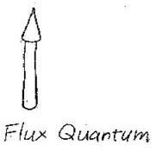
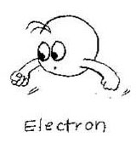
Composite fermions
Jain ’89
composite fermion (CF) = electron + correlation hole
= e + 2 vortices of many-body wave function = e + 2 magnetic flux quanta hc/e
interaction → emergent (essentially) free quasiparticles
interacting electrons in strong magnetic field
(Fig. Kwon Park)
almost free CFs in reduced magnetic field

Slide 18
Composite fermions – experimental evidence
The plot of electric resistance (R) vs magnetic field (B), in which R=0 signifies QHE, is strikingly self-similar
Resistance
Magnetic field (T)
R=0 → QHE (R_{H}=const), quantum liquid, etc.

Slide 19
Composite fermions – experimental evidence
The plot of electric resistance (R) vs magnetic field (B), in which R=0 signifies QHE, is strikingly self-similar

Slide 20
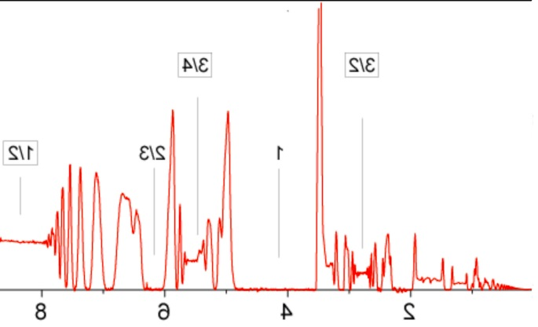
Composite fermions – experimental evidence
The plot of electric resistance (R) vs magnetic field (B), in which R=0 signifies QHE, is strikingly self-similar
B→B*

Slide 21
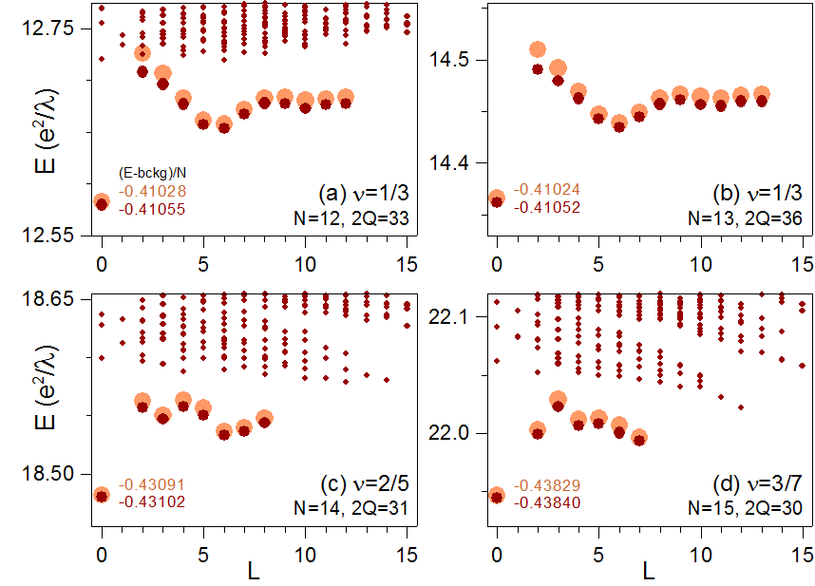
Composite fermions – numerical evidence
(own work)
e
e
e
e
2Q
e
Average CF energies
Haldane model:
N electrons on sphere
field B from monopole 2Q
2Q=flux through surface
LL degeneracy=2Q+1
ν ~ N/2Q
Coulomb eigenenergies
LL1
Q+1
LL0
ℓ =Q
generalized (monopole) spherical harmonics: Y_{Q,l,m}(θ,ϕ), |m|≤ ℓ
E = total Coulomb energy, L = total angular momentum
Labels = correlation energy per particle
Coulomb interaction V=1/r

Slide 22
Own research: correlations in low dimensions
1. Interacting electrons in semiconductor quantum dots
2. Fractional quantum Hall effect / quantum liquids
♦ topological effects
♦ microscopic mechanisms of condensation
♦ interaction with light (optical properties)
♦ composite fermion theory
• CFs with residual interaction
• CFs with spin (→ skyrmions)
• CFs with additional freedom (flavor)
• realistic systems (thickness, finite magnetic field, disorder)
♦ interacting fermions on artificial lattices
3. Two-dimensional crystals (graphene, MoS₂, etc.)

Slide 23
Summary of keywords and concepts
interacting electrons in extreme conditions (2D, atomic perfection, low T, high B) → strong correlations
topology – cause of universality / exactness of a macroscopic (transport, electric) phenomenon: quantum Hall effect
quantum phase of matter: quantum liquid
new particles: anyons, non-Abelions, and composite fermions

