Slide 1



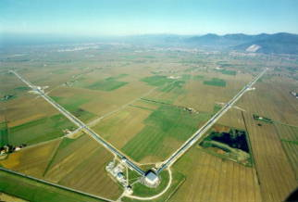

GRAVITATIONAL WAVE EXPERIMENTS
István Rácz
RMKI
Wigner Virgo group

Slide 2
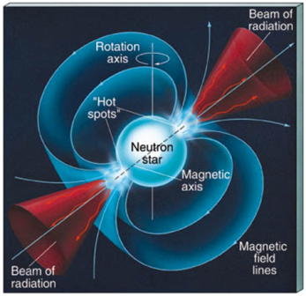
Talk Outline
Introduction to the Gravitational Wave (GW) search
Gravitational wave detectors
  Today
  Near future
The aim of the game: gravitational wave astronomy
Perspectives

Slide 3
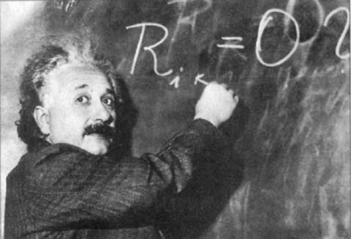
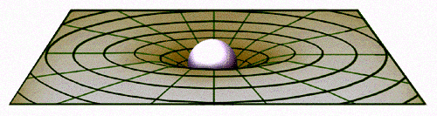
General Relativity and GW
GW are predicted by the Einstein General Relativity
  GR is a metric theory of gravity
Einstein field equation links G_{μν}
to the matter source T_{μν}
(energy-momentum tensor)
Using appropriate gauge: Einstein field equations can be seen to form a set of coupled nonlinear wave equations.
Far from the sources, linear approximation and radiation gauge can be used, yielding wave equation for the perturbation of the background geometry

Slide 4
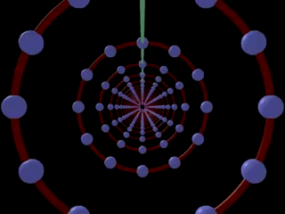



Gravitational Waves
GWs are deformations of the spacetime geometry propagating with the speed of light
Two polarizations: h₊ & h×
The effect of GWs on a mass distribution is the modulation of the reciprocal distance of the masses
h×
h₊

Slide 5
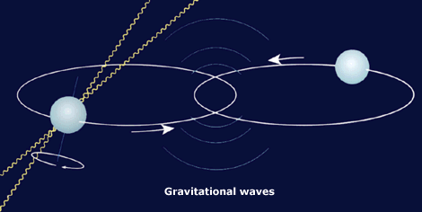
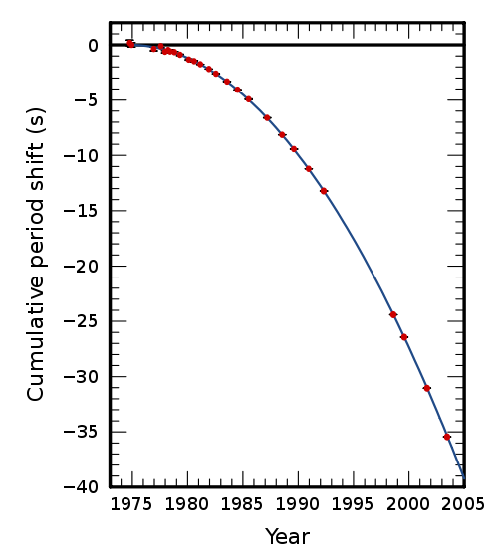

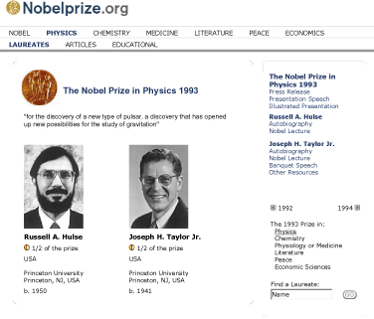
But, do GWs really exist?
Neutron star binary system: PSR1913+16
  Pulsar bound to a “dark companion”
  7 kpc from Earth, relativistic: v_{max}/c ~10⁻³
  GR predicts such a system to loose energy via GW emission: orbital period decrease
  Radiative prediction of general relativity verified at 0.2% level
Nobel Prize 1993: Hulse and Taylor

Slide 6
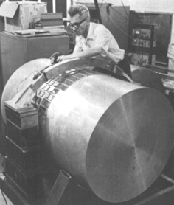
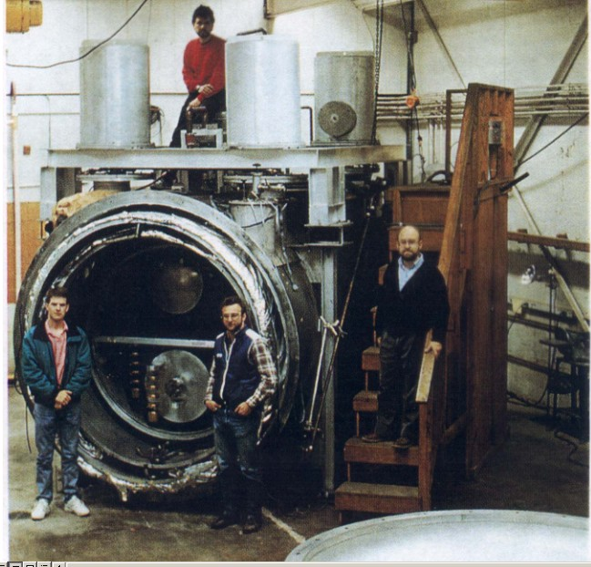
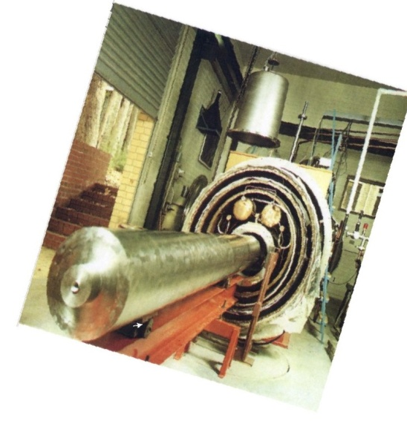
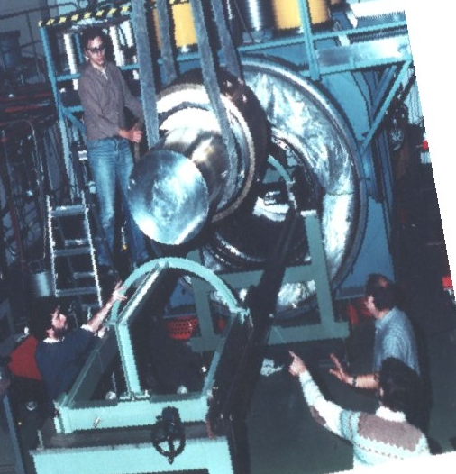
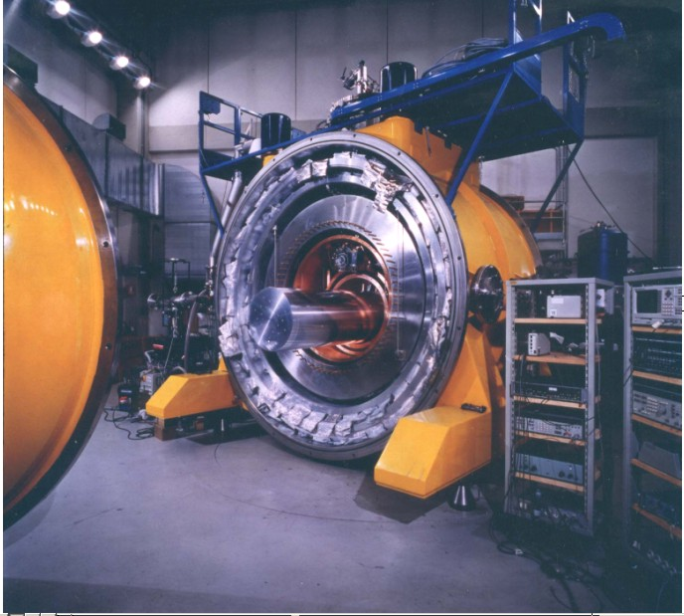
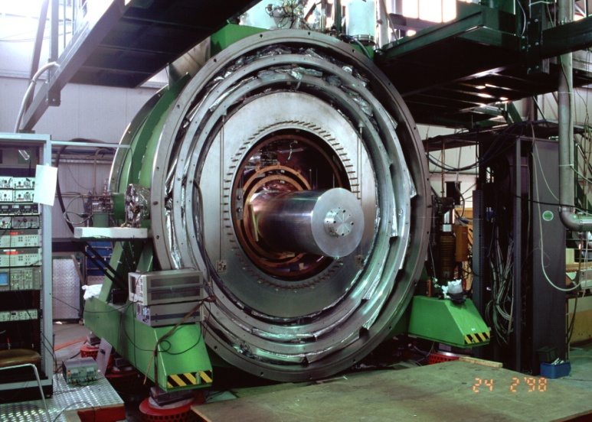
GW detectors: the resonant bars
The epoch of the GW detectors began with the resonant bars
Then a network of cryogenic bars has been developed in the past
Joseph Weber
(~1960)
Piezoelectric
transducers
Resonant bar
suspended in the middle

Slide 7
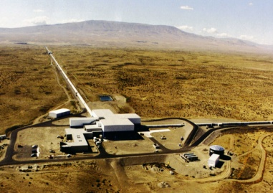


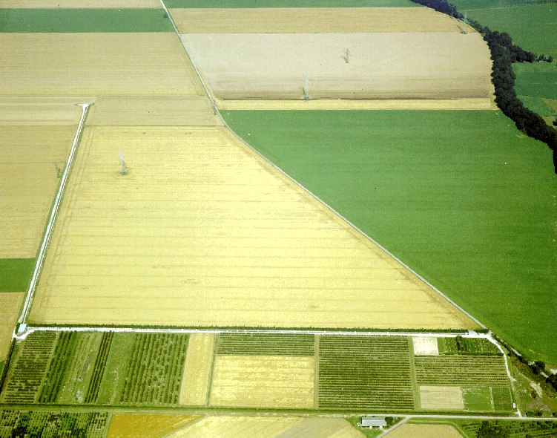
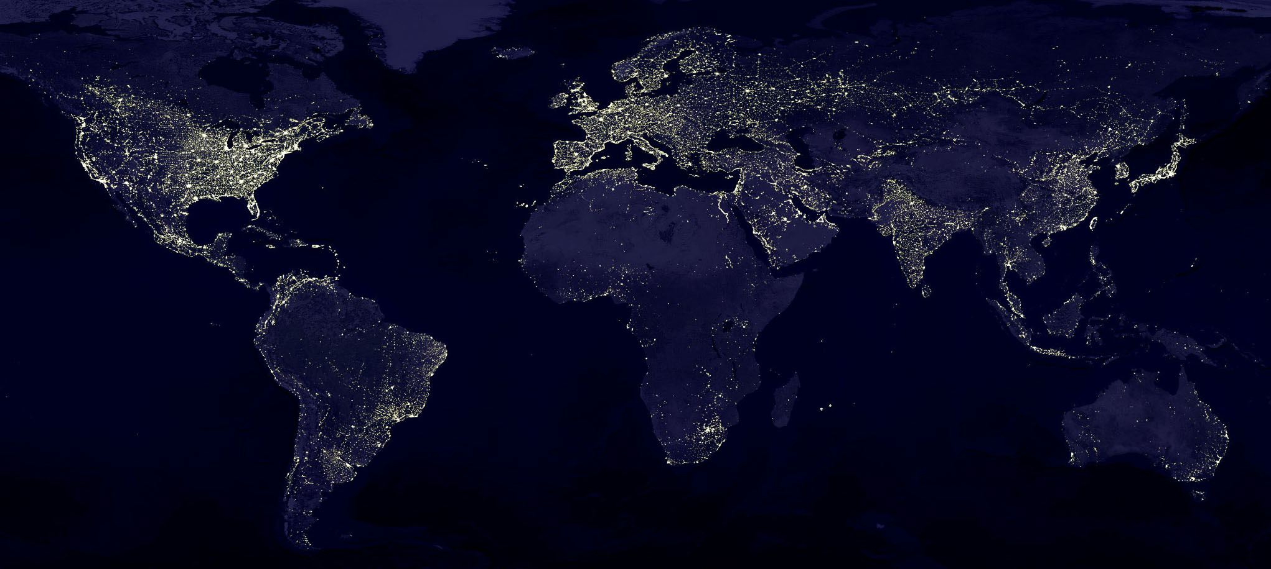
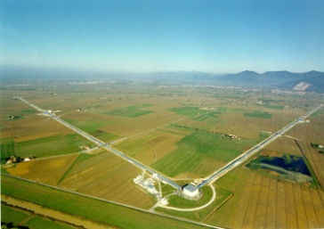
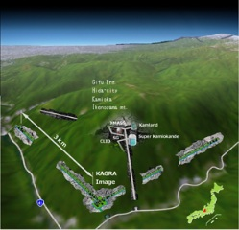


GW interferometric detectors
A worldwide network of detectors has been developed:
GEO, Hannover, 600 m
LIGO Hanford, 4 km: 2 ITF àt the same site!
KAGRA, Kamioke,
3 km, 2.5 gen.
Virgo, Cascina, 3 km
LIGO Livingston, 4 km

Slide 8
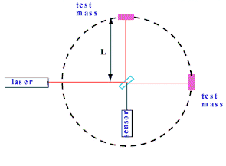
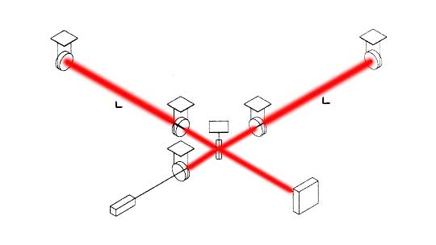
Working principle
The quadrupolar nature of the GW makes the Michelson interferometer a “natural” GW detector
10²≤L₀ ≤10⁴ m in terrestrial detectors
E₁
Typical wave length ~100km
We need a “trick” to construct such a detector on the Earth
E_{in}
E₂
Fabry-Perot
cavity
Effective length:

Slide 9
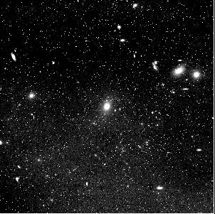
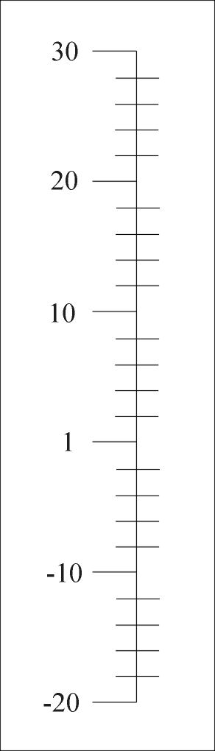
How small is 10⁻¹⁸ m?
Size of the Universe
Virgo cluster
Galactic center
1 Light-year
Target GW wavelengths
Neutron star radius
Wavelength of YAG laser
Size of an atom
Proton radius
Virgo sensitivity
log10 r

Slide 10
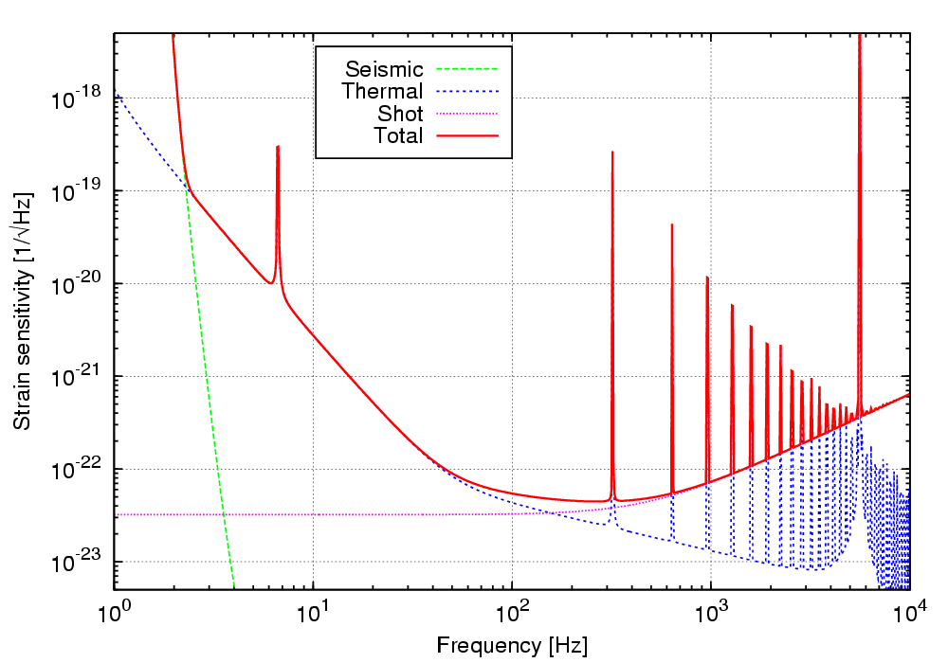
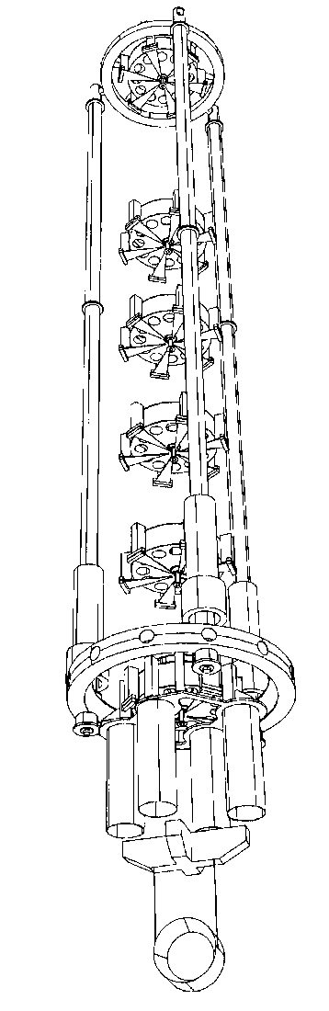
Detector sensitivity
The faint space-time deformation measurement must compete with a series of noise sources that are spoiling the detector sensitivity
Seismic filtering:
in Virgo pendulum chains to reduce seismic motion by a factor 10¹⁴ above 10 Hz
~10 m
Virgo nominal
sensitivity

Slide 11
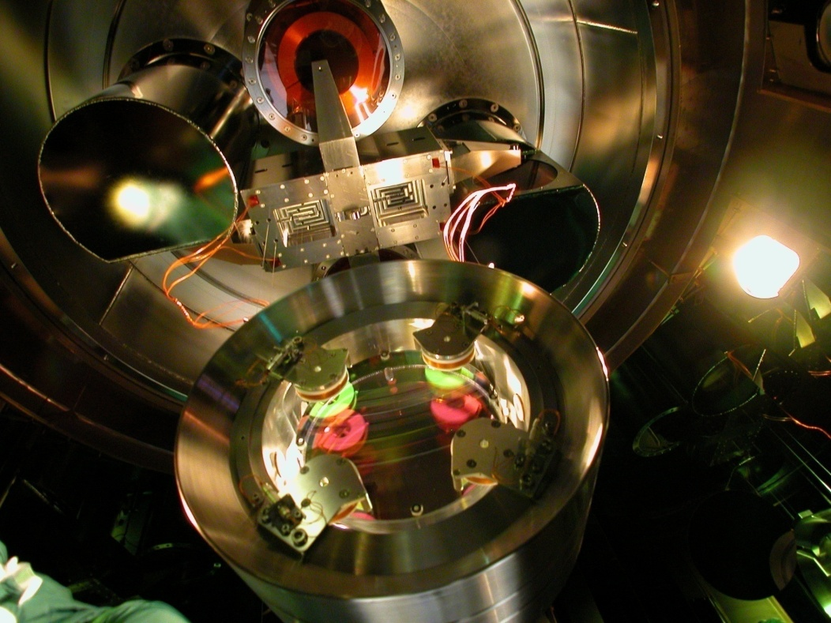
Detector sensitivity
The faint space-time deformation measurement must compete with a series of noise sources that are spoiling the detector sensitivity
Optimization of the payload design to minimize the mechanical losses

Slide 12
Detector sensitivity
The faint space-time deformation measurement must compete with a series of noise sources that are spoiling the detector sensitivity
Maximization of the injected laser power, to minimize the shot noise

Slide 13
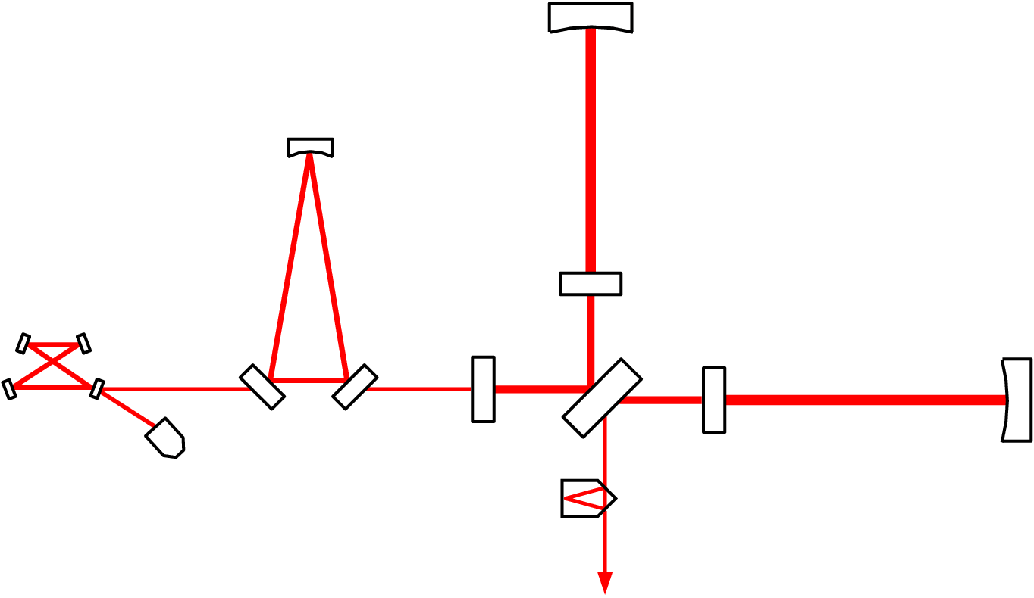
A real detector scheme
Virgo optical scheme
Input Mode Cleaner
3 km long Fabry-Perot cavities:
to lengthen the optical path to
100 km, ~50 kW
Laser 20 W
Output Mode Cleaner, ~1W
Power recycling mirror:
to increase the light power
to 1 kW

Slide 14
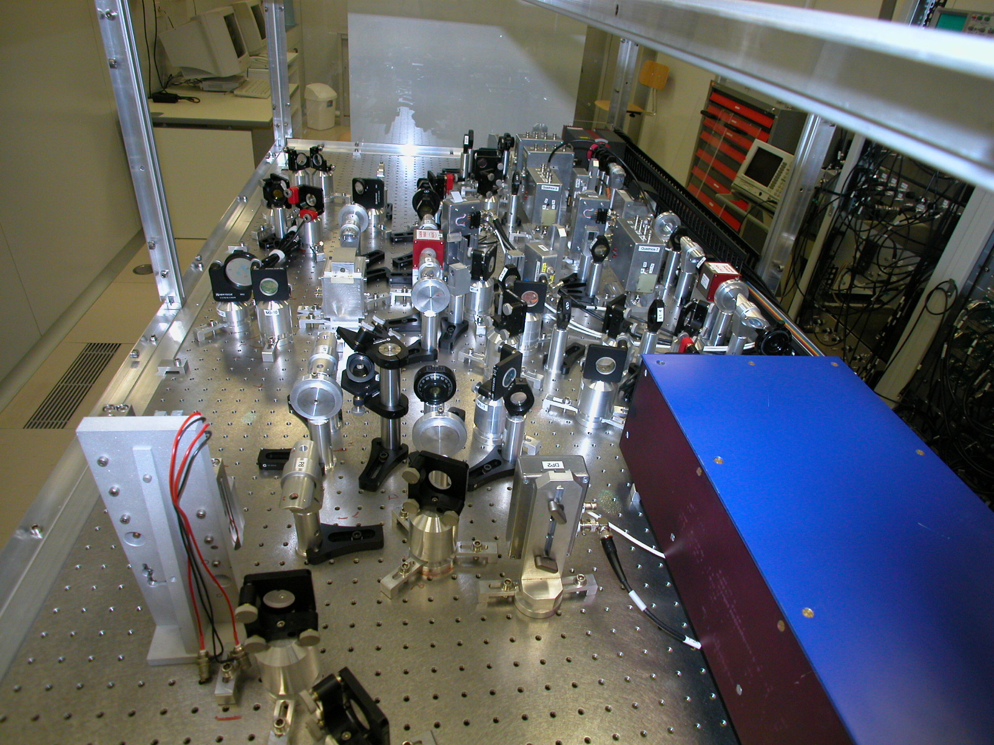
Laser
Master laser, 1W
F.I.
F.I.
E.O.
F.I.
Main Beam Path
Slave laser, 22W

Slide 15
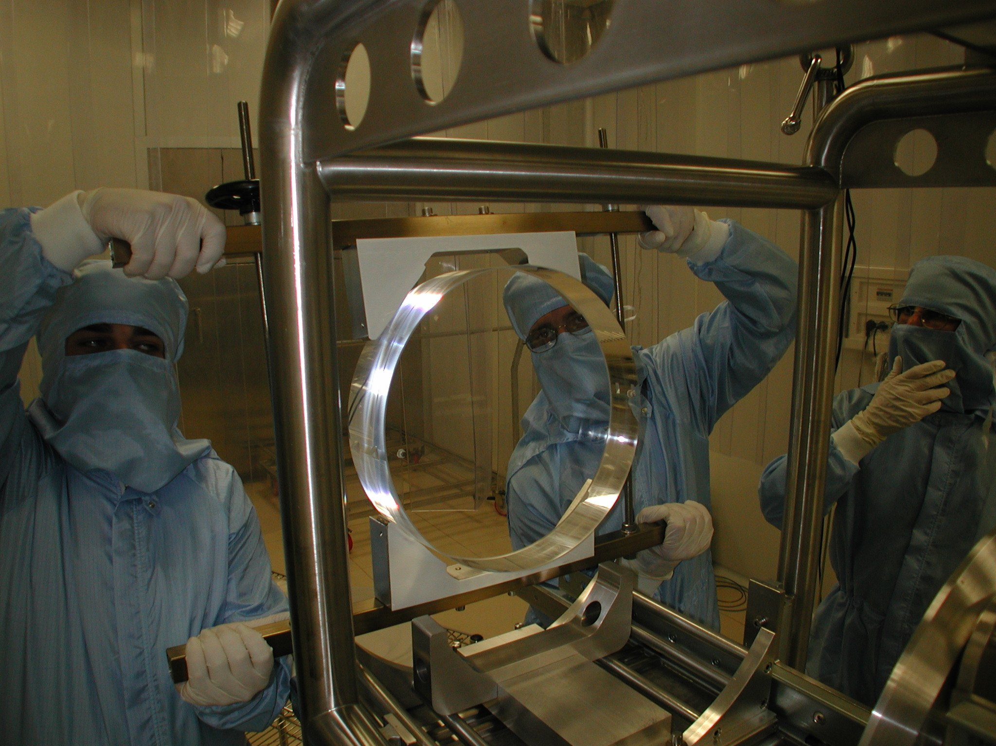
Super mirrors
Fused silica mirrors
35 cm diam, 10 cm thick, 21 kg
Scattering losses: a few ppm
Substrate losses: 1 ppm
Coating losses: <5 ppm
Surface deformation: λ/100

Slide 16
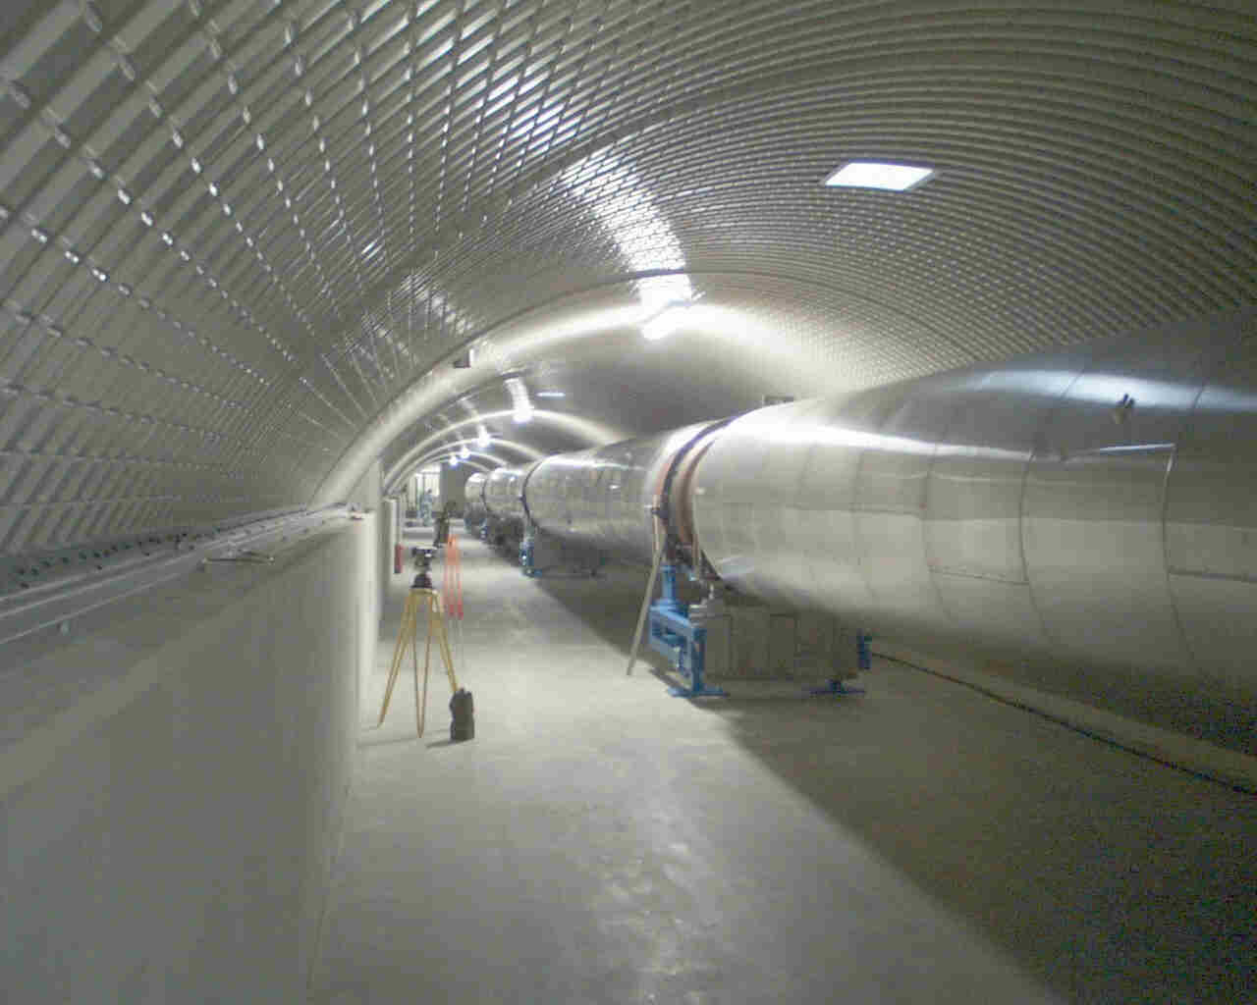
Vacuum enclosure
7000 m3
Requirements
10⁻⁹ mbar for total pressure
10⁻¹⁴ mbar for hydrocarbons

Slide 17
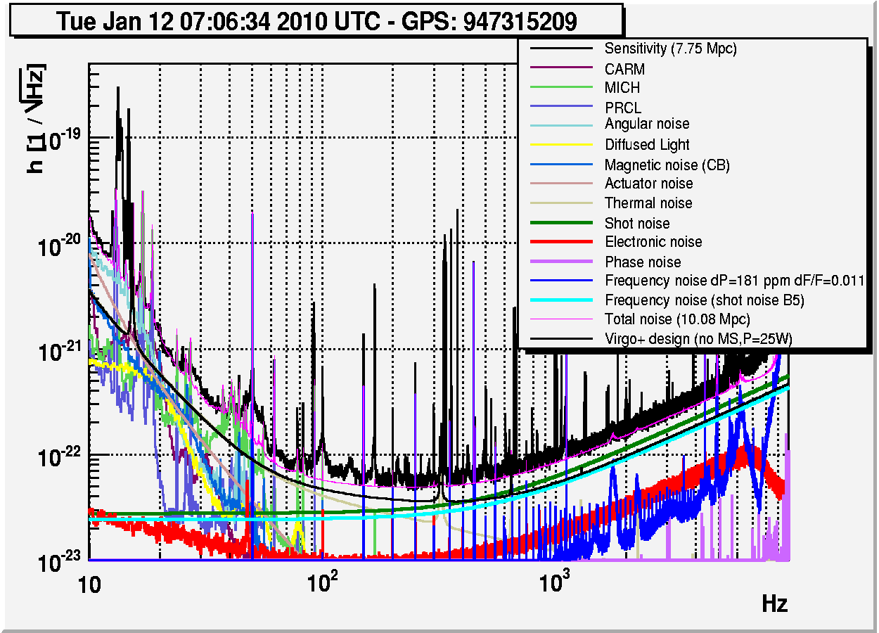
Sensitivity: real life
Virgo+ noise budget example

Slide 18
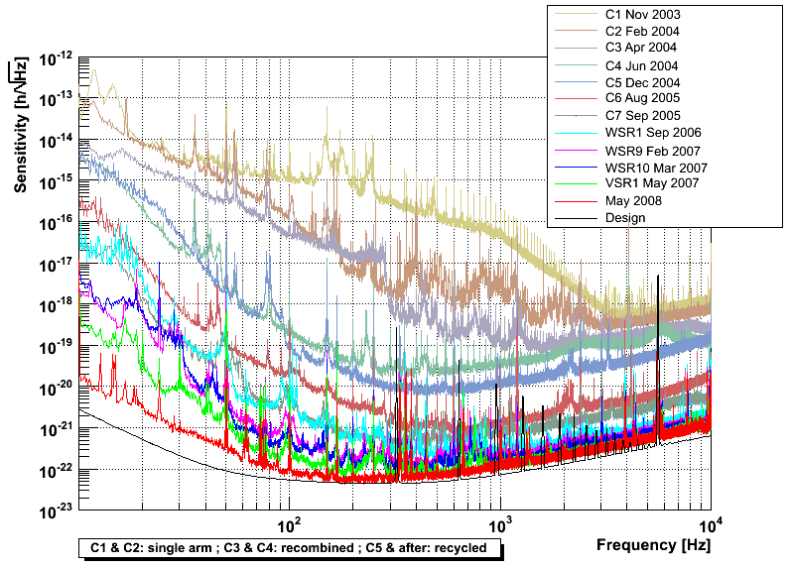
Virgo sensitivity evolution

Slide 19
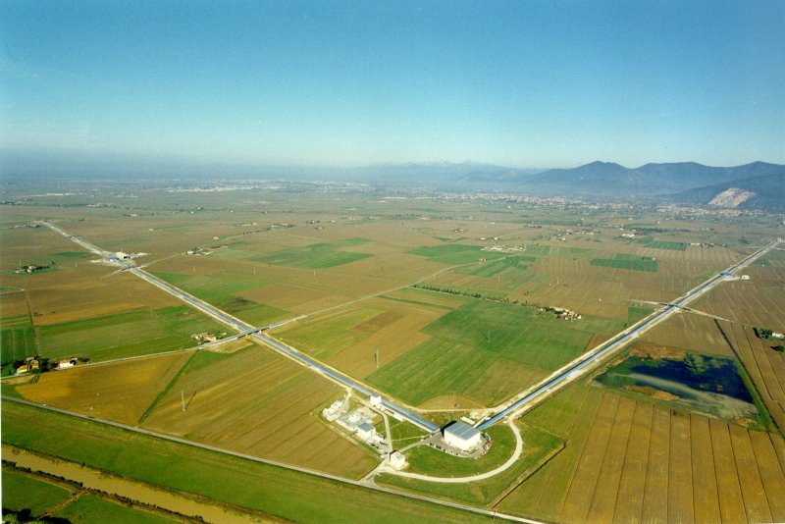
The VIRGO collaboration
LAPP – Annecy
NIKHEF – Amsterdam
GPG – Birmingham
INFN – Firenze-Urbino
INFN – Frascati
INFN – Genoa
VIRGO
IPN – Lyon
INFN – Napoli
OCA – Nice
LAL – Orsay
ESPCI – Paris
APC – Paris
INFN – Padova-Trento
INFN – Perugia
INFN – Pisa
INFN – Roma 1
INFN – Roma 2
Univ of Warsav
Wigner - Budapest

Slide 20
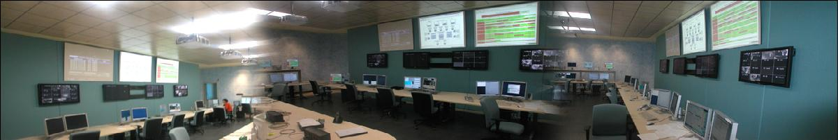
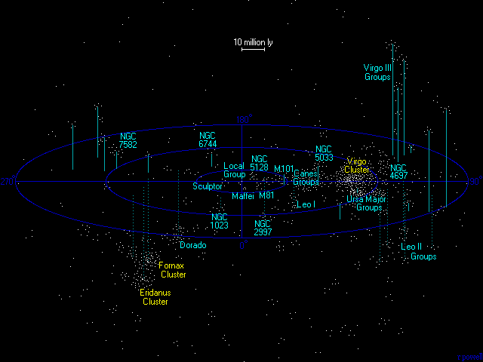
1ST GENERATION INTERFEROMETERS CAN
DETECT A NS-NS COALESCENCE
AS FAR AS VIRGO CLUSTER (15 MPc)
LOW EXPECTED EVENT RATE:
0.01-0.1 ev/yr (NS-NS)
Thousands of galaxis in the distance ~50 million light years

Slide 21
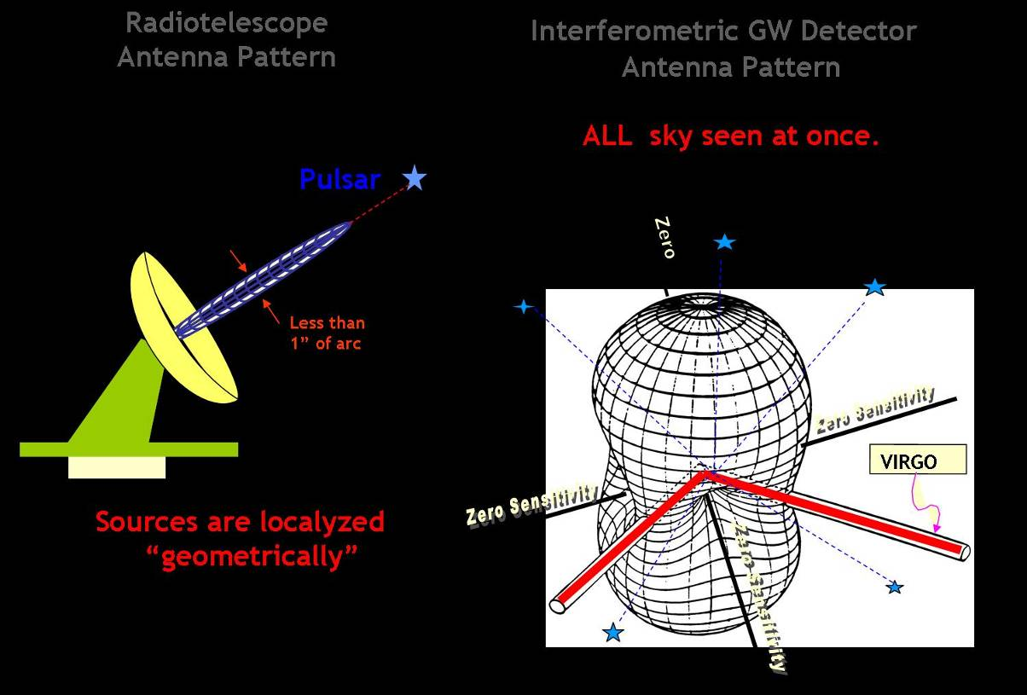
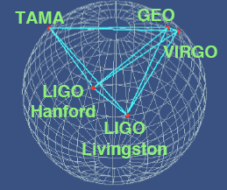
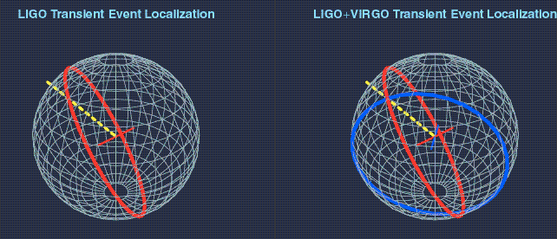
Benefits by the LIGO-Virgo network
Avoide false alarm coincidence
Triangulation allowing to pinpoint the source
A network allows to measure signal parameters, including source distance for BNS signals
Joint operation yields a longer observation time, and a better sky coverage
Notes:
21

Slide 22
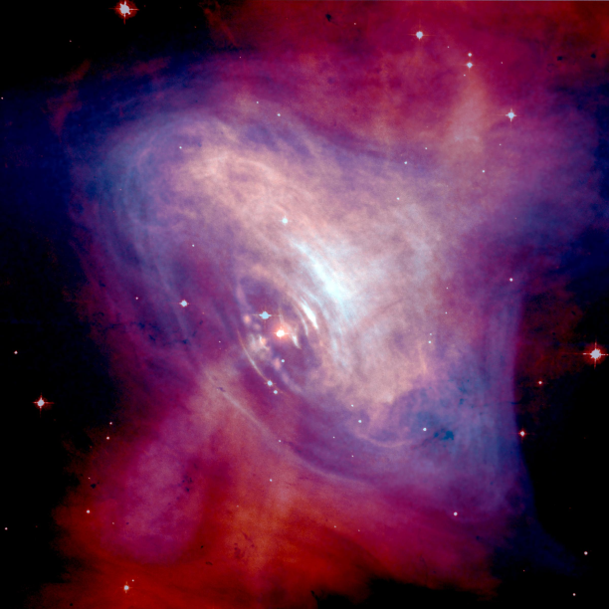
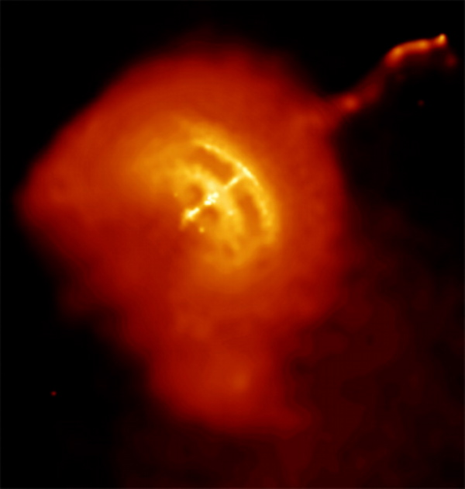
GW sources: isolated NS
Isolated NS are a possible source of GW if they have a non-null quadrupolar moment (ellipticity)
Crab pulsar in the Crab nebula (2kpc)
LIGO-S5 upper limit: 6% of the SD limit in energy
Vela pulsar in its nebula (0.3kpc)
Spin-down limit to be determined in the Virgo VSR2-VSR3 runs
Credits: C.Palomba

Slide 23
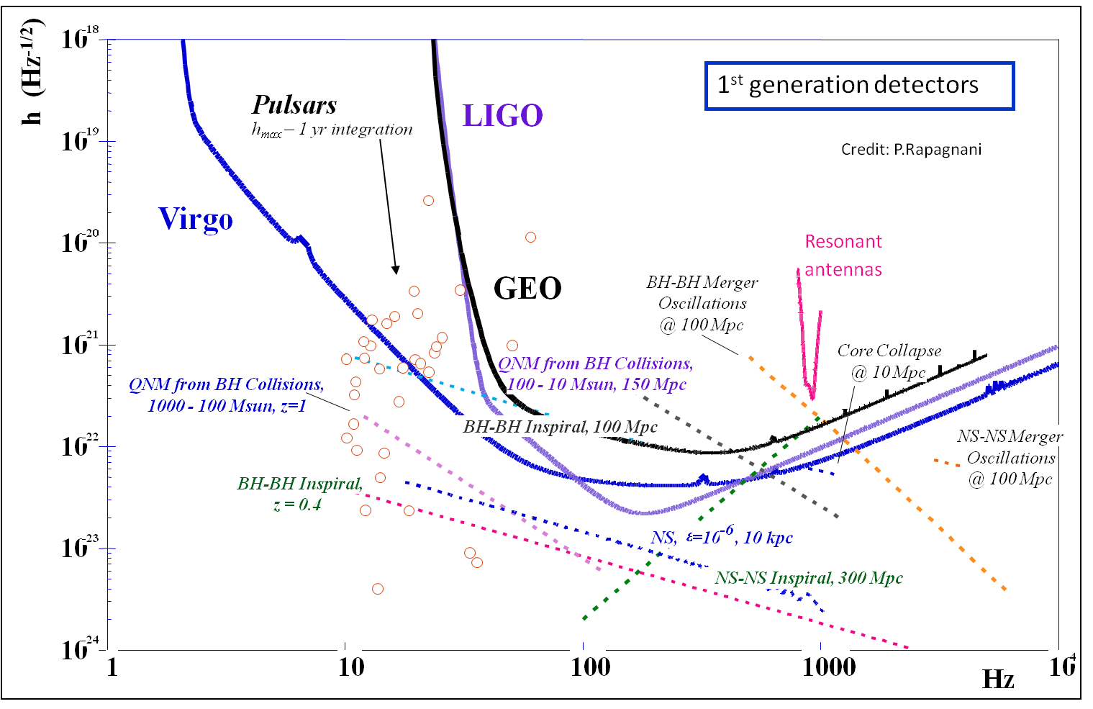
1st generation GW detector nominal sensitivities

Slide 24

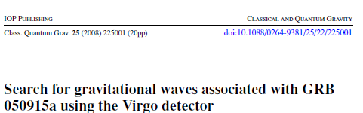
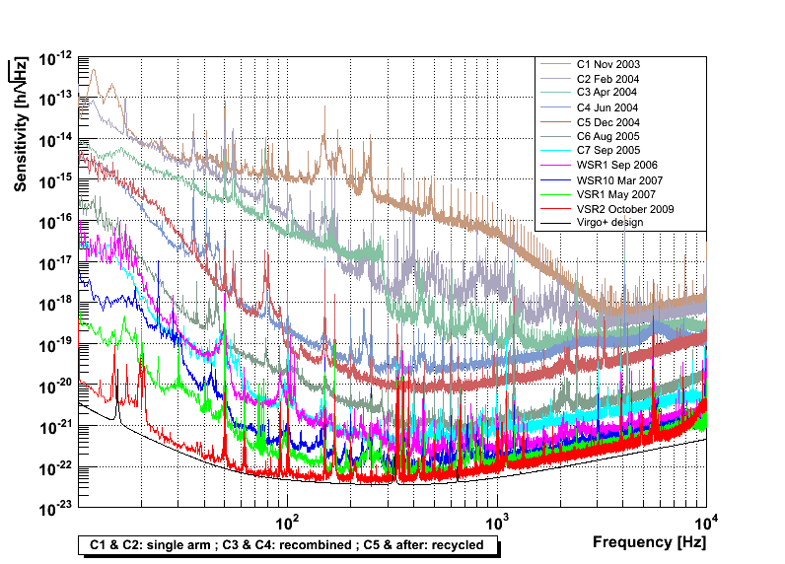

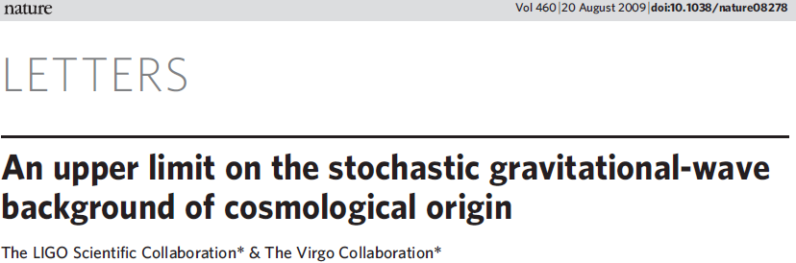
GW interferometer past evolution
Evolution of the GW detectors (Virgo example):
Detection distance (a.u.)
Proof of the working principle
Upper Limit physics
Commissioning
& first runs
Infrastructure realization and detector assembling
Same
infrastructure
year
2003
2008

Slide 25
GW interferometer present evolution
Evolution of the GW detectors (Virgo example):
First detection
Initial astrophysics
Test of “advanced” techs
UL physics
Advanced
detectors
Detection distance (a.u.)
Justification of he working principle
Upper Limit physics
enhanceddetectors
Commissioning
& first runs
Infrastructure realization and detector assembling
Same
infrastructure
Same
infrastructure
Same
infrastructure
year
2003
2008
2011
2017

Slide 26
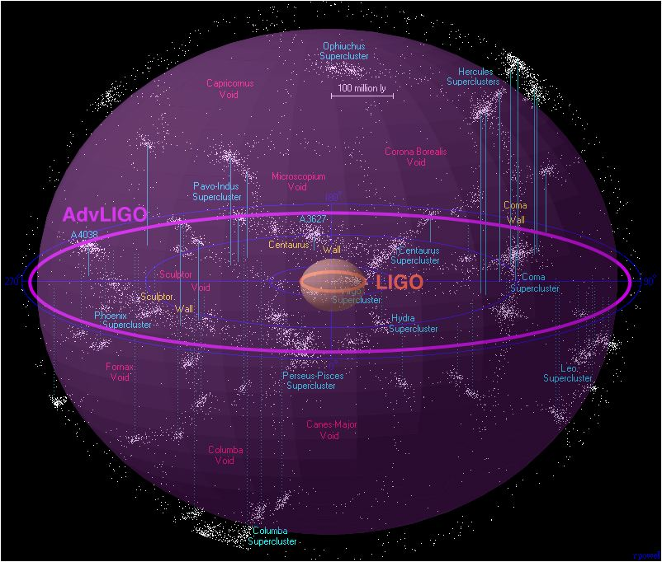
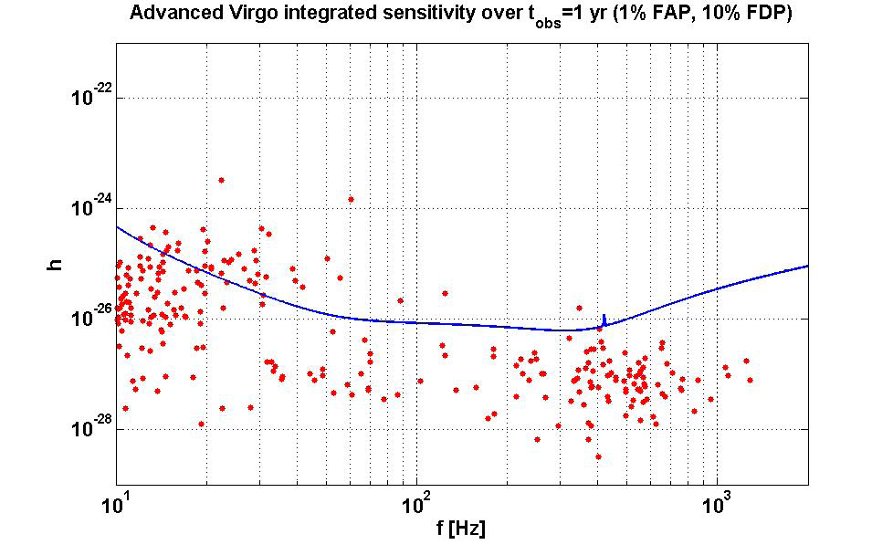
Advanced detectors
  Increase of the BNS detection distance from 20MPc to 200 MPc
  A BNS detection rate ~ 10/year with a limited SNR:
  The beating of the spin-down limit for many known pulsars
Enhanced LIGO/Virgo+
Virgo/LIGO
10⁸ ly
Credits: C.Palomba
Adv. Virgo/Adv. LIGO
Credit: R.Powell, B.Berger

Slide 27
Virgo upgrade plans
16
Mpc
BNS inpiral range – expected progress
103
15
Advanced Virgo
Advanced Virgo Science Run 1
102
14
101
13
Advanced Virgo commissioning
100
12
08
10
12
14
16
18
yr
Advanced Virgo installation
11
Virgo Science Run 3
Virgo+
Installation of monolithic suspensions (?)
10
Virgo Science Run 2
09
Virgo+ commissioning
Virgo+ installation
08

Slide 28
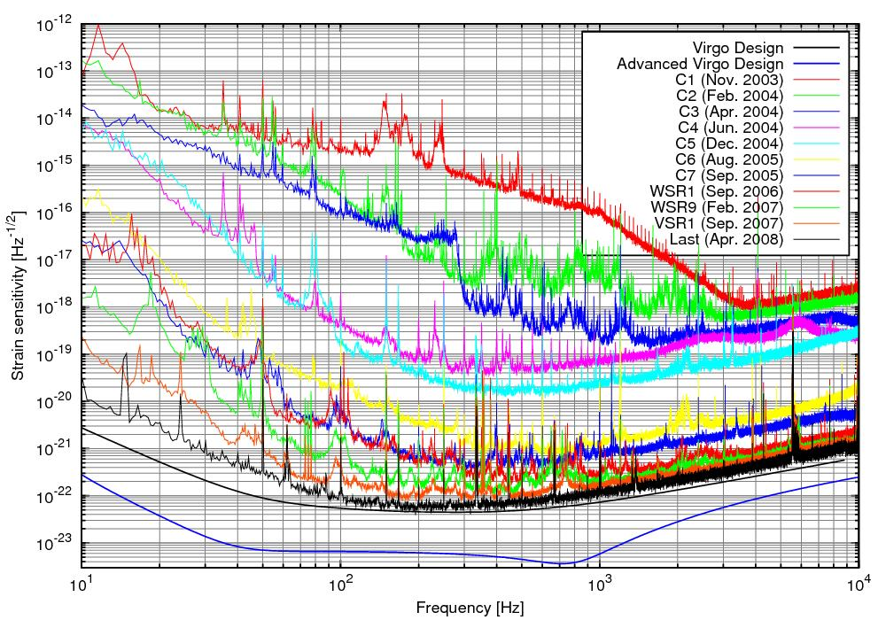
Advanced Detectors will see GWs
The technology of interferometric detectors has been demonstrated
A further step in sensitivity appears necessary to open the way to physics and astronomy. Some sources appear certain, unless astrophysical assumptions are wrong
To make science, a multimessenger approach will be mandatory

Slide 29
3rd generation?
Precision Astrophysics
Cosmology
?
Evolution of the GW detectors (Virgo example):
Limit of the current infrastructures
First detection
Initial astrophysics
Test of “advanced” techs
UL physics
Advanced
detectors
Detection distance (a.u.)
Proof of the working principle
Upper Limit physics
enhanceddetectors
Commissioning
& first runs
Infrastructure realization and detector assembling
Same
infrastructure
Same
infrastructure
Same
infrastructure
Same
Infrastructure
(≥20 years old for Virgo, even more for LIGO & GEO600)
year
2003
2008
2011
2017
2022

Slide 30
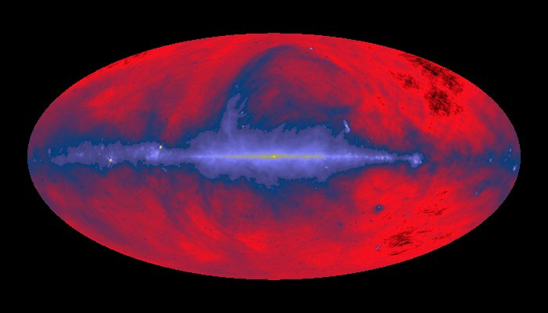
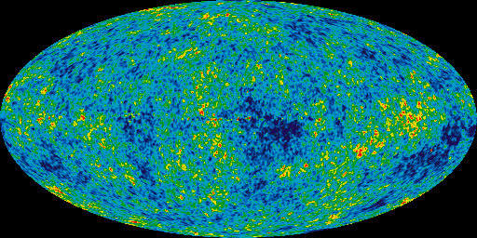
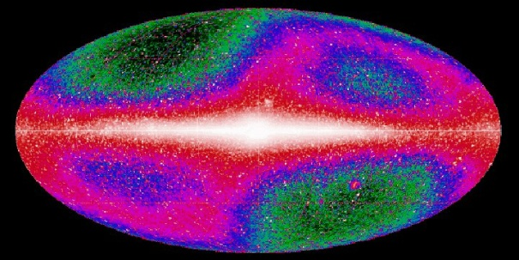




GW Astronomy ?
Current e.m. telescopes are mapping the Universe in all the wavelengths detectable from the Earth and from the space but mainly the outer region is known.
  Truly dynamical processes are hidden inside stars, only indirect methods
94% of the universe is dark. Composed by either dark energy or dark matter. The dark part interact via gravitation.
Gravitational wave telescopes could complement the e.m. observation opening the GW astrophysics era.
Thanks to the small interaction between graviton and the matter, GW are the best messenger to investigate the first instants of the Universe.
408MHz
WMAP
Infrared
visible
X-ray
γ-ray
GW ?
GRB

Slide 31
Physics Beyond GW Detections
Astrophysics:
  Measure in great detail the physical parameters of the stellar bodies composing the binary systems
    NS-NS, NS-BH, BH-BH
    Constrain the Equation of State of NS through the measurement
      of the merging phase of BNS
      of the NS stellar modes
      of the gravitational continuous wave emitted by a pulsar NS
  Contribute to solve the GRB enigma
Relativity
  Compare the numerical relativity model describing the coalescence of intermediate mass black holes
  Test General Relativity against other gravitation theories
Cosmology
  Measure few cosmological parameters using the GW signal from BNS emitting also an e.m. signal (like GRB)
  Probe the first instant of the universe and its evolution through the measurement of the GW stochastic background
Astro-particle:
  Contribute to the measure the neutrino mass?
  Constrain the graviton mass measurement

Slide 32
Measuring Properties of Neutron-Stars with GWs
In GR properties of NSs are determined by the equation of state (EoS) via TOV equation
  Nuclear model, laboratory experiment
  Astrophysical observations
  NS merger: EoS should yield imprint on the emitted GW signal

Slide 33

Orientation averaged spectra
Notice the EoS dependence of f_{peak}

Slide 34

Peak frequency vs radius of M_{NS}=1.35xM_{sun} (left)
  f_{peak} is higher for smaller radius !!!
f_{peak} vs $\sqrt{Mtot/R\max^{3}}$ , M_{𝑡𝑜𝑡}=2 M_{NS} (right)
Values of R and M_{NS} can be inferred from the pre-merger PN part of the wave form

Slide 35

Credit: B.Sathyaprakash
h (1/√Hz)‏
10⁻²²
10⁻²³
10⁻²⁴
10⁻²⁵
1st generation detectors
eLISA
2009
2028?
Advanced detectors
2015-6
3rd generation
2020
0.1m 10m 1 Hz 100 10k
frequency f / binary black hole mass whose freq at merger=f
4x10⁷ 4x10⁵ 4x10³ M 40 0.4

Slide 36

The infrastructure
Pictorial view
Thanks for your attention
~100 m

